Slide 1




GAFFI
Global Action Fund for Fungal Infections
OUR VISION IS TO REDUCE ILLNESS AND DEATH ASSOCIATED WITH FUNGAL DISEASES WORLDWIDE.
LEAVE NO ONE BEHIND: Too many people
have no access to life-saving fungal diagnostics
and antifungal medicine. This has to change!

Slide 2

Deaths from fungal infections need to fall
Fungal Infection | TB (2015) | Malaria (2015)
>1,660,000 | 1,800,000 (400,000 with HIV) | 429,000
www.GAFFI.org

Slide 3

GAFFI is calling for:
By 2025, ensure that 95% of people with serious fungal disease are diagnosed and 95% treated
www.GAFFI.org

Slide 4
1.1 million deaths from AIDS in 2015
~400,000 due to TB
~50% due to fungal disease?
www.GAFFI.org

Slide 5
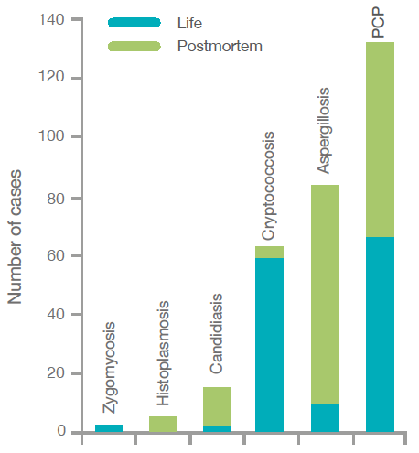
Missed diagnoses in AIDS – including PCP
Antinori S et al, Am J Clin Pathol 2009;132 :221
www.GAFFI.org

Slide 6
Cryptococcal meningitis in AIDS
Impact of therapy
Survival at 10 weeks / 1 year
75% / 60%
Best treatment
with amphotercin B and 5FC
50% / 30%
No treatment,
always fatal
Fluconazole
0%
www.GAFFI.org

Slide 7
Histoplasmosis
Impact of therapy
Survival
100%
87%
Itraconazole
BUT 30% of patients with disseminated histoplasmosis also have TB
Amphotericin B
0%
Severe Less severe
www.GAFFI.org

Slide 8
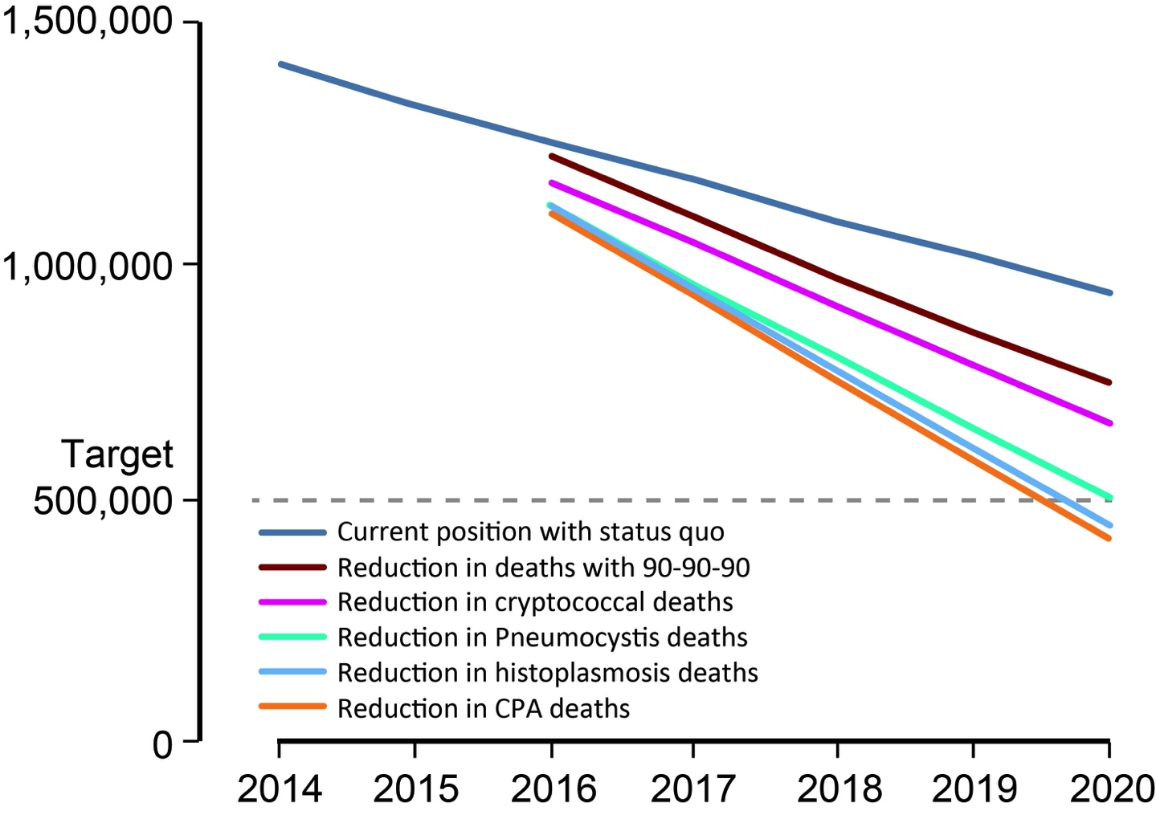
Reducing deaths from AIDS with improved access to diagnostics and antifungals
Current trajectory
90-90-90
Crypto
PCP
Histo
CPA
Denning DW. Phil Trans R Soc 2016; 371: 20150468
www.GAFFI.org

Slide 9
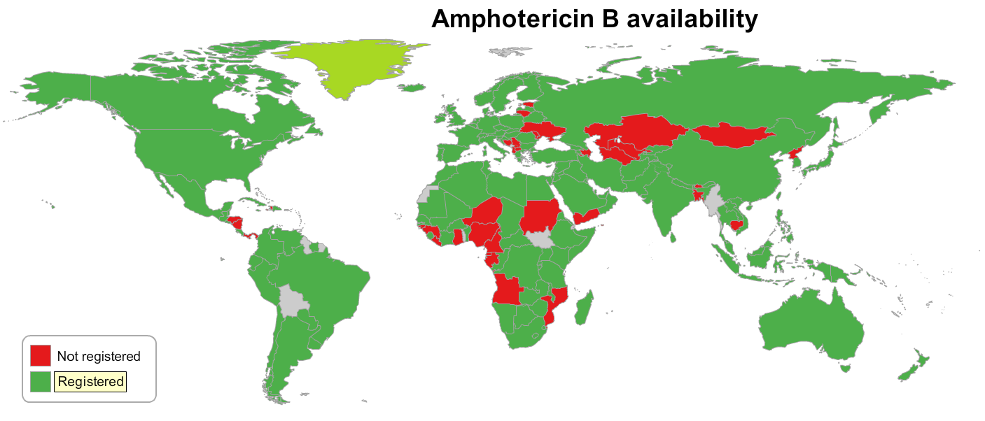
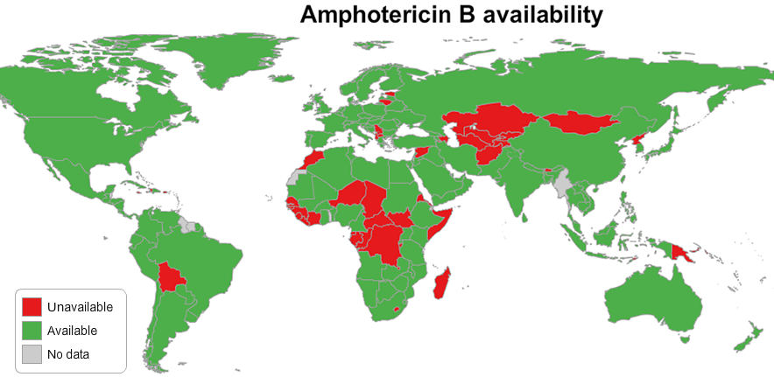
registration
Access to antifungal drugs
www.gaffi.org/why/burden-of-disease-maps/

Slide 10
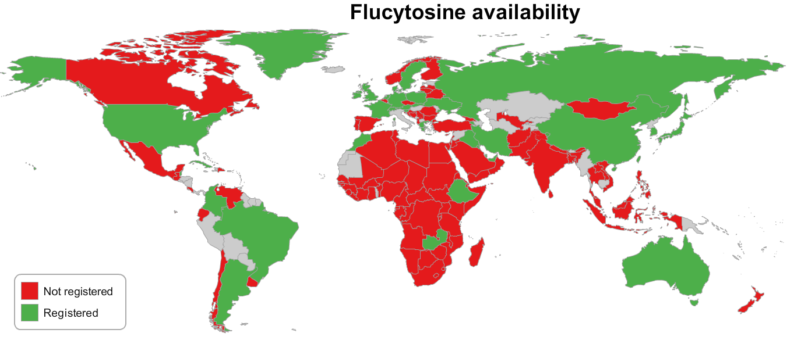
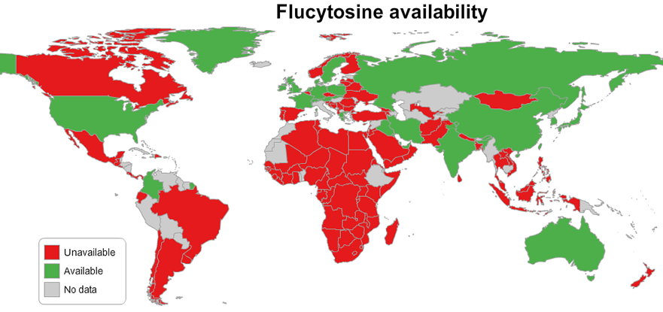
registration
www.gaffi.org/why/burden-of-disease-maps/

Slide 11

UK issues
Burden of asthma and fungal asthma – partially avoidable
Notes:
Current EML listing is:
amphotericin B (deoxycholate or liposomal), clotrimazole (vaginal cream or vagina tablet), fluconazole (capsule, injection, oral liquid), flucytosine (capsule, Infusion), griseofulvin (oral liquid), nystatin (lozenge, oral liquid, pessary, tablet)
In the complimentary list potassium iodide saturated solution.
For PCP:
sulfamethoxazole +trimethropin (injection, oral liquid, tablet) and in the complimentary list pentamidine (tablet)

Slide 12
Poor housing and asthma
Multiple factors contribute to home dampness, including cavity wall insulation, double glazing, drying clothes indoors, poorly-repaired gutters and plumbing and external drain problems.
Focus of the ‘green’ agenda, rather than healthy homes – ventilation important.
Poor council and housing association responses to dampness and internal mould, in many cases.
Tight regulations for new build, not so for older housing stock.
Notes:
Current EML listing is:
amphotericin B (deoxycholate or liposomal), clotrimazole (vaginal cream or vagina tablet), fluconazole (capsule, injection, oral liquid), flucytosine (capsule, Infusion), griseofulvin (oral liquid), nystatin (lozenge, oral liquid, pessary, tablet)
In the complimentary list potassium iodide saturated solution.
For PCP:
sulfamethoxazole +trimethropin (injection, oral liquid, tablet) and in the complimentary list pentamidine (tablet)

Slide 13
Poor housing and asthma - actions
Better epidemiological data – needs research
More careful allocation of housing to ensure mould-free environments for asthma-risk families.
Environmental mould measurements need to be standardised and more available
Educating households on how to maintain safe relative humidity levels within their homes
Increased education/improved guidelines for GPs and chest physicians on clues to the identification of fungal asthma.
Notes:
Current EML listing is:
amphotericin B (deoxycholate or liposomal), clotrimazole (vaginal cream or vagina tablet), fluconazole (capsule, injection, oral liquid), flucytosine (capsule, Infusion), griseofulvin (oral liquid), nystatin (lozenge, oral liquid, pessary, tablet)
In the complimentary list potassium iodide saturated solution.
For PCP:
sulfamethoxazole +trimethropin (injection, oral liquid, tablet) and in the complimentary list pentamidine (tablet)

Slide 14
UK issues
Burden of asthma and fungal asthma – partially avoidable
Patient complexity is increasing – requiring more time and expertise, both in short supply
Notes:
Current EML listing is:
amphotericin B (deoxycholate or liposomal), clotrimazole (vaginal cream or vagina tablet), fluconazole (capsule, injection, oral liquid), flucytosine (capsule, Infusion), griseofulvin (oral liquid), nystatin (lozenge, oral liquid, pessary, tablet)
In the complimentary list potassium iodide saturated solution.
For PCP:
sulfamethoxazole +trimethropin (injection, oral liquid, tablet) and in the complimentary list pentamidine (tablet)

Slide 15
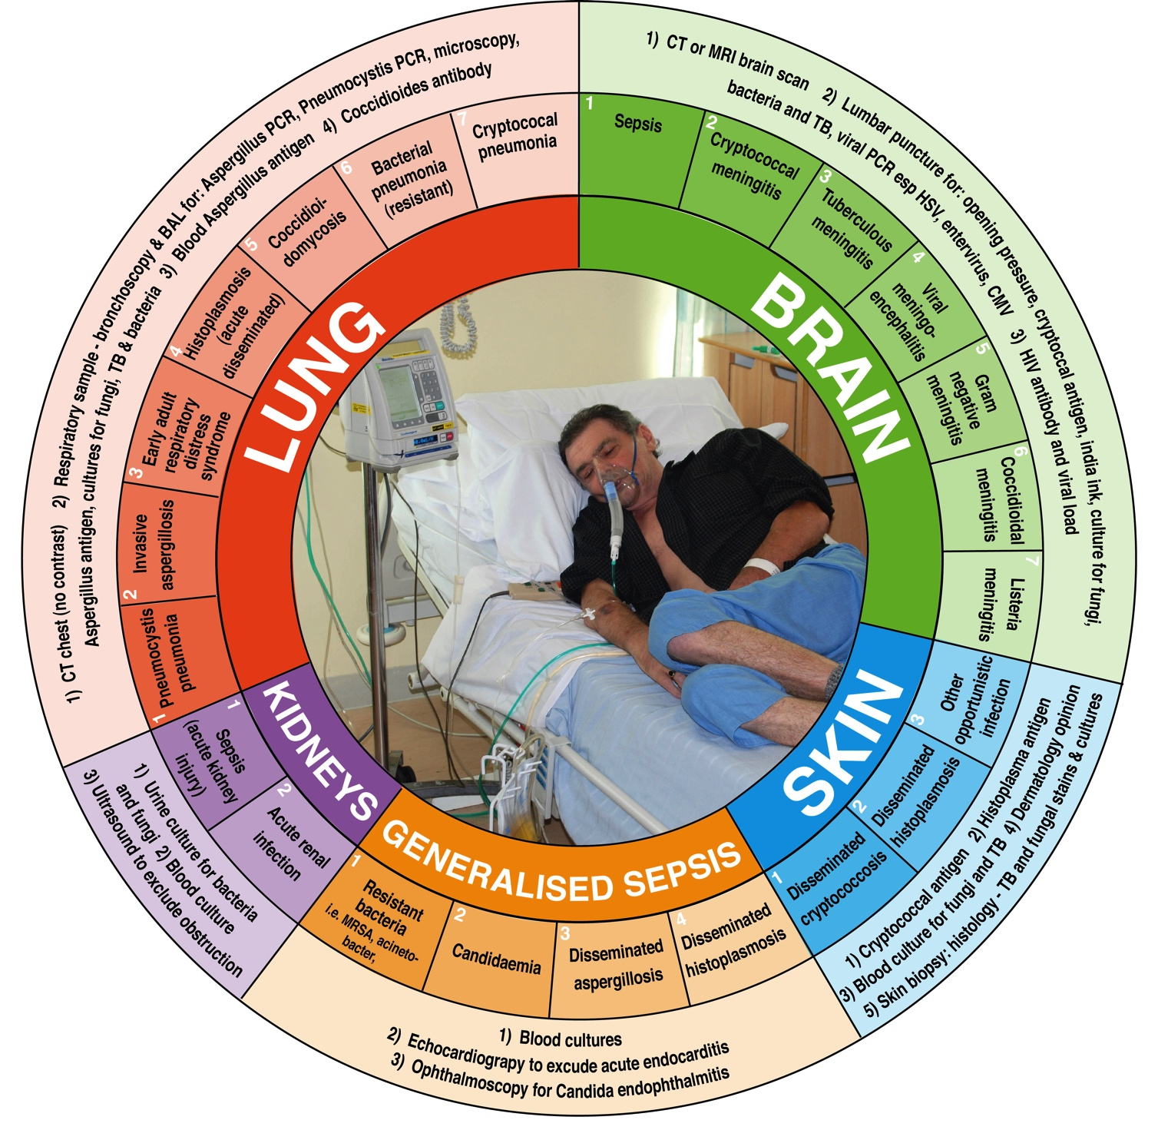
Increasing patient complexity
Brown et al, Sci Transl Med 2012;4:165rv13
Notes:
Current EML listing is:
amphotericin B (deoxycholate or liposomal), clotrimazole (vaginal cream or vagina tablet), fluconazole (capsule, injection, oral liquid), flucytosine (capsule, Infusion), griseofulvin (oral liquid), nystatin (lozenge, oral liquid, pessary, tablet)
In the complimentary list potassium iodide saturated solution.
For PCP:
sulfamethoxazole +trimethropin (injection, oral liquid, tablet) and in the complimentary list pentamidine (tablet)

Slide 16
UK issues
Burden of asthma and fungal asthma – partially avoidable
Patient complexity is increasing – requiring more time and expertise, both in short supply
Diagnostic turnaround times too slow for acutely ill patients in most hospitals
Notes:
Current EML listing is:
amphotericin B (deoxycholate or liposomal), clotrimazole (vaginal cream or vagina tablet), fluconazole (capsule, injection, oral liquid), flucytosine (capsule, Infusion), griseofulvin (oral liquid), nystatin (lozenge, oral liquid, pessary, tablet)
In the complimentary list potassium iodide saturated solution.
For PCP:
sulfamethoxazole +trimethropin (injection, oral liquid, tablet) and in the complimentary list pentamidine (tablet)

Slide 17

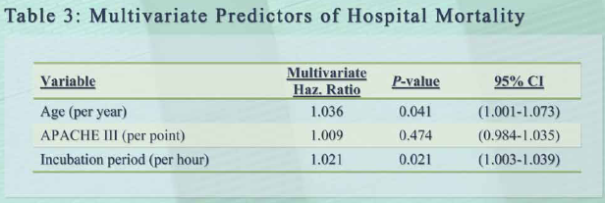
ICAAC 2007 K-2173
This equates to an 2.4% increase in mortality per incubation hour

Slide 18
UK issues
Burden of asthma and fungal asthma – partially avoidable
Patient complexity is increasing – requiring more time and expertise, both in short supply
Diagnostic turnaround times too slow for acutely ill patients in most hospitals
Antifungal resistance
Notes:
Current EML listing is:
amphotericin B (deoxycholate or liposomal), clotrimazole (vaginal cream or vagina tablet), fluconazole (capsule, injection, oral liquid), flucytosine (capsule, Infusion), griseofulvin (oral liquid), nystatin (lozenge, oral liquid, pessary, tablet)
In the complimentary list potassium iodide saturated solution.
For PCP:
sulfamethoxazole +trimethropin (injection, oral liquid, tablet) and in the complimentary list pentamidine (tablet)

Slide 19
Candida auris
Resistance patterns:
Fluconazole R - 93%
Voriconazole R - 54%
Amphotericin R - 34%
Echinocandin R - 6%
4% multi-drug resistance (ie untreatable)
Notes:
Current EML listing is:
amphotericin B (deoxycholate or liposomal), clotrimazole (vaginal cream or vagina tablet), fluconazole (capsule, injection, oral liquid), flucytosine (capsule, Infusion), griseofulvin (oral liquid), nystatin (lozenge, oral liquid, pessary, tablet)
In the complimentary list potassium iodide saturated solution.
For PCP:
sulfamethoxazole +trimethropin (injection, oral liquid, tablet) and in the complimentary list pentamidine (tablet)

Slide 20
Addressing antifungal resistance
Enhance resistance surveillance
Improve diagnostic access and turnaround times for testing to minimise unnecessary prescribing of both antifungals and antibacterial agents, and optimise dose
Encourage early adoption of better diagnostics in the NHS
Consider revising PBR exclusion for antifungals
Promote the removal of specific (5) azole antifungals as fungicides from use in Europe
Encourage new antifungal drug development
Prevent any new class of medical antifungal being used as a fungicide
Notes:
Current EML listing is:
amphotericin B (deoxycholate or liposomal), clotrimazole (vaginal cream or vagina tablet), fluconazole (capsule, injection, oral liquid), flucytosine (capsule, Infusion), griseofulvin (oral liquid), nystatin (lozenge, oral liquid, pessary, tablet)
In the complimentary list potassium iodide saturated solution.
For PCP:
sulfamethoxazole +trimethropin (injection, oral liquid, tablet) and in the complimentary list pentamidine (tablet)

