Slide 1
Unlocking a more sustainable future with AI

Slide 2
Notes:
It’s no secret that the health of our planet is declining. Deforestation, melting sea ice, rapidly disappearing species and more have weakened Earth’s ecosystems, and climate change is arguably the most pressing issue of our time. We need to think outside of the box – and move swiftly – to recover a sustainable future. The solution isn’t going to come from the small percentage of the world who are willing to overhaul their lifestyle by not travelling by aeroplane, for example. it’s going to come from as many people as possible taking their own inches towards a cleaner, greener energy system, and when we add up all those inches, that’s going to be the difference between winning and losing this fight against climate change. So how do we get everyone in the country, or on the planet to do their bit? Let’s look at something like the plastic bag tax. Charging 10p for plastic bags has resulted in their use plumetting by 85% compared to the year before it was introduced. The thing that I believe has made this even more sticky though is that the strong 10p bags, or cloth bags which you bring from home are better than any of the free cheap plastic bags we used before. They are stronger and don’t hurt your hand so much. You can get more into them, and sling them over your shoulder which makes them less cumbersome to carry. After the initial transition period, the consumer shopping experience is now better. Ultimately, to make big changes like this, we have to create experiences that make consumers want to change because it adds value to their lives in some way.

Slide 3
DeepMind's machine learning capabilities have reduced the amount of energy needed to cool Google’s data centers by 40%
Notes:
And the same goes for businesses, there is a misconception that sustainability must increase business costs when in fact the two can go hand in hand. Take this example of DeepMind.

Slide 4
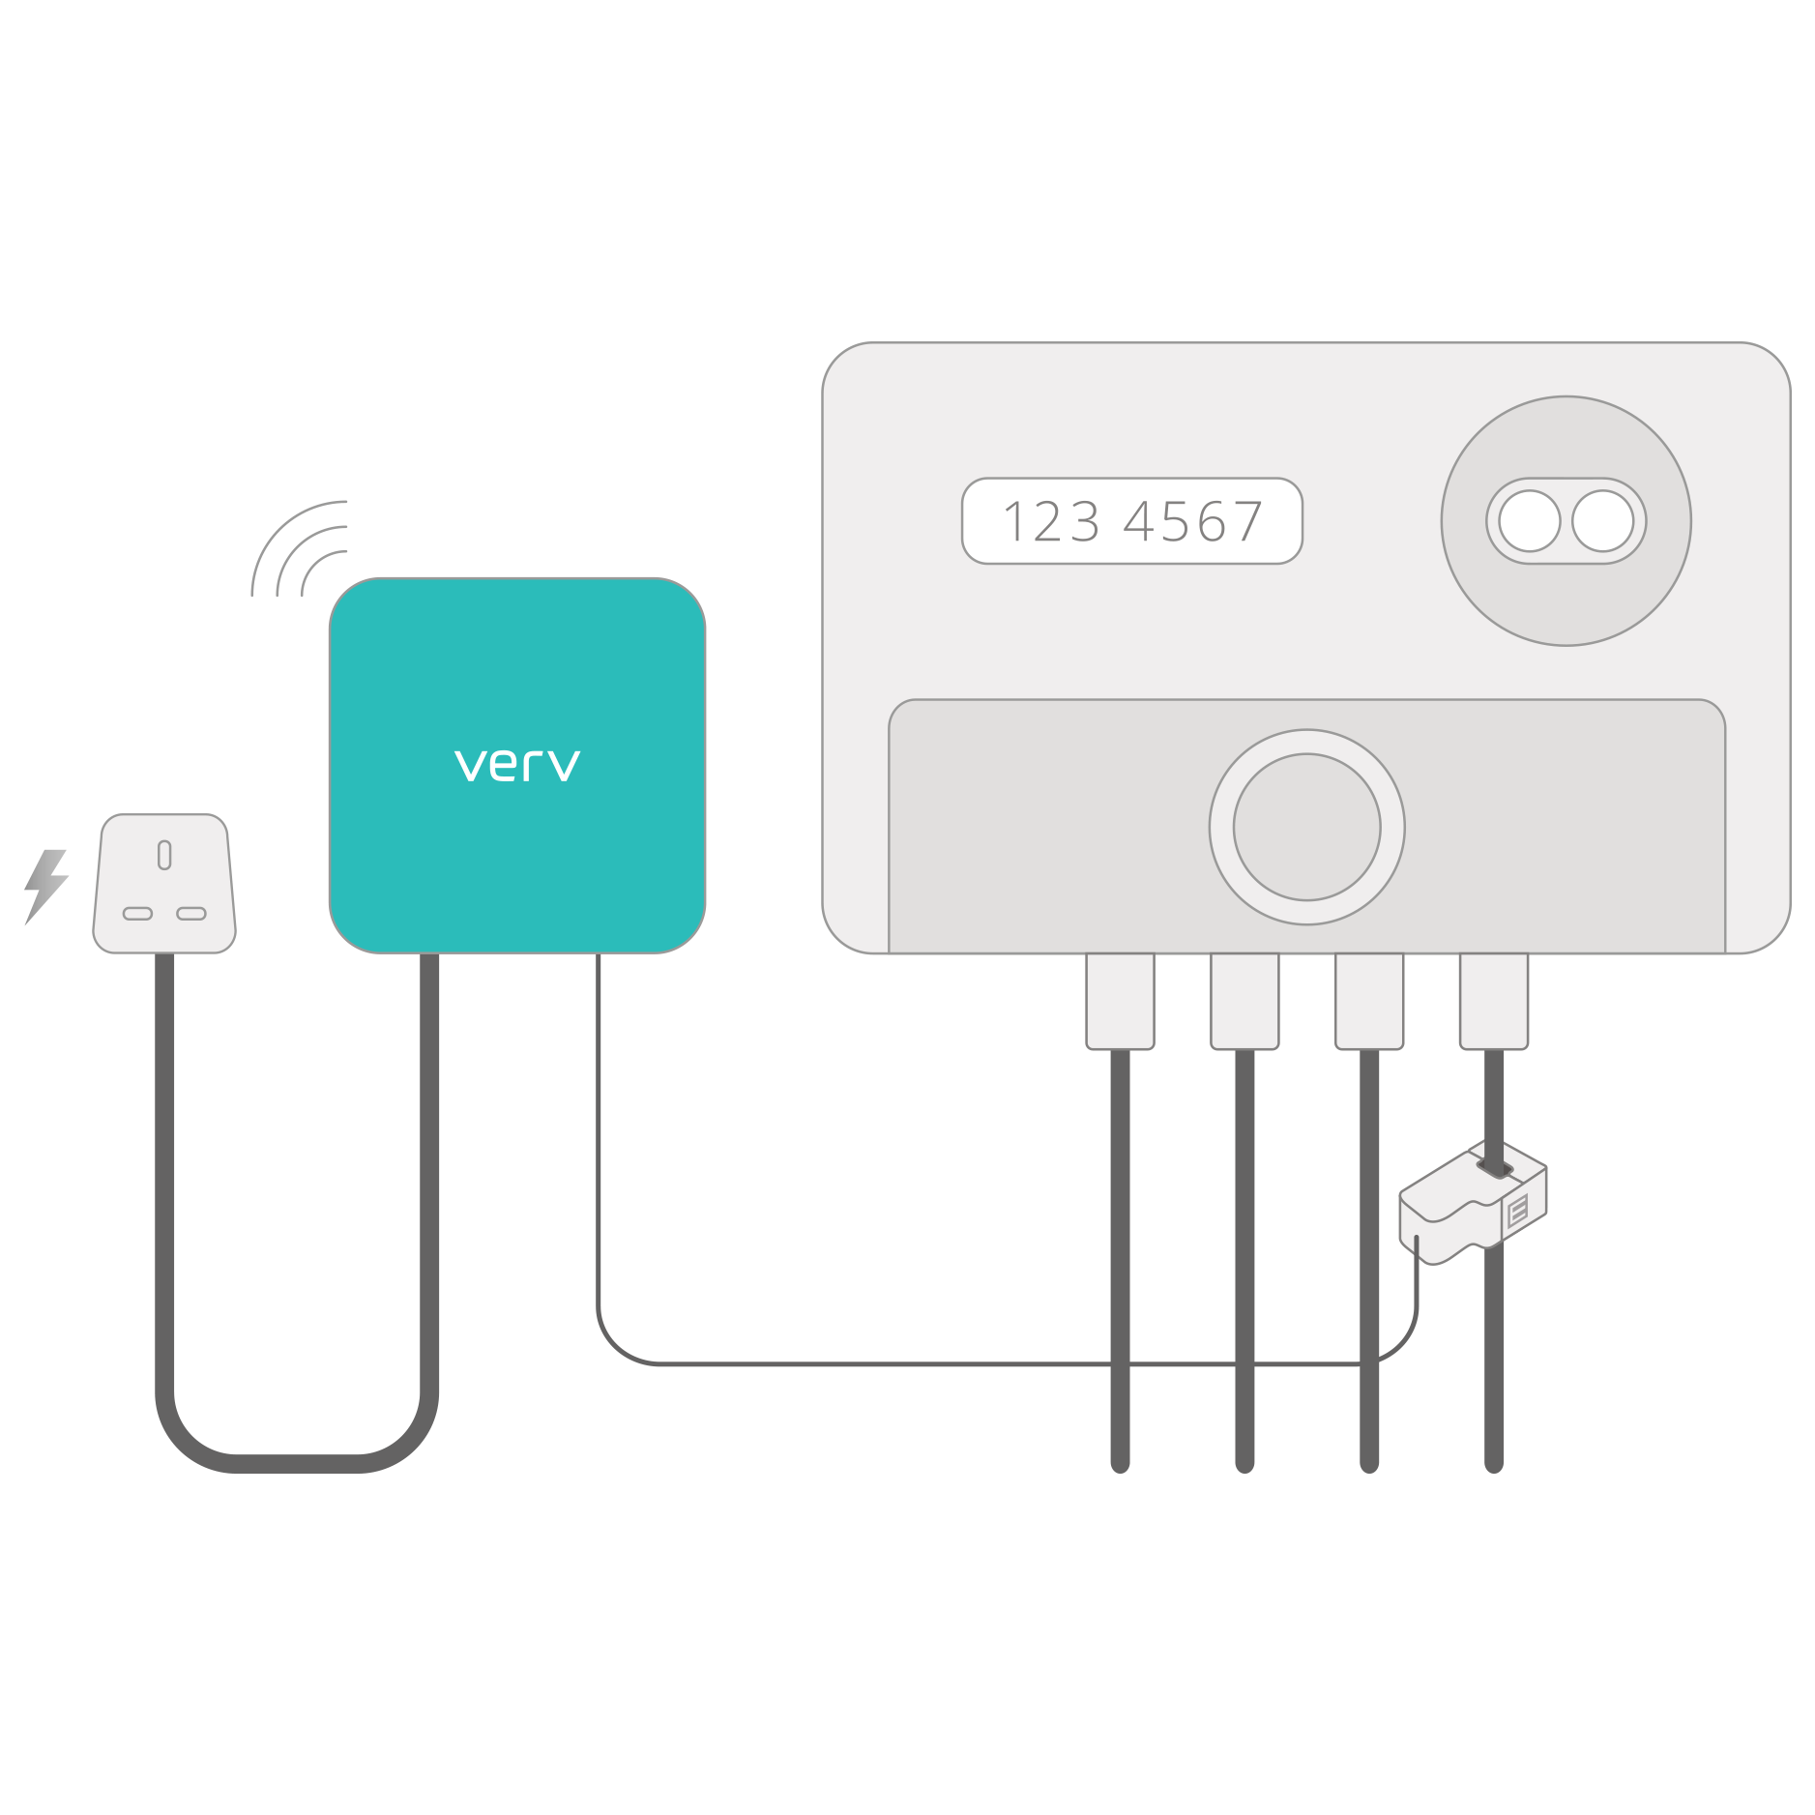
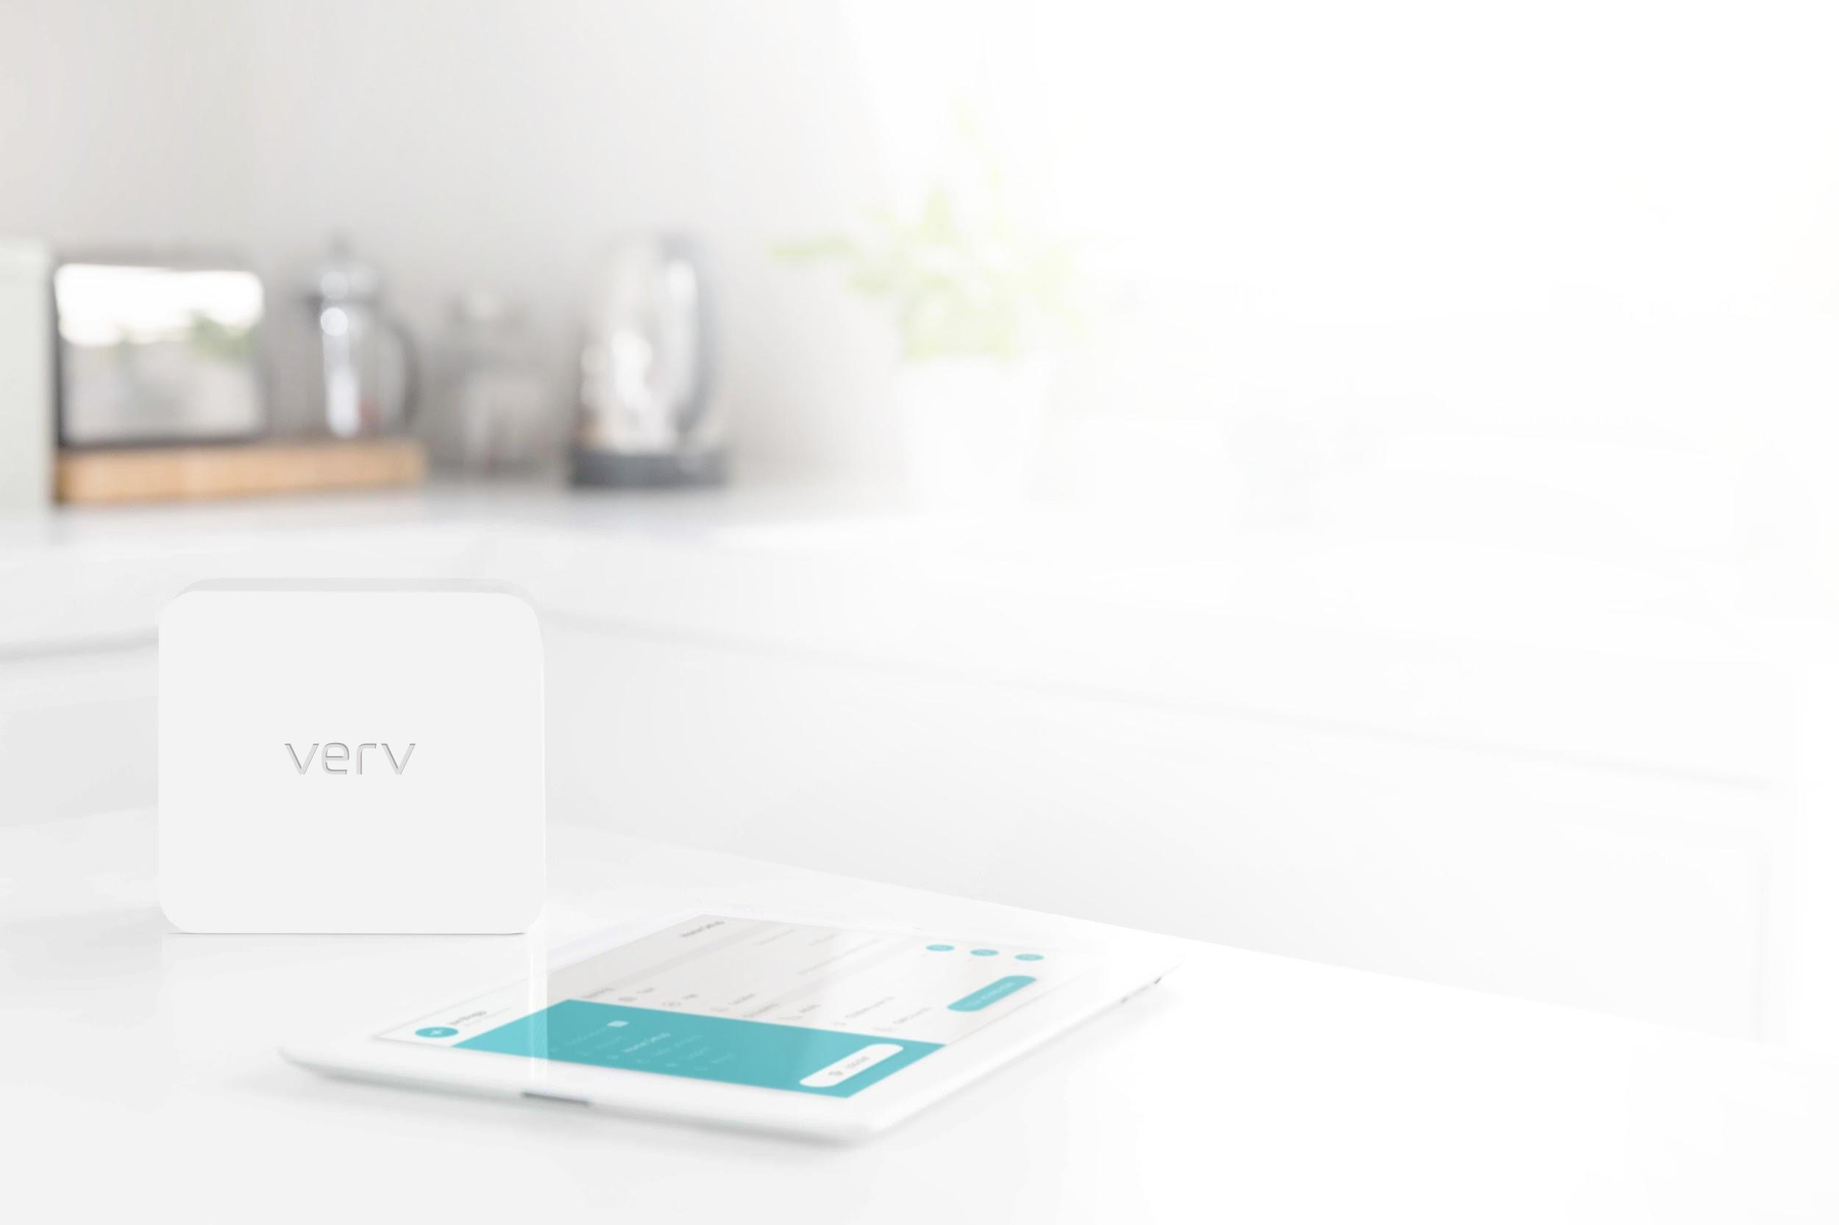
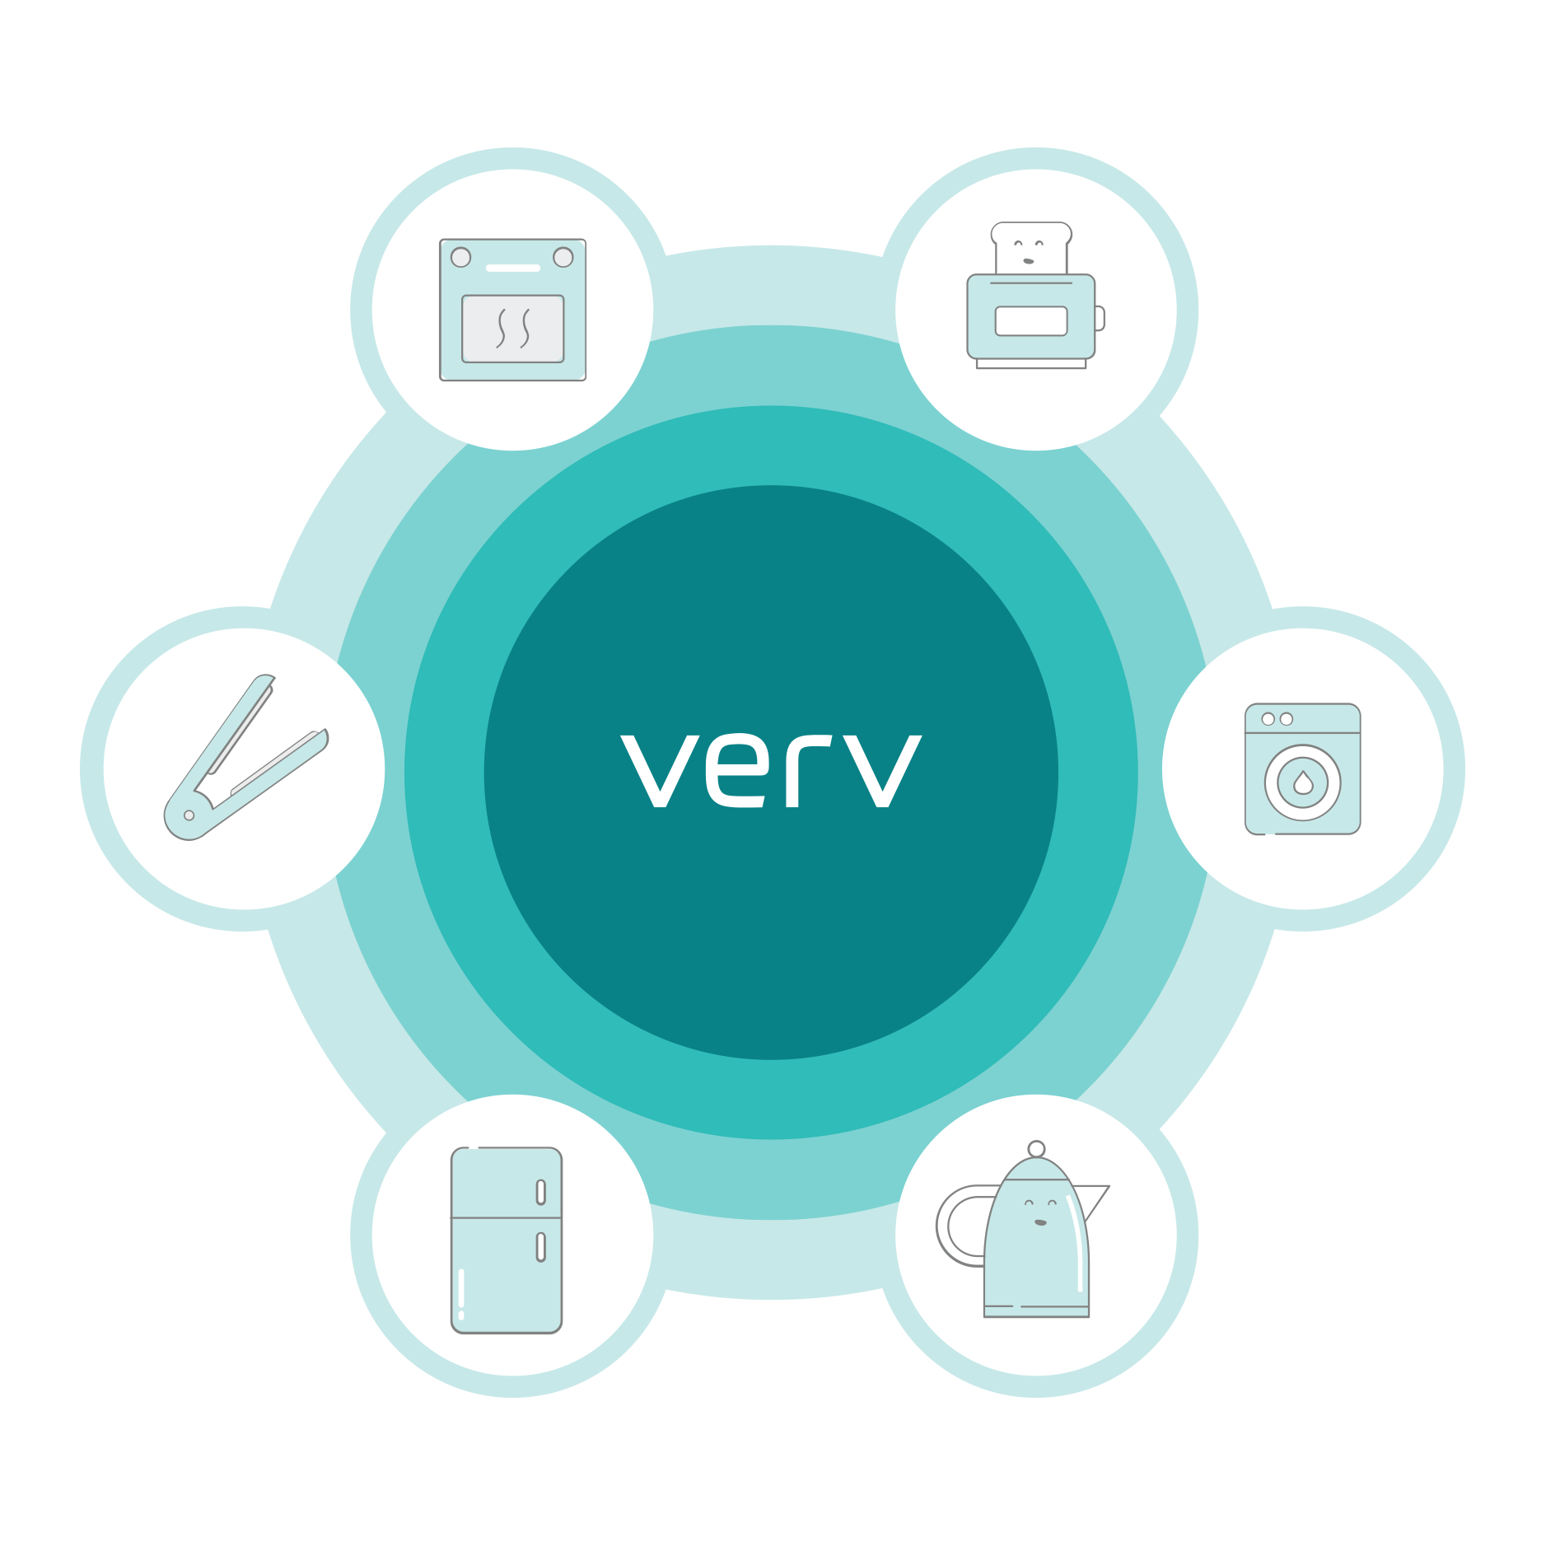
Introducing Verv’s AI solutions
A simple and intuitive installation process
Verv listens out for key appliances from a single point in the home
Notes:
I believe that AI will be a key technology in helping to tackle climate change in innovative ways. At Verv, we have applied AI to the energy space to provide green solutions. For example, by listening to the current at one single point at your electricity meter, we can tell users in real-time which appliances are on and how much they’re costing to use, as well as provide budgeting tools. Small things can help users to lower their carbon footprints, even by being more savvy about how much energy and money it costs to run a tumble dryer.

Slide 5
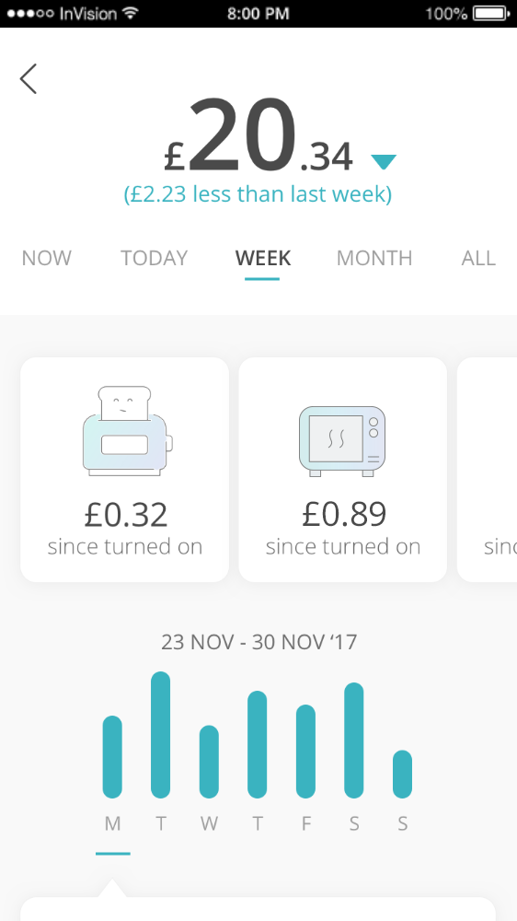
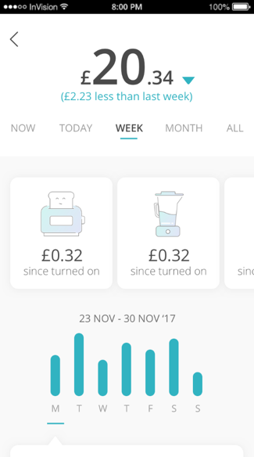
AI is used to determine which appliances are on in the home and how much they’re costing in real-time
*Numbers for illustrative purposes only
Notes:
This is the type of data we can acquire using high speed data monitoring techniques and apply machine learning to in order to detect individual appliance energy signatures and thus identify what is consuming power.

Slide 6
Verv has incorporated blockchain into its tech to create a peer-to-peer energy trading platform
The platform enables households with solar to sell the excess energy that they generate directly to their neighbours.
Verv’s deep dive into consumption and generation data combined with AI creates optimal forecasting and a trading system with an inherent, information first advantage.
Funded by government grants
Notes:
Going one step further, we have teamed blockchain with AI to create a renewable energy trading platform that adds a new dimension to smart energy. The platform enables households with solar to sell the excess energy that they generate directly to their neighbours. Communities can benefit from cheaper energy whilst those with with solar panels can receive an ROI by selling to their neighbours. Given it is not currently legal for consumers to sell energy to one another, we were extremely luck to receive funding for innovate UK to develop this project further.

Slide 7
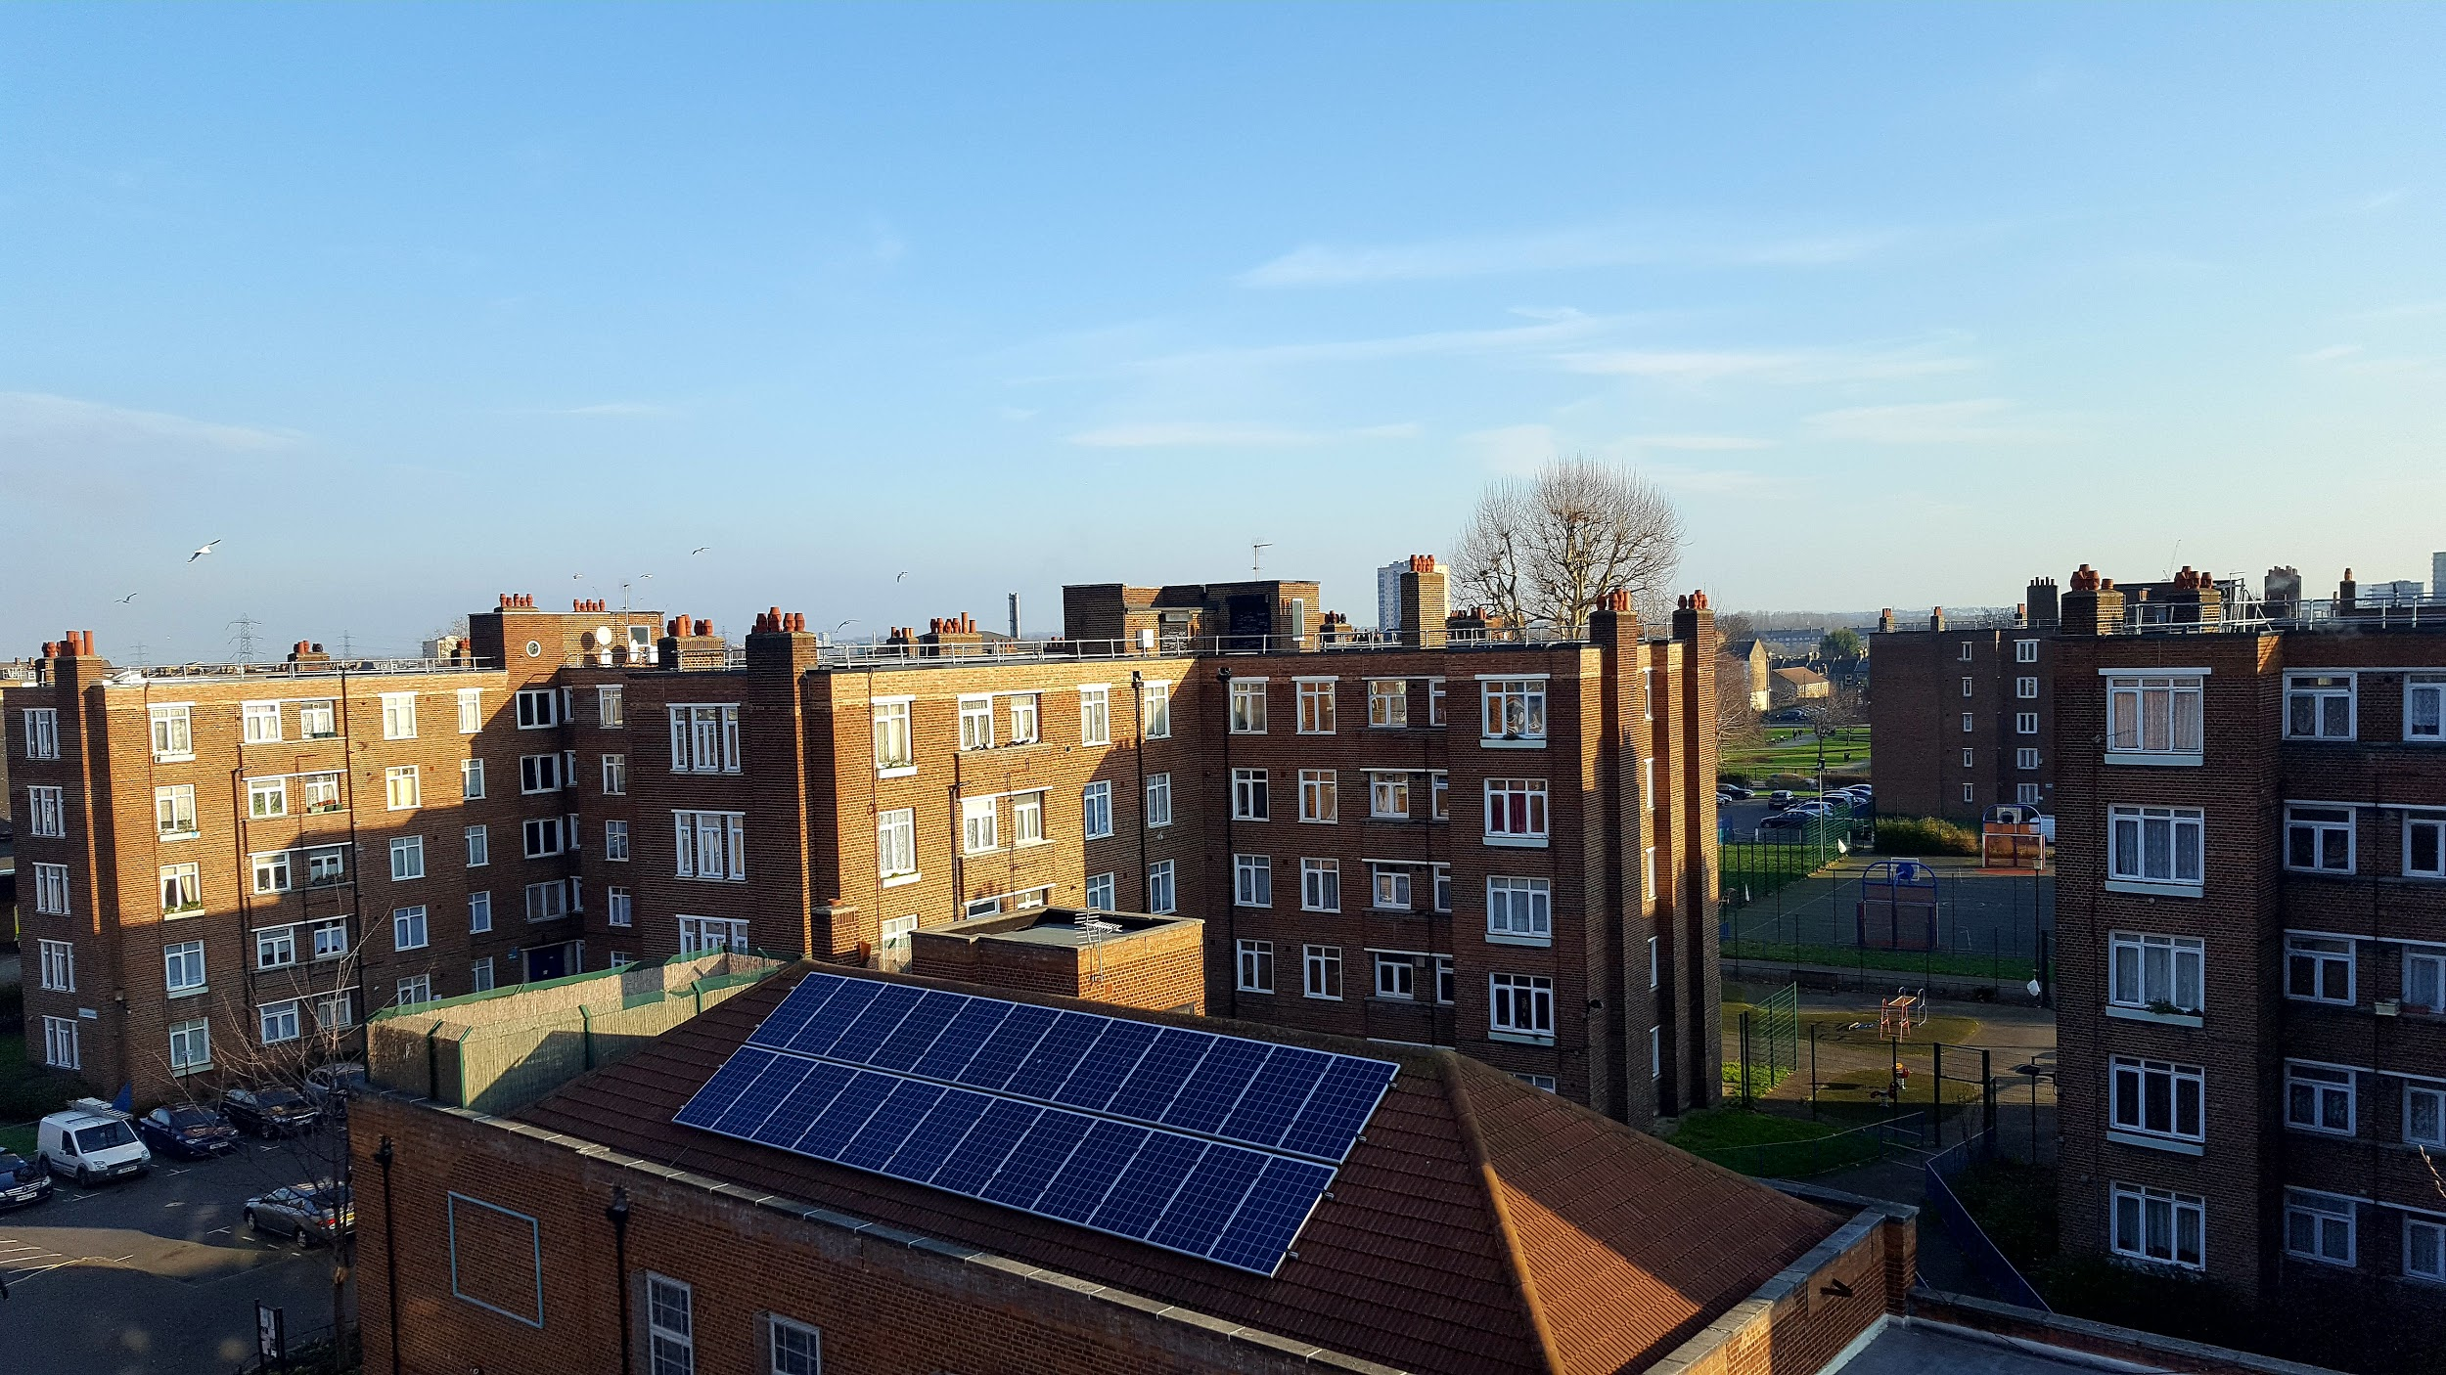
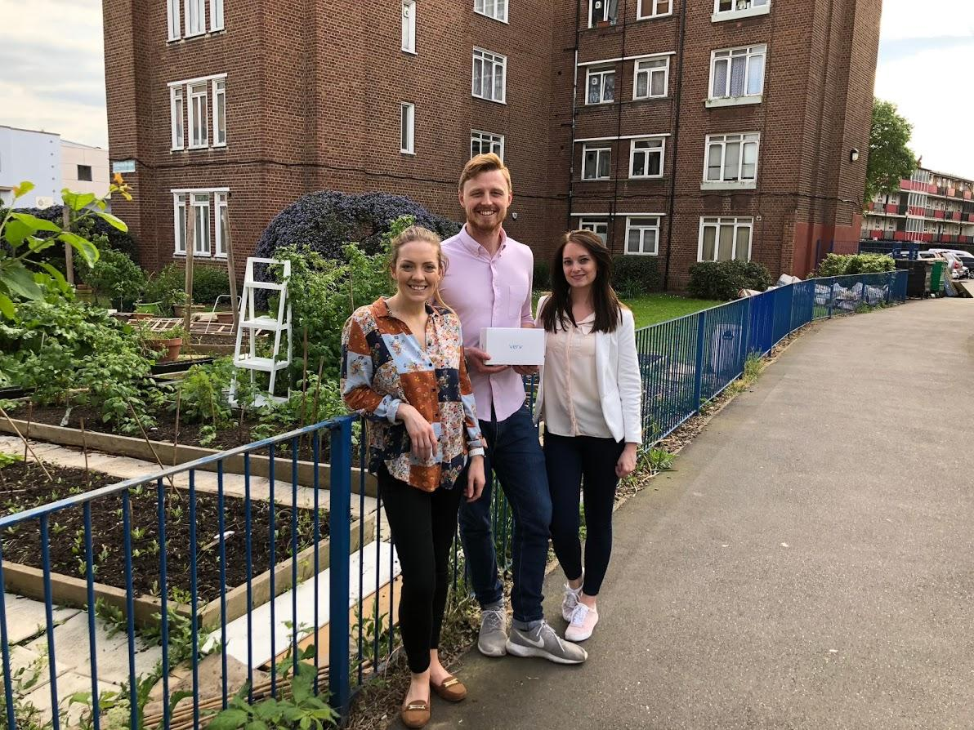
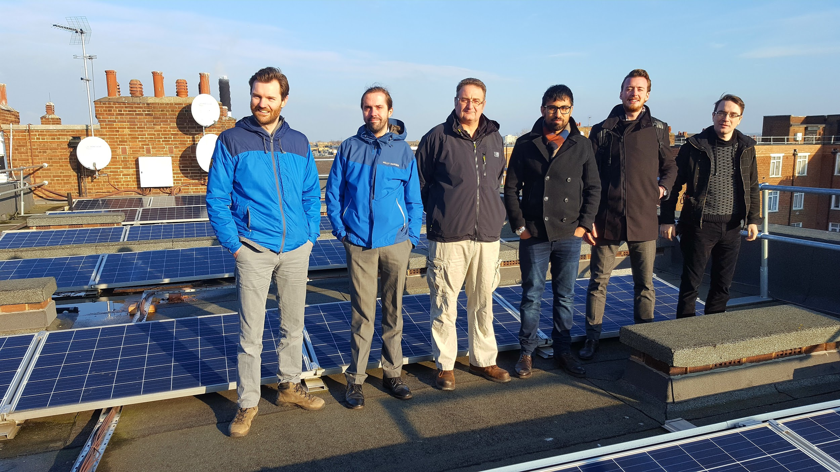
Verv’s live energy trading community - London pilot
Verv conducted the UK’s first P2P trade of energy on the blockchain - 2018
Other partners & pilots
Working with the UK regulator on their sandbox for P2P energy trading
Notes:
In 2018, with funding from Innovate, we took our platform to the next level and at a social housing estate in Hackney where there are solar panels on the 14 blocks of flats but residents can’t currently benefit from them due to the state of the UK electricity market. We were given regulatory flexibility in order to bring our platform to life and in April 18 we conducted the UK’s first trade of energy on the blockchain. The impact of our work has been more than we could’ve imagined with case studies of our work in reports and articles worldwide, Ofgem promoting the benefits of our technologies and in 2019 we supported New Anglia energy in raising a modification to UK law (p379) which takes a massive step towards making p2p energy trading legal.

Slide 8
Innovation continues to outpace regulation as we run out of time to achieve net zero
Notes:
Despite that, we are still waiting...innovation continues to outpace relegation and we are running out of time. More needs to be done at government level to ensure that technologies that can have a real impact can be commercialised quickly.

Slide 9
How else can we leverage smart energy to reduce carbon emissions?
Notes:
So whilst we’re waiting for that to become legal, how else can we do our bit?

Slide 10
A long-lasting washing machine will generate over 1.1 tonnes less CO2 over 2 decades than a short-lived model
Notes:
A recent study estimates that because of the CO2 emitted in the manufacturing process, a long-lasting washing machine will generate over two decades 1.1 tonnes less CO2 than a short-lived model. That’s huge...a use of the CO2 emitted in the manufacturing Because of the CO2 emitted in the manufacturing process, Because of the CO2 emitted in thBece manufacturing beprocess, process,

Slide 11
Introducing the Verv Connect Plug
Application: Domestic white goods
Features:
Energy Monitoring
Remote Control
Fault Detection
DSR-
Ready
Notes:
So how are we tackling that? Using the same machine learning algorithms and high speed data sampling technology I mentioned at the beginning of my presentation, we are targeting the white goods marketing with a predictive maintenance plug that can provide energy monitoring, remote control of appliances, fault detection, as well as contribute to DSR once the domestic play is ready.

Slide 12
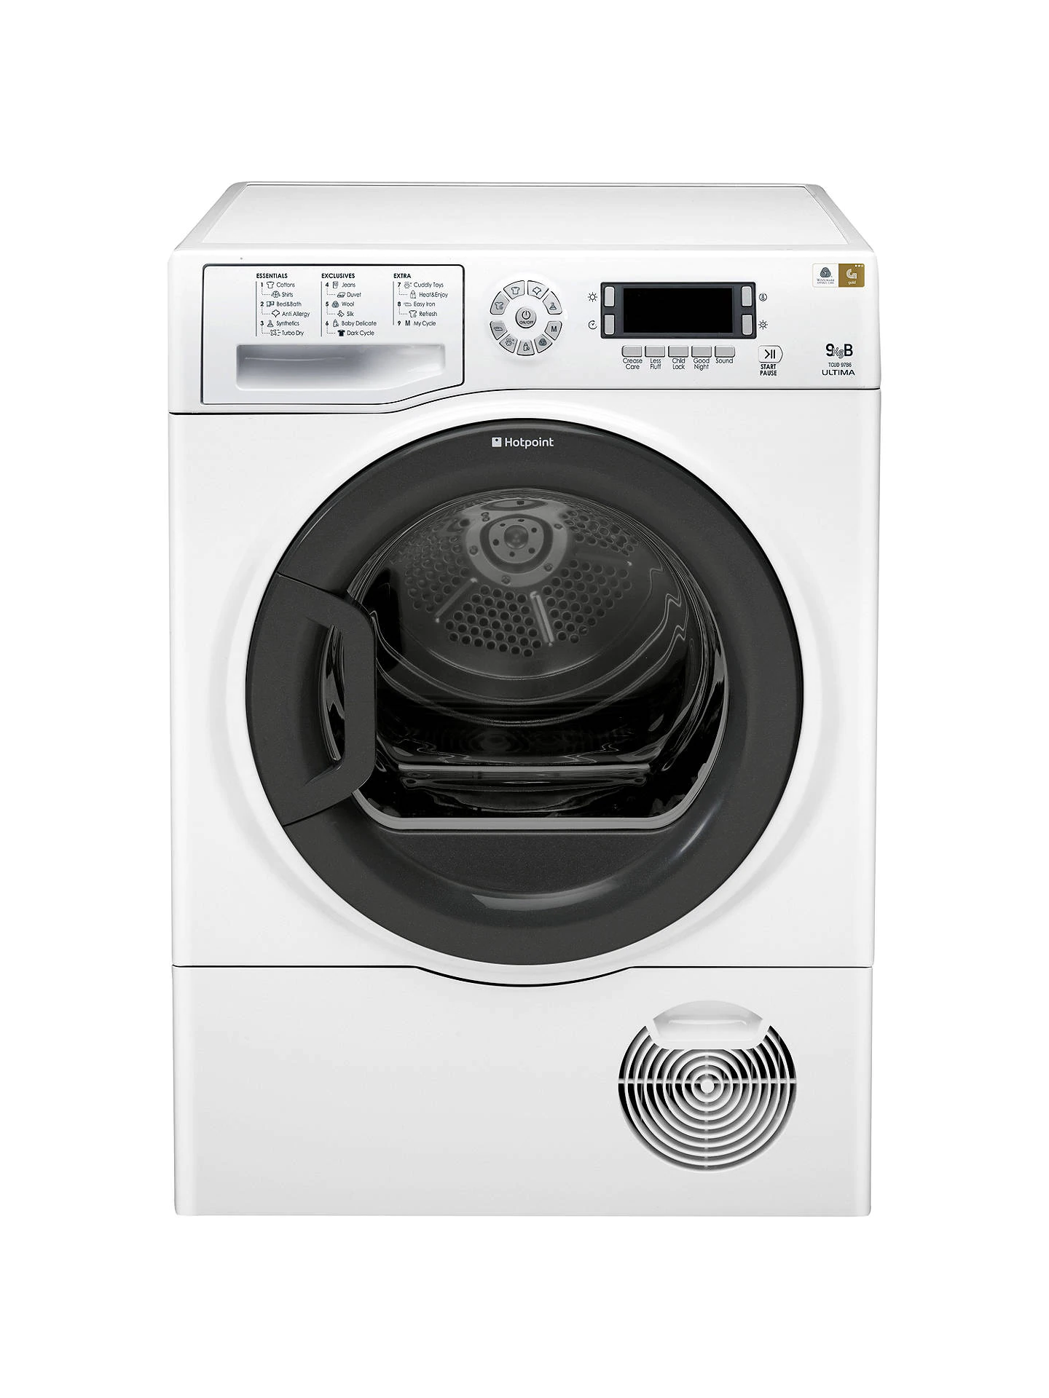
How does it work?
Our patented high speed data sampling and deep learning algorithms enable us to gather and analyse high resolution energy data at a component level.
Using this data we can perform real-time detection for anomalies in the electrical signature of appliances. This gives us the ability to pick up appliance failures before they occur and thus ensure longer lasting white goods with less damage to the planet.
Patents
Notes:
Our patented high speed data sampling and deep learning algorithms enable us to gather and analyse high resolution energy data at a component level.
Using this data we can perform real-time detection for anomalies in the electrical signature of appliances. This gives us the ability to pick up appliance failures before they occur and thus ensure longer lasting white goods with less damage to the planet.

Slide 13
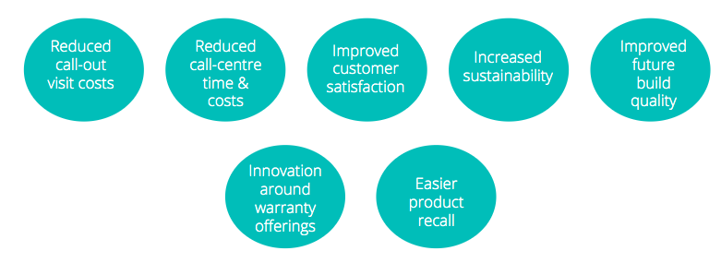
Benefits
Patents
Notes:
And as I eluded to earlier, sustainability does not have to equal increased costs. These are all of the benefits to manufacturers could receive using smart energy AI (including signicant reduced costs in call-outs!), not to mention consumers who will have less downtime of their appliances, as well as smart control!

Slide 14
Notes:
What do future business models look like in the circular economy? Pay per wash

Slide 15
How can you help make a difference?
Notes:
CTA: Lots of innovation vs no move in regulation- things are moving to slowly for us to commercialise so we must grant fund. How can you help in our goal to making white goods more sustainable? Right to repair laws in place but now it’s time to get predictive maintenance tech in homes

Slide 16
Notes:
There is no time to waste.

Slide 17
Thank you
@Verv_energy
@Mmckav

