Slide 1
The Skills Gap
Recruiting the next generation of Acoustical Engineers
Professor Chris Barlow PhD MSc BMus MIOA MAES
Professor of Acoustics, Solent University, Southampton
Chair, Education and Learning Working Group, Institute of Acoustics
Notes:
Me
Noise public health
Increasing population/urbanisation
Need sufficient acoustical eng.
Noise control, measurement compliance, design solutions.
Mitigation’s, new products.
The issue faced is a significant skills gap – more demand than supply

Slide 2
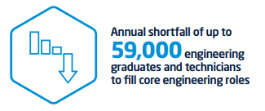
Engineering industries – A General Problem
Source: Engineering UK, 2018
Notes:
need to recruit sufficient acoustical engineers
all of the relevant sectors
problems,
engineering community generall
a general shortfall of qualified engineers
59,000 graduates per year fewer than needed over 5 years.

Slide 3
Engineering recruitment
Source: HESA Statistics
Notes:
165,000 students on Engineering Higher Education courses in the UK.
Shortfall means that there is strong competition for skilled candidates,
Engineering courses increased slightly.
Not catching up with the number of engineers required by the industry.
a lack of diversity,
particular lack of female entrants
fairly poor BAME representation.
Recruitment. Pool

Slide 4
The Diversity gap
Source: STEM Women 2020
Notes:
School and FE sector
Increase in female students taking sciences
More female than male from 2018.
But not physics, core for engineering
Maths also lags behind with only 39% of a level students being female.

Slide 5
Awareness
Source: Engineering UK, 2018
Notes:
Lack of awareness
Only 23.6% of young people aged 11 to 14 and 25.5% of those aged 14 to 16 reported knowing what people working in engineering actually do

Slide 6
Recruitment into the Acoustics Industry
Source: Independent, March 2017
56% of Acoustic consultancies report struggling to recruit appropriately qualified staff.
Source: Association of Noise Consultants, 2017
Notes:
This problem of awareness exacerbated.
Hidden industry – weirdest jobs.
hits recruitment into courses,
steered into the ‘traditional’ engineering subjects which are better understood by teachers.
term Acoustics is largely missing from the school science curriculum at all levels,
Target for recruitment is often unaware of the profession.
Physics syllabus.
BTeC national diploma in Music Technology,
Classical physics replaced by modern physics.
acoustically relevant degrees
lot of competition for engineering graduates,
lack of awareness only a very small proportion are attracted into the acoustics industry.
I fell into Acoustics’, or driven in by a hobby

Slide 7
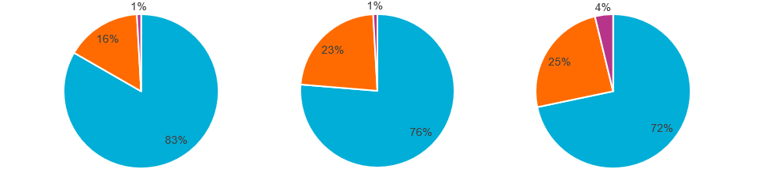
Recruitment into the Acoustics industry
Size of Acoustics Companies
2010
2015
2020
Source: Association of Noise Consultants 2020
Notes:
UK Value of Acoustics UK Music £3.5bn
Lack Historic data - Indications progressively grown over the past 10 years.
ANC,
reported progressive increases in the size of member companies
Struggle to recruit staff.
is particularly a problem in a sector which is still dominated by SMEs.
Small companies find it harder to undertake their training internally due to the proportional costs of taking staff away from income earning activities.
3333 2015
2977 2010
3497 2017

Slide 8
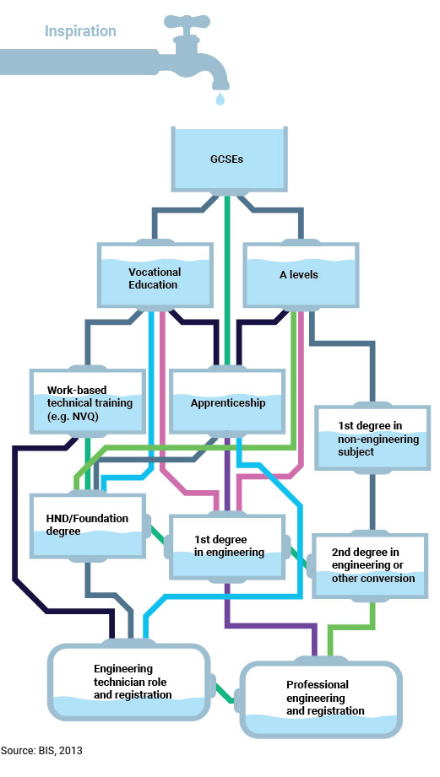
Notes:
engineering professions can be illustrated by the engineering recruitment pipeline.
Typically apprenticeship, relevant degree or conversion
traditionally three routes into Acoustics – undergraduate degree, postgraduate degree or other professional qualification, or direct recruitment from an engineering, physics or maths degree and in-house training in acoustics in the company.
Increased competition, harder to recruit as graduates can easily find roles in their discipline
perception issues as well –‘second rate’ heavy engineering’ industries, – the ‘hard hat’ mentality, where acousticians are considered to be primarily construction site engineers
Fails to recognize the wide range of roles for acousticians.

Slide 9
Acoustics Education
MSc
Professional
BEng/BSc/MEng
185
110
110
Notes:
only 4 institutions with undergraduate courses
7 institutions which run taught Master’s courses
There is one Professional qualification at postgraduate level.
around 270 graduates per year entering the workforce.
Acoustics forms a tiny proportion – less than a quarter of a percent – of the total number of engineering st
Poor diversity, like engineering
increasing number of people who change careers
up to 3 times across their working lives,
do not just need to look at traditional ‘graduate’ populations for recruitment.
changing careers need the ability to fund their relevant training
‘softer’ skills courses with acoustics elements
These students need further training.
Mechanical engineering, but in a sector dominated by SMEs, these students still need specialist training and education in acoustics, particularly on test and measurement and on legislation and standards, and this is often difficult to do in-house.
These ‘soft’ focused courses also put pressure on recruitment to existing courses as students opt for the easier option
Most institutions report gradually declining numbers and financial pressure
(IoA E&LWG 2020)

Slide 10
Industry initiatives
Qualifications and education
Industry Awareness
STEM Outreach
BDP, Vanguardia, AAPB, Adnitt, Bickerdike Allen, Accon UK, Sustainable Acoustics, Wardell-Armstrong, Apex Acoustics, Aecom, Sandy Brown, Arcadis, RBA Acoustics, Institute of Acoustics, ANC
Notes:
The industry has tried to address this from a number of angles.
IoA Diploma – back in 1975. This was aimed at providing education and training in acoustics to those coming out of non-specialist qualifications. However, while there have been changes in the patterns of recruitment (for instance more distance learning students), there has been no overall increase in numbers studying the diploma despite uplift in the sector. The same appears to apply to HE provision – mean recruitment is stable or slightly declining over the past 10 years.
The institute is also developing increasing numbers of specialist short courses to help people enter the industry and upskill and maintain currency within the industry.
This year the acoustics industry has launched a level 4 apprenticeship as a new trial. This is new territory for the sector which has traditionally recruited from the graduate market, but has been identified as a way of both attracting young people into acoustics and helping to reduce the skills shortage. Further discussions are taking place regarding developing more apprenticeships at other levels.
Both the Institute and professional organizations are undertaking outreach and awareness campaigns to get young people to better understand the acoustics industry as well as to engage with acoustics at a younger age – this includes the ANC’s Explore Acoustics campaign, the IoA’s a Sound Career guide (and accompanying video and social media campaigns), and support for the International year of sound including an international year of sound photo competition.
The industry are also involved in a lot of STEM outreach initiatives aimed at getting Acoustics known at a younger age so that people can make appropriate school and career choices. This has including Institute’s commissioning of Edinburgh Science to undertake specialist outreach events including school visits, a new exhibition at Winchester Science Centre specifically focused on Sound and Vibration and supported by industry and academic partners, and engagement with initiatives such as the Big Bang and Tomorrow’s Engineers organisations, which aim to promote STEM careers to a younger audience by both getting them more aware of and enthusing them for engineering careers.
The Institute is also liaising with other relevant professional bodies to increase awareness of Acoustics in those professions (Construction, Architecture, Environmental Health, Planning etc)

Slide 11
What needs to be done?
Recognition and awareness of Acoustics
Recognise the diverse sectors in which Acoustics operates
Awareness of potential job roles in high tech industries as well as ‘heavy’ industries
Address awareness in curricula and careers guidance
Specific mention of Acoustics in school curricula
More classical physics?
Mention in UCAS subject guides
More acoustics elements in relevant university courses such as engineering
Address diversity issues
Increase recruitment by expanding the recruitment pool
Look at diversity in STEM subjects at School level
Make funding available for career-change
Enabling people to diversify
Availability of the postgraduate student loan for professional as well as degree courses?
Notes:
Is it enough – simply, no. It is very difficult to raise the profile of acoustics without policy change which raises the profile of noise and acoustics.
Noise is a health problem which is experienced by more people worldwide than any other.
In order to continue to address the need to deal with noise as a major health problem we need more acousticians in all the industries which are served by acoustic engineers.
This needs some support from policy, to make potential students aware of the potential of acoustics as a career.
Classical physics primarily involved mechanics (the study of the forces that affect the motion of objects), hydrodynamics, optics, thermodynamics and acoustics. Some of the important laws of classical physics are the laws of conservation of mass and of energy.

