Slide 1


Light:
Enabling UK Growth and Resilience
UK Photonics Overview & Roadmap
  John Lincoln & Lewis Hill,
  Photonics Leadership Group
  Photonics for AI and datacentres
  Julia Coym, Seagate
Photonics defence and security
Iain Carrie, Thales
P&SC Meeting
Tuesday 8th September 2026
All images remain copywrite of indicated source
Notes:
20mins 10:40-11:00

Slide 2

Photonics is the technology of light
Generate, shape, transmit, interact and detect light
— from single photons to kilowatts.
Generate
  LEDs Lasers, Lamps, Sun
Detect
  Cameras, microscopes, telescopes..
Manipulate
  Filter, magnify, concentrate, code
Photonics (Light)
Interact
  Adsorb, reflect, heat
Transmit
  Fibre, glass, windows, space
Light any form, any time

Slide 3
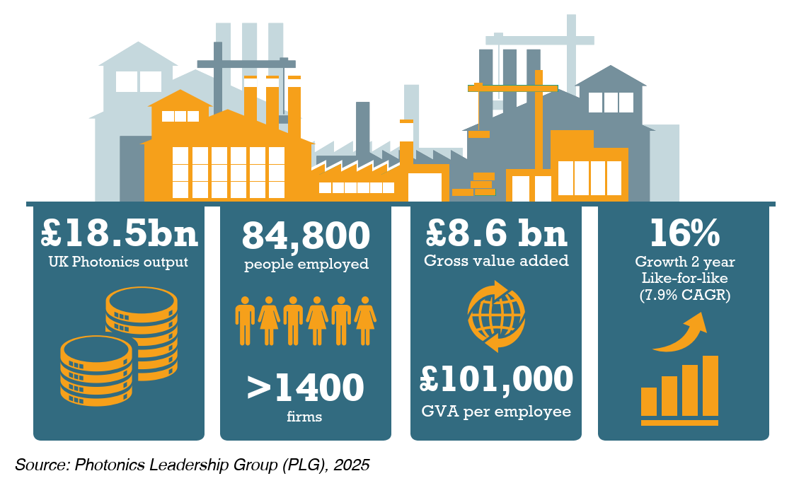
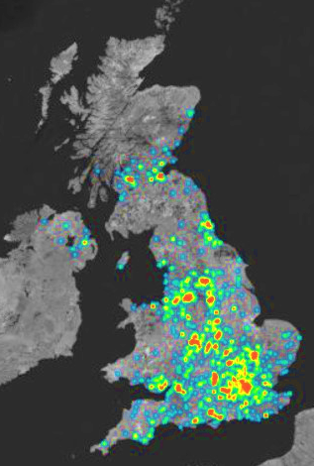
1,400 companies
40+ research centres
photonicsuk.org/directory
Distributed across all regions
  Clusters in NI, Scotland, Wales, NE, SW…
Consistently growing
  4X general UK manufacturing
$ trillion global industry
UK Photonics £50 billion by 2035 with coordinated action
UK Photonics
a UK success story
Notes:
John
additional firms +300 - 80

Slide 4
Photonics ahead
Photonics Employs:
Growth
More than Aerospace or Motor manufacturing
3X more than Pharma, Steel or Chemical
Photonics Revenues:
Greater chemical manuf, > 2X steel revenues.
On track exceed aerospace and pharma
Number Photonics Firms
50% > Aerospace, Chem, Pharma, Petroleum or Steel manufacturing
Productivity
33% > UK manufacturing average
4X UK Manufacturing
based on comparison to ONS data by SIC code
Outperforming higher-profile sectors
Notes:
John
Others based on ONS data
Including
Firm-level labour productivity from the Annual Business Survey: summary statistics, 1997-2022, UK, Office of National Statistics, https://www.ons.gov.uk/economy/economicoutputandproductivity/productivitymeasures/datasets/firmlevellabourproductivityestimatesfromtheannualbusinesssurveyabssummarystatistics

Slide 5

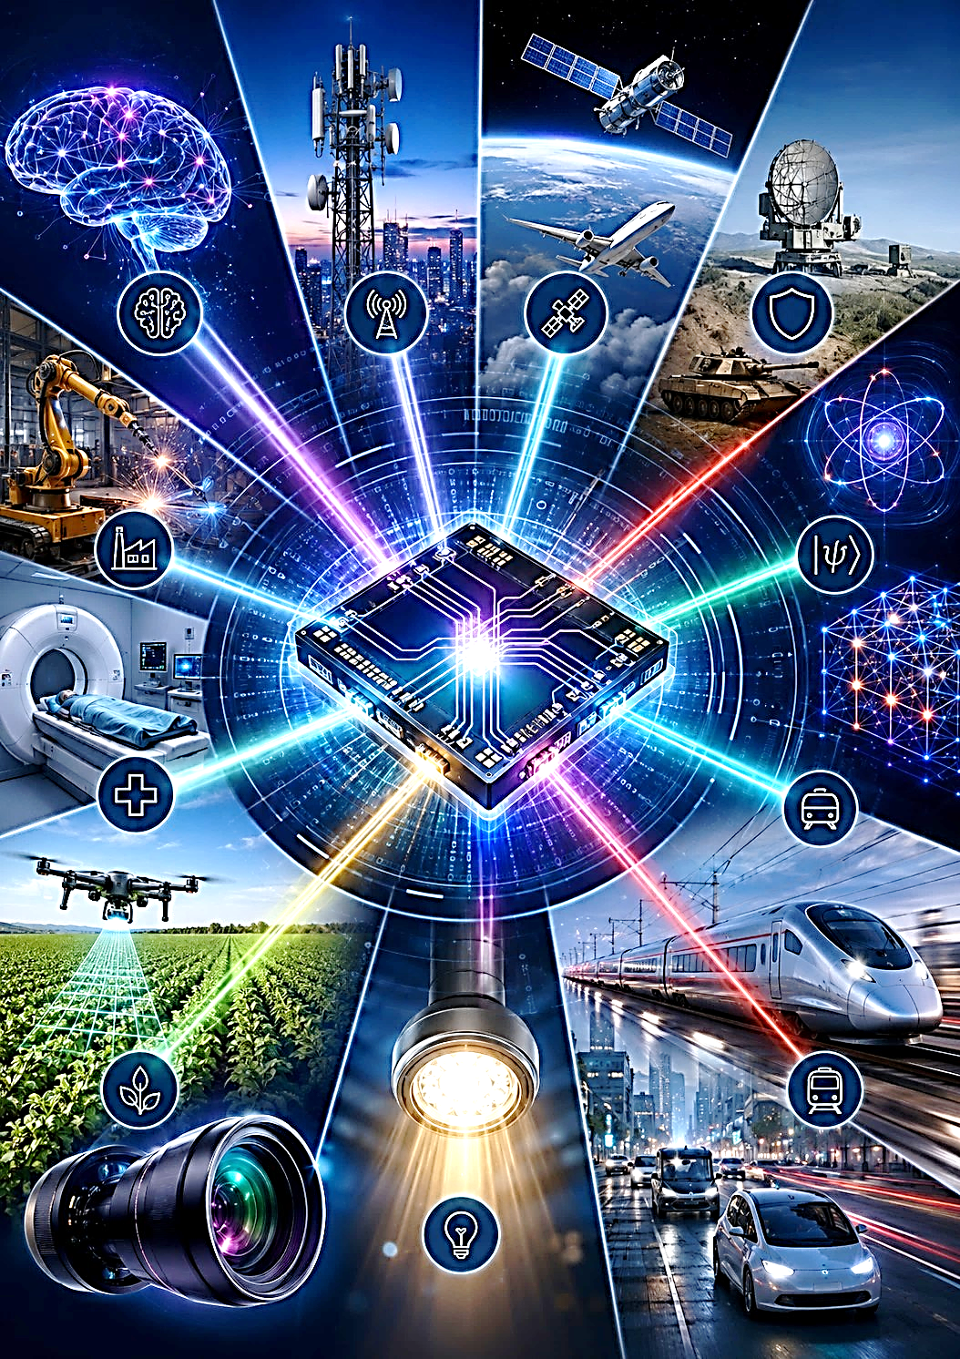
Photonics is everywhere
- enabling modern world
Photonics connects, senses, images, manufactures, communicates & protects - across all sectors
All change: Integrated Photonics Revolution
from discrete components
to scalable photonic chips & modules
huge opportunity, huge risk
Photonics already vital
Data networks
Medical imaging
Laser welding / marking
Defence sensing
..more essential
Lower power AI / data
Quantum compute
Secure comms
Autonomous systems
Personal health
AI · communications · health · defence · manufacturing · autonomous transport · agriculture · lighting · power
Coordination matters:
Common technology base across all sectors
Notes:
Lewis
Talk track: This is the redesigned version of original slide 5. Slide 2 now answers what photonics is; this slide answers what photonics does. The picture from the original slide is retained because it communicates breadth quickly. The key message is not just that photonics is a future opportunity: it has always been embedded in critical systems such as communications, imaging, manufacturing and defence. The change now is integrated photonics: optical functions increasingly move onto chips and packaged modules, making them smaller, lower power, scalable and strategically important for AI, quantum, secure communications and sensing. This breadth is economically powerful but institutionally fragmented, which sets up the later roadmap and parliamentary-coordination ask.

Slide 6

The UK has a research advantage —
but global competition is accelerating
Photonics is embedded across global science.
National share of publications including photonics
13% of all global publications include photonics
160 million articles, 35 years
UK 3rd most prolific publisher of research including photonics
UK in the leading group- but competition is rising
Opportunity: turn research leadership into UK manufacturing, UK adoption
= supply chain resilience and economic value
.
Source: OpenAlex analysis presented in Photonics Leadership Group materials.
Notes:
Lewis
Talk track: This slide keeps the redesigned clarity but restores the key value of the original slide 6: the 35-year trend. The old claim that the UK was third behind only the USA and China is no longer used; the 2024 snapshot puts China, the USA and India slightly ahead of the UK. The correct message is still very strong: the UK is among the leading photonics research contributors. However, China and India have increased their shares markedly, and competition is accelerating. This sets up the case for delivery: the UK cannot rely on research strength alone; it has to convert science into scale-up capability, manufacturing, trusted supply chains and economic value.

Slide 7

Government Position:
- Recognition accelerating
- Delivery key
Infrastructure:
Skills:
add photonics modules to level 3-5 vocational courses
Procurement
Support UK photonics components buy /develop in challenge interventions
AI hardware plan
Defence
International:
Full UK participation Horizon EU successor
Eu Chips ACT 2.0
Pilot line Integrated photonics
£250-500m
Council Science & Tech Feb 26 letter
“Photonics a great UK Success”
National photonics Roadmap
        Protect and grow UK position
        Lead integration revolution not follow
        Leverage in capital funding
        Support critical defence supply
Is funding secured?
Likely roadmap recommendations
Is DfE onboard? Equipment?
Where is it?
Not free – MoD £ needed?
Add UK £ in needed?
Notes:
To coordinate funding, leverage existing clusters, build on technological strengths

Slide 8
Summary
Photonics underpins society now
  Major UK and global industry
    Jobs, revenue and exports from across UK
UK excels at photonics
  From research to manufacturing
Integrated photonics revolution now
Critical to a secure and resilient future
    Manufacturing to health to defence to AI
Need your support to
  Signal to investors and customers, employees
    “Photonics is a great UK success”
  Deliver Funded Roadmap
  Bring departments together
  Integrate Photonics into gov strategy
  Turn gov words into action

Slide 9

Nudging industry, academia, support agencies & government together
Making Photonics bigger, faster, stronger
  www.photonicsuk.org , John.Lincoln@photonicsuk.org / Lewis.hill@photonicsuk.org
Sponsored by
Photonics Leadership Group Supported by
AILU
Alrad
Anchored In
Bay Photonics
Cadfem
Cambridge Consultants
Central Laser Facility / STFC
Coherent Scotland
CPI
CS Applications Catapult
Edmund Optics
Fibercore / Humanetics
Fraunhofer Ctr Applied Photonics
G&H Group
Glyndŵr University, OptiC
Heriot-Watt University
Harlin Ltd
Imperial College London
Intel (Optoscribe)
IQE
Laser 2000
Optica
Oxford Fiber
Oxford Lasers
PowerPhotonic
Singular Photonics
Photonics Scotland / Tech Scotland
SPIE Europe
STFC / Central Laser Facility
Thales
Thorlabs
University of Aston
University of Glasgow
University of Southampton
Wave photonics

