Slide 1
Radiotherapy: Cancer treatment of the past or future?
A presentation by
The British Institute of Radiology and the Institute of Physics and Engineering in Medicine
Parliamentary Scientific Committee
Monday 10th October 2016

Slide 2
What is the issue?
Dr Alexandra Stewart
Consultant Clinical Oncologist,
Royal Surrey Hospital
(Formerly Chair of BIR Oncology and Radiotherapy
Special Interest Group)

Slide 3
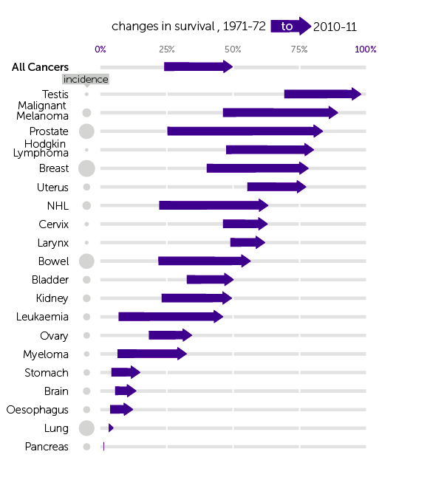
Changes in cancer survival over time

Slide 4
Radiotherapy cures more people than chemotherapy

Slide 5
How radiotherapy helps
Radiotherapy for cure
  Cervix cancer
  Head and neck cancer
Radiotherapy to save function
  Anal or rectal cancer
  Larynx cancer
Radiotherapy to decrease recurrence
  Breast cancer
  Uterus cancer

Slide 6
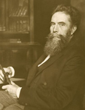
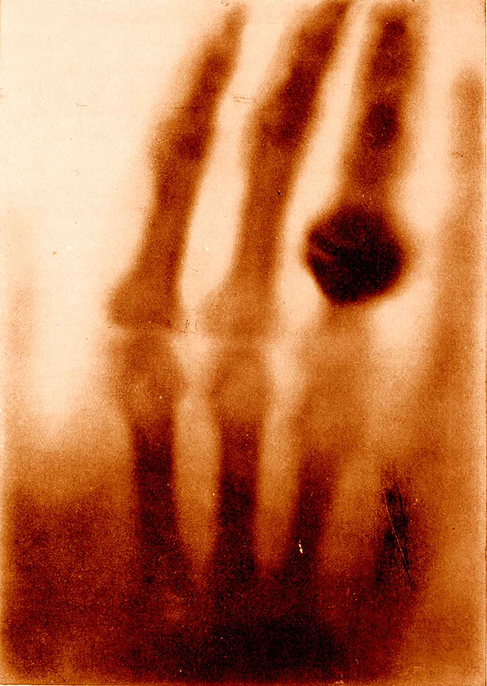
British Roentgen Society
1897

Slide 7
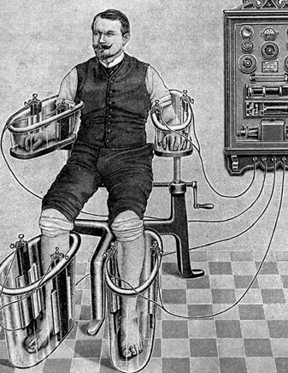
Electrotherapeutic Society
1902
￼

Slide 8
Radioactivity
1896 Becquerel discovers radioactivity
1898 Marie Curie extracts Radium
First radiation patient treated
1903 Nobel to Becquerel and Curies
1906 Pierre Curie dies
1911 Nobel Prize to Marie Curie

Slide 9
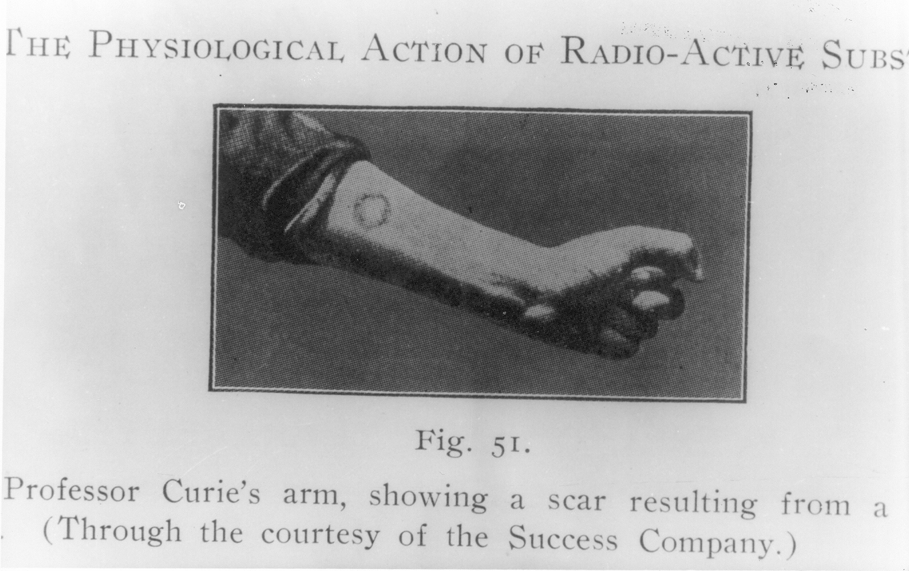

Slide 10
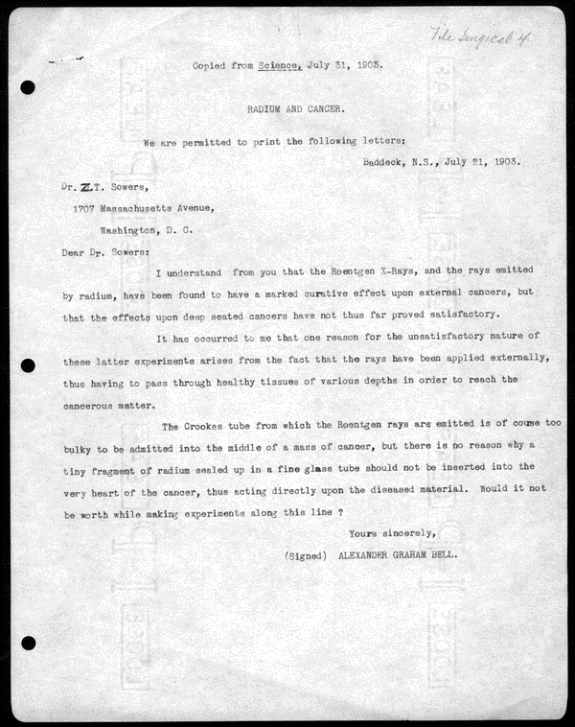

Slide 12
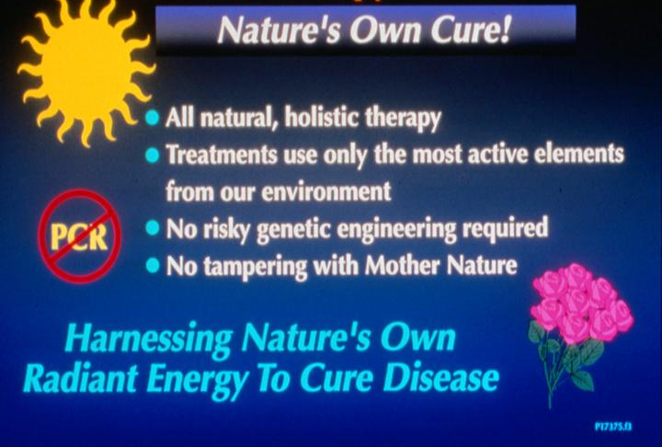

Slide 13
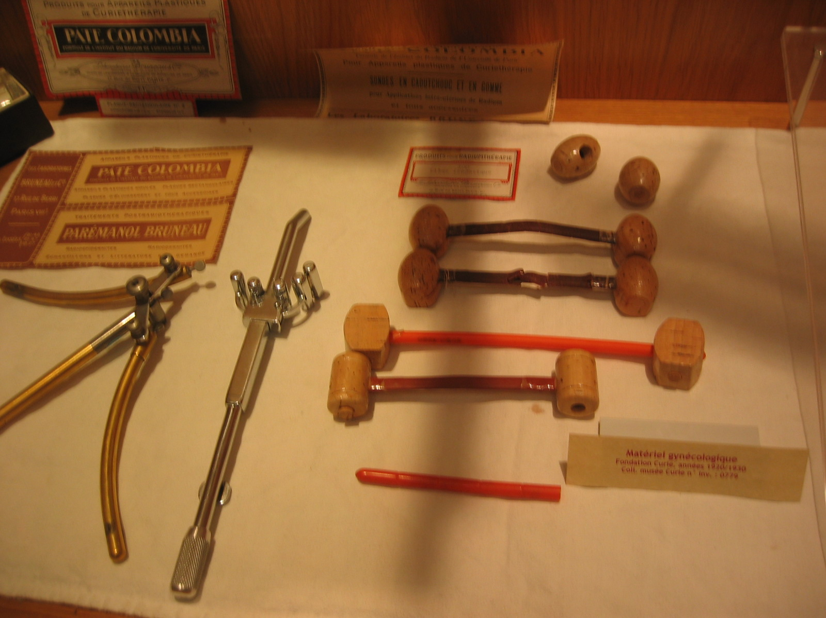

Slide 14
British Institute of Radiology
1924
To promote and encourage the study and practice of the art and science of radiology, radiobiology and nuclear science
Oldest radiology/radiotherapy society in the world
Notes:
- To promote and encourage the study and practice of the art and science of radiology, radiobiology and the medical applications of nuclear science in all their aspects and the study of kindred sciences.
- To maintain and extend to the public advantage the usefulness of the work of the radiologist, radiobiologist, physicist, radiographer, and X-ray engineer in the field of medicine and in the expanding field of the industrial application of radioactive substances.
- To disseminate knowledge concerning all aspects of the science of radiology, radiobiology and the medical applications of nuclear science.
- To accept subscriptions and gifts of all kinds, whether absolute or conditional, and to undertake and administer trusts for purposes falling within the objects of the Institute.

Slide 15
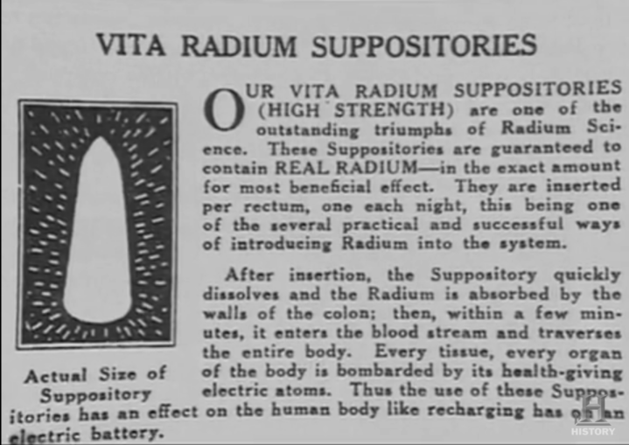

Slide 16
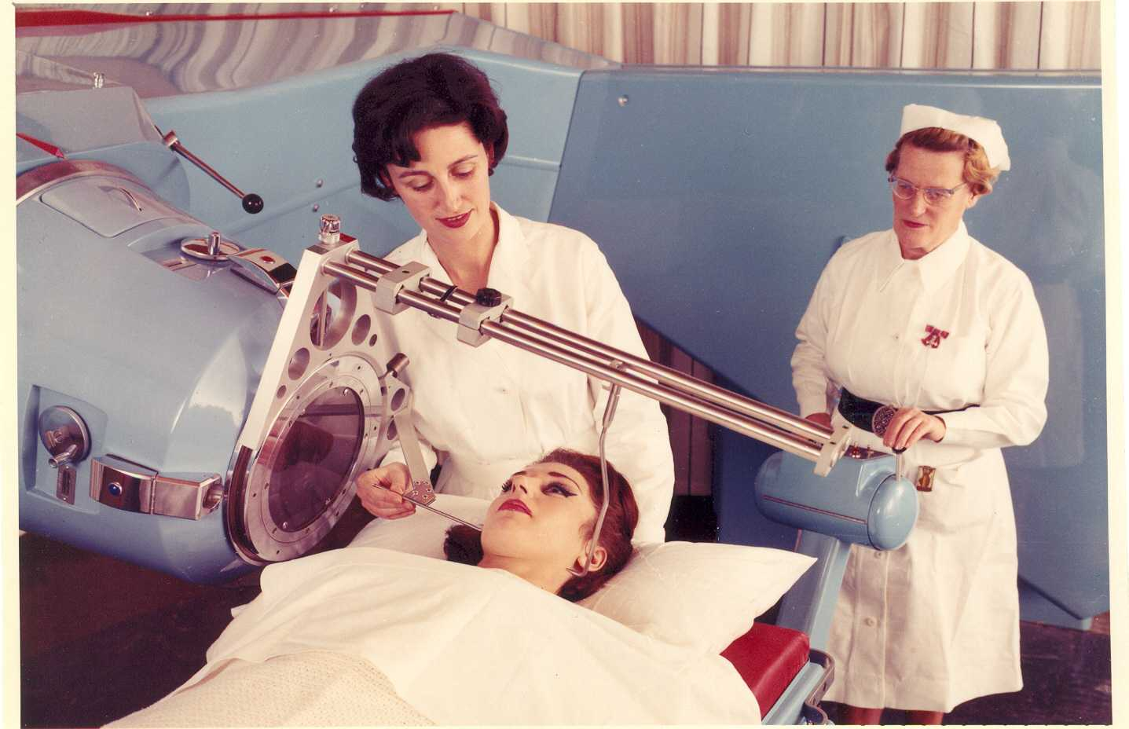
The advent of external radiotherapy machines

Slide 17
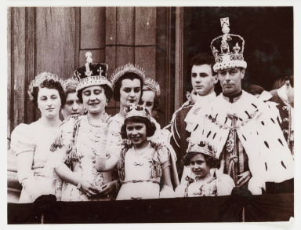

Slide 18
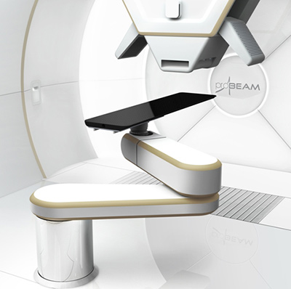
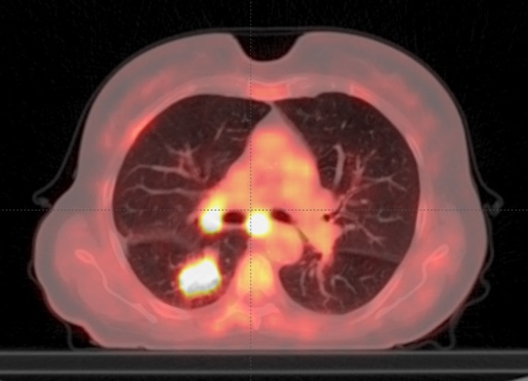
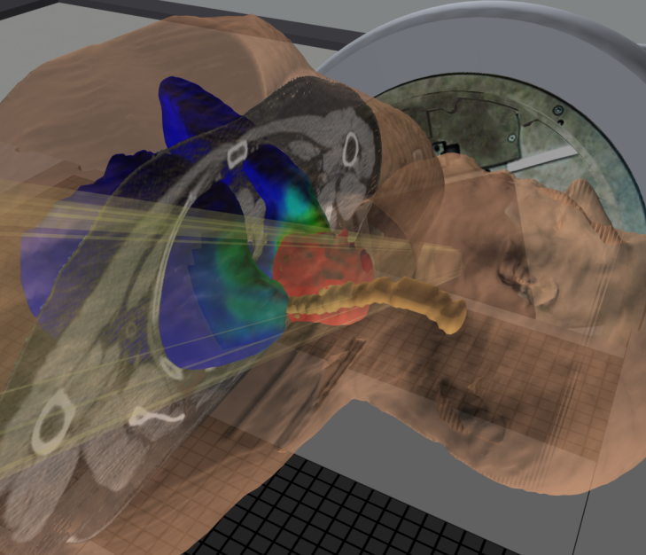
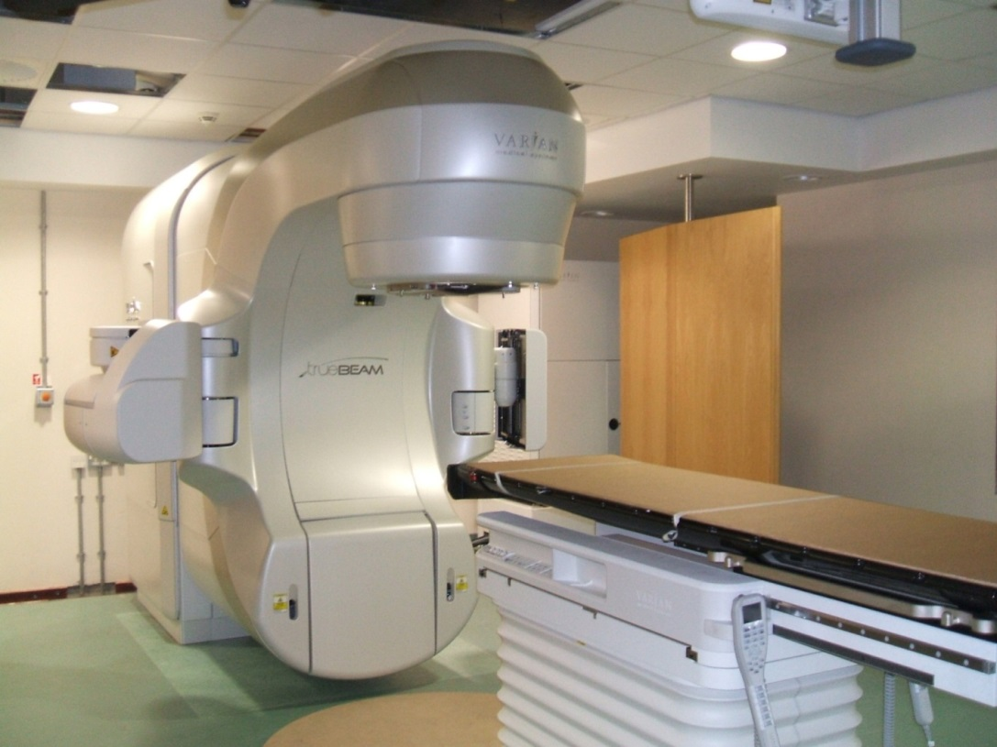
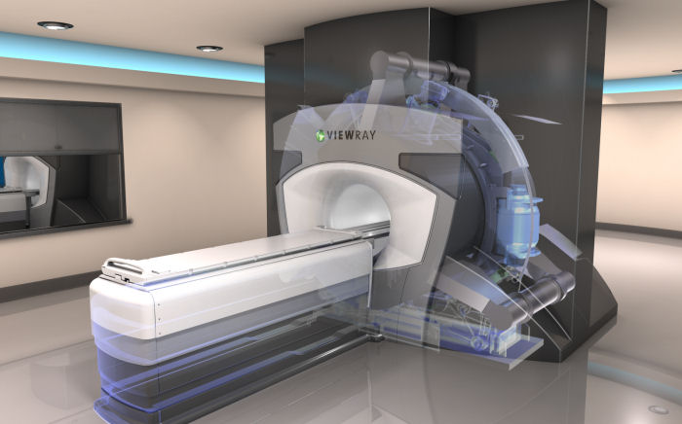
Improving technology and improving precision

Slide 19




Sharing expertise

Slide 20
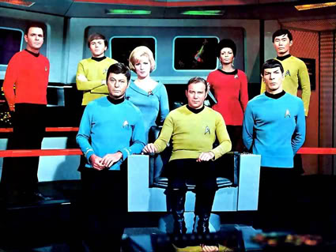
Key members of the workforce
Admin
Dosimetrist
Radiographer
Engineer
CNS
Oncologist
Physicist
The patient

Slide 21
Aim
To deliver a tumoricidal dose of radiation to a defined target volume whilst sparing normal tissue
Therapeutic use of high energy ionising radiation
  Electromagnetic waves or subatomic particles
Damage DNA therefore interfere with DNA replication

Slide 22
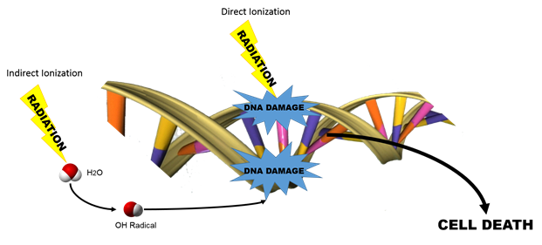
Radiotherapy damages DNA

Slide 23
Evaluation and Staging
Treatment Intent
MDT discussion
Pre-planning
Consent
Patient Immobilisation
Image acquisition
Delineation of treatment
Dosimetry and planning
Planning
Verification
Treatment monitoring
Care on treatment
Evaluation of outcome
Treatment delivery

Slide 24
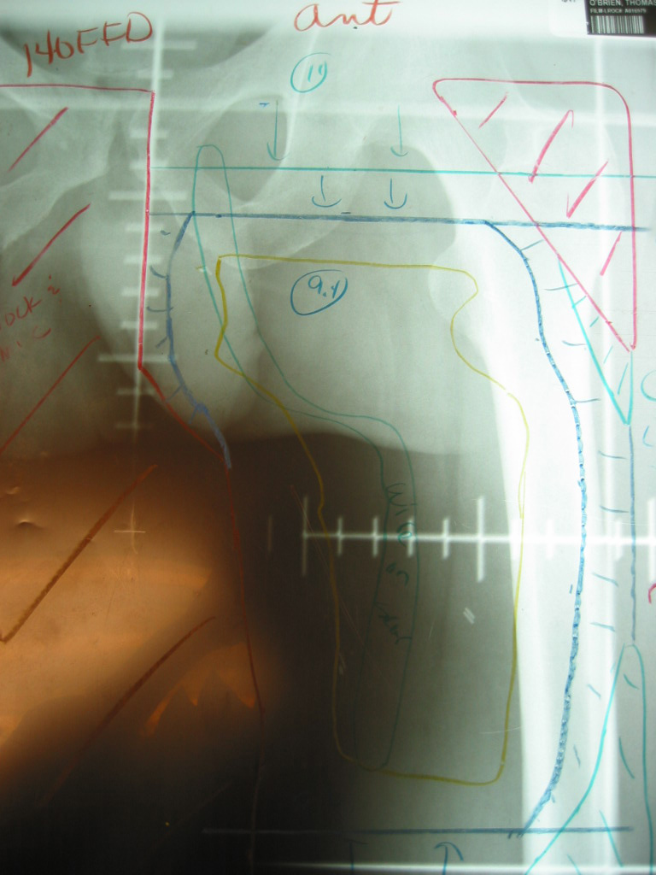

Slide 25
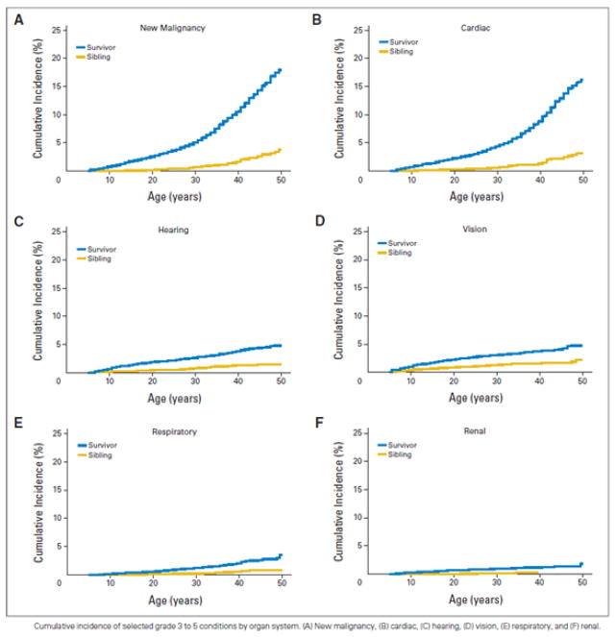

Slide 26
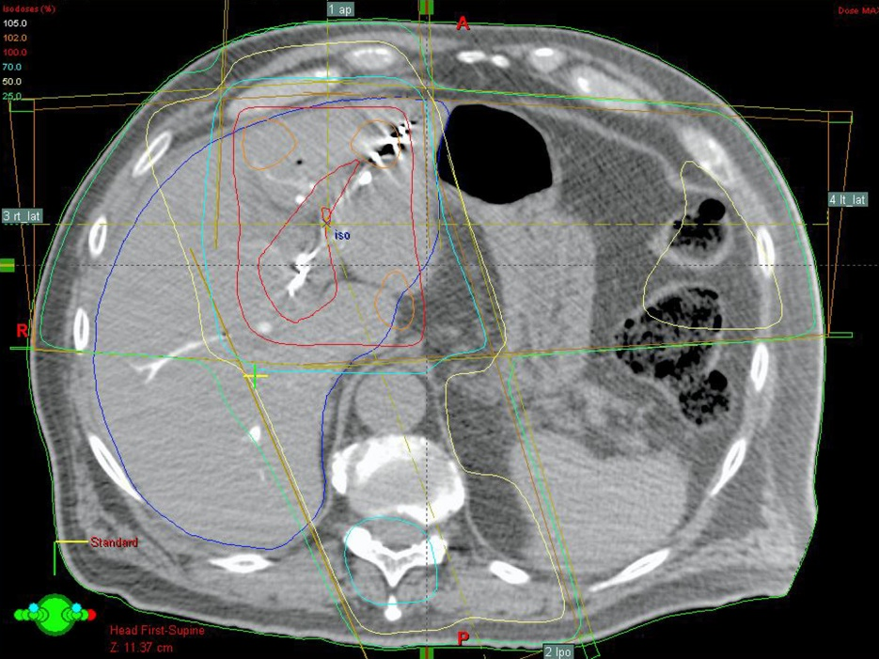
How do we deliver dose?

Slide 27
More conformal radiotherapy will automatically lower acute side effects and allow for dose escalation

Slide 28
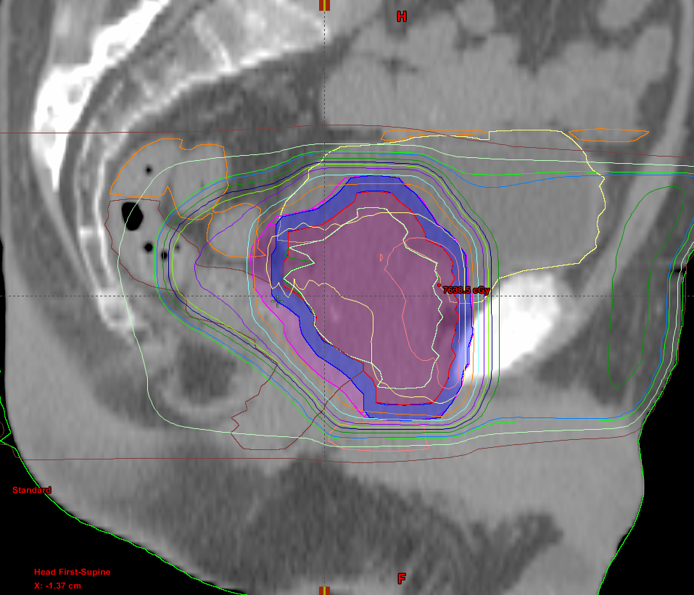
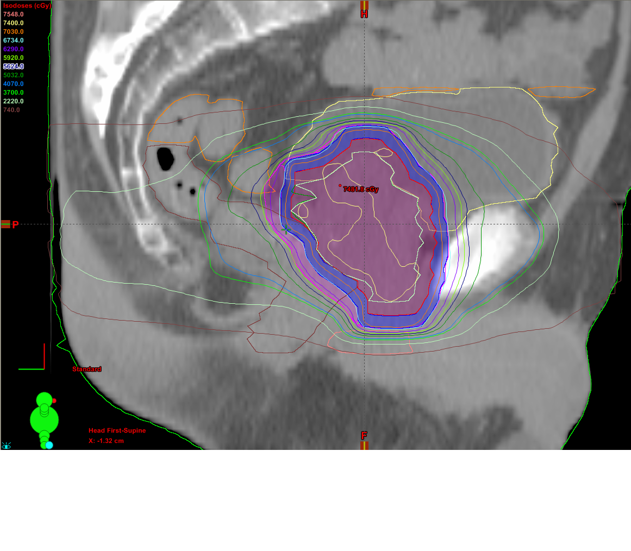
Conformal Plan
IMRT Plan

Slide 29
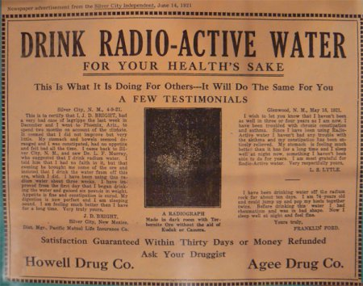

Slide 30
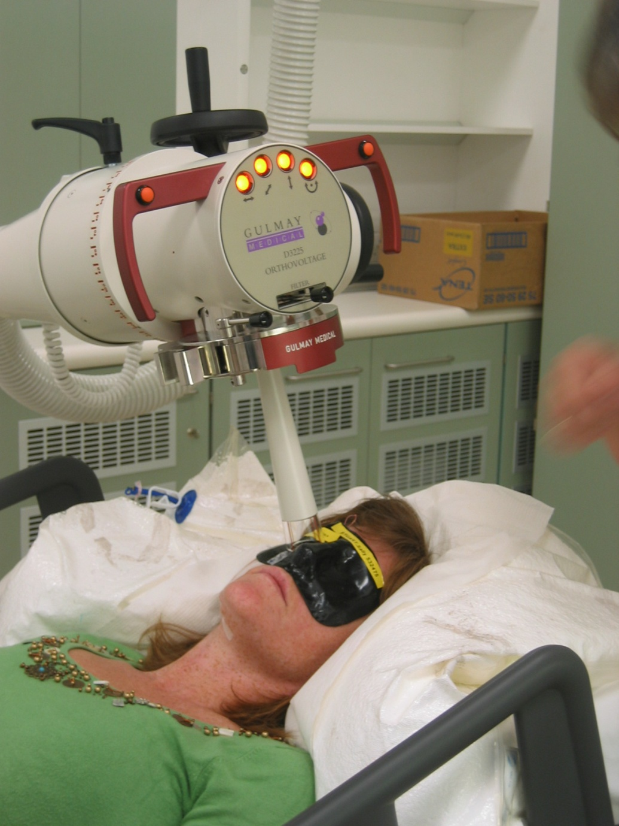
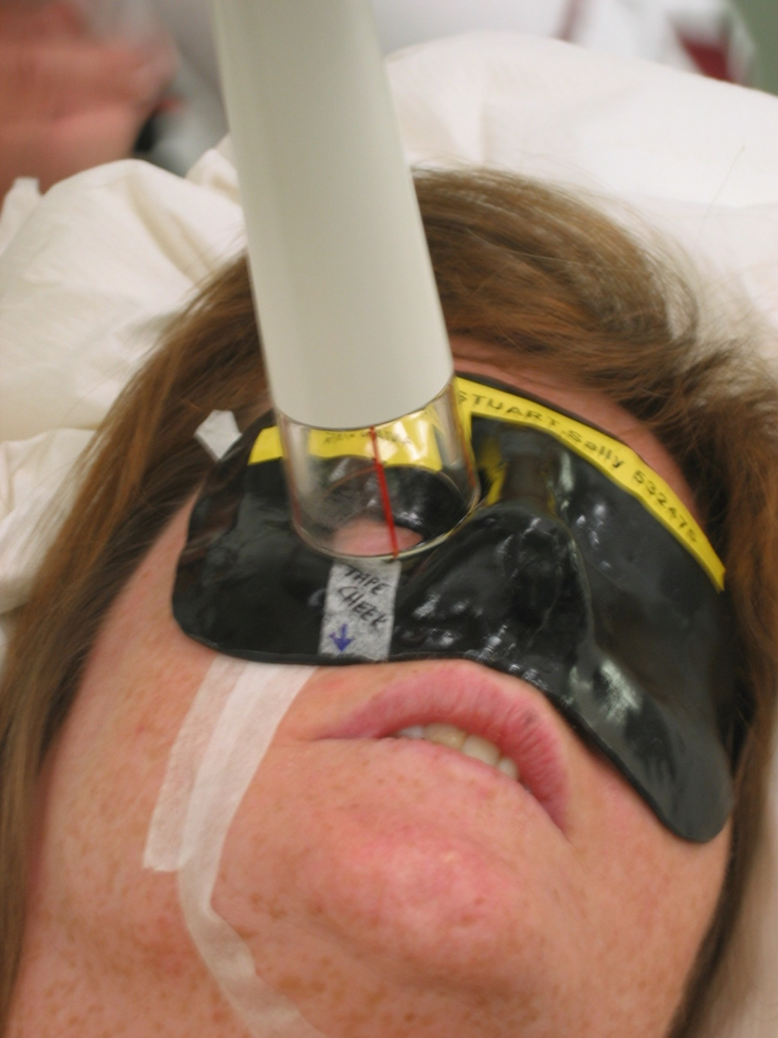

Slide 31
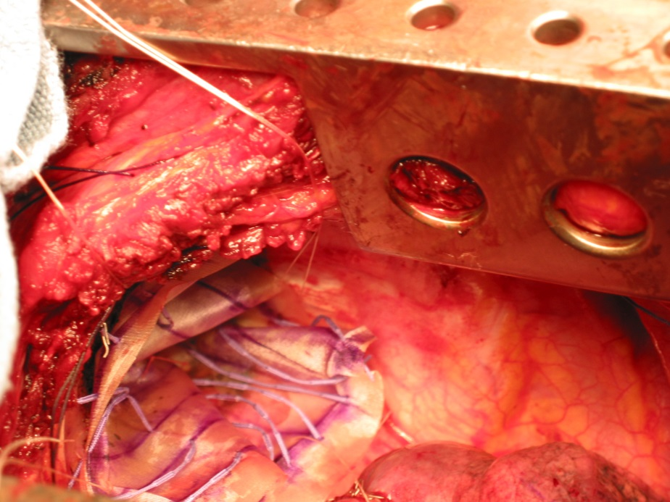
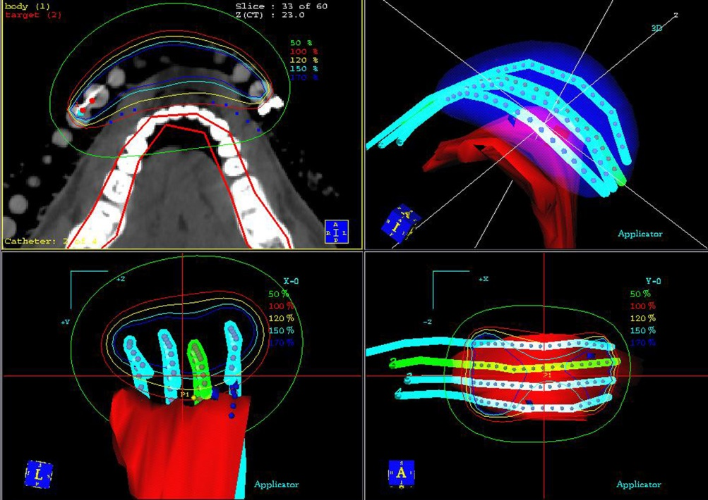
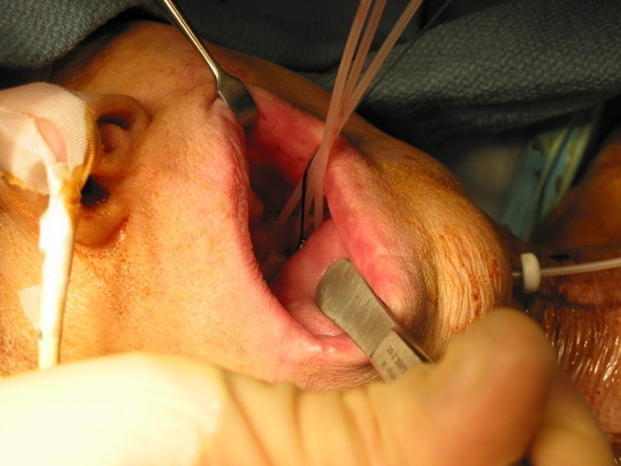
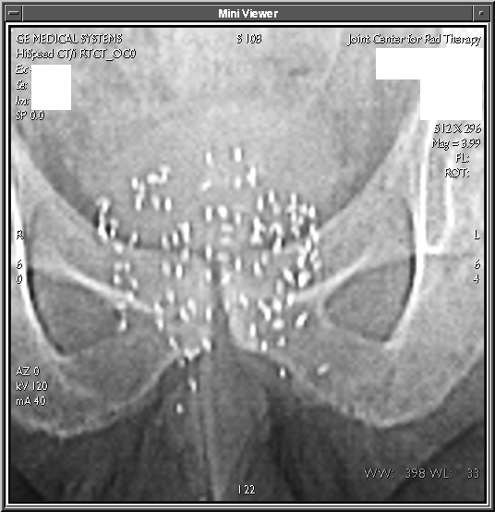
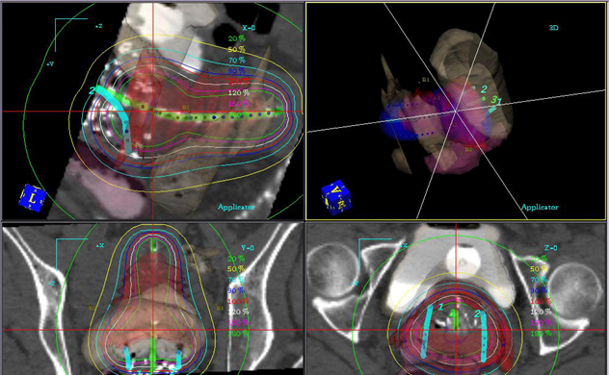
Brachytherapy

Slide 32
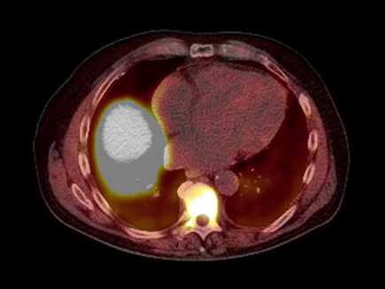
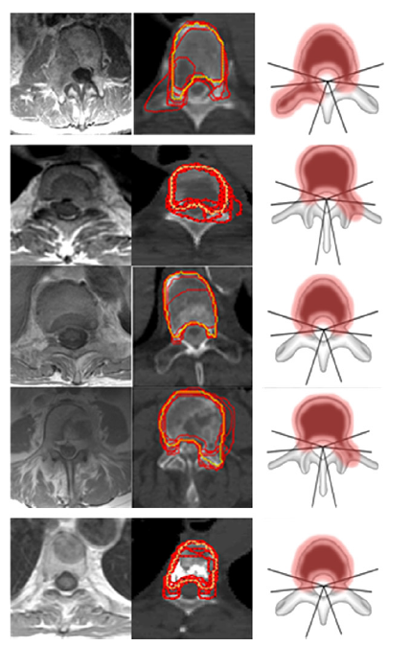
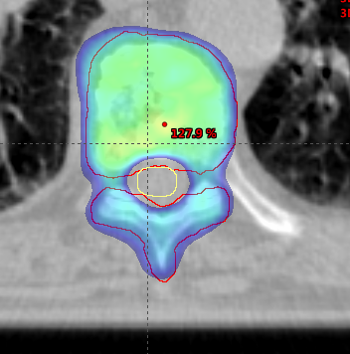
Stereotactic radiotherapy

Slide 33
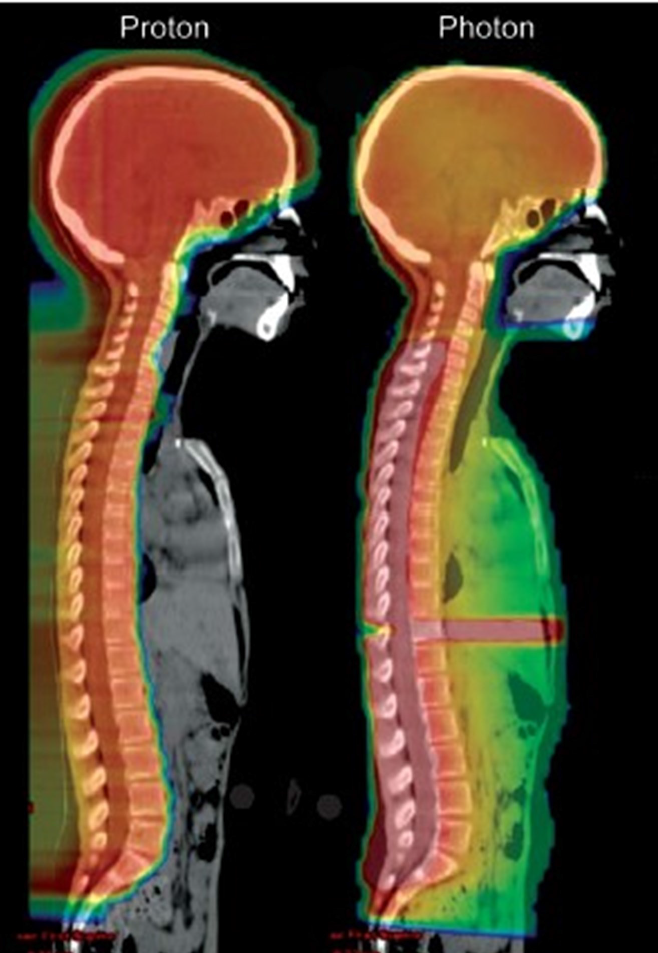
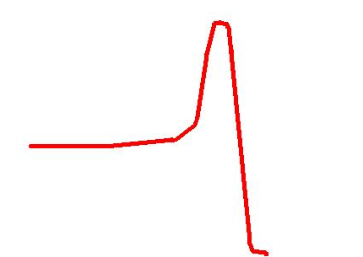
Protons
Ionization
Depth

Slide 34
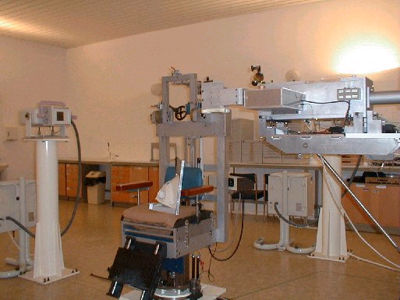
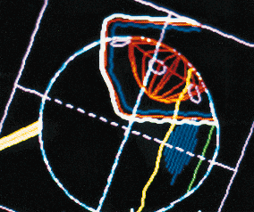
Heavy Ions
UK experience Clatterbridge, Liverpool
Since 1990 >1500 patients with ocular melanoma; local control >98%.
Notes:
First example of 3D computer treatment planning in UK; eye gaze angle is varied relative to beam
Surgical clips and computer reconstruction of eye and tumour dimensions from ultrasound measurements used: good example of image guided radiotherapy.
High Dose prescription of 53 Gy in 4 fractions in 4 days ensures high local control rates; normal tissue volume reduction and sharp dose fall off in spread out Bragg peaks ensures low morbidity: note optic nerve and macula are completely spared.

Slide 35
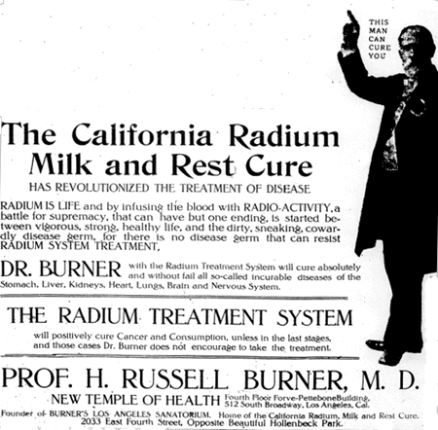

Slide 36
28 year old woman
2 month history of bleeding
Cancer shown on smear test
MRI shows surgery would not fully remove cancer
Radiotherapy is given with curative intent
Chemotherapy weekly will help make the radiotherapy more effective

Slide 37
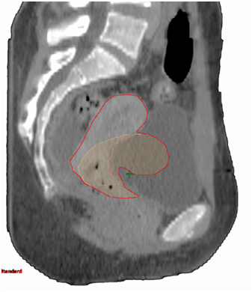
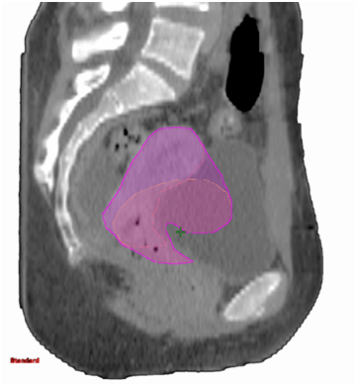
Full bladder
Empty bladder

Slide 38
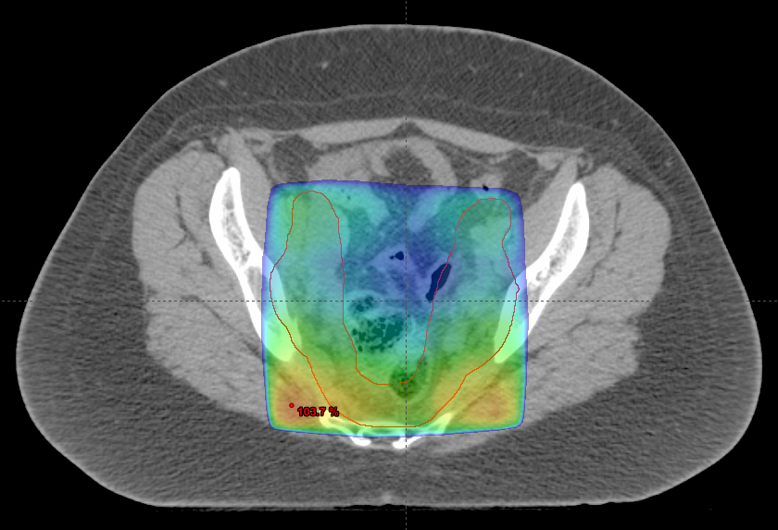
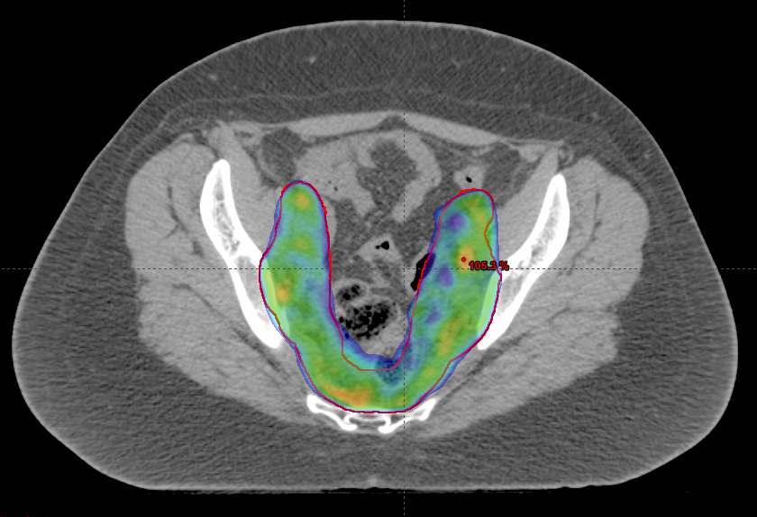
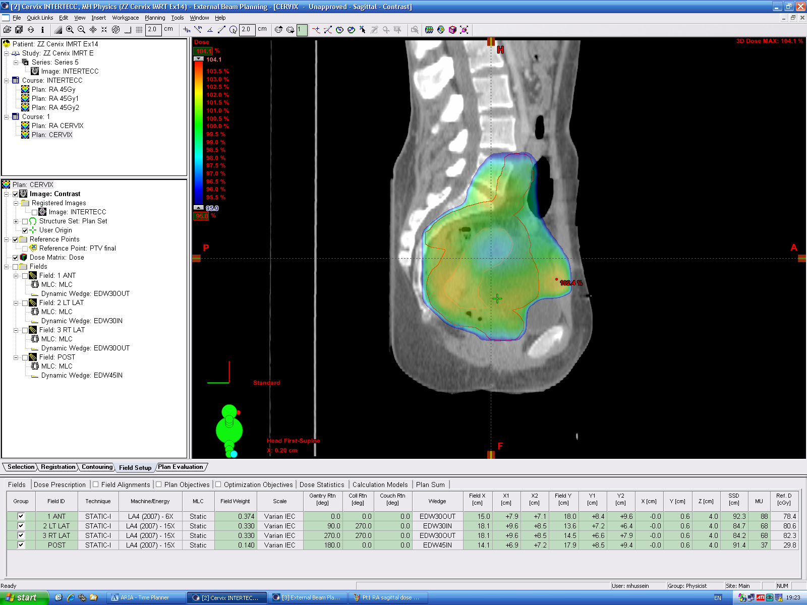
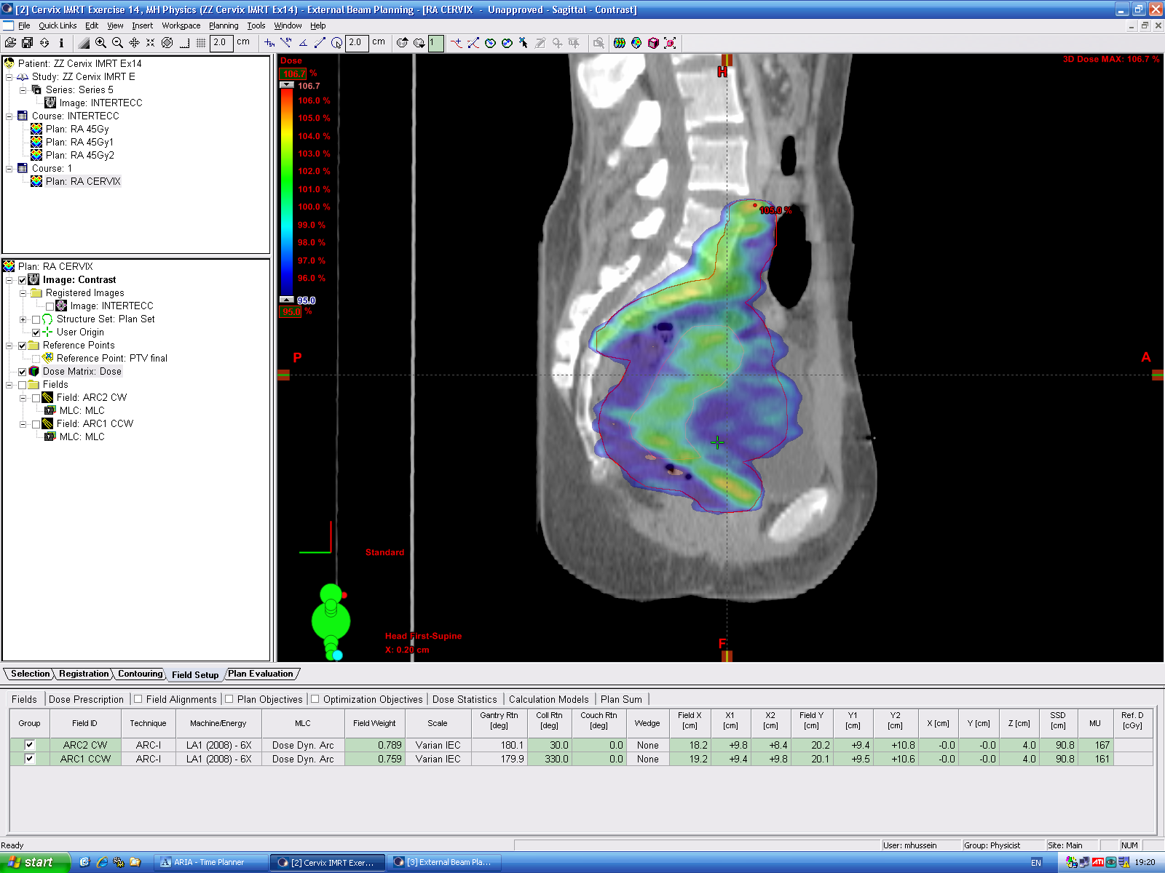
Dose distribution comparison: intact cervix
3D RT
IMRT

Slide 39
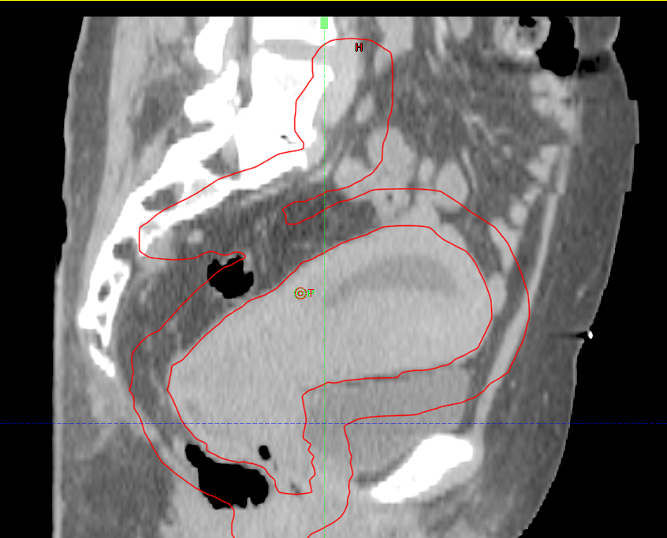
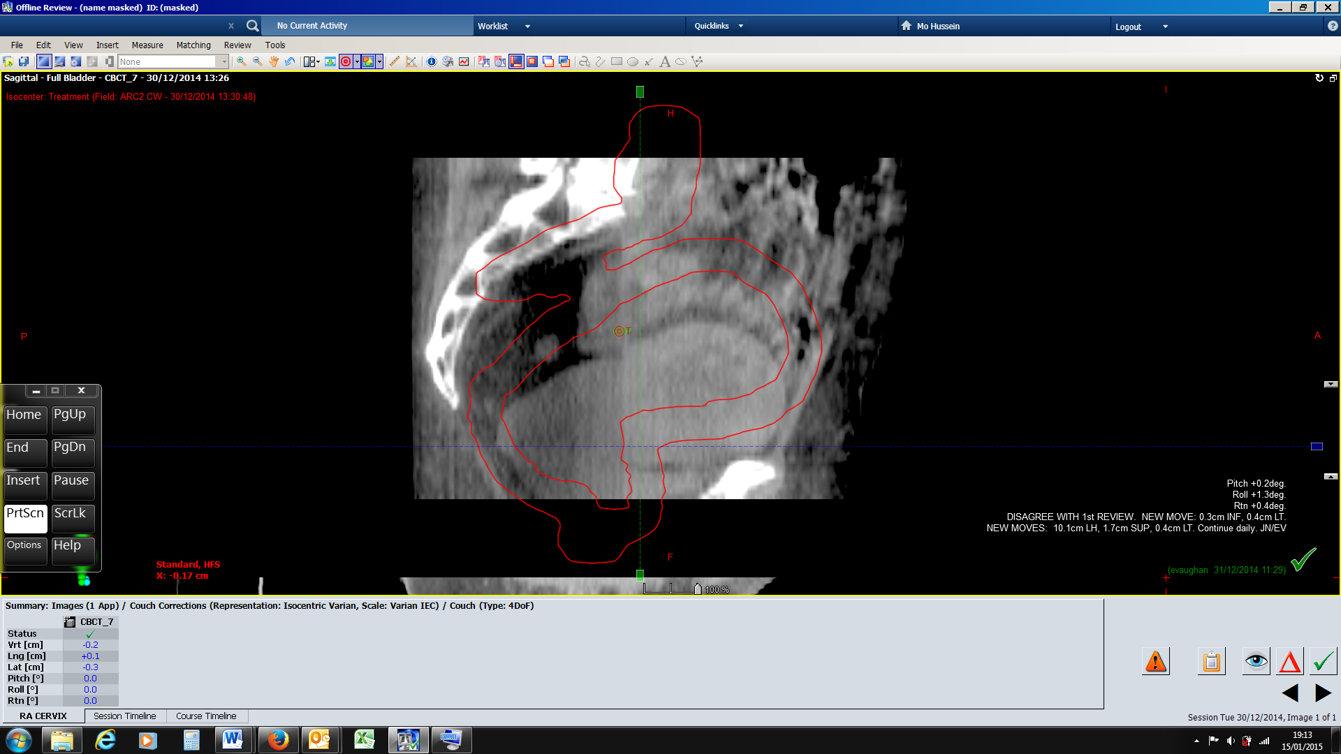
Personalised Treatment

Slide 40
Care on Treatment
  Weekly chemotherapy
  Blood tests
  Nutrition
    regular dietician review
  Skin nurse assessment
  Radiographer review
  Physician review

Slide 41

4 Years later

Slide 42
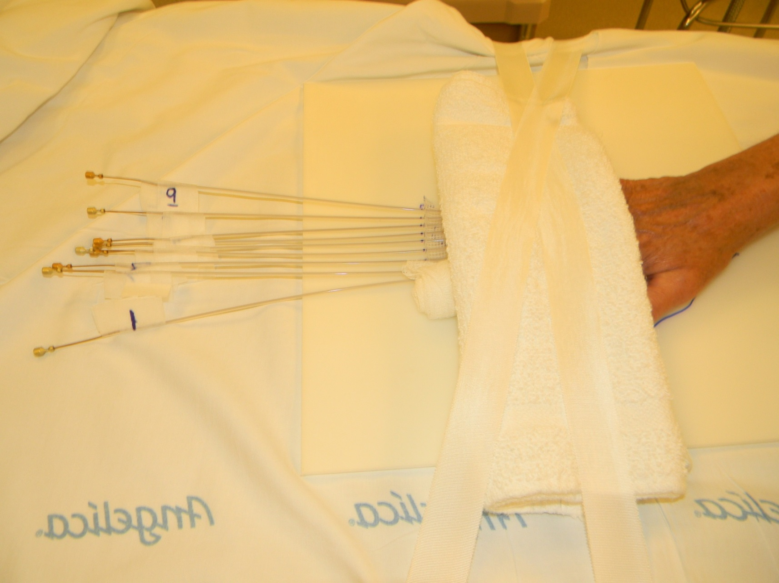

Slide 43
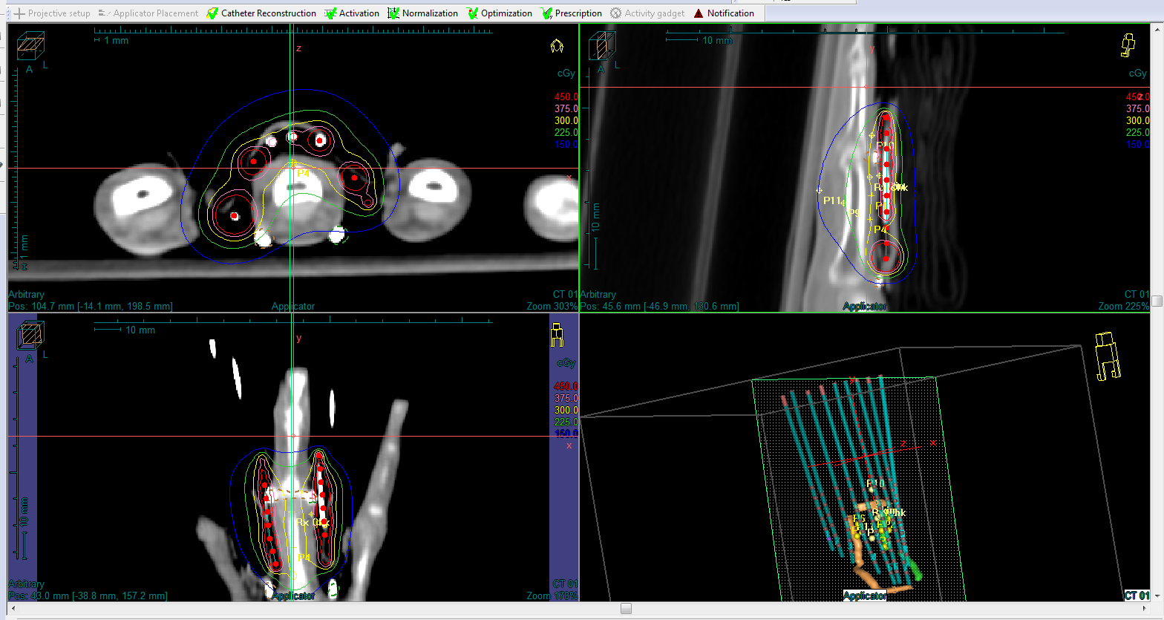

Slide 44
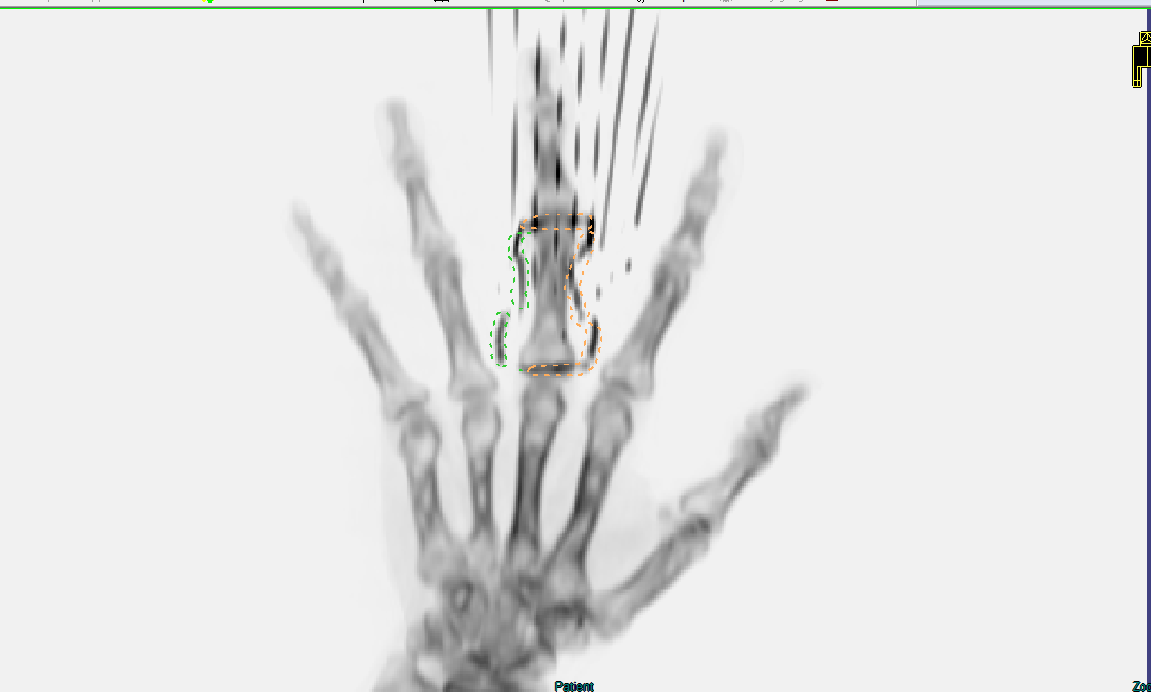
Mrs. Roentgen’s Hand Oct 1895
Mrs W’s Hand Oct 2016

Slide 45
Radiotherapy: Cancer treatment of the past or future?
A presentation by
The British Institute of Radiology and the Institute of Physics and Engineering in Medicine
Parliamentary Scientific Committee
Monday 10th October 2016

Slide 46
Managing Cancer Outcomes
Radiotherapy &
Patient Choice
By
Mark Davies

Slide 47

Importance of Early Diagnosis

Slide 48



You have cancer
Mr Davies

Slide 49

Location, Location, Location

Slide 50


My Treatment
Options

Slide 51


Papillon Radiotherapy
+ TEMs
AKA Shrinking it and using the hole which is already there!

Slide 52


Fear vs. Time?

Slide 53

Patient Pathway

Slide 54



Types of Treatments –
Better planning means better treatment

Slide 55

Hospital Time

Slide 56
Cost of having Cancer
A calculation of the burden of cancer in the EU shows that the costs for loss of working days was around €9.43 billion Euro*
A calculation of the expected lifetime costs for all cancers borne by employers in Australia is $220 million dollars, or $7000 dollars per person – largely consisting of overtime and management costs of temporary absenteeism, and search, hiring and retraining costs of workers that leave paid employment**
*Luengo-Fernandez R. Leal J. Sullivan R. (2013), Economic burden of cancer across the European Union: a population-based cost analysis, The Lancet Oncology
**Cost of Cancer in NSW, A report by Access Economics Pty Limited, for the Cancer Council NSW, Australia, Published in April 2007

Slide 57

Realities of
Survival

Slide 58

UK aging population

Slide 59

Education

Slide 60

Changing your lifestyle!

Slide 61

M.D.T.

Slide 62

Patient Choice

Slide 63



Living With &
Beyond Cancer

Slide 64

“Cancer treatment must not just be about Prevention of Death
but also about
Preparation for Life!”
Mark Davies

Slide 65

Thank you and…

Slide 66
Radiotherapy: Cancer treatment of the past or future?
A presentation by
The British Institute of Radiology and the Institute of Physics and Engineering in Medicine
Parliamentary Scientific Committee
Monday 10th October 2016

Slide 67
Delivering high quality radiotherapy services: challenges & opportunities?
Charlotte Beardmore
Director of Professional Policy,
Society and College of Radiographers

Slide 68


Delivering high quality radiotherapy services: challenges & opportunities?
          Context
          What’s needed for a world class service?

Slide 69



What do patients want?
  Survival with high quality personalised care
  A positive patient experience
  Fewer long term side effects
HIGH QUALITY CANCER CARE & TREATMENT
Multiprofessional team

Slide 70




Context
  Achieving World-Class Cancer Outcomes: Report of the Independent Cancer Taskforce 2015
  Improved survival
  Reduction in incidence
  Improved experiences of care, treatment and support
  Improving the quality of life of patients after treatment and at the end of life
  Improved efficient and effectiveness of cancer service delivery
  Improved utility and reduction in costs
  Financial sustainability
“We want the best cancer care anywhere”
  National Cancer Director

Slide 71

Radiotherapy Vision 2014-2024
    Strong leadership
    Standardised treatment protocols
    Evaluating & quickly adopting innovation
    Realising the full potential of advancement in treatment imaging
    Optimising the use of the highly skilled workforce
    Harnessing the power of data
    Embedding research activity into the service
    A continued drive for cost efficiency
    Better public awareness of radiotherapy
“all patients will have access to the highest quality radiotherapy –clinically beneficial & cost effective”

Slide 72



Context
Developing world class services
      Benefits of modern radiotherapy
      Geography
      Equipment replacement/upgrade
      Workforce
      World class patient care – infrastructure & access to research

Slide 73
1. Radiotherapy profile
The value of radiotherapy – is it understood ?
Cost effective
Cutting edge
Cures cancer

Slide 74


2. Geography -challenges
59⁺ NHS services across the UK [52⁺ in England] – acute sector Access to radiotherapy - some centres have satellite centres
Population served : ranges from 270,000 – 3,250,000
Treatment machines : 2 – 12
Clinical Oncologists :3 – 35
Therapeutic radiographers :8-112
Independent sector provision growing

Slide 75


2. Geography - Challenges
Patient access & journey times
Integration with cancer teams/ expertise
High cost equipment: maximising efficiency
Routine v specialist treatments
Affordability/sustainability

Slide 76
3. Equipment challenges
Current NHS Radiotherapy Equipment (Linear Accelerator) replacement requirements in England
Data correct as of September 2016
Source: NHS Supply Chain
Data correct as of September 2016
Source: NHS Supply Chain

Slide 77




3. Equipment : new geographical location versus existing centre?
Principles
Not necessarily more centres
Treatment machine specification important
Sustainable equipment replacement plans
Co-ordination not competition between centres

Slide 78

4. Workforce - UK Radiotherapy Services
Latest radiotherapy
workforce census

Slide 79



4. Radiotherapy workforce -challenges
England – NHS
Radiography
169 WTE Therapeutic Radiographer vacancies (6.8% vacancy rate) (total in post = 2863]
Physics
68 WTE Clinical Scientist vacancies (9.0% vacancy rate)
41 WTE Physics Practitioner vacancies (9.2% vacancy rate)
24 WTE Engineering Practitioner vacancies (8.2% vacancy rate)
Clinical Oncologist
In 2015 England fill rates were 93% (Health Education England)
Clinical oncologists deliver both radiotherapy & chemotherapy

Slide 80


4. Radiotherapy workforce
Increasing demand for more numbers
Increasing demand for new skills
Increasing growth of new roles
Skills mix : technology
Cut in 2016 budget for CPD = non medical workforce by around 50%

Slide 81

5. Building sustainable/resilient services -what’s required?

Slide 82





5. World class patient care
Recognition of the important role of investment in NCRI CTRAD / RTTQA Group

Slide 83
5. Building sustainable/resilient services -what’s required?
Oversight across population
Role of Radiotherapy is recognized
Investment in equipment
Investment in workforce
Improved support for patients
Improved access to radiotherapy trials
Notes:
Collective population oversight - integrated with surgical and non-surgical cancer pathways/services- specialised commissioning
Acknowledgement of the role of Radiotherapy in current and future cancer care: intensive focus on cancer drugs/ awareness
Investment in radiotherapy equipment capability across the treatment pathway: equipment specification; upgrades; tariff ; capacity
Investment in workforce skills; numbers; local planning
Improved support for patients : for example travel/facilities
Patients must have improved access to radiotherapy trials

Slide 84

Summary
Goal
Equitable & appropriate access to high quality innovative radiotherapy treatment and care appropriate to the condition being treated
Improve both life expectancy and quality of life for patients

Slide 85
Radiotherapy: Cancer treatment of the past or future?
A presentation by
The British Institute of Radiology and the Institute of Physics and Engineering in Medicine
Parliamentary Scientific Committee
Monday 10th October 2016

Slide 86
Exploiting the potential of radiotherapy: Innovation, integration and Improving outcomes
Prof Andrew W Beavis PhD
Head of Radiation Physics Dept
Queens Centre for Oncology, Hull.
Hon Prof. University of Hull
Visiting Prof. Sheffield-Hallam University

Slide 87
Reminder: Radiotherapy works
40% of those patients whose disease was controlled had radiotherapy
Notes:
Radiotherapy is second only to surgery in its effectiveness as a treatment modality for cancer

Slide 88


How does Radiotherapy work?
Radiation damages cells ability to properly reproduce themselves via DNA disruption
Obvious answer?: Use a lot of Radiation ‘dose’ and destroy the tumour
HOWEVER, radiation does not discriminate between tumour and healthy cells
Side effects
Tumour Control

Slide 89

Challenging patient – needed Image guided, Intensity modulated Radiotherapy
‘tumour’ was wrapped around the spinal cord
Surgeons were unable to offer an option
No IGRT, no IMRT, no RT option, no treatment
lungs
tumour
spinal cord
Contemporary radiotherapy provided a treatment option

Slide 90


DOES IMRT WORK?
IMRT reduced ‘dry mouth’ side effect
IMRT does what it says on the tin!
UK Randomised IMRT trial 2003-2007
PARSPORT (UK) head and neck trial results
IMRT reduced ‘long term damage to salivary glands’

Slide 91





Other efficiencies: deliver the treatment differently
Highly conformal/ accurate radiotherapy allows Hypo-fractionation (fewer treatment sessions)
  SABR, SRS, SBRT, Stereotactic radiotherapy, CtE
UK CHHiP trial (utilising IMRT) completed June 2011 - Prostate cancer
No significant difference in changes to various functions from baseline to two years post treatment between men treated over
37 ‘days’, 20 ‘days’ or 19 ‘days’
Bowel
urinary
sexual
function

Slide 92
Innovation – the chance to improve radiotherapy further
→ improve outcomes
Driven by evolving Technology
  Needs to happen in the clinical departments
  Workforce – developed multi-disciplinary approach that utilises technology safely and robustly
  Developing consensus across three professional bodies
  QC at core of clinical trails – RTTQA centre
Precedent of centrally managed, national project that yielded results
  Radiotherapy Innovation Fund, 2013

Slide 93


2013 Radiotherapy Innovation Fund – how it got us closer to a World Class service
Money spent
RIF: £23M spend
Established a minimum use of IMRT nationally and increased average usage

Slide 94

How can we make a further tangible difference to UK radiotherapy
Can’t neglect fact that the services need to fund refreshment of equipment profile
  126 Linacs (£250M+), planning and imaging systems
However, a RIF2 – a centrally managed modest spend - could repeat some systematic enhancements to services
  More technology driven efficiency releases
  Potential focus: ADAPTIVE RADIOTHERAPY
    Improve outcomes by ‘adapting’ to changes during treatment
    Personalised radiotherapy

Slide 95

Use the Technology to drive efficiency and improve outcomes

Slide 96




MRI guided Radiotherapy
Edmonton
Canadian
Elekta
Viewray
Australian

Slide 97






Viewray MRIdian
Washington Univ. 1/14
Univ. Wisconsin 9/14
UCLA 10/14
SNUH 10/15
Univ. Miami 4/16
VUmc 3/16
926 Patients treated (as of end of Aug)

Slide 98

  Soft tissue tracking during treatment
GTV
PTV

Slide 99
Case study: Adrenal metastasis
  Coverage of ‘target volume’ initially compromised by overlapping Organ At Risk
    OAR = radiation sensitive, non-cancerous, organ
    Compromise needed to treatment intent
  At first treatment session spatial separation apparent
    Previous compromise now un-necessary
    Re-optimisation of plan possible
  Clinical example of daily ‘adaptive radiotherapy’
    Possible due to image guided, intensity modulated radiotherapy

Slide 100

Solitary NSCLC adrenal met

Slide 101


Original plan – not as ‘curative’ as desired, due to potential ‘collateral damage’ to duodenum
Target coverage initially limited by duodenum

Slide 102


Imaging on first day: more separation
Pre-treatment
Increased space on Fx 1 MR
Day 1

Slide 103


Adaptive plan – replanned for BETTER t/ment
Re-optimization performed to evaluate for increased PTV coverage

Slide 104


Adaptive plan – Improved coverage and reduced OAR dose
New plan evaluated in real time.
Plan Rx Comparison tool
GTV
PTV
Duodenum
Small Bowel
BETTER CHANCE TO CONTROL THE CANCER

Slide 105
MRI guided radiotherapy delivery
= ‘high end adaptive radiotherapy’
Patients have been / are being treated who were previously considered too high risk for RT given how close the organs at risk were to the ‘tumour’
Mainly in USA
  Two avenues are happening/ opening in England
    Elekta: Royal Marsden and Christie
    Viewray: 5 centres exploring ‘novel funding mechanism’
adaptive treatments on more common treatment machines also under investigation

Slide 106
Using ‘drug’ technology/ biological innovations in conjunction with ‘high end’ radiotherapy
Reminder: Radiotherapy works by damaging DNA in the tumour cells
  However, the cells can repair this damage, thus reducing the effectiveness of radiotherapy
Can use DNA repair inhibitor drugs to ensure maximal effectiveness of radiotherapy

Slide 107

CURRENT TRAILS: Combination of radiotherapy with molecularly targeted agents
Courtesy: Prof Anthony Chalmers

Slide 108



Modifying the Tumour’s Environment ‘to our advantage’
Hypoxic (oxygen deprived) cells are resistant to radiotherapy
  Use drug treatments to improve their oxygenated status → advantage!

Slide 109
Proton therapy
Been a rapid expansion of this internationally
  Currently we have a national programme allowing the referral of patients abroad
  We are building two NHS facilities
    With six delivery rooms
  Private centres and a research centre are also under construction/ planning

Slide 110

Why use Proton beams for radiotherapy?
Proton
X-Ray
Their Physical properties are beneficial in some cases
  Less collateral damage!
No more dose
X-Ray
Proton

Slide 111

What will NHS service look like?
2 sites selected
  The Christie (Manchester)
  UCLH (London)
2 Sites, 1 Service
  Integrated clinically within the hospital setting
  Integrated with existing conventional photon facilities
  Collaboration across all areas
    Referral
    Protocol Development
    Technology
    Research
  Due to open in 2018

Slide 112
Cancer taskforce strategy
Response by the radiotherapy Clinical reference group (expert group)
  Due to be published w/s 17/10/16
Innovative changes expected to the configuration of RT services
  But shouldn’t affect the ability to innovate clinically/ respond to drivers for clinical change
  Rather, potentially improve this ability??

Slide 113
Sustainable revenue funding
Tariff system that is currently in place doesn’t work well
Reset what we consider to be ‘routine radiotherapy’
  Penalties for lack of appropriate use??
Need a review and a better system that doesn’t stifle innovation
Innovative financial management of services, to promote clinical innovation and sustainable services

Slide 114
Thank you for the opportunity to present
Radiotherapy is a developing and innovative science
  Continually improving
  Exiting developments are still to come!
  Potential to improve cancer outcomes further
NHS service enjoys committed staff
  Who drive innovation
  Who can make the UK service ‘world class’

Slide 115
Any questions?
The British Institute of Radiology
www.bir.org.uk
@BIR_News
The Institute of Physics and Engineering in Medicine
www.ipem.ac.uk
@ipemnews

