Slide 1
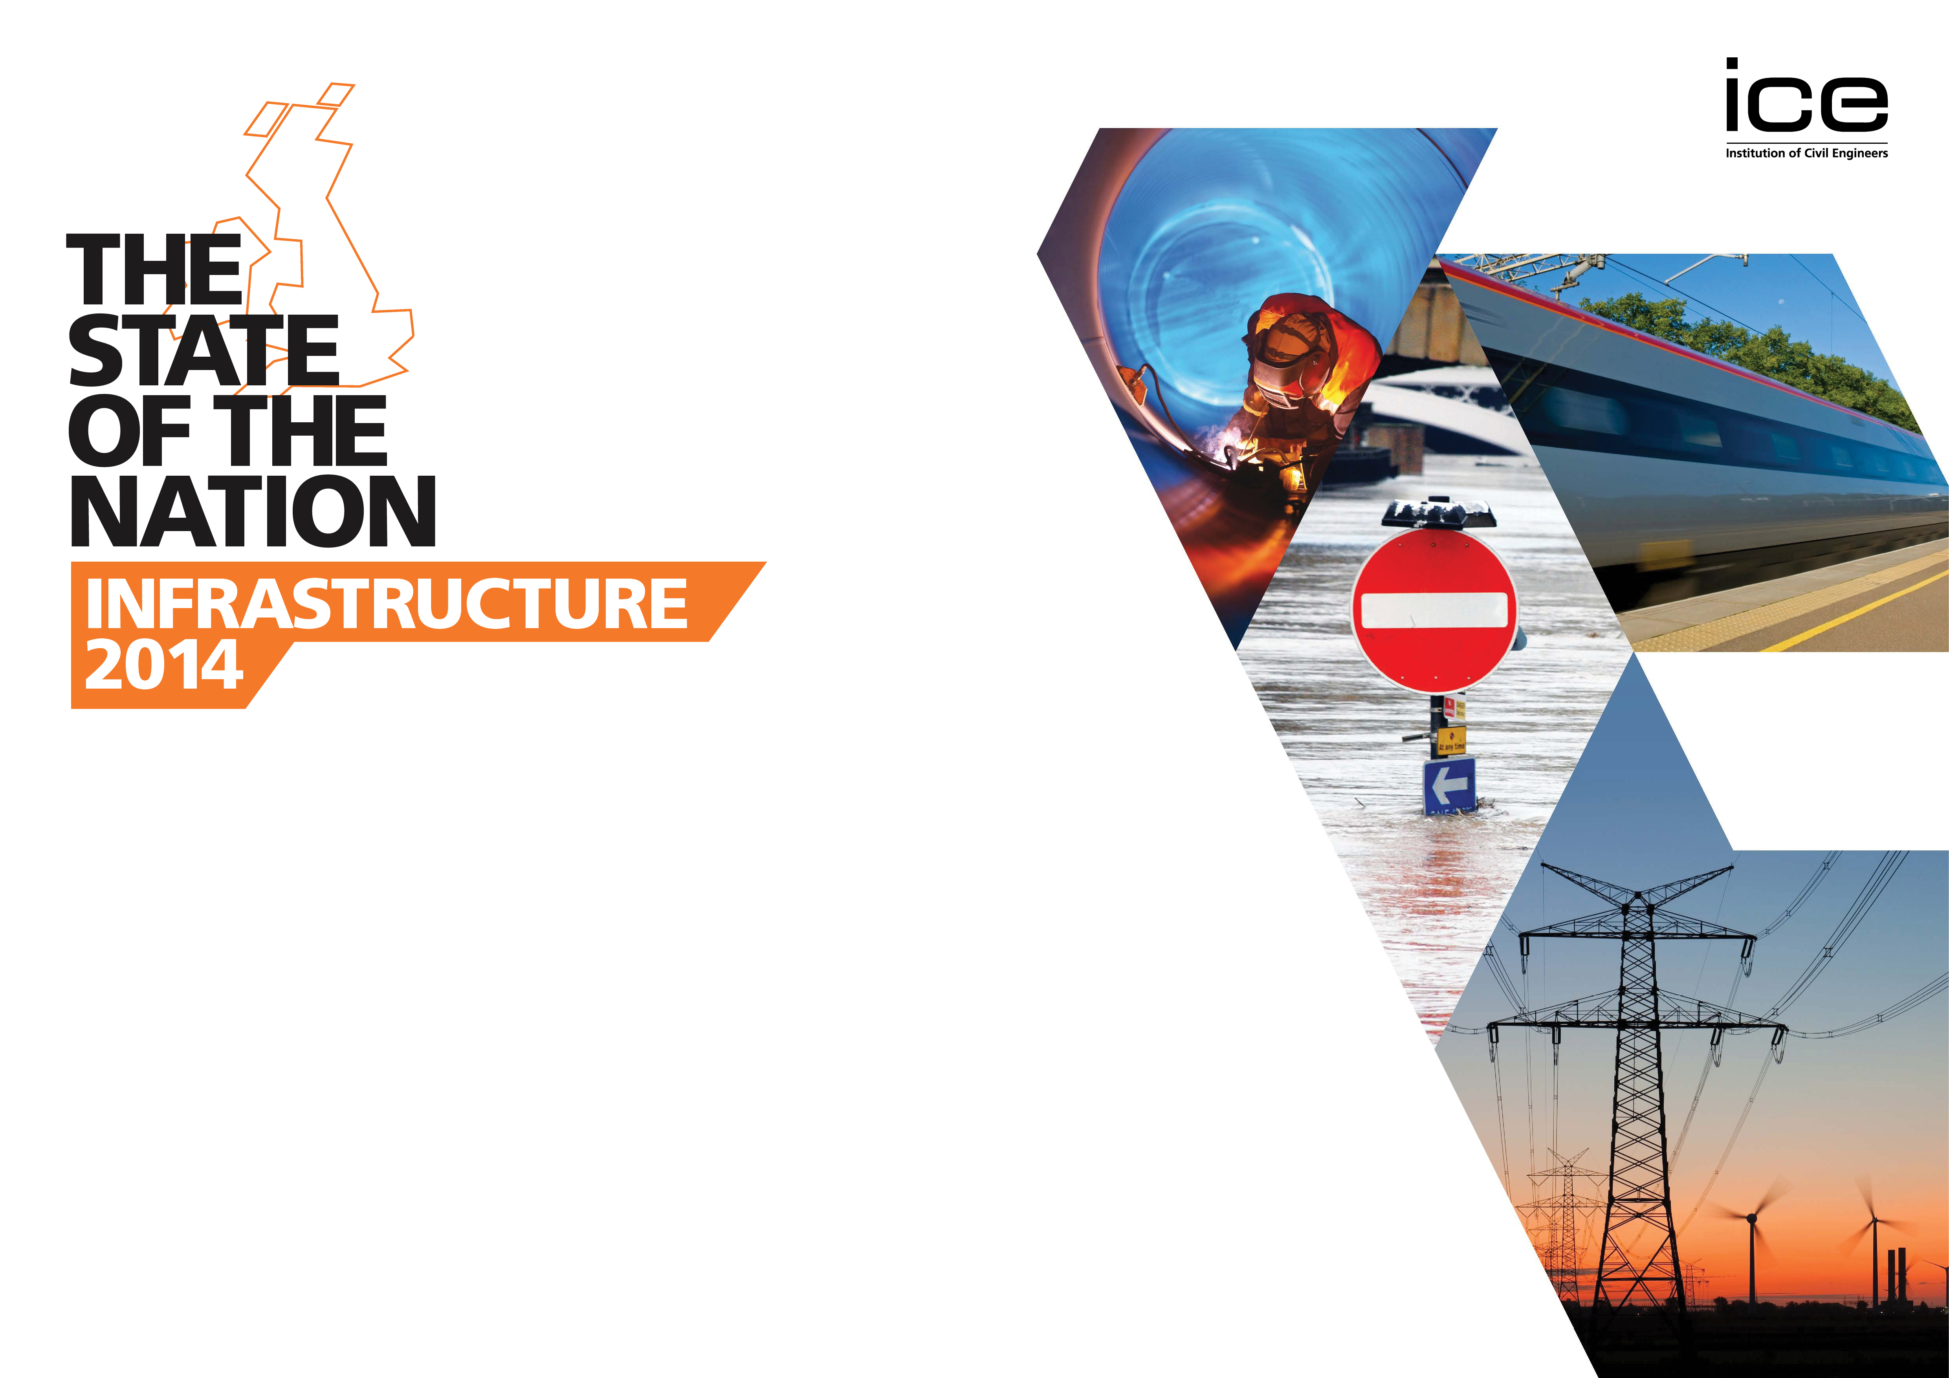
Does the UK have the Infrastructure it needs?
Nick Baveystock, Director General, Institution of Civil Engineers
Notes:
As DG of ICE, I’m delighted to have the opportunity to speak at this meeting of the Parliamentary and Scientific Committee on ‘Does the UK have the Infrastructure it Needs? ICE very pleased to be a member of the PSC, you do invaluable work in promoting the value of science, engineering and technology to parliamentarians etc etc.
ICE:
Established in 1818
Charitable organisation, bound by Royal Charter
Politically neutral
80,000 + members worldwide
Members in client bodies, consultants and contractors
Independent voice of infrastructure
We exist to:
qualify our members
exchange best practice
promote the benefits of civil engineering
inform political and public opinion about infrastructure issues
One key way we inform the infrastructure debate - State of the Nation reports. Through these reports, we seek to raise importance of infrastructure to UK economic performance - maintain the condition & management of assets – and ultimately improve the delivery of infrastructure projects. Providing policymakers with workable, practical solutions to infra challenges.

Slide 2

UK’S INFRASTRUCTURE
REQUIRES ATTENTION
Context:
Extreme Weather Events
Demand from growing population
Funding constraints
Notes:
SoN: Infrastructure was launched in June 2014.
Sought to assess the condition and capacity of the UK’s economic infrastructure, its level of resilience, the governance and regulatory arrangements and the investment and funding issues.
In recent years the broad political narrative has been dominated by the need to reduce the deficit and kick-start economic growth. ICE has contributed to this by demonstrating infrastructure’s importance - reiterating the impact that infrastructure investment and civil engineering can have on economic growth, job creation, as well as social well-being - regenerating communities and helping people get from A to B.
Our report found, however, that the UK’s infrastructure requires attention.
UK was up this year to 27th from 28th for quality of infrastructure in the World Economic Forum – but needs to do better…
The 2013/14 weather events showed the vulnerability of our infrastructure networks to extreme events and flooding.
Since 1990 the UK has experienced 8 of the 10 warmest years on record and 5 of the 10 wettest years – 2000 and 2012 were the wettest on record.
We also see populations projections which are staggering. The UK pop will be up to 73.5 million by 2037 – that’s an increase of 10m.
So we need to build more efficient, smarter infrastructure, but we need to fund it – tax payer or user charge. A clear political choice.

Slide 3
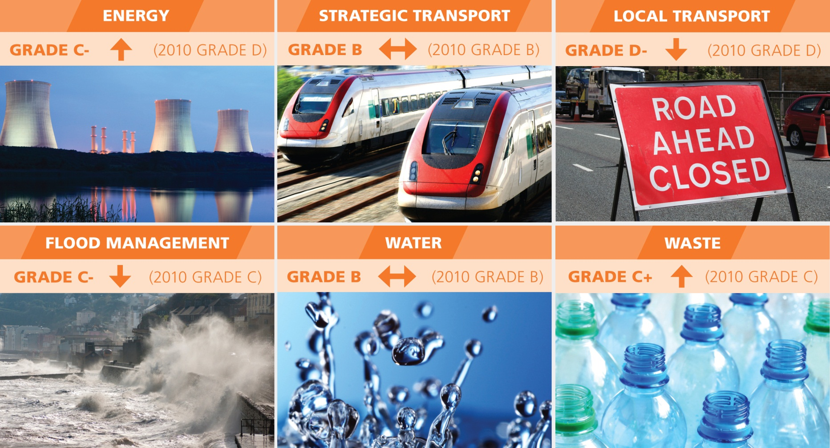
2014 INFRASTRUCTURE GRADES
Notes:
This slides shows the grade for each sector we assessed in our State of the Nation report.
You can see the areas that have improved, those that have stayed broadly the same and those that have declined.
I plan to focus on energy and water in this presentation, which may seem odd at first glance as these two areas seem to be doing ok based on our graphic - however, energy only improved from a very low base and the water sector faces some significant challenges in the near future.

Slide 4
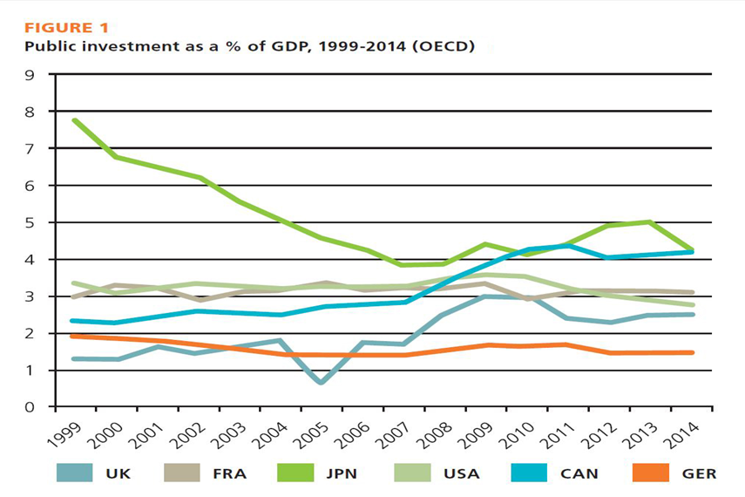
Investment Challenges
2011-15 £45 bn per annum
NIP Value £380bn
Approx. 60% in Energy Infrastructure
Notes:
But before diving into these sectors, let’s look at the investment challenges because let’s face it, without investment we can neither build infrastructure, or maintain what we already have.
The graph shows that the UK’s public investment as a percentage of GDP is one of the lowest among developed counties. This leaves us behind our principle competitors.
Although investment in infrastructure has slightly increased per annum from 2005, it remains relatively low. The value of the NIP sits at £380bn - however approx 60% is required in energy infrastructure which must be sourced from the private sector.

Slide 5
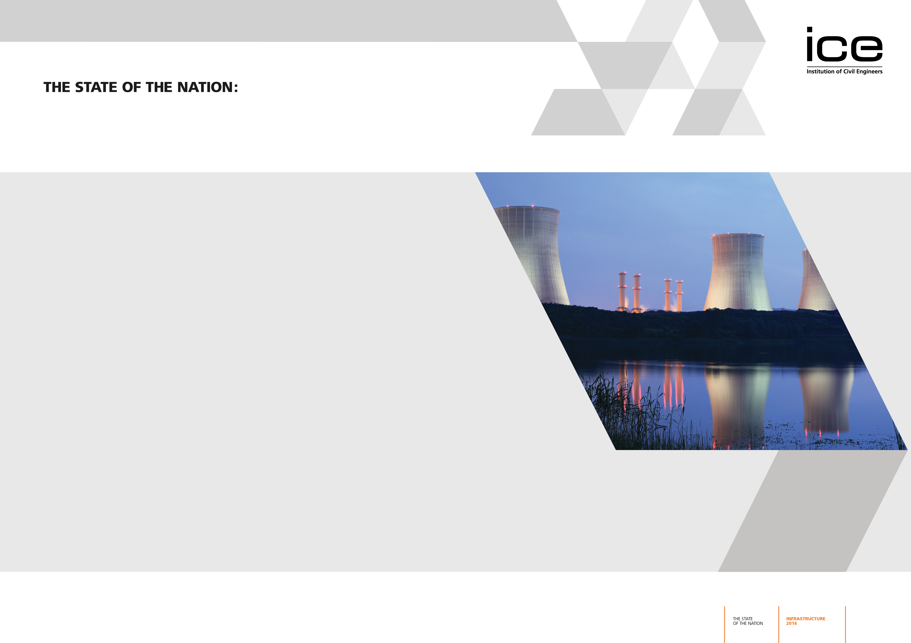
Energy Trilemma
Security or supply
Low Carbon
Affordability
Notes:
Significant quantities of the UK’s existing electricity generation capacity are expected to be retired soon, with major implications for security of supply unless the conditions to attract investment in new generation are provided. This situation is expected to be further exacerbated as the use of electricity for transport and residential heat increases demand.
For the UK to meet its legally binding targets for decarbonisation beyond 2020, it must transform the way that it generates and uses energy. The UK is bound by domestic targets to reduce greenhouse gas emissions by 34% from 1990 levels by 2020, and 80% by 2050. It is also bound by EU directives to reduce energy consumption and greenhouse gas emissions, and increase its share of renewables to 15% by 2020.
All of this has to be delivered in a way that is affordable to consumers. NAO report in 2013 estimates an increase of £221in the average household energy bill between 2013 and 2030 in real terms.
The key to achieving this is for Parliament to enact the secondary legislation to implement Electricity Market Reform (EMR), creating the conditions to incentivise generation, maximise investor confidence and ensure sufficient capacity to meet peak demands – and thankfully we’ve now seen this happen.
Govt also needs to resolve political uncertainties around the lack of a clear decarbonisation target and the future of the carbon price floor – and adopt a more determined approach through policies, behaviours and technologies that actively drive energy demand management.

Slide 6
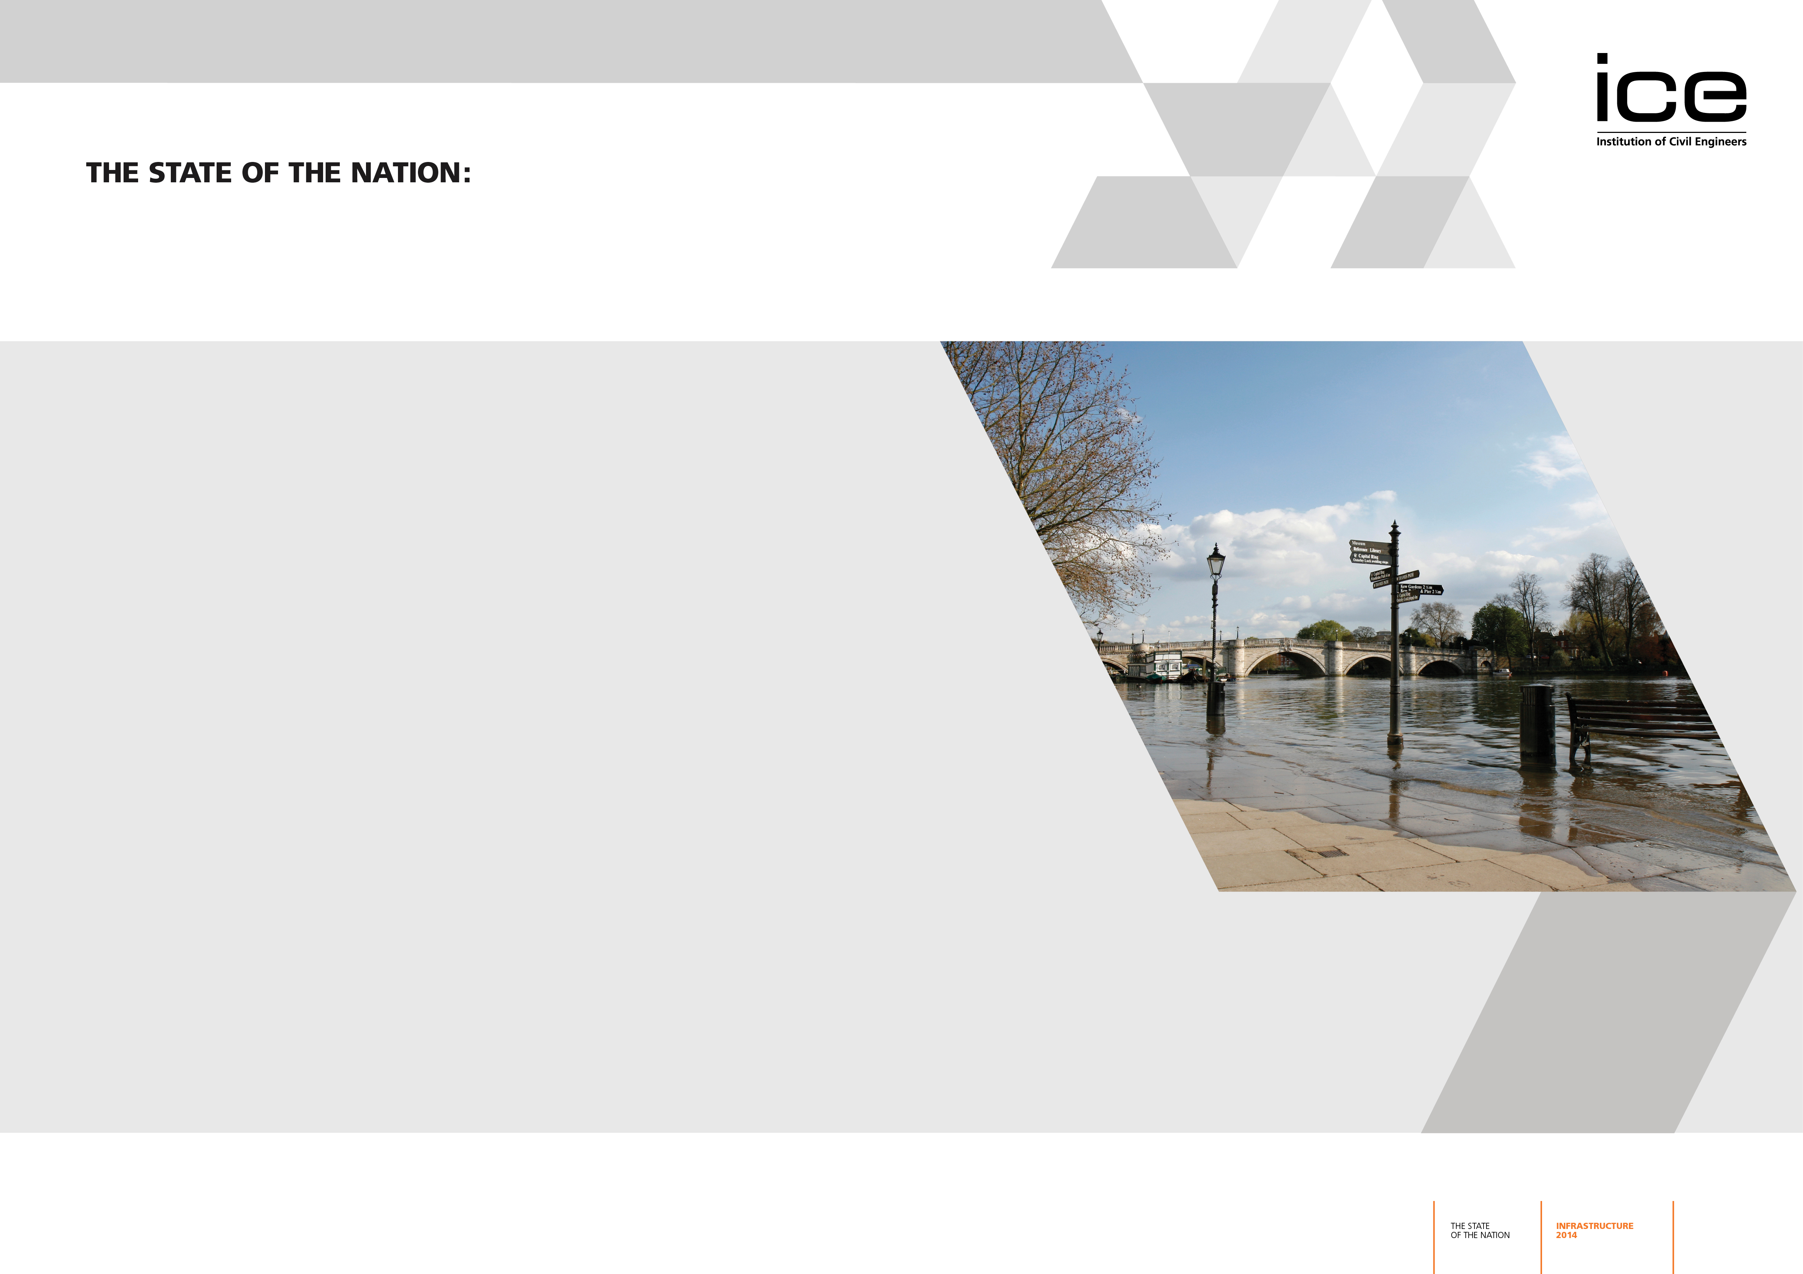
Water Security
Water availability
Increasing demand from multiple users
Ageing infrastructure
Notes:
Alongside the ‘energy trilemma’, we also have a water security issue.
Although the amount of rain we get makes this seem illogical the changing nature of weather patterns is impacting on water availability. Put simply, rain does not fall when or where we need it. So in the SE we have a water scarcity issue while the area will see an increased demand from a population that is set to grow by approx. 23% over the next 20 or so years.
We also have an increasing demand from multiple users. Although we often talk about water as a domestic supply and removal of waste water, its uses are far wider. I will highlight this further in the next slide.
We also have ageing infrastructure assets in the water sector. We have been left an excellent infrastructure legacy by the Victorians; however, leakage is still too high and the type of infrastructure we need to manage our water effectively is changing. In fact, we don’t always need infrastructure if we can shift to a catchment wide approach to managing our water resources.

Slide 7
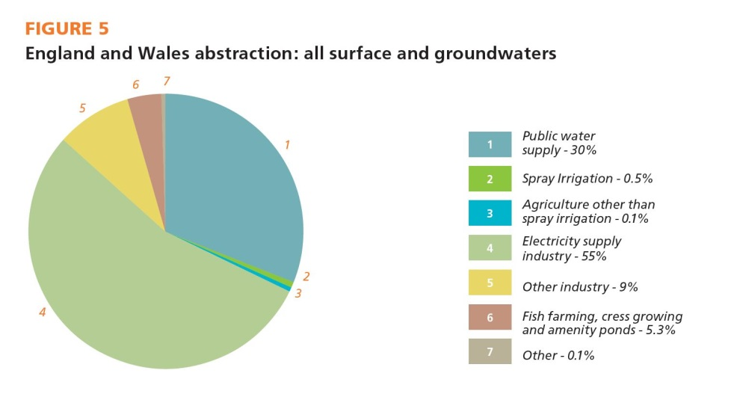
Water Use
Water for agriculture
Water for energy
Water for people
Water for the environment
Notes:
As you can see, water has multiple uses and users. Interestingly is demand from electricity supply that is the largest user of water. Domestic comes in second. Now although water use in agriculture appears low it varies among regions and is as high as 24% in East Anglia during peak irrigation demand. Worryingly this is the same region that is set to see a significant population increase over the next 30 years, so you can see the problem.
But this is not just a problem for the South East. The Department for Environment Food and Rural Affair’s (Defra) Climate Change Risk Assessment (CCRA), the numbers of catchments offering sustainable abstraction is predicted to reduce significantly by 2050. These reductions are predicted to be particularly acute in the South West and North of England, and in Western Wales.
The same assessment predicts that by the 2050s, summer river flows may reduce by 35% in the driest parts of England and by 15%for the wetter river basin regions in Scotland. This has a significant impact on water available for cooling power plants, but also the water available for a healthy and thriving environment. The EA abstraction reform is seeking to address this, but it will take over a decade to fully implement and in the meantime we need to start the process for increasing water storage and short distance water transfers.
However, the oft mentioned ‘water grid’ will not resolve this in a low carbon, low energy way. We need regulation which incentivises water sharing and trading across company boundaries. Also water companies must work together to build multi purpose infrastructure, such as reservoirs which offer a resource, leisure facilities, flood prevention and perhaps even power.

Slide 8
Flood Management
Interdependencies
Investment - maintenance
Catchment Management
Notes:
One of the areas of concern for ICE, and the one which highlights the vulnerability of all our physical infrastructure networks and assets is in flood management. As I touched on at the beginning of this presentation, in 2013/14 flooding severely disrupted both transport and energy networks. In previous years it has affected the supply of water to communities. We have to better manage its impacts.
Part of achieving this is to manage water and flooding together. Managing at catchment scale so that we can reduce and slow down the water actually getting into our sewerage systems, which as I have said are legacy assets, can have a significant benefit. We welcome the EA’s catchment management pilots and hope that these continue to gain government support.
Flood management does require investment. This winter we saw the Govt respond by throwing money at flood solutions; however, this still does not make up for the shortfall in investment. This has been a particular issue in maintenance, where maintenance grants from the EA will be 22% lower in 2014/15 than they were in 2010/11. According to the Committee on Climate Change Defra will underinvest by £1.4bn between 2015 – 2021. We hope the forthcoming 6 year flooding settlement will go some way in addressing this issue.

Slide 9
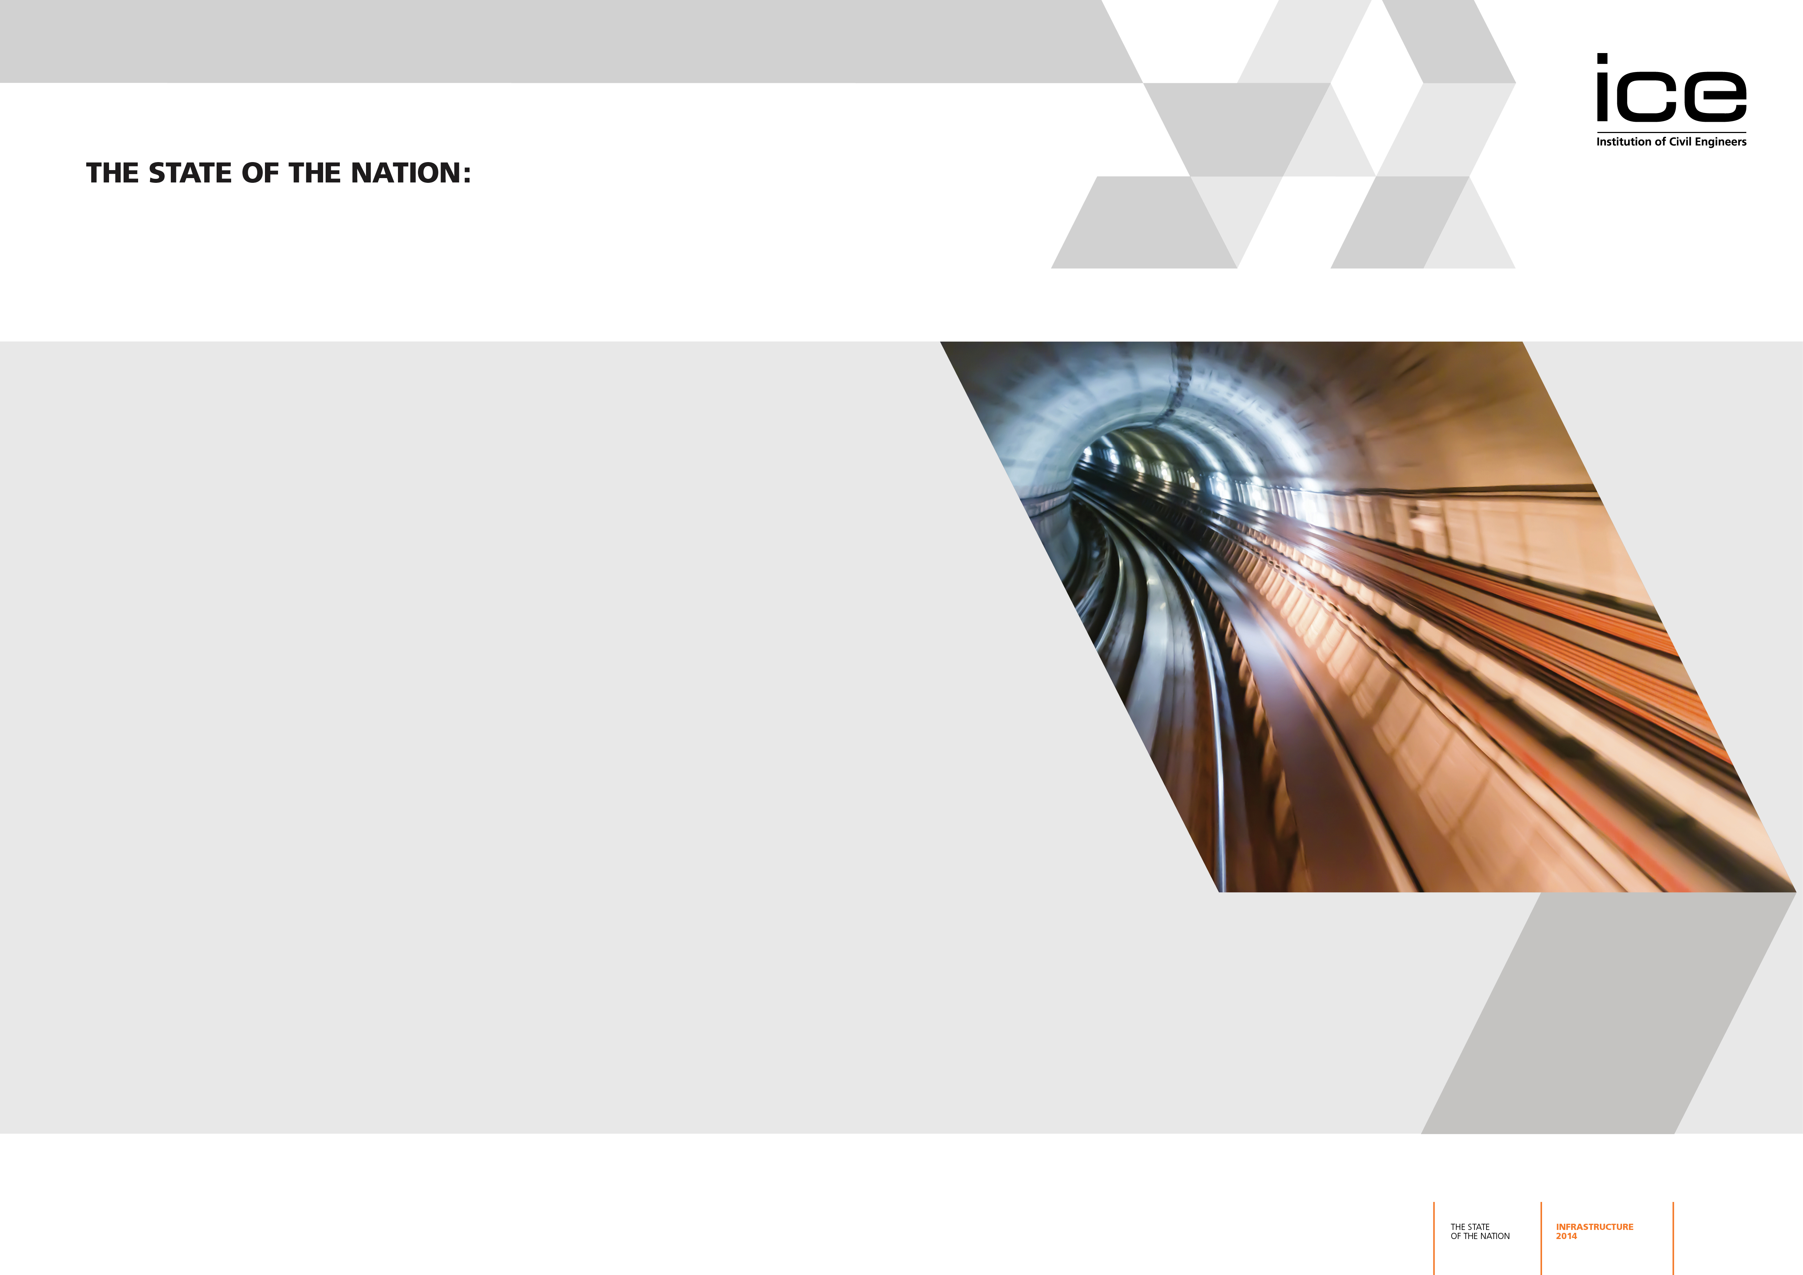
Waste and Resource Management
Circular Economy
Office for Resource Management
Carrot and stick
Notes:
Finally, the importance of waste and resource management infrastructure. The distinction in terminology here is important. The transition to a ‘circular economy’, which ICE has called for since 2011, requires a philosophical shift in the way we think of our waste - a shift from the ‘take-make-dispose’ model to one that extends products’ usage - extracting maximum value, reducing waste and increasing reuse.
This change requires political leadership and we already see this in devolved countries; however, Govt policy for waste is currently spread across a number of departments in England. We believe the establishment of an Office for Resource Management, situated within BIS, would show a clear indication from Govt that we need to reduce waste and see it as a business resource.
Greater political leadership has worked in the sector already. The Landfill Tax escalator has driven behaviour by imposing costs on those wishing to Landfill. Between 2002 and 2012 the amount of waste going to landfill has decreased by approximately 54%. As well as reducing landfill the tax has provided the environment for incentivising recycling and reuse. There is a window of opportunity now to shift to the circular economy. Because as we return to economic growth and populations continue to increase, there will be increased pressure on landfill and recycling that will require more political leadership, will and drive.

Slide 10
Nick Baveystock, Director General, Institution of Civil Engineers
Notes:
So – in answer to the question posed tonight, ‘Does the UK have the Infrastructure it Needs?,’ I think my answer is ‘Not yet – but progress is being made.’
With just over 6 months until the General Election, tough political choices are ahead. Clarity and stability required - political grandstanding doesn’t deliver infrastructure projects. Need to ensure that the improved policy climate will translate into tangible impacts on infrastructure. To secure the future of the UK’s infrastructure, strong leadership and political will is needed – from whichever party holds power in May 2015. Because the infrastructure challenges that ICE’s Victorian civil engineering ancestors faced are very different to the ones presented today.
We’re not naïve enough to think we can ever remove politics from infrastructure - however, more needs to be done to reach genuine political consensus on long-term priorities and short-term actions to help deliver them.
ICE will keep reiterating the need for politicians and industry to work together to secure our long term resilience and capability – and undertake better planning to help us face the long term challenges ahead that I’ve touched on – climate change, population growth and demographic changes, global competitiveness and the evolving role of technology.
It’s crucial that parliamentarians and industry continue to work together – and help turn today’s infrastructure problems into tomorrow’s infrastructure solutions. Thank you.

