Slide 1
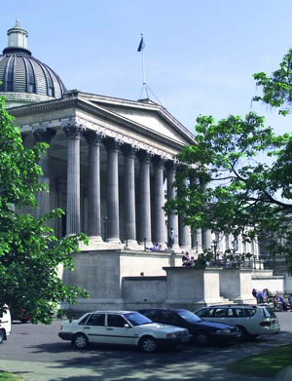
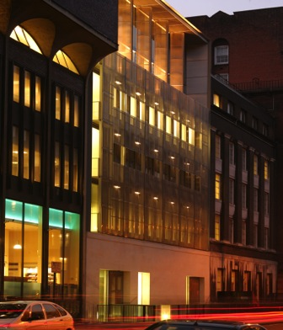
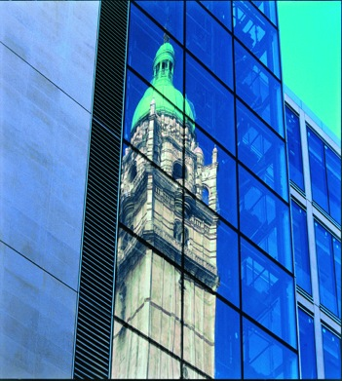


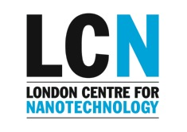
Introduction to Nanotechnology
Andrew Fisher

Slide 2
Outline
Nanotechnology and its tools
  Controlling matter below 100nm
What is the LCN?
What these tools can do for
  Bio-nanotechnology and the future of healthcare
  Imaging, new materials and environmental care
  Ultimate atomic control, quantum technologies and the future of information technology

Slide 3
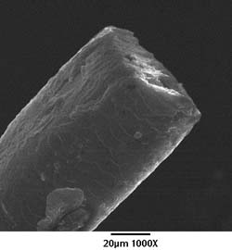
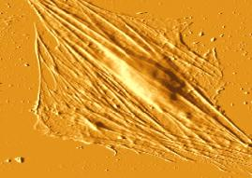
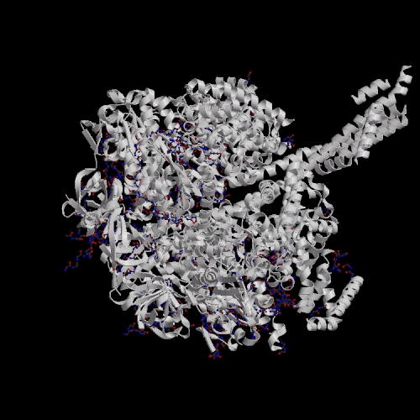
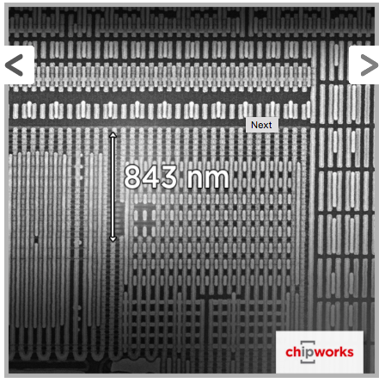
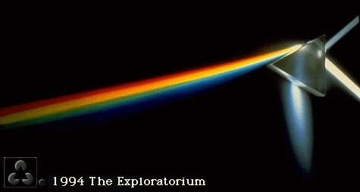
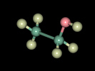
The nanoscale
Human hair
Living cells
Biomolecules
Nanotechnology: precise control of matter on scales below 100nm
1mm=10⁻³m
1μm=10⁻⁶m
1nm=10⁻⁹m
Atoms
Wavelength of visible light
Current chips (14nm node)
Small molecules

Slide 4
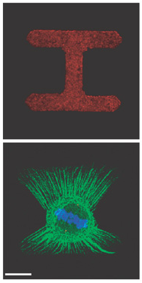
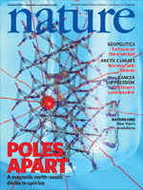
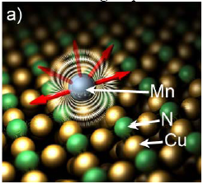
Big Problems
We are interested in the big problems that
Redefine scientific fields
Reach out to have great impact in the world
Clean, efficient energy production and storage
New forms of order and new symmetries of matter
Probing local biological environments
Nanoscale dimensions
Understanding the molecular machinery of the living cell
New ways to represent and process information
The limits of quantum behaviour in matter
What do we need to equip ourselves to tackle them?
Facilities to design, grow, and characterize
A multidisciplinary environment
Symbiotic science and technology

Slide 5

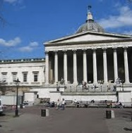
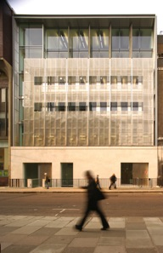

London Centre for Nanotechnology
A multi-disciplinary research centre combining London’s leading
technology and medical research institutions
£30M investment in world class facilities and over 200 multi-disciplinary staff
Imperial College London
University College London
Electronic
Engineers
Materials
Scientists
Physicists
Chemists
Medical
Scientists
Earth
Scientists
Notes:
The LCN is a joint collaboration
Was founded in 2006

Slide 6
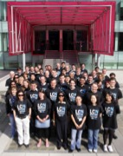
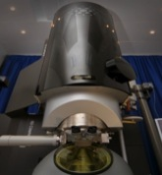
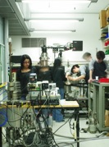
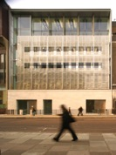
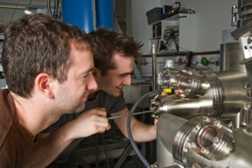
Mission Statement
  To deliver excellent science and solutions to real world problems
within three themes:
Information Technology
Healthcare
Energy and the Environment
Notes:
Fundamental basic sci
Translational research (e.g. Healthcare with UCL Partners, HPA)

Slide 7
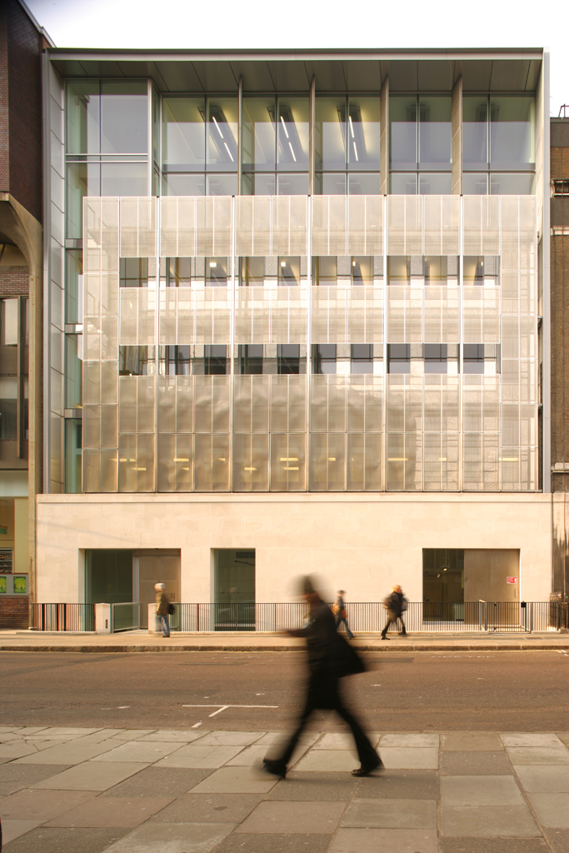
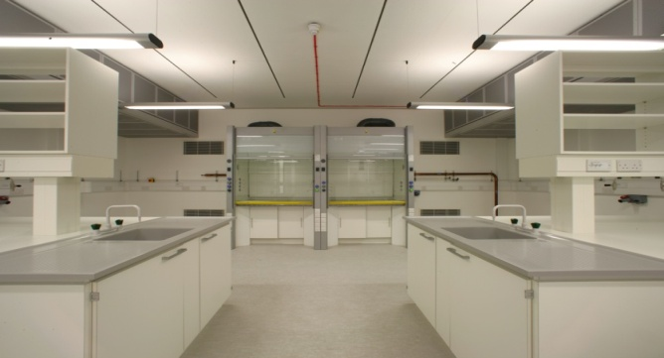
New Facilities in Central London
Eight-storey building in the heart of London
Clean rooms
High end computing for modelling
Ultra-low vibration
Characterisation, fabrication, modelling
Nanomedicine research laboratories
Joint laboratory facilities & access
LCN clean rooms
SEM/FIB at UCL
Titan TEM at Imperial Materials
AFM training scheme at UCL
TEM training at IC Materials
Notes:
7

Slide 8
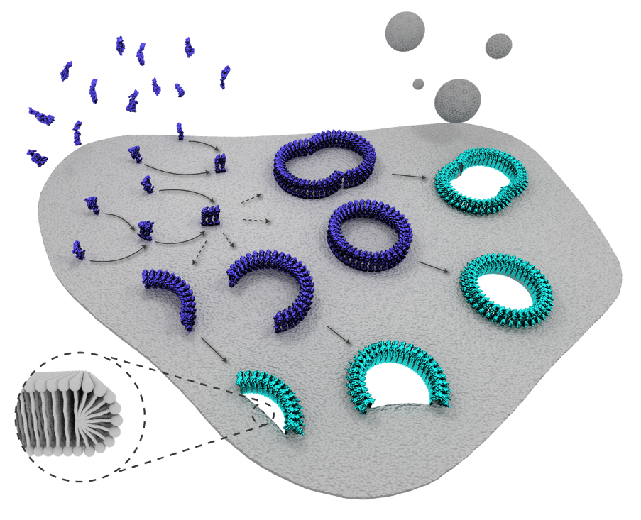
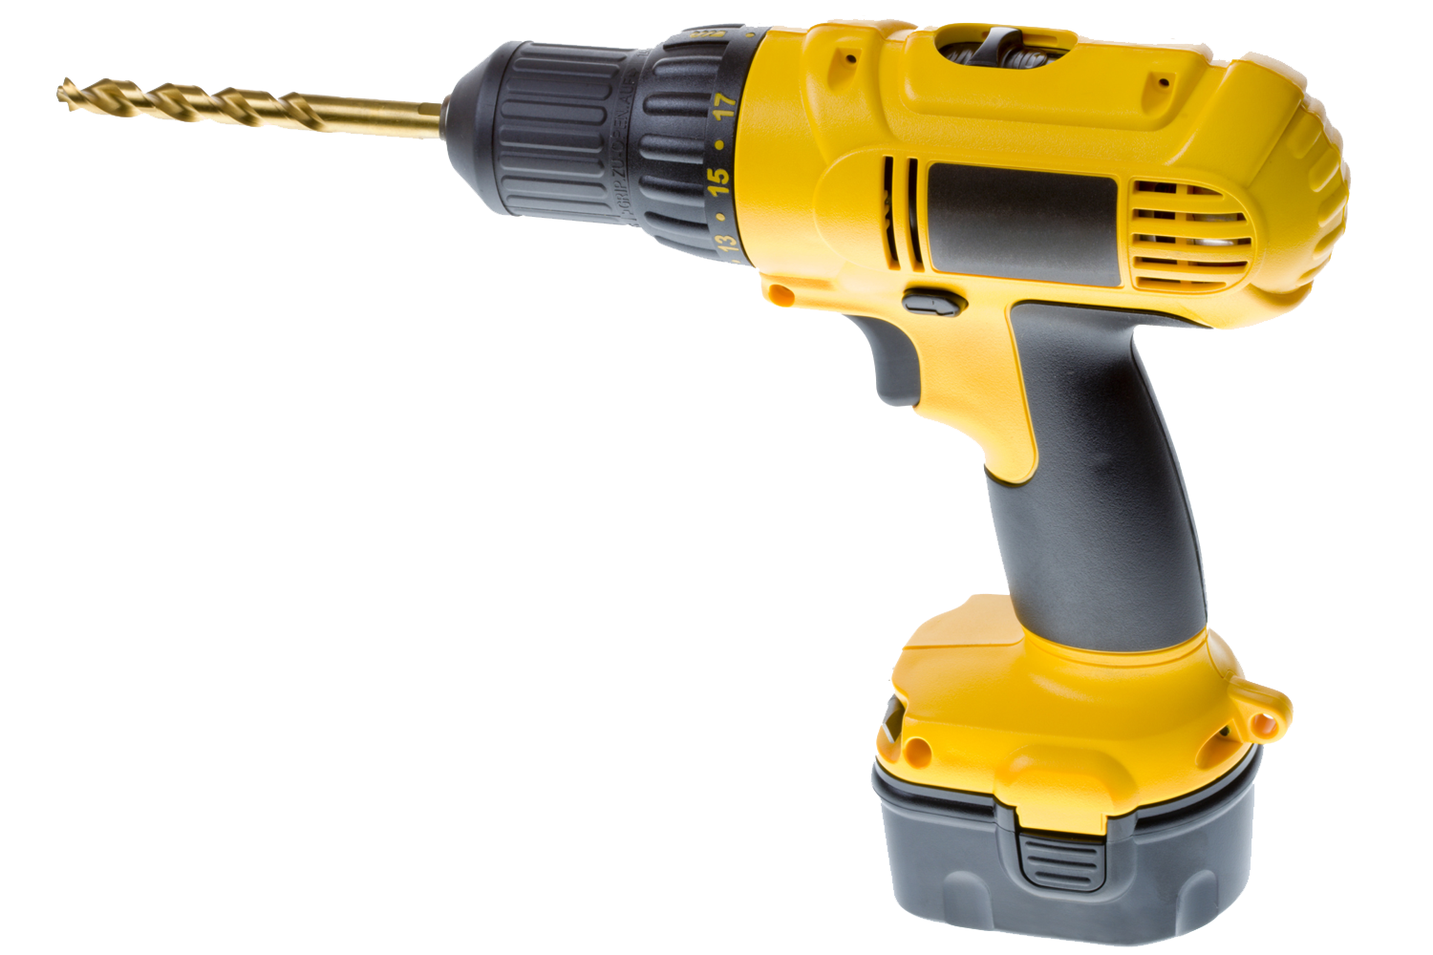
Cell surface attacked by bacterial nanodrills

Slide 9
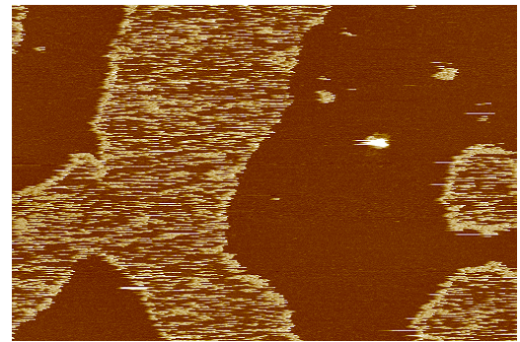
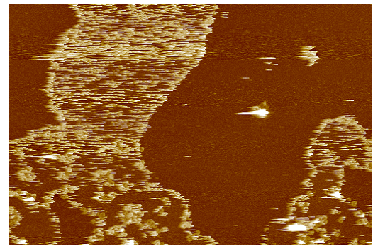
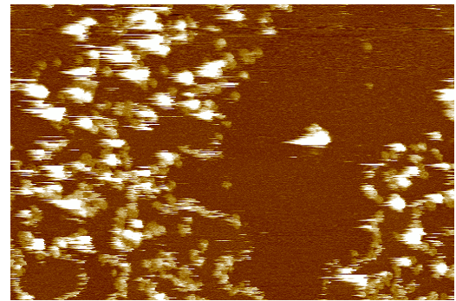
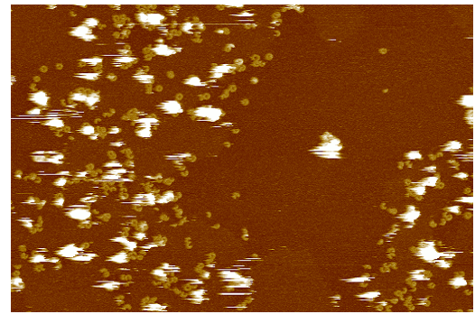
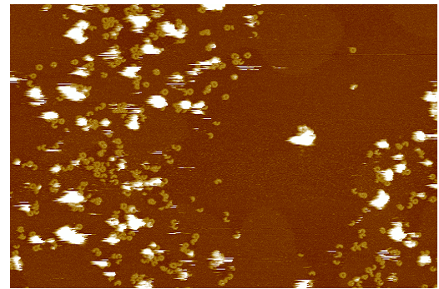
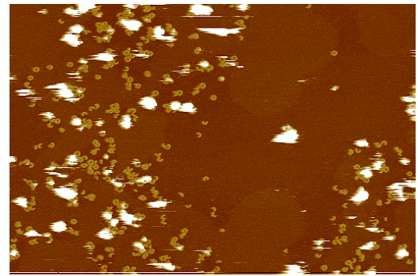
Membrane perforation in real time
+ DTT
1
4
6
2
3
5
200 nm
Bart Hoogenboom, LCN

Slide 10
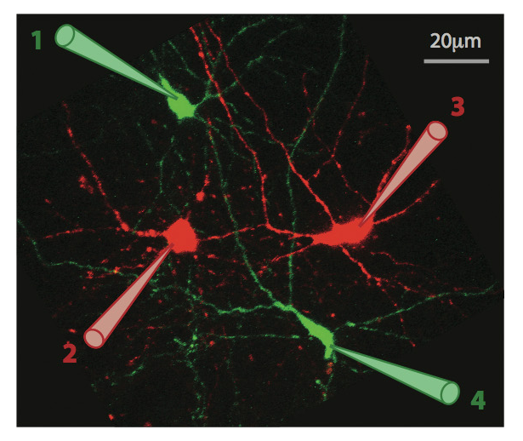
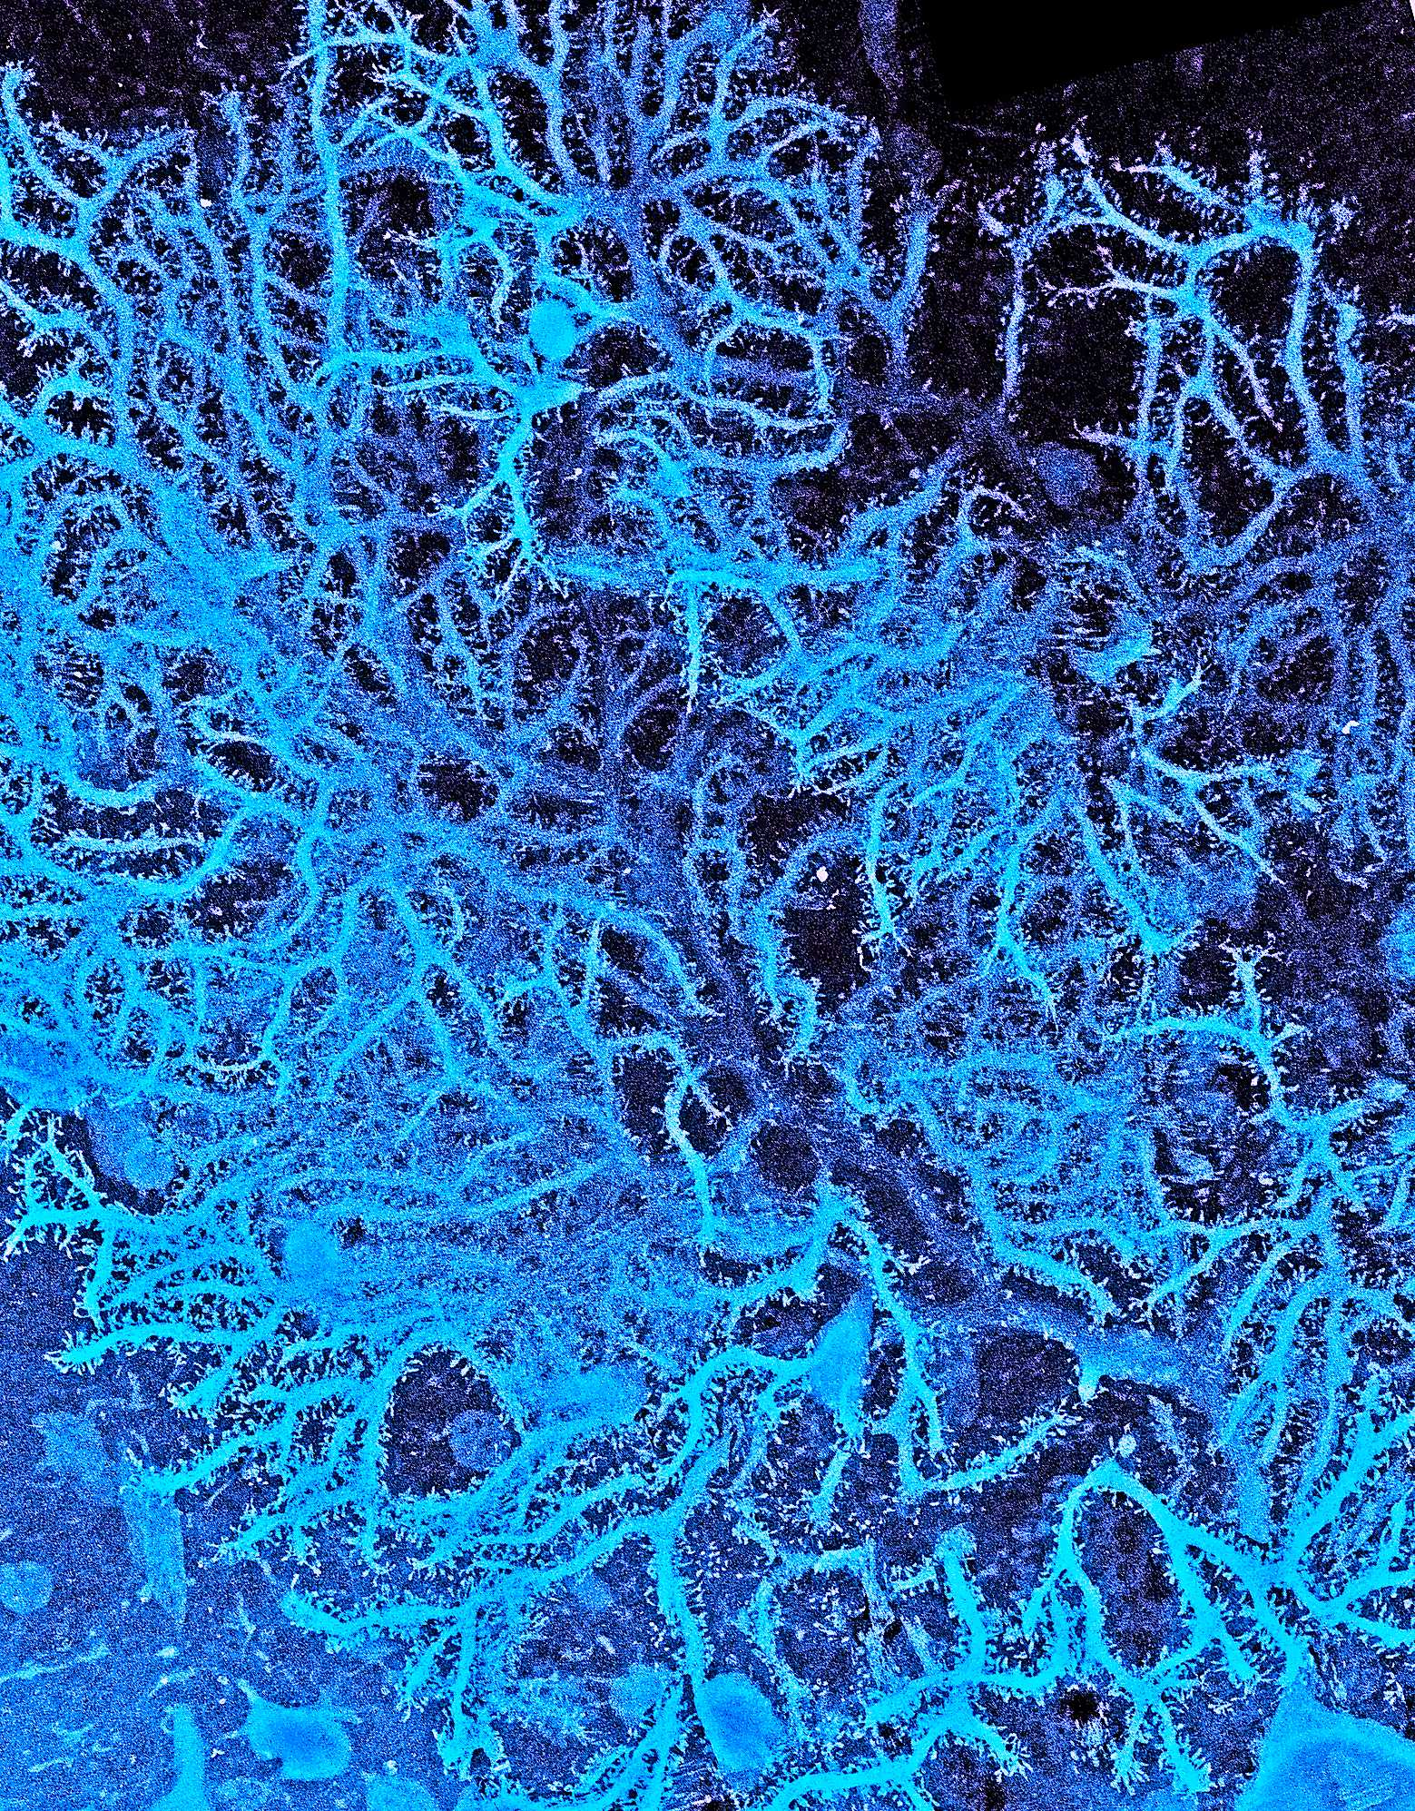
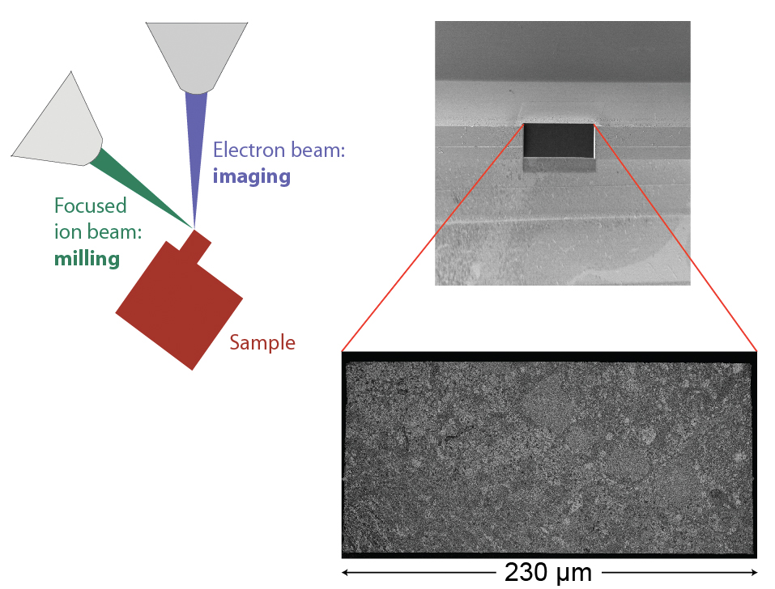
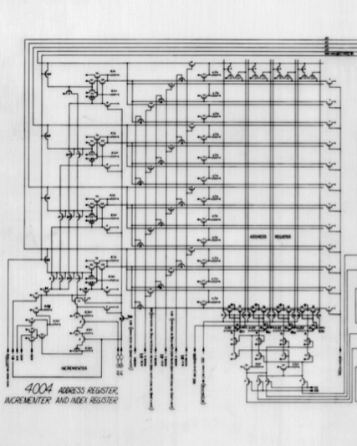
Neural function and structure
Electron microscopy
Experimental information obtained using nanoscience tools
Functional characterization
Circuit reconstruction
& modelling

Slide 11
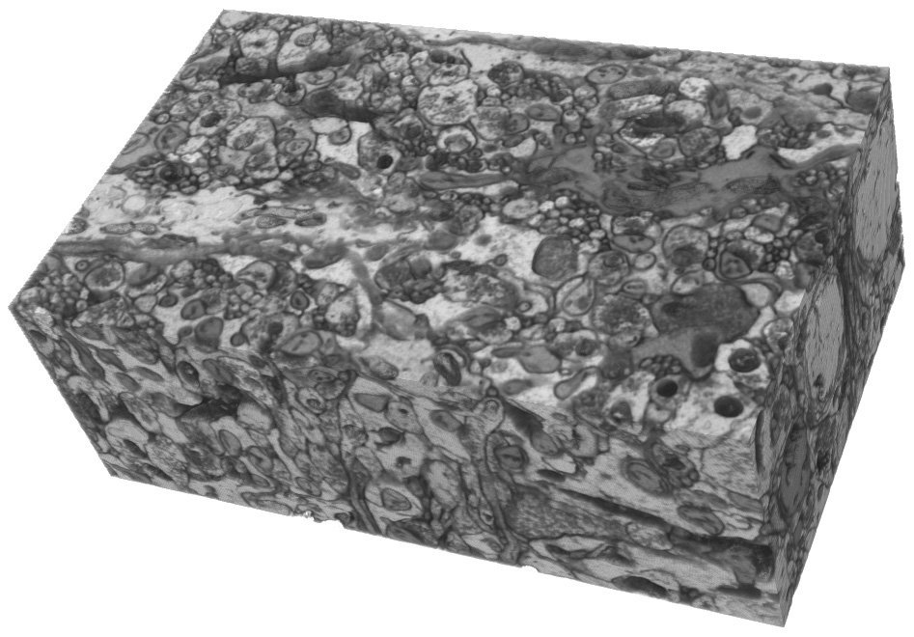
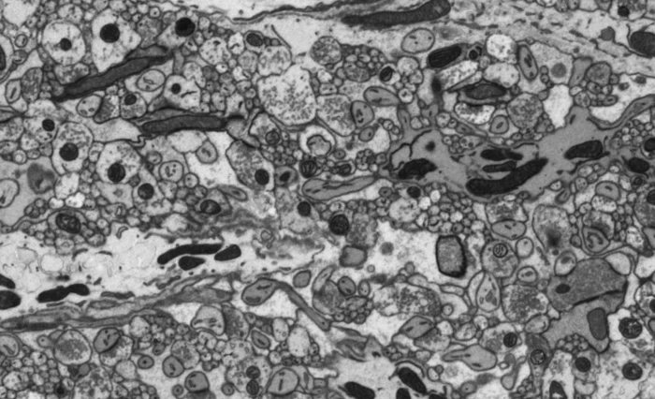
3D reconstruction
Michael Hausser and Arnd Roth

Slide 12
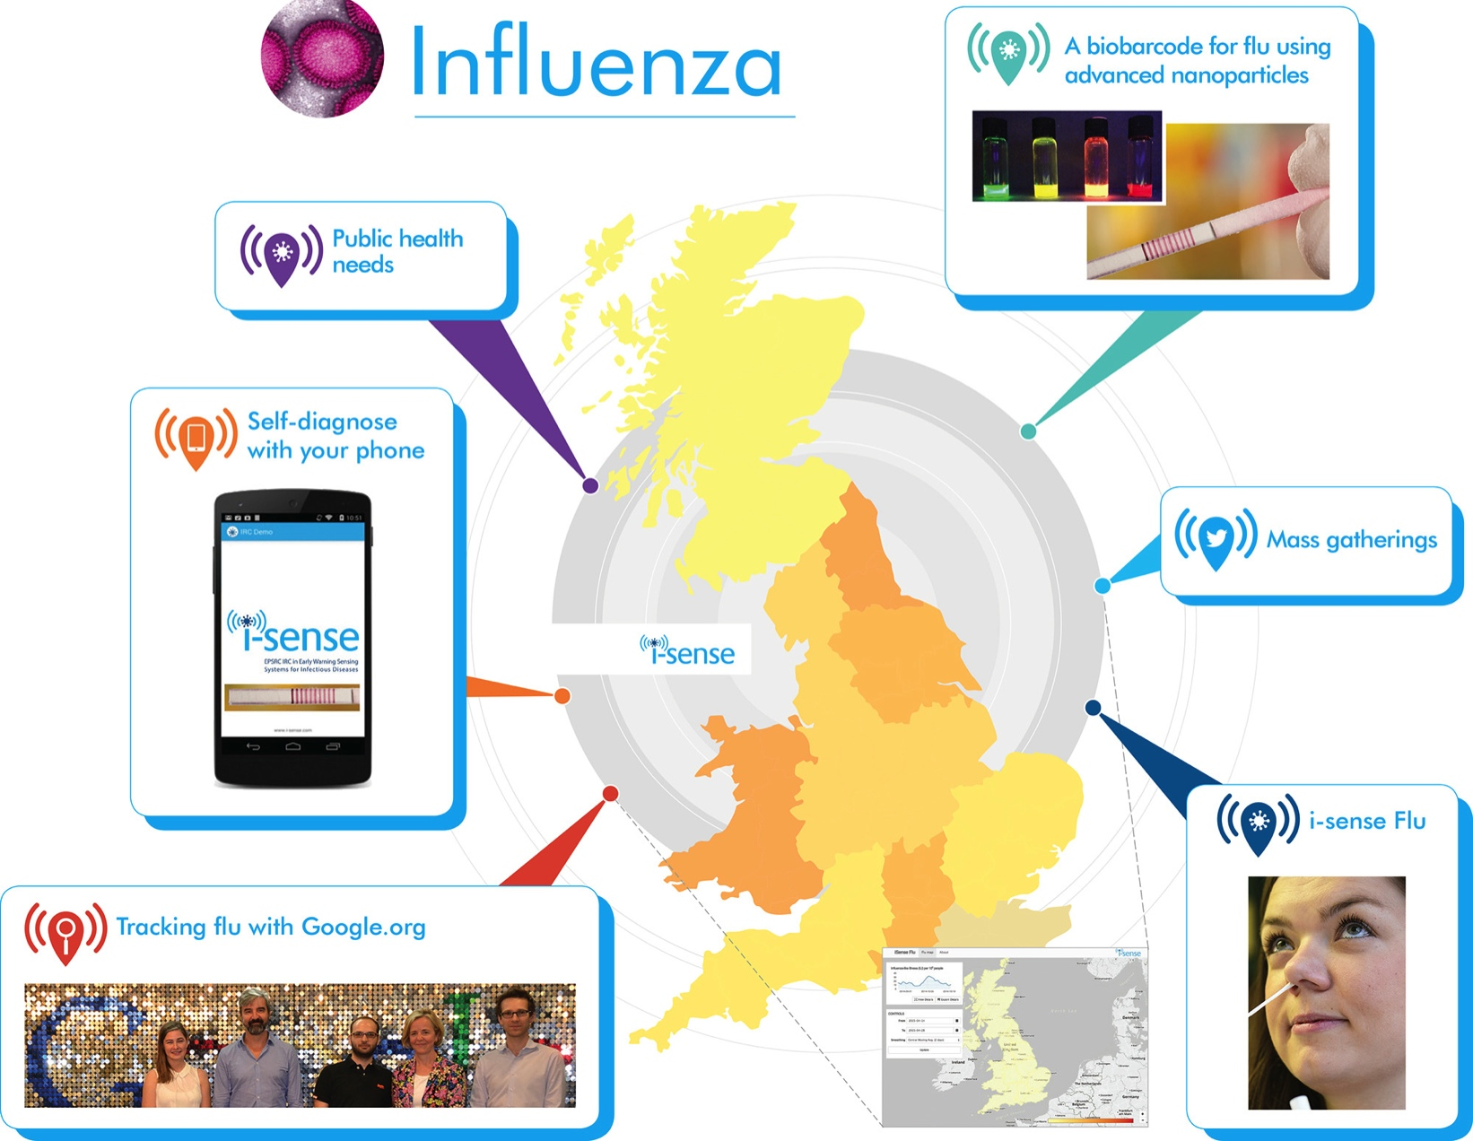
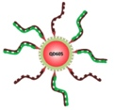
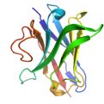
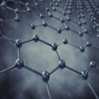
Early Warning Systems for Influenza
‘Biobarcodes’
Quantum dot sensors
Gold nanoparticle enhancement
Graphene electrodes
Llama nanobodies
Rachel McKendry (LCN) and colleagues
Notes:
Biobarcodes are paper tests for self-testing, similar to a pregnancy test but with an array of information e.g. on influenza subtype.
Nanotechnology allows the paper test to be specific and sensitive, aiming to be as sensitive as a gold standard lab-based test. Designed to be cheap and easy to use with minimal reagent required.

Slide 13
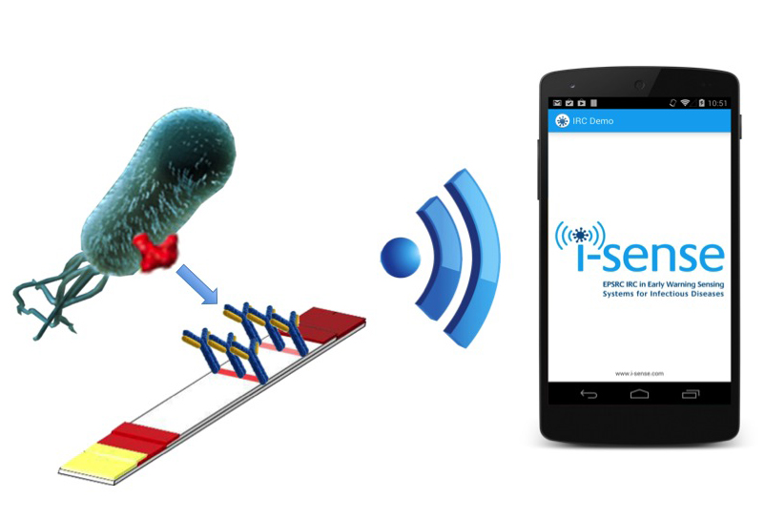
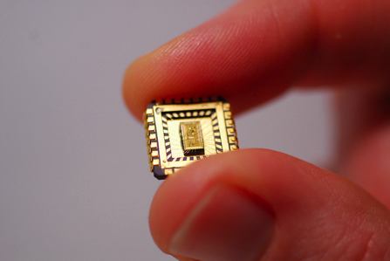
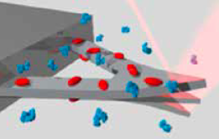
Detection of Bacterial Infections
(C.difficile, E.coli, MRSA)
CMOS chips for impedance measurement
Lateral flow tests using DNA and RNA aptamers and antibodies, selected using novel cloud computing techniques
Cantilever nanomechanical sensors
Flanagan, K, Cockell S, Harwood C, Hallinan J, Nakjang S, Lawry B, Wipat 1. J Integr. Bioinform. (2014) 11(2):242
McKendry R. A., Kappeler, N. Nature Nano (2013) 8, 483-484
Notes:
2 types of test here:
Paper based lateral flow test (similar to biobarcode) but that identifies whole bacteria. This would use aptamers or antibodies to bind to markers on the cell surface. CMOS chips for impedance readout.
Cantilever tests to identify antibiotic resistant strains of bacterium.

Slide 14
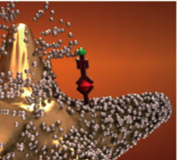
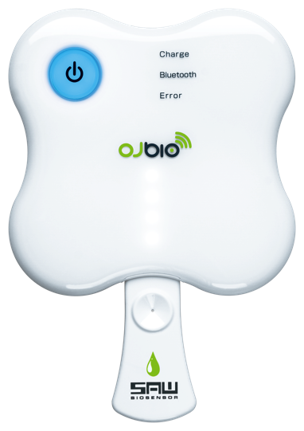
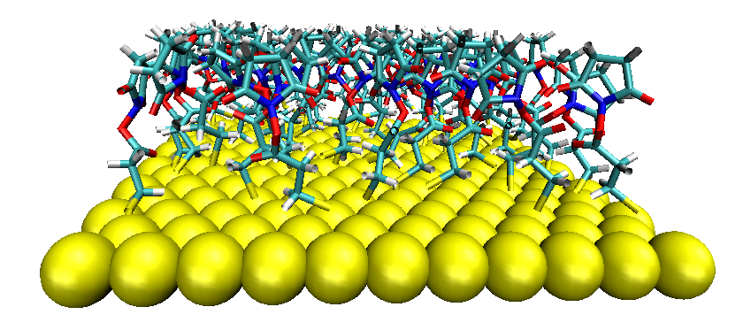
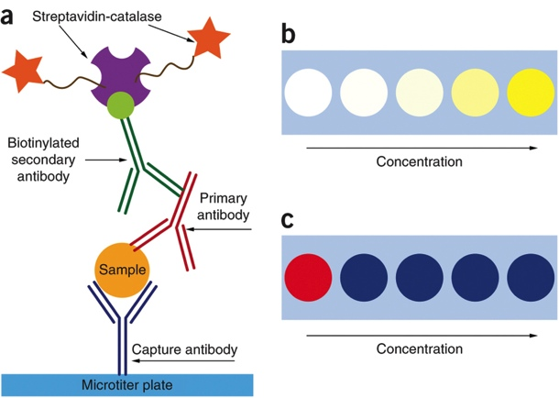
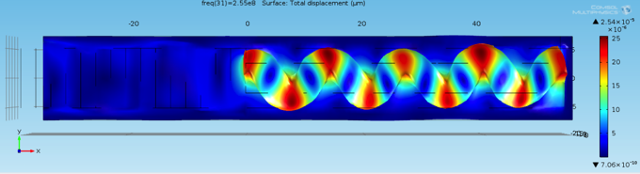
Early Detection of Human Immunodeficiency
Virus (HIV)
Ultrasensitive detection using
nanostars &
plasmonic nanoparticles
Surface acoustic wave (SAW) sensors with nano capture coatings
Modeling of SAW interactions for coating design
Rodriguez-Lorenzo et al Nature Materials 11, 604–607 (2012)
Howes, P.D. et al Science 346, 1247390–1247390 (2014)
Howes, P.D. et al ' Chem. Soc. Rev., 43, 3835–3853 (2014)
Notes:
Two types of test again:
SAW tests with nanoenabled coatings.
Lateral flow tests using ultrasenstive nanoparticle assays (Molly Stevens)
[Nanostar assay – H2O2 mediated silver deposition on gold nanostars (colour change)]
[Plasmonic ELISA – H2O2 directed nucleation of gold nanoparticles (colour change aggregated blue, not aggregated red)]

Slide 15

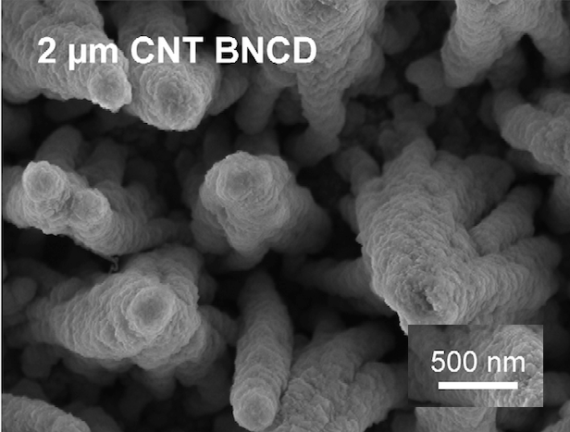
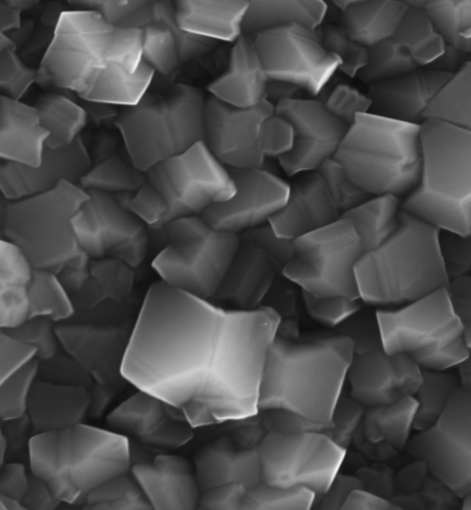










Diamond Electronics
Diamond and Graphite, and nanoscale carbon – applications spanning healthcare, manufacturing and defence
Richard Jackman, LCN
Photonis SAS on next generation Night Vision
SCD
NCD
NDs
CNTs
Detection devices under trial on ‘ASTUTE’ class submarines and other BAES projects
CNOs

Slide 16



Imaging of exhaust catalysts
  Many pollutants to be removed
    CO
    Residual hydrocarbons
    NOx
    Particulate Matter (Diesel)
Diesel Cars
  Diesel cars have better fuel efficiency – engines run under highly oxidising conditions
    BUT NOx reduction is challenging – how to reduce NOx under highly oxidising conditions?
200nm

Slide 17




Ice formation
Combining nanoscience and supercomputer-enabled computational chemistry
In collaboration with U. Liverpool, Nature Mater. 8 427 (2009)
Notes:
Ice formation is the most common everyday physical process on earth but we still don’t understand how it happens at the nanoscale. This is a problem because it prevents us developing new technology to control ice formation; it’s desirable to stop it to prevent e.g. planes from crashing (ice formation in a fuel pipeline was the cause of a crash in heathrow in 2008). It’s also important to know how it happens to improve models of climate change and to make better short term weather predictions. It’s relevant to biology, when cells freeze we die. It’s also highly relevant to the food industry (frozen foods including ice cream!) and artificial insemination (big business in farming, cows are all artificially inseminated these days apparently! and cryopreservation.
It’s difficult to understand however and requires very sophisticated experiments (e.g. shown is STM, Geoff’s machine I think). In this area there is a symbiotic relationship between experiment and theory. These experiments however need simulations to be interpreted and the nice image shown on the left needs calculations for the structure at the atomic level to be worked out. The structure we found is that it’s a chain of pentagons. This was a surprise because ice is always associated with hexagons. This insight could help with making more efficient searches for novel coatings to control the formation of ice.
Note the STM image was taken in Andrew Hodgson’s group in U. Liverpool, not the LCN.

Slide 18




Implications
Climate science, energy, transport, food…
“HeteroIce” ERC Project
Understanding & control of ice at surfaces
BP Project
Understanding & control of ice (hydrate) formation
Angelos Michaelides, LCN
Notes:
Some direct and immediate implications of this work are:
- A 2million euro ERC grant to understand how to control ice formation in the atmosphere (my ERC grant)
BP got interested and funded a PhD to do simulations in the LCN and a post-doc in Neal Skipper’s group to do neutron scattering work at ISIS to better understand how one particular type of ice forms at conditions relevant to their oil pipelines. Specifically methane clathrate nucleation.
--longer term is the design of materials for better control of ice formation enabling safer and cheaper extraction of oil from deep water reserviors, safer air travel, few potholes (stretching it?), and a much better understanding of cloud formation…

Slide 19


More than Moore
Miniaturization has driven revolutionary progress in science and innovation over the last half century
Dramatic challenges arise as feature sizes approach single atoms
The ultimate nanotechnology challenge: engineer the properties of materials atom by atom
1956
today

Slide 20



New kinds of sensors
B. Warner et al., Nature Nanotechnology 10, 259 (2015)
We study how electrical current flows through a magnetic molecule.
We can create a new class of magnetic sensors with 100x enhancements in sensitivity.
This has applications ranging from medical imaging to data storage.

Slide 21






Quantum engineering in silicon
The story so far…
The future...
The ultimate resolution...
Integrated circuits
Quantum engineering
Atomic scale writing
Constructing an artificial molecule one atomic orbital at a time
Filled-state topography
Empty-state (low bias)
Empty-state (high-bias)
S.R. Schofield et al.,
Nature Communications 4, 1649 (2013)
Neil Curson, Cyrus Hirjibehedin, Stephen Schofield, LCN

Slide 22


Quantum technology at the nanoscale
Quantum effects already present in nanoscale transistors
Next we actively exploit quantum mechanics to enable fundamentally more powerful quantum computers
Silicon – the key material for today’s processors, is an excellent host for quantum information
Record-breaking quantum memory lifetimes
G Wolfowicz et al., Nature Nano 8 561 (2013)
M Steger et al. Science 336 1280 (2012)

Slide 23
Quantum technology at the nanoscale
Quantum effects already present in nanoscale transistors
Next we actively exploit quantum mechanics to enable fundamentally more powerful quantum computers
Silicon – the key material for today’s processors, is an excellent host for quantum information
Measuring the state of a single phosphorus nucleus in silicon
John Morton, LCN
JJ Pla et al., Nature 489 541 (2012)
JJ Pla et al., Nature 496 334 (2013)

Slide 24




Conclusions
Nanotechnology is a set of tools that
  Lie at the heart of key scientific questions today
  Will enable many of tomorrow’s technologies
These functions are symbiotic
The field is
  Pervasive
  Highly competitive
  International (15 nationalities represented in 130 staff and students in LCN@UCL)

