Slide 1
Immigration White Paper
21 January 2019 – Parliamentary and Scientific committee

Slide 2
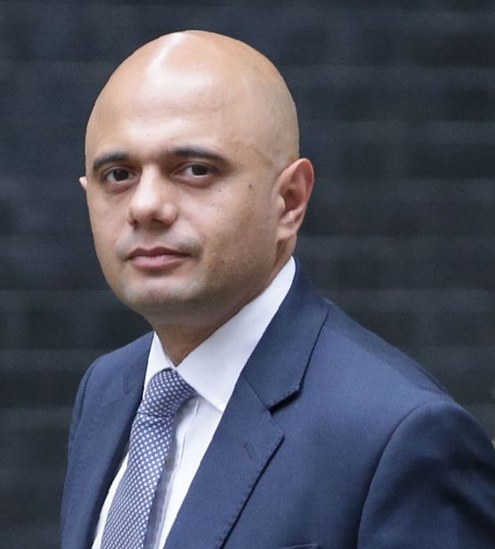
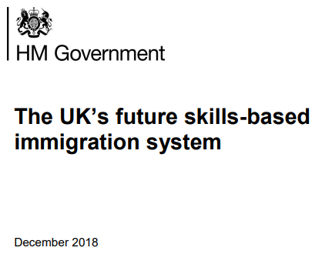
Immigration White Paper
The White Paper fails to meet the needs of our economy
Serious concerns remain over the following proposals:
Idea of a £30,000 salary threshold for skilled visas – whilst further consultation with business on the final level is welcome, a threshold at this level must be firmly ruled out.
Example: Lab technicians in life sciences, manufacturing of drugs
12-month temporary visa – only having a time-limited route below the threshold will lead to an increase in churn of lower-skilled workers, negatively impacting both productivity and local integration.
£1,000 immigration skills charge and £400 health charge – retention of charges at these levels will make the immigration system unaffordable and inaccessible to a large number of firms.
Ambitious changes will take many years to deliver – radical reform is welcome, but worried by “phased in over time” from 2021.
The new immigration system must work from day 1, not minor tweaks to Tier 2 with the promise of changes in the future.

Slide 3
Analysis of Immigration White Paper
 | Evaluation compared to CBI member views
Government proposal | Positive | Neutral | Negative
Further consultation with business on the level of salary threshold
Access to intermediate level skills by lowering skills threshold
12-month temporary visa for lower-skilled labour
“Ambitious changes” to remove bureaucracy, speed up and digitise employer sponsorship
Removal of visa cap and resident labour market test
Retention of immigration skills and health charges
Enhanced post-study work offer to international students
Mobility and migration in trade deals as well as business visitor activities
In-country switching from visitor to work visa routes
Bespoke Shortage Occupation Lists for devolved nations
Reformed role for Migration Advisory Committee
No specific proposals on addressing local impact of migration
Retention of net migration target

Slide 4
CBI report – open and controlled
CBI report Open and controlled published in August 2018
Sector by sector analysis of 18 parts of the economy including life sciences, manufacturing and technology.
Recommendations for new EU migration controls compatible with a close relationship with the single market:
Compulsory registration for EU citizens soon after arrival
Restrict ability to stay to three months unless in work, study or financially self-sufficient
Switzerland – new test so in areas of high unemployment job opportunities must be offered to UK residents first
Reinstate controls on in-work benefits agreed between the UK and the EU prior to the referendum
These align with proposals for EEA migration outlined by the Home Affairs Select Committee in July 2018.

Slide 5
Tom Barrett
Senior Policy Adviser, Immigration
e: tom.barrett@cbi.org.uk
t: +44 (0)20 7395 8036
m: +44 (0)7990 004 514

