Slide 1
DIY Bioterrorism
Les Baillie, School of Pharmacy and Pharmaceutical Sciences, Cardiff University, Cardiff Email: baillieL@cf.ac.uk

Slide 2
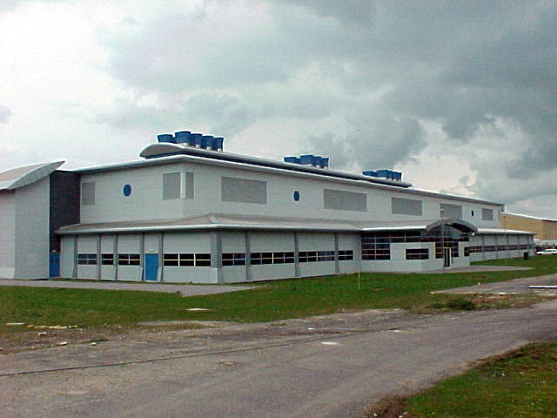
Expertise

Slide 5
State sponsored threats

Slide 6
Non-state Intentional, Non-intentional / accidental

Slide 7
Non-state- Intentional

Slide 8
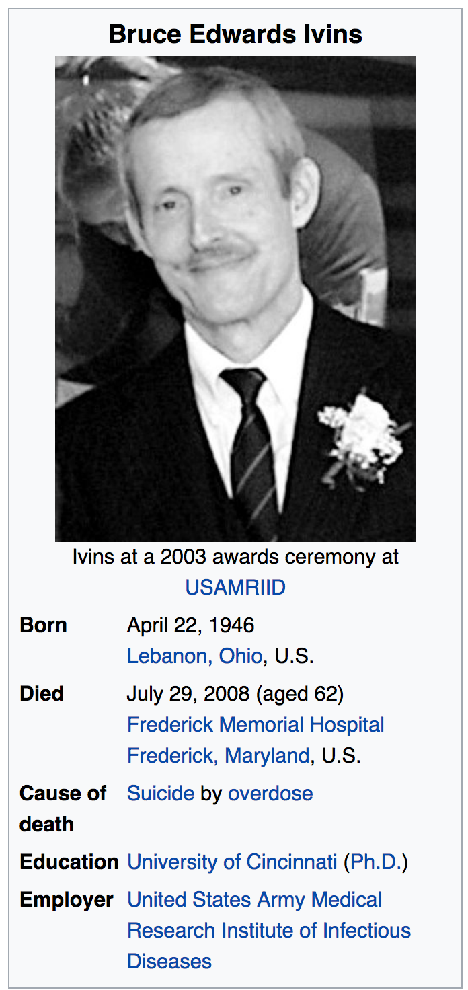
Non-state. - Intentional
The insider

Slide 9
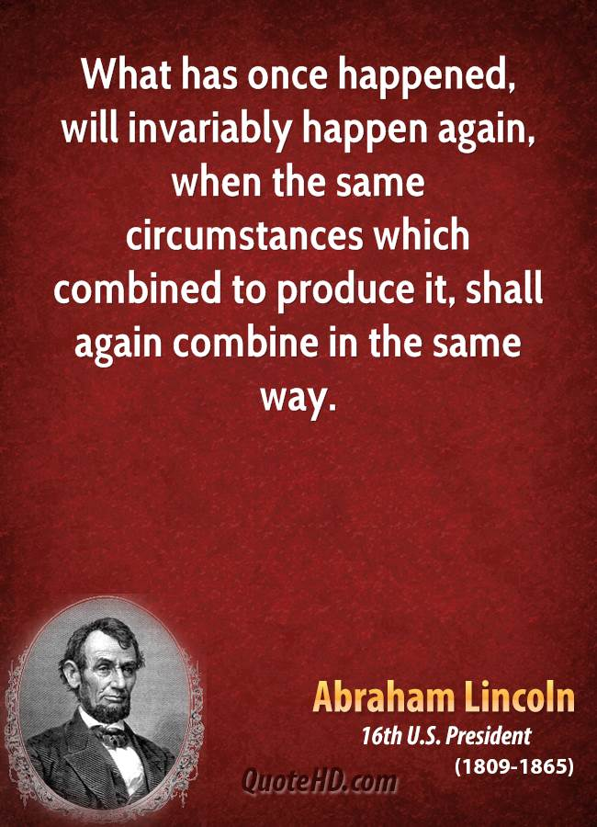
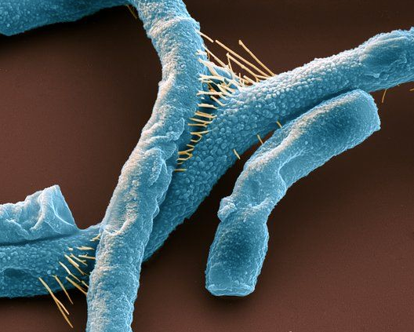
So why have we not seen a repeat of the 2001 anthrax attacks ?
1. Bomb making materials easier to access
2. Restricted access to knowledge
3.Regulations
4. Luck ?

Slide 12
The democratization of knowledge

Slide 13
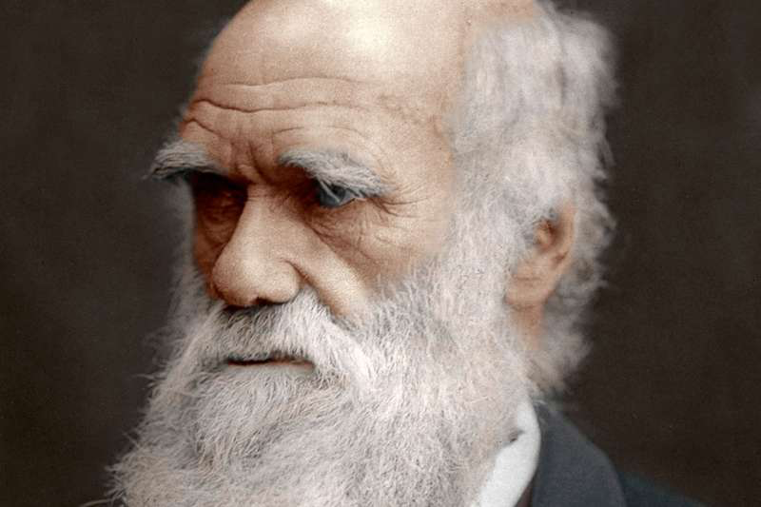

Slide 14
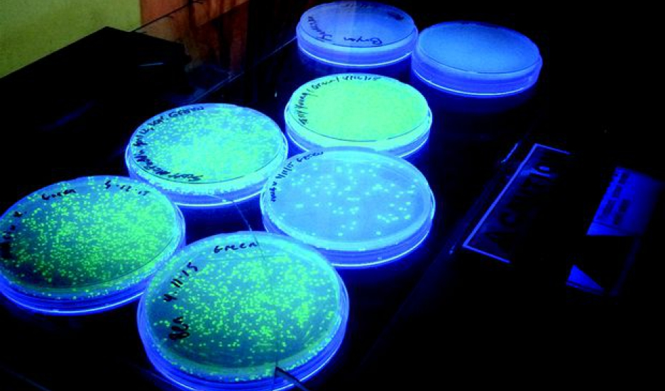

Slide 15
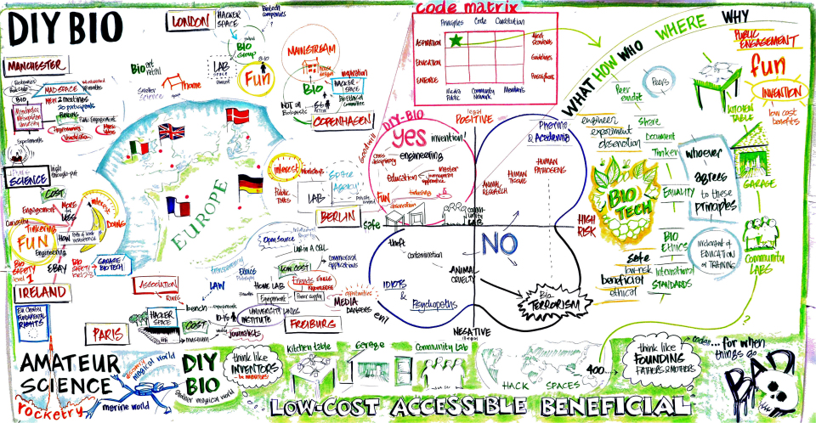

Slide 16
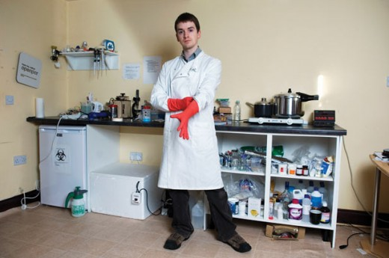
“Doing biotechnology
in my bedroom”

Slide 17
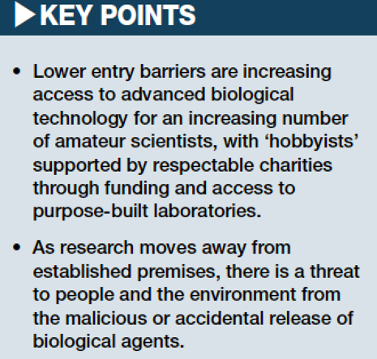
Non-state – Intentional / accidental

Slide 18
Non state- Intentional
- Subvert Regulations

Slide 19
CRSIPR- experiment on self
Non state- Intentional- No Regulations

Slide 20
Non state – Intentional- Ignored Regulations

Slide 21
Societal benefits from open access versus the risk of misuse

Slide 22
What can we do ?

Slide 23
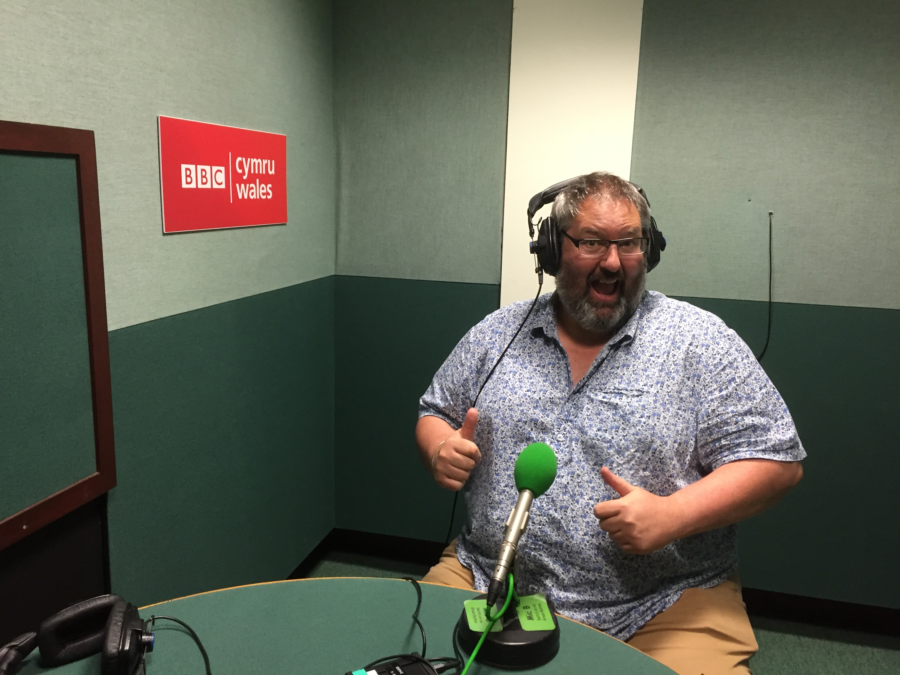
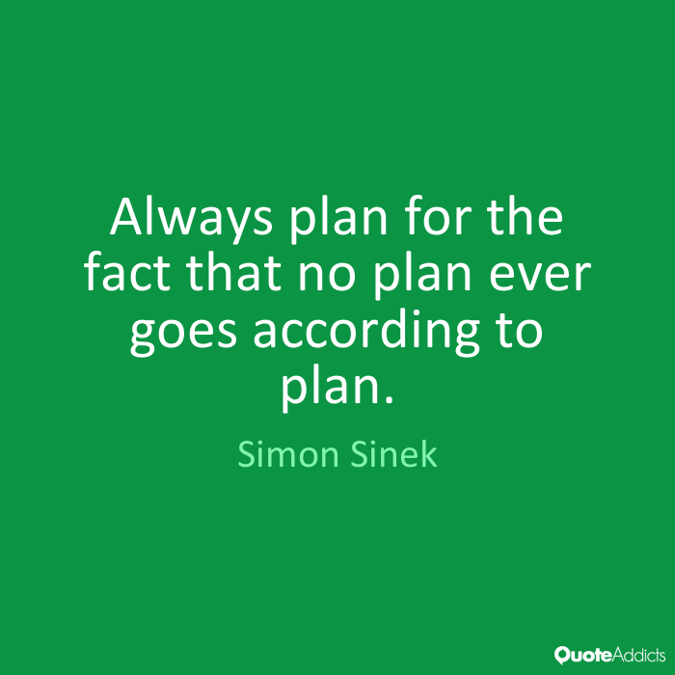
Questions ?

