Slide 1
Chemical weapons
Jeni Spragg
POST Fellow
25 February 2019

Slide 2
POST
Bridges research & policy to ensure that the best available research evidence feeds into the legislative process and scrutiny of Government, through:
Reactive advice for Committees and Libraries (POSTbriefs)
Events
Knowledge Exchange (internal and external)
Horizon scanning briefings (POSTNotes)
Fellowships (run with Research Councils & learned societies)
Notes:
POST is an office of both Houses of Parliament, providing independent and balanced analysis of public policy issues that have a basis in science and technology. It acts as a bridge between research and policy, and ensures that the best available research evidence feeds into the legislative process and Government scrutiny.
It does this through: Producing 4 page horizon scanning briefings (POSTnotes); Providing advice to committees and the House of Commons and Lords libraries (through POSTbriefs and private briefings); running events; internal and external knowledge exchange and; running fellowship schemes (funded by research councils and learned societies)
POSTnotes are comprehensive, impartial four page briefings on topics likely to come onto the parliamentary agenda in the coming months. They synthesise the research evidence and draw together different stakeholder perspectives.
POST supports committees and libraries with advice and research support.
POST runs events to bring together Parliamentarians and their staff, parliamentary staff, researchers and other external stakeholders to talk about areas of research of parliamentary relevance.
Knowledge exchange supports the exchange of information and expertise between researchers and Parliament. Via activities including: the ‘parliament for researchers’ (monthly regional training courses), advice and info from our knowledge exchange unit, and promoting opportunities to engage with parliament through the @UKParl_Research twitter account.
POST runs fellowships funded by research councils and learned societies

Slide 3
Ashok Kumar fellowship
The Institution of Chemical Engineers (IChemE) is the professional qualifying body for chemical, biochemical, and process engineers.

Slide 4
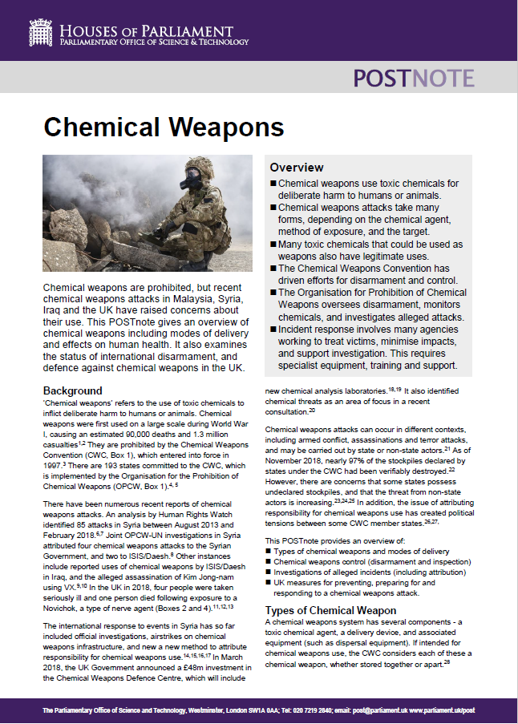
Chemical weapons POSTnote
Types of chemical weapon & modes of delivery
Chemical weapons control (disarmament and inspection)
Investigations (including attribution)
UK chemical defence (prevention, preparation and response).

Slide 5
Introducing chemical weapons

Slide 6
Timeline
1914- 18
WWI
1947-1991
Cold War
1997
Chemical Weapons Convention
1925
Geneva Protocol

Slide 7
Timeline
2011 – present
Syrian civil war
2017
Alleged assassination of Kim Jong-nam
2018
Salisbury & Amesbury incidents
2014 -2017
Reported chemical weapons use by ISIS/Daesh in Iraq¹

Slide 8
Defining chemical weapons
According to the Chemical Weapons Convention,
each of the following is a chemical weapon
– whether stored separately or apart –
if intended for deliberate harm to humans or animals
via the release of toxic chemicals²
Toxic chemicals and reactants (precursors) used in their production
Equipment ‘directly in connection’ with munitions and devices
Munitions
and devices

Slide 9
Introducing the CWC
The CWC requires States to:
Declare stockpiles within a certain timeframe
Destroy stockpiles under close monitoring
Comply with a verification regime
Adopt national laws against prohibited activity.²

Slide 10
Introducing the OPCW
The OPCW:
Verifies the destruction of declared chemical weapons stockpiles
Monitors certain chemicals & production facilities
Carries out investigations, which aim to be scientifically rigorous & impartial
Assists states to prepare for and respond to incidents.^{3,4}

Slide 11
Facts and figures
193
States Parties to the CWC
representing
98%
of the world’s population
96.80%
of declared stockpiles destroyed
including
69987
tonnes of
chemical agents
Figures correct as of 31 January 2019. Source: OPCW⁵
Notes:
69987 tonnes = 5600 Routemaster buses

Slide 12
Insights & challenges

Slide 13
Preventing re-emergence
Responding to risks
Non-compliance
Non-state actors
Strengthening the CWC
Improving controls
Effective decision-making

Slide 14
Responding to risks
How to respond to suspected non-compliance by states?
Undeclared stockpiles
Investigation
Attribution

Slide 15
Responding to risks
How to respond to the threat from non-state actors?
OPCW Executive Council, October 2017:
“The Council expressed concern about non-State actors’ continued interest in the development, acquisition and use of chemical weapons, and the potential for this threat to increase over time.
The Council underscored the role of the OPCW in preventing and responding to this threat.” ⁸

Slide 16
Strengthening the CWC
If and how should certain chemicals be better controlled?
Riot control agents⁹
CNS-acting (incapacitating) agents¹⁰
Novichoks

Slide 17
Strengthening the CWC
How to ensure decision-making at the OPCW continues to be effective?

Slide 18
Thank you
www.icheme.org
@IChemE (Twitter)
If you are interested in supporting the Ashok Kumar Fellowship please contact: ashok@icheme.org

Slide 19
Current work programme
In production:
Online safety education for young people
Advances in cancer treatment
Causes of obesity
Climate change and vector-borne disease
Outward medical tourism
Adaptation and mitigation in agriculture
Assessing and restoring soil microbiomes
Climate change and fisheries
Climate change and wildfire frequency
Developments in wind power
Environmental gain
Approaches to reducing violent crime, focusing on early interventions
Behaviour change in health and social care
Scheduled:
Civilian drones
Alternatives to plastic food packaging
Blockchain technology in the food chain
Industry influence on public health policy
Insect population decline
Improving eyewitness testimony

Slide 20
References
Bunker (2019). Contemporary Chemical Weapons Use in Syria and Iraq by the Assad Regime and the Islamic State. US Army War College.
OPCW. Fact Sheet 2: The Chemical Weapons Convention: A Synopsis of the Text. Accessed 21/02/19.
OPCW (June 2018). Restoring Restraint: Enforcing Accountability for Users of Chemical Weapons. Keynote Address to the Center for Strategic and International Studies (CSIS).
OPCW. Our Work. Accessed 14/12/18.
OPCW. OPCW by the numbers. Accessed 22/02/19.
Security Council Report (2017). In Hindsight: The Demise of the JIM. Accessed 22/02/19.
OPCW Decision addressing the threat from chemical weapons use (27/06/18).
OPCW (October 2017). Eighty-Sixth Session of OPCW Executive Council Acts on Non-State Actors. Accessed 22/02/19.
Crowley (2013). Drawing the line: Regulation of “wide area” riot control agent delivery mechanisms under the Chemical Weapons Convention. Bradford Non-lethal Weapons Project & Omega Research Foundation.
OPCW (March 2017). Aerosolisation of central nervous system-acting chemicals for law enforcement purposes. Accessed 02/01/19.

