Slide 1
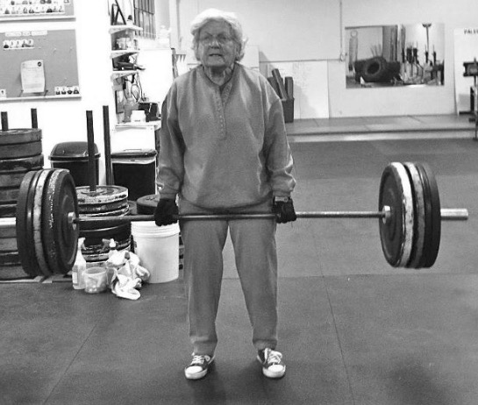
The role of nutrition and activity in healthy musculoskeletal ageing
Professor Emma Stevenson
Human Nutrition Research Centre
Newcastle University
Parliamentary and Scientific Committee meeting March 2019

Slide 2
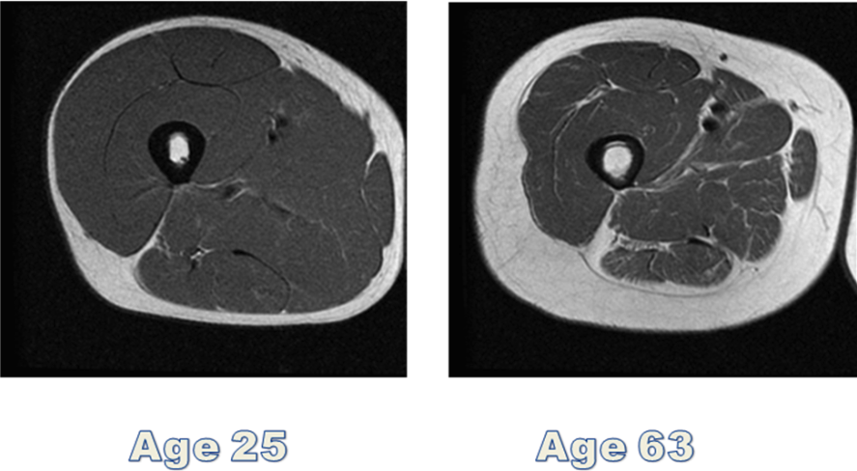
Age-related loss of muscle mass

Slide 3
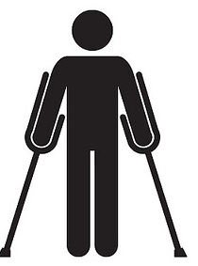
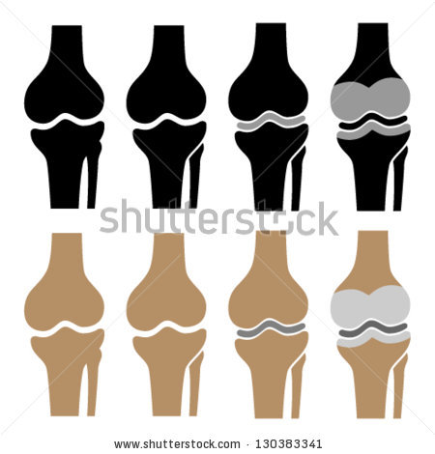

Age-related loss of muscle mass
Healthy
Disuse-accompanied
Muscle mass (AU)
“Threshold of disability”

Slide 4
Ageing and muscle function
Degens and McPhee 2013

Slide 5
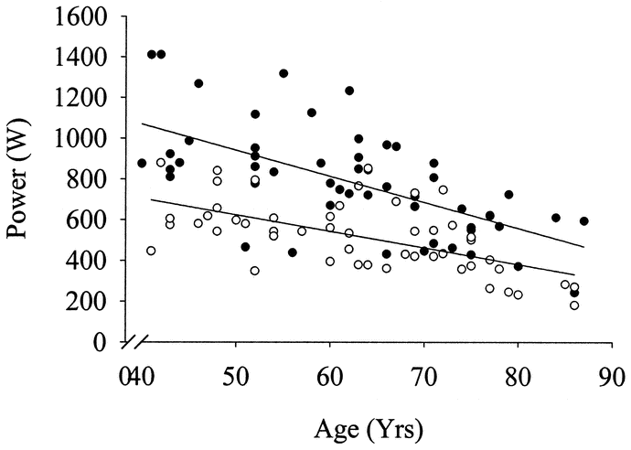

Age related decline in power
(Pearson et al., 2002)

Slide 6
Health Care Costs
Annual costs per person for different uses of health and social care according to muscle strength (Pinedo-Villanueva et al. 2019)

Slide 7
The role of activity and nutrition
Muscle loss with ageing is underpinned by a negative net muscle protein balance
+
A
A
A
Muscle Protein Balance
Time
B
B
B
_
Meal
(and/or
exercise
Meal
(and/or
exercise)
Meal
(and/or
exercise)

Slide 8
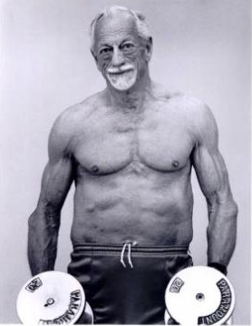
Optimising muscle protein synthesis
Maximise anabolic potency
Enhance anabolic sensitivity
Daily protein intake
Meal-by-meal protein intake
Prior exercise
Coingesting other nutrients
Leucine
Creatine
Anti-inflamm.
nutrients
Vit D
Antioxidants
Nitrates
Alcohol
β-HMB
Curcumin
Arginine
N-3 PUFA
Vit C and E
Citrulline
Resveratrol
Courtesy of Dr Oliver Witard

Slide 9
Cartee et al. (2016)

Slide 10
‘We do not stop exercising because we get old – we grow old because we stop exercising’ Dr. Kenneth Cooper

Slide 11
Protein and exercise in older adults
Older adults can gain/maintain muscle mass with exercise and good nutrition
Protein requirements of older adults may be elevated
Protein source, timing of ingestion and quantity are all important to consider
Increase in research investigating the effects of protein supplementation on body composition, strength and functionality in older adults

Slide 12
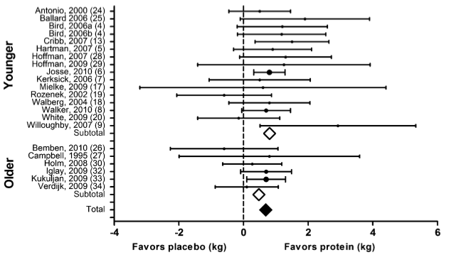
Protein and fat free mass: meta-analysis
Protein increases muscle mass with resistance training in younger and older participants
Cermack et al. (2012)

Slide 13
Protein Intake
Are we consuming enough protein?
UK Reference Nutrient Intake is 0.75g/kg BM, however older adults should consume at least 1.2g/kg BM
83%
61%
26%
0.75g/kg
1.00g/kg
1.20g/kg
Percentage of Adults 40+ not achieving daily protein levels (Source: NDNS 2014-16)

Slide 14
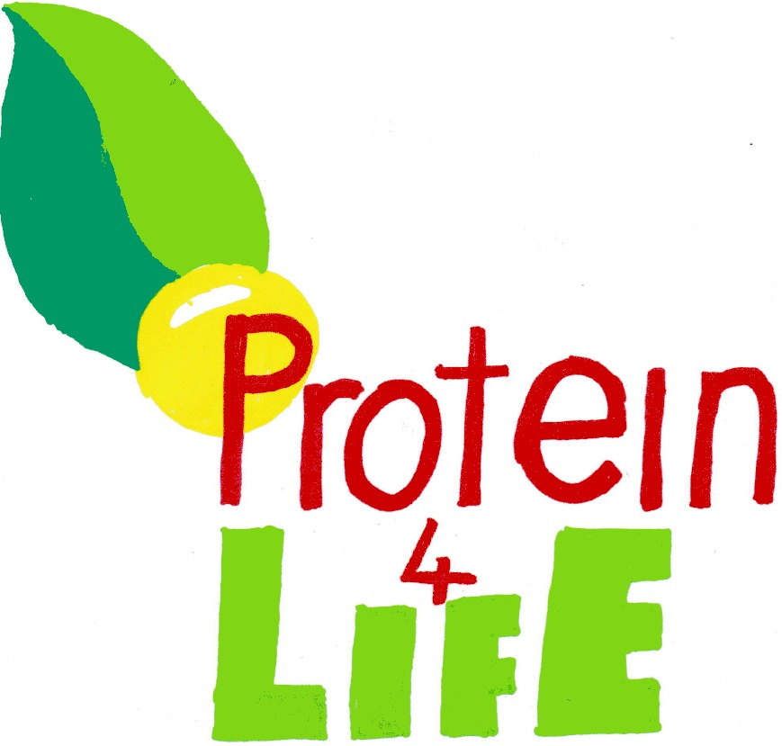




Protein for Life
Funded through the Priming Food Partnership initiative
Multidisciplinary approach to a public health issue with industry stakeholder support
Our research question IS: How do we maintain a healthy protein intake in an ageing population?

Slide 15


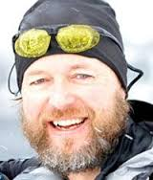


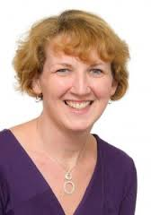
Project Team
Prof Emma Stevenson
Newcastle University
Prof Jeff Brunstrom
University of Bristol
Dr Bernard Corfe
University of Sheffield
Dr Alexandra Johnstone
University of Aberdeen
Dr Mark Green
University of Liverpool
Dr Liz Williams
University of Sheffield

Slide 16







Industry Stakeholders

Slide 17
Protein for Life
Working with the food industry to understand food preferences and purchasing habits of our target population
Understand patterns of protein intake throughout a day and barriers and opportunities to increase protein intake
What should industry focus on in designing higher protein products suitable for different populations?
Cost, sustainability, palatability issues to be considered

Slide 19
Summary
Exercise and good nutrition can help to maintain muscle mass with ageing.
Older adults need to consume more dietary protein to increase muscle protein synthesis rates
We are failing to meet the needs of our ageing population in terms of overall protein intake
Further public focussed education and industry engagement is important

Slide 20
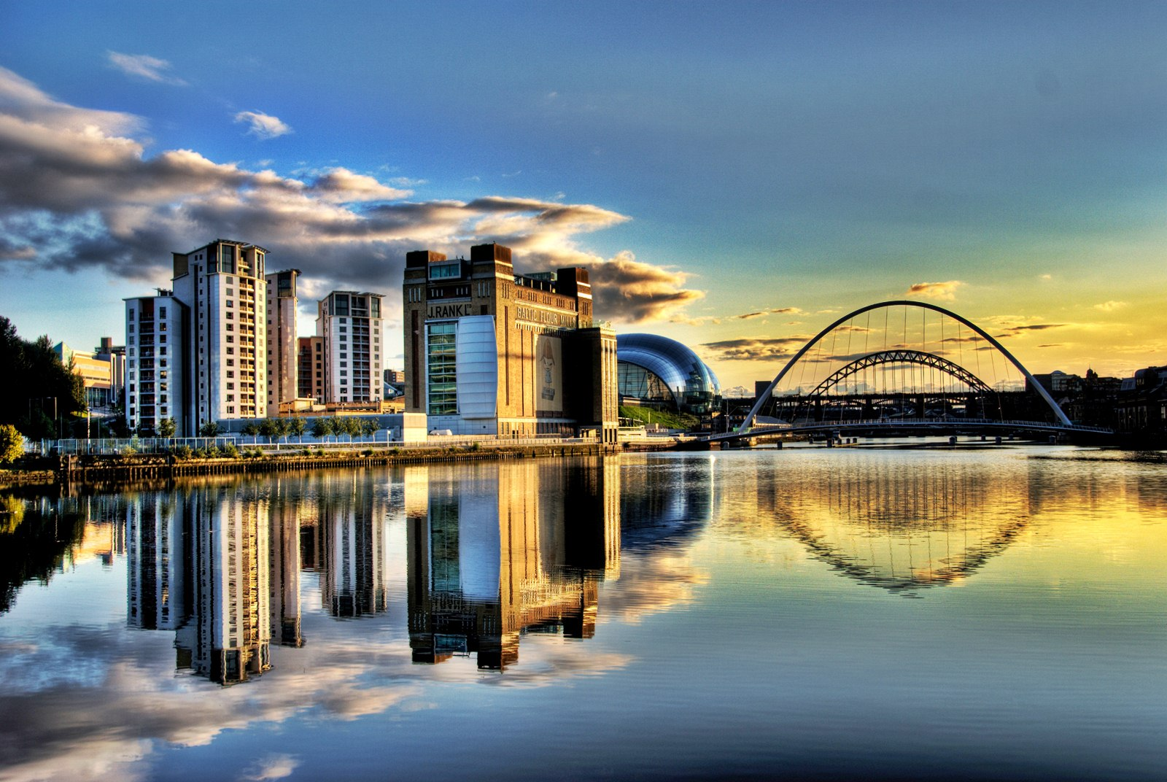


@EmmaJStevenson
Emma.stevenson@newcastle.ac.uk

