Slide 1
General physical and functional decline with ageing- the health & social costs
Ilaria Bellantuono
Co-Director of the Healthy Lifespan Institute
Department of Oncology and Metabolism
Faculty of Medicine, Dentistry and Health, University of Sheffield, UK
Notes:
What is Translational path for these drugs ?
This will raise interesting questions on the way we treat older people and whether this will be the same in the enxr 10-20 years

Slide 2
We live longer but not healthier
Women
Men
19
21
18
Life
expectancy
Life
expectancy
20
17
16
18
Expectancy at 65 in UK (years)
Expectancy at 65 in UK (years)
16
14
14
12
12
Healthy Life
Expectancy
Healthy Life
Expectancy
11
11
10
10
2005
2015
2005
2015
Every year spent in good health is worth 0.3% GDP
Source: Eurostat & European Commission Ageing Report 2015

Slide 3
Older people have increasingly complex medical needs
Long term conditions that cannot be cured but can be controlled by medication and other therapies
Multimorbidity simultaneous presence of multiple health conditions
Frailty, accumulation of deficits, often associated with multimorbidity, loss of resilience to adverse events and loss of independence

Slide 4
50% of over 65s has multimorbidity
Kingston et al. Age and Ageing 2018

Slide 5
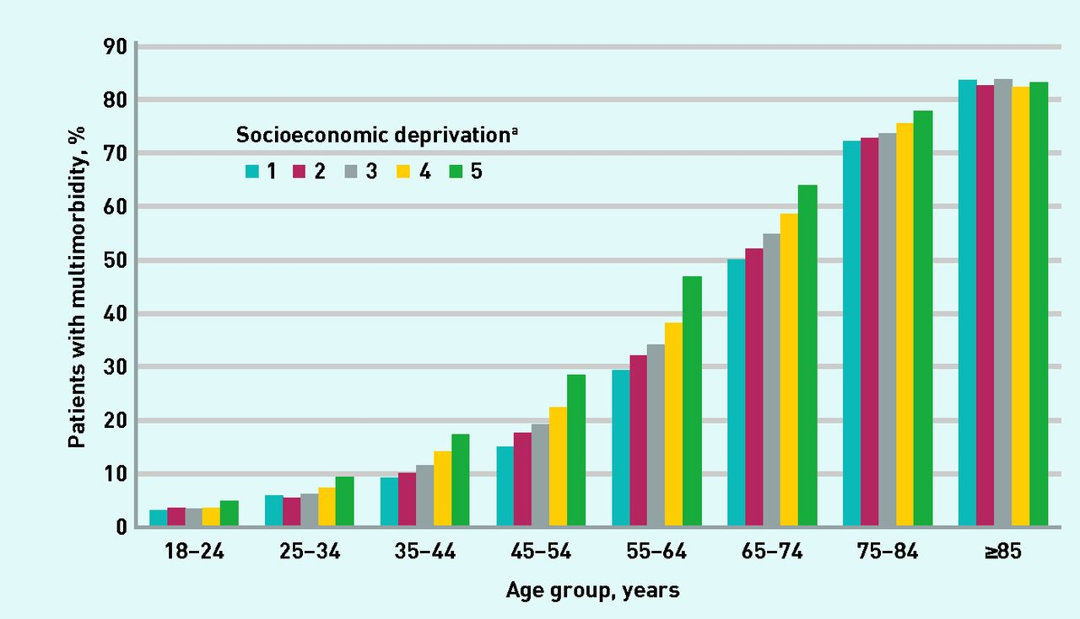
Prevalence of multimorbidity is the
greatest socio economic deprivation
Anna Cassell et al. Br J Gen Pract 2018
©2018 by British Journal of General Practice
Notes:
Prevalence of multimorbidity by age and socioeconomic status. ª1 is the quintile with the least socioeconomic deprivation, 5 is that with the greatest.

Slide 6
Multimorbidity is the leading cause of service use
50% of GP appointments
64% of outpatient appointments
70% of inpatient bed days
70% of the total health and care spend in England
Source: Department of Health,
Long term conditions compendium of information:
third edition, 2012

Slide 7
Average health and social care costs increase with the number of conditions
Data in South Somerset
Source: Centre for health economics, University of York

Slide 8
Frailty
25-50% of aged over 80 has frailty
Fatigue, weight loss, slow walking, accumulation of deficits
50% present multimorbidity
Loss of resilience, i.e. response to minor adverse events such as infections and reduced recovery
Loss of independence
Cost double more that individuals of the same age without frailty
Source: Clegg et al 2013 Lancet & Bock et al. 2016 BMC Health Services Research

Slide 9
The single disease paradigm is not serving older people well
Application of guidelines from NICE for an older person with five conditions could mean (Hughes LD et al. 2013)
administration of 11-21 different medicines per day
routinely engage in nine self-care/lifestyle alterations
attend 8–10 routine primary care appointments for their physical conditions,
4–6 GP appointments
8–30 psychosocial intervention appointments for their depression,
multiple appointments for smoking cessation support and pulmonary rehabilitation if they chose to accept a referral.
Trials exclude older people and people with significant comorbidity (over 80% of randomised controlled trials) (Van Spall HGC et al 2007)

Slide 10
The impact of polypharmacy is under investigated and can harm
2 wks
5 commonly used drugs
Locomotor function is significantly reduced
From: Adverse Geriatric Outcomes Secondary to Polypharmacy in a Mouse Model: The Influence of Aging
J Gerontol A Biol Sci Med Sci. 2015;71(5):571-577. doi:10.1093/gerona/glv046
J Gerontol A Biol Sci Med Sci | © The Author 2015. Published by Oxford University Press on behalf of The Gerontological Society of America. All rights reserved. For permissions, please e-mail: journals.permissions@oup.com.
Notes:
Figure 1. Change in outcomes from baseline to after the intervention period with control or polypharmacy diet in old and young male C57BL/6 mice. ( A ) Locomotor activity old; ( B ) locomotor activity young; ( C ) rotarod latency old; ( D ) rotarod latency young; ( E ) front paw wire holding impulse old; ( F ) front paw wire holding impulse young; ( G ) systolic blood pressure old; ( H ) systolic blood pressure young; and ( I ) Mouse Clinical Frailty Index old. The difference between baseline and postintervention measures was calculated for each mouse and presented as the mean (±SEM) change (result at baseline minus result after intervention) for each age and treatment group. For locomotor activity, rotarod latency, and front paw wire holding impulse, higher values indicate better function and therefore a positive value for change indicates a decline in function over the intervention period. For Mouse Clinical Frailty Index, higher values indicate more severe frailty and therefore a negative value for change indicates a decline over the intervention period. Numbers in each group: old control, n = 8; old polypharmacy, n = 13; young control, n = 5; and young polypharmacy, n = 5. C, control diet; P, polypharmacy diet; * p < .05 for comparison of the change between baseline and postintervention measures of an outcome, within an age group. The medicines for the polypharmacy regimen were selected based on drug classes most commonly used by older Australians
lipid-lowering agent for prevention and treatment of cardiovascular disease (simvastatin 20mg/kg/day) ( 30 ), a beta blocker for prevention and treatment of cardiovascular disease (metoprolol 350mg/kg/day) ( 42 ), a proton pump inhibitor for treatment of gastroesophageal reflux disease (omeprazole 10mg/kg/day) ( 33 ), a simple analgesic (acetaminophen 100mg/kg/day) ( 43 ), and a selective serotonin reuptake inhibitor antidepressant (citalopram 10mg/kg/day)
10

Slide 11
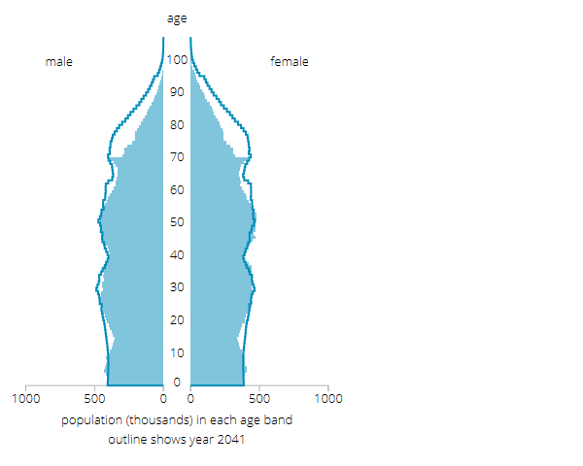
Over 70s is the fastest growing segment of the population
Source: Office for National Statistics

Slide 12
Change emphasis from cure to prevention
Think about ageing differently

Slide 13
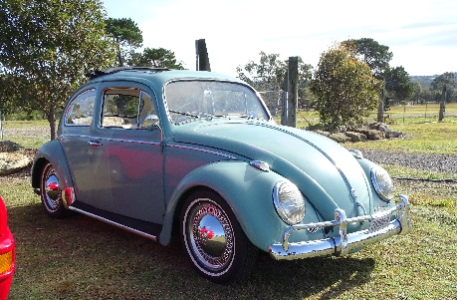
Ageing is the major risk factor for age-related diseases
Young cell
We understand what accelerate and decelerate ageing
Senescent cells accumulate with age
Senescent cells are an important driver of multimorbidity and frailty
Old cell
Senescent cell
Source: Bellantuono et al. 2018 Nature

Slide 14
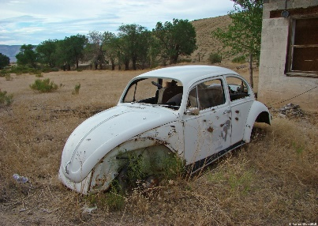
Diet, exercise, medicinal drugs reduces levels of senescence
Cellular ageing
Senescence
Tissue dysfunction
Musculoskeletal
Cognitive
Metabolic
Cardiovascular
Immune
Respiratory
Single disease
Atherosclerosis
Osteoarthritis
Osteoporosis
Parkinson
Alzheimer’s
Diabetes type 2
COPD
Multimorbidity and Frailty
Additional
hits
Time for intervention
Source: Figueira et al. 2016 Mech Ageing & Dev

Slide 15
Prevention through integrated measures
Interventions
Community
Economic
Public health
Policy
Individual
Social
Behavioural
Pharmacological
Common Factors modulating ageing
Social deprivation
Poor lifestyle
Environmental factors
Genetic factors
Common mechanisms of ageing causal to multiple diseases
Multimorbidity
Frailty

Slide 16
Conclusions
The single disease model approach does not serve older people well and is costly
A more holistic approach which is applied from research to training of doctors and health professional to delivering of services is required.
The geriatrician should be involved much earlier in the care of older people
More emphasis on prevention using integrated approaches.
When a drug approach is required wider participation in clinical trials when testing new interventions
More research on effects of polypharmacy

