Slide 1
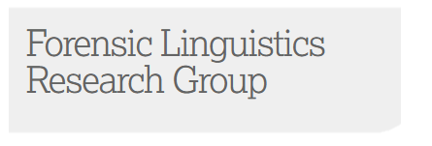
Linguistics and disinformation: motivations for sharing fake news
William Dance
Linguistics and English Language (LAEL)
Lancaster University
@williampdance

Slide 2
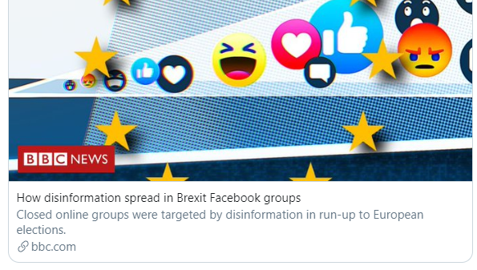
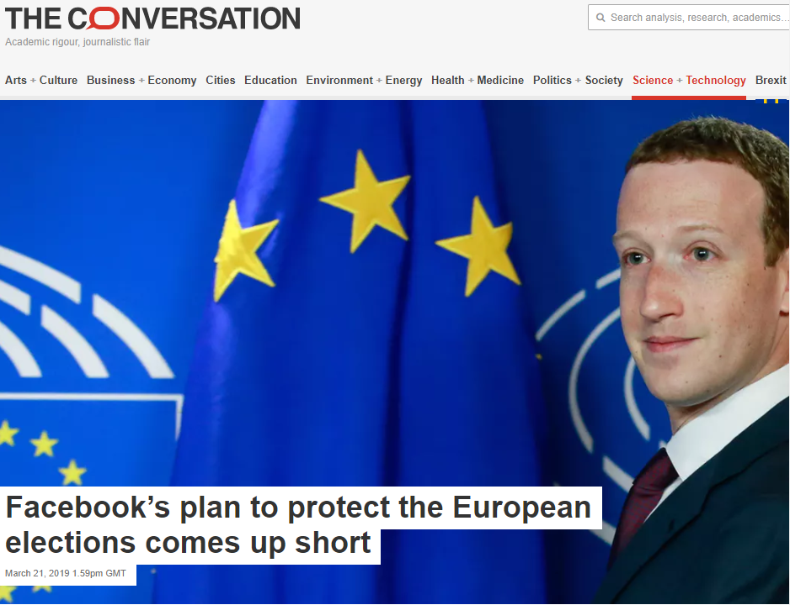
Who am I?
PhD student and associate lecturer at Lancaster University
Background has always been in linguistics and I started researching fake news about three years ago
What’s important to me?
Public outreach
Not just journals and articles, but informing the public about my research

Slide 3
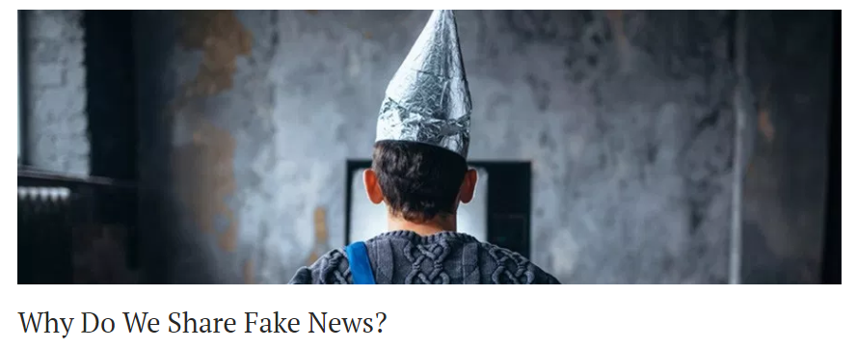
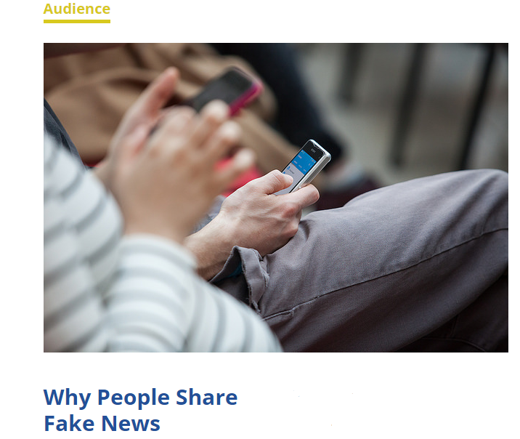
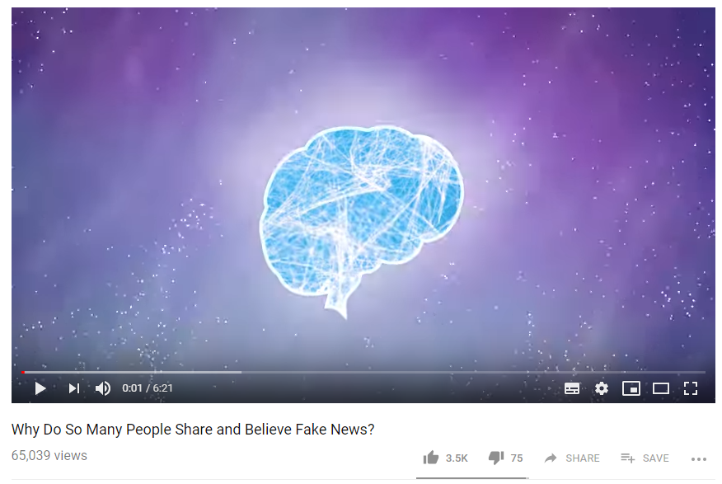
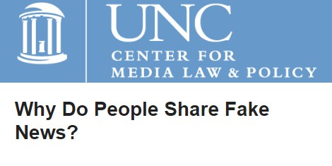
What I’m talking about today
A background of disinformation
Definitions and a history of ‘fake news’
The fake news phenomenon
My research
Motivations for the dissemination of fake news
Answering the question:

Slide 4
What is fake news?
¹intentionally ²factually incorrect news that is published to ³deceive and misinform its reader

Slide 5
A History of fake news
Example | Year | Usage
1 | 2019 | Why is there so much "Fake News" in this age of information?
2 | 2017 | Why make fake news up?
3 | 1692 | What is the reason there is so much false news spread abroad , and that many delight to make others believe strange things ?
Using historical bodies of text (1.2B words): licentious discourses; half whispers; light tales; murmurings
Spoken fake news: c1527
Written fake news: c1672

Slide 6
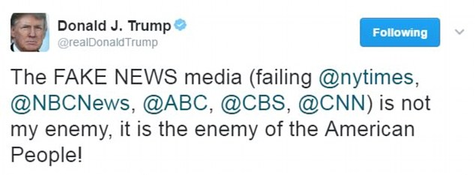
Why does fake news exist?
FNaB – Fake News as a Business
Fake news websites can make $10,000s by advertising on their sites
Who would advertise on a fake news site?
Ideologically driven
State-sponsored information operations to influence the outcomes of elections (Brexit, US 2016)
People resent ‘traditional’ media

Slide 7
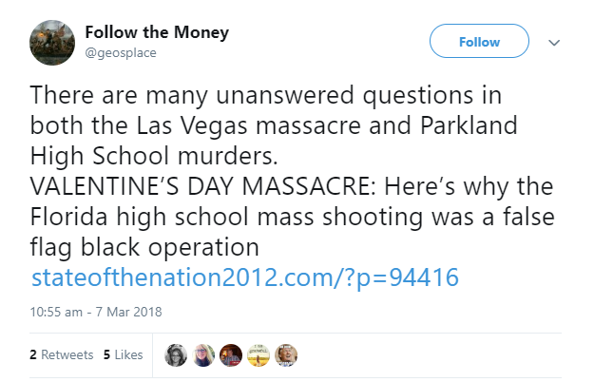
The Data
Fake news share text
The linguistic data from a social media post that links to a fake news article
In total: 1,454,555 words

Slide 8
The Method
corpus linguistics
Corpus (plural: corpora) = Latin: body
Linguistics = the scientific study of language
What does this mean? Analysing very large quantities of natural language
University Centre for Computer Corpus Research on Language

Slide 9
The Results
Need a way of grouping words together
Manual? ❌
Automated? ✔️
Semantic categories
Grouping words by similar meaning
What do these mean?
On their own, nothing
Rank | Label
1 | Closed; Hiding/Hidden
2 | Dead
3 | Evaluation: False
4 | Judgement of appearance: Negative
5 | Degree: boosters

Slide 10
Closed; Hiding/Hidden
cover up; hiding; anon; classified; secret; burying; disappears; concealed; disguised; secret_society
Poverty of knowledge can contribute to falling victim to deception (Urchs, 2007)
people rely on news to bring them the knowledge that they are impoverished of
Therefore: stories that were hidden or concealed will have a bigger impact and are more likely to be consumed
However…

Slide 11
Open; Finding; Showing
show; find; reveals; discovered; exposes; open; revealed; uncovers
They can never have heard these stories before because they are fabricated
Therefore: everything is a revelation because it is invented knowledge
Fake stories tap into political resentment by claiming to expose people in the public eye

Slide 12
Dead
killer; massacre; murder; deadly; deaths; slaughter; genocide; assassinated; homicide; execute; deaths
Data:
Factually incorrect
Far-right
Sensationalist
Tabloid-style sensationalism is more emotive and dramatic – thus the emphasis on death

Slide 13
Evaluation: false
lies; liars; disingenuous; nonsense; false; charade; deception; kidding; telling_lies; fabricated; misleading; fiction; crafty
“the declining trust in mainstream media could be both a cause and a consequence of fake news gaining more traction.” (Allcott and Gentzkow, 2017)
Trust, both off and on social media, is decreasing in the global north (Reuters, 2018)

Slide 14
Judgement of appearance: Negative
nasty; disgusting; vulgar; horrible; despicable; trashy; tasteless; vile; awful; tainted; soul-less
Negative sentiment: anger
Usage: disgusting [noun]
Example: disgusting conspiracy; disgusting FBI; disgusting supporters; disgusting media

Slide 15
Degree: boosters
really; more; very; so; such_a; far; extremely; as_hell; awfully; heavily; seriously; particularly
Intensifiers that amplify to a high degree (but not the upper extreme)
Not just negative evaluation:
Leave it to the trolls to stoop to this , and much worse
Something is seriously wrong with the #DOJ
Also a very good sign this is another false flag
David HOGG has been astonishingly articulate &; highly skilled at spreading a new narrative

Slide 16
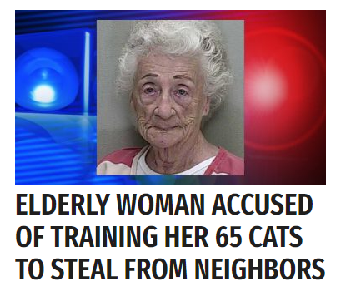
What does all of this mean?
Declining trust conditions fake news
All fake articles are revelations as they are fabricated and therefore could not have been previously seen
People are very passionate
It isn’t just careless, it’s extremely careless
It isn’t just great, it’s very great
People’s emotions compromise their critical faculties
People use fake news
They use fake news as an authoritative source to underpin their arguments and support their beliefs:
[article] shows [x]
[article] proves [y]

Slide 17
How we talk about fake news matters
“Discourse is socially constitutive as well as socially conditioned […] language constitutes situations, objects of knowledge, and the social identities of and relationships between people and groups of people […] it helps to sustain and reproduce the social status quo, and contributes to transforming it.”
(Fairclough and Wodak, 1997:258)
Social situations govern and are governed by the very language we use
‘Fake news’ as a term itself is problematic, and how we discuss the issues of fake news, disinformation and misinformation will determine how effective we can be in dealing with it.

Slide 18
Thank you for listening.
William Dance
Linguistics and English Language (LAEL)
Lancaster University
@williampdance

