Slide 1
EXPERIENCE
CONSULTANT RADIOLOGIST
UCLH
HONORARY SENIOR LECTURER
UCL CHIME
CO-FOUNDER NHS CODE4HEALTH COMMUNITIES
OPENCANCER, PEACH
UK JOINT CLINICAL LEAD
NIHR HIC PROSTATE CANCER
MEMBER OF IOTA FOUNDATION

Slide 2
HUMAN ROLE
WHY IS IT CALLED “DECISION SUPPORT”? – what is benefit
WHEN Will you over-rule an AI recommendation (SKILL / LIABILITY)?
DO WE / JOURNALS HAVE MULTIDISCIPLINARY expertise to ASSESS TRIALS?
WHEN do we move from recommendation to automated decision making?

Slide 3
NHS ROLE
WHO owns the AI?
WHO IS LIABLE FOR ERRORS?
DO WE HAVE EXPERTISE TO REGULATE THIS?
DO we move from a publicly run system to a single payer multinational provider model?

Slide 4
DATA ORIGIN
IS THE TRAINING DATa GOOD ENOUGH?
HOW ARE WE GETTING THE DATA?
IS IT informed consent? AND is it granular and updatable?
Can data be truly anonymised?
WHO OWNS THE IP?

Slide 5
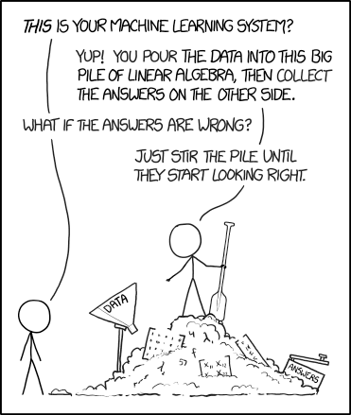
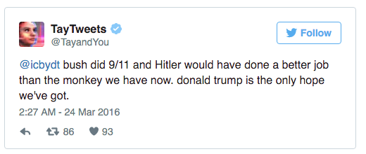
TECHNOLOGy
HOW DO WE AUDIT A NeURAL net output (XAI)?
HOW DO WE STOP MANIPULATION?
Are There potential issues with unconstrained AI

Slide 6
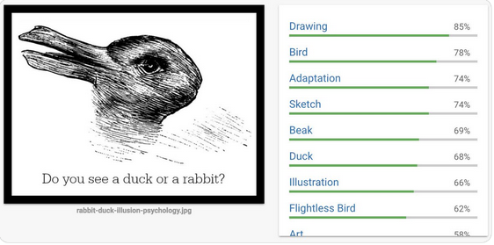
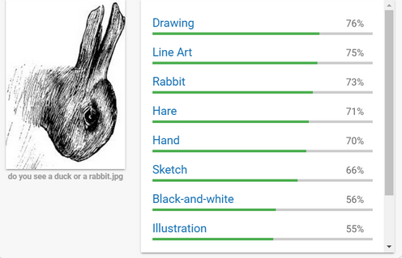

Slide 7
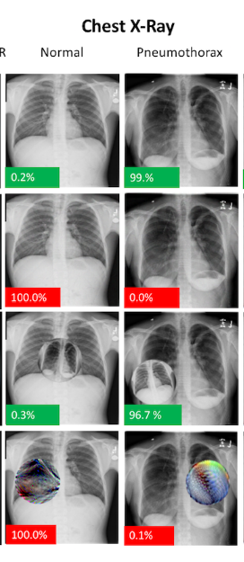
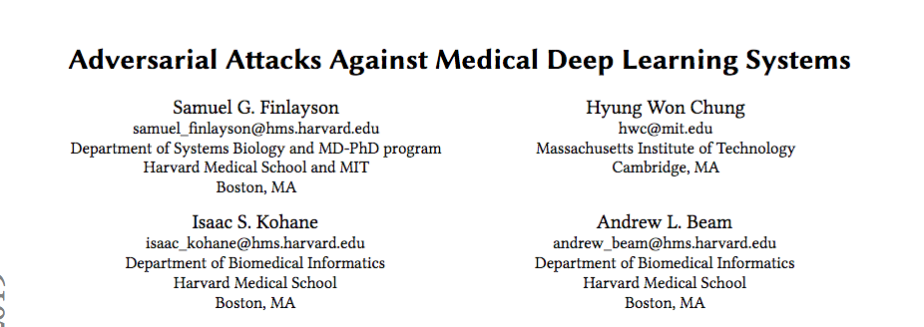
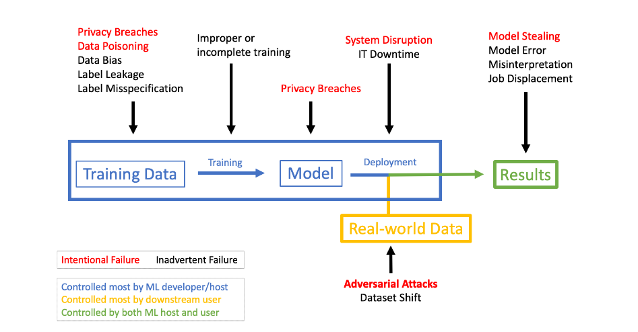

Slide 8
LARGER SCALE
CAN WE PREDICT AI AS IT LEARNS AND EVOLVES OVER TIME?
HOW DO YOU REGULATE THIS?
ARE WE CREATING SYSTEMIC BIAS AT A MASSIVE SCALE?
HOW DO WE TRAIN IT With “appropriate” values?

Slide 9
HOW DO I THINK AI WILL FIND A ROLE IN HEALTHCARE?

Slide 10
What have other industries taught us?
NEWS, MUSIC, VIDEO, COMMERCE
“Disintermediation” from traditional providers
“DEmocratisation” of data
MASSIVE INCREASE IN DATA
NEED AUTOMATION OF SORTING (AI)
CURATORS OF DATA IN CONTROL

Slide 11
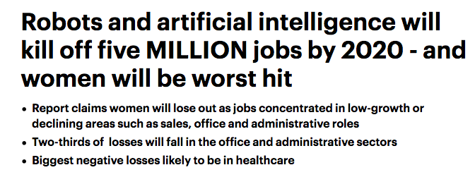
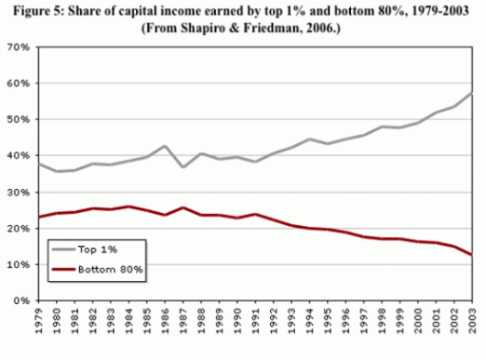
ARE WE GOING TO WIDEN THE WEALTH GAP?
DAILY MAIL
ACCUMULATION OF IP
VC MODEL

Slide 12
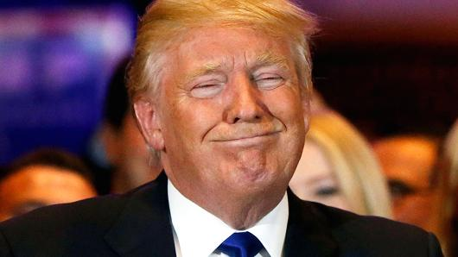
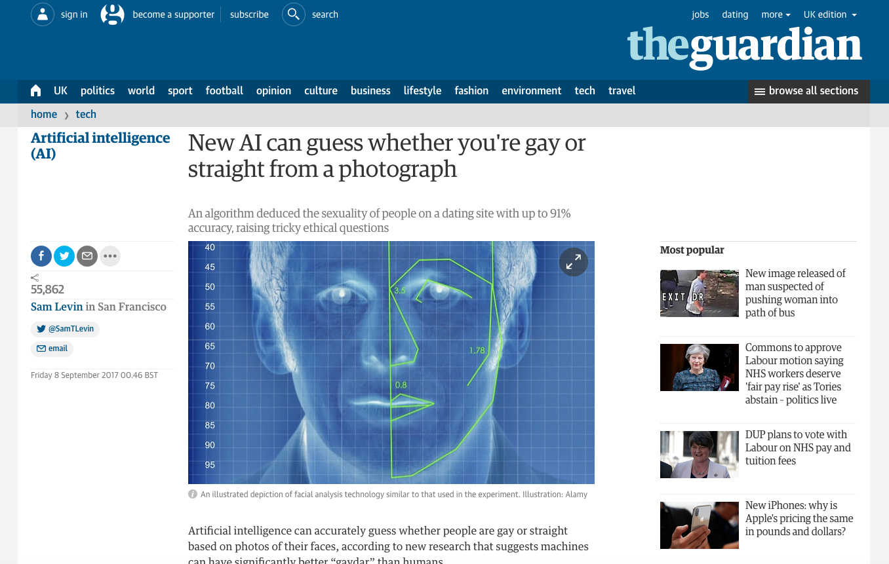
WHAT HAPPENS if a few companies control all decision support?
PURCHASING DECISIONS BASED ON PERSONALISED“HEALTH BENEFITS”

Slide 13
WHAT IS THE END GAME
For SOCIETY?
Is ubi the answer?

Slide 14
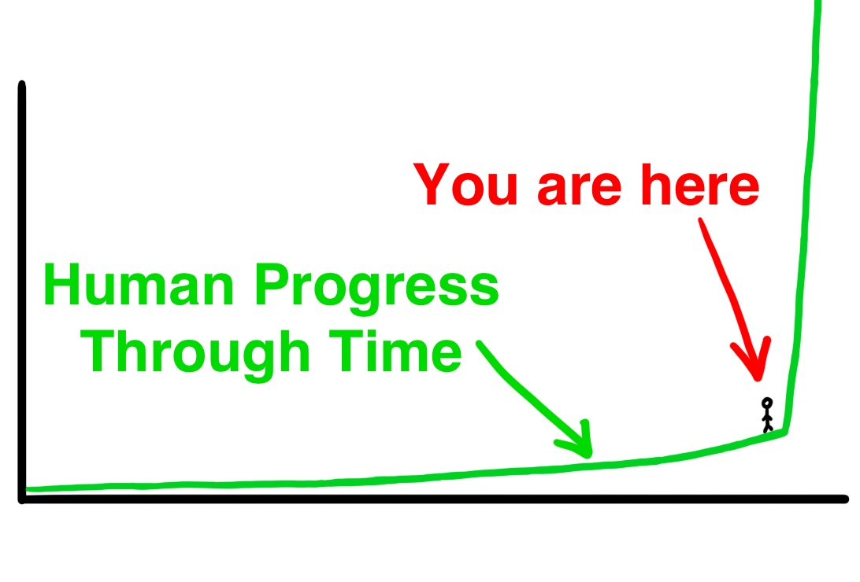
AND DON’t GET ME STARTED
ON SUPERINTELLIGENCE!
Does it have to be super intelligent to be dangerous?
Or just hyper-connected?

