Slide 1
SIR DAVID KING
Climate Change: what is plan B?
AFFILIATE Partner, SYSTEMIQ; Senior Strategy Advisor to the President of Rwanda; Former UK Govt CSA, 2000-7; FCO Climate Envoy, 2013-17
Executive Chair, Centre for Climate Repair at Cambridge
House of Commons, London 14th October 2019

Slide 2
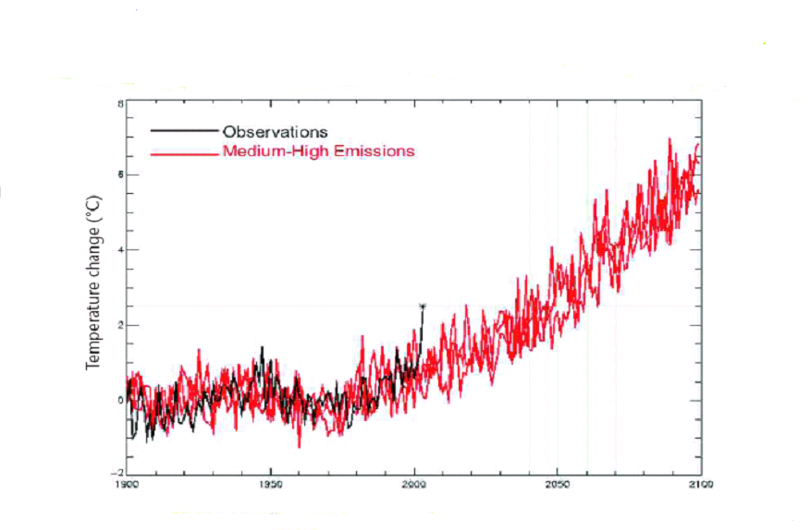
European Summer Temperatures1900-2100
Source: Hadley Centre

Slide 3
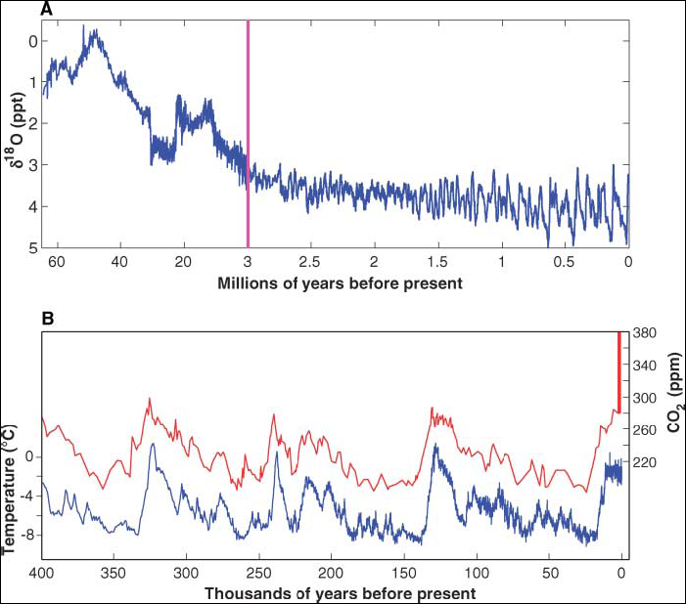
OBSERVED GLOBAL TEMPERATURES
413 ppm (2019)
Source: Fedorov et al, Science 312 (2006) 1485
Notes:
Variations in δ¹⁸O over the past 60 million years. Higher values of δ¹⁸O indicate colder climate (greater global ice volume). The gradual cooling over the past ~50 years is evident. Note that the time scale changes at 3 Ma. The Milankovitch cycles are modest in amplitude up to ~3 Ma but then start amplifying (13).
Fluctuations in temperature and in atmospheric concentration of carbon dioxide over the past 400,000 years as inferred from Antarctic ice-core records (45). The vertical red bar is the increase in atmospheric carbon dioxide levels over the past two centuries and before 2006.

Slide 4
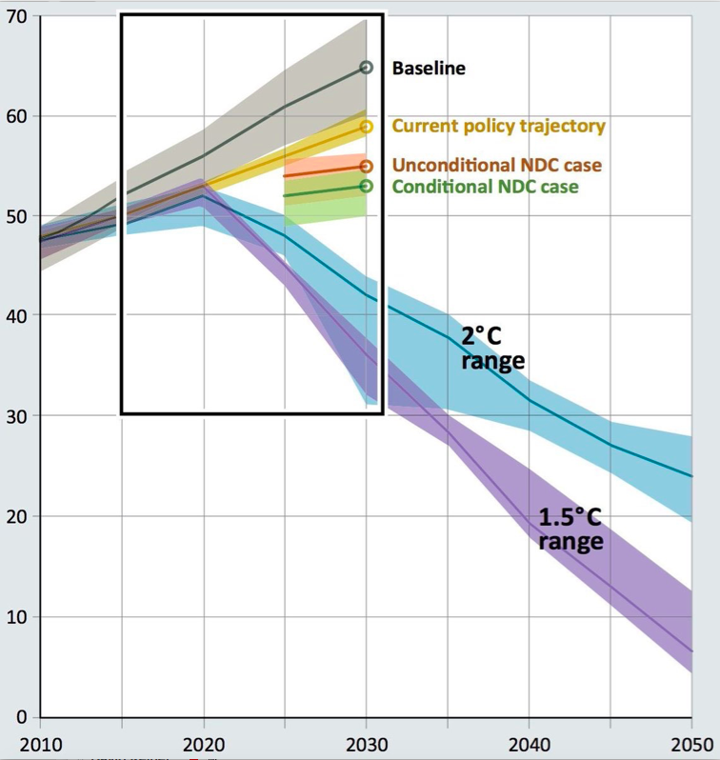

Slide 5
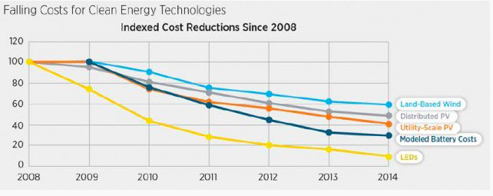
Falling costs for Clean Energy Technologies

Slide 6

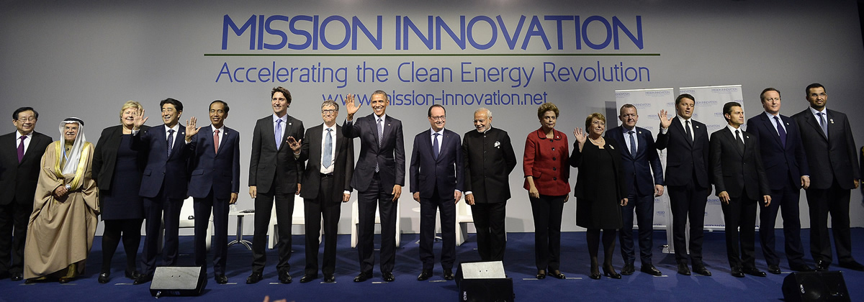
Mission Innovation
High-profile initiative to strengthen public funding of clean energy RD&D.
22 nations, committed to doubling by 2020/2021: annual spend of approx $30bn.
Breakthrough Energy Coalition, 29 investors pledged to invest $2bn in solutions.

Slide 7
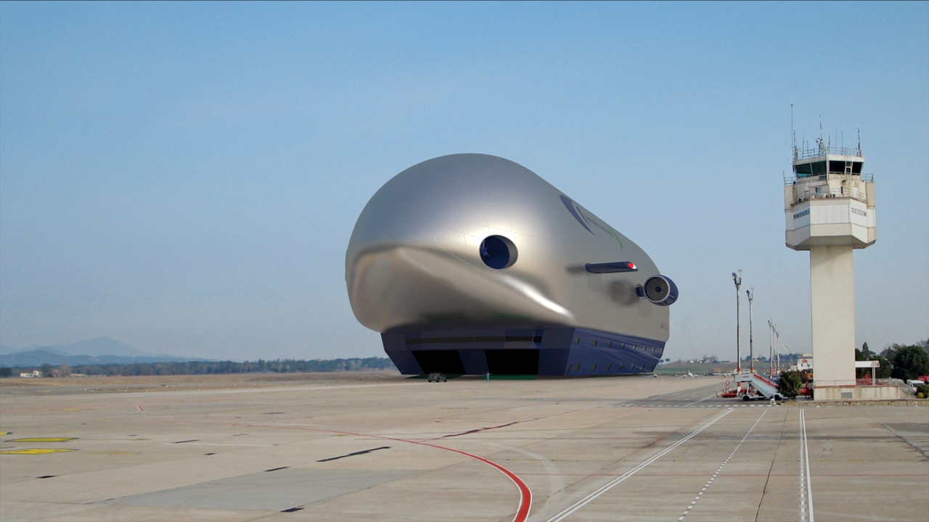
VariaLift Airship

Slide 8
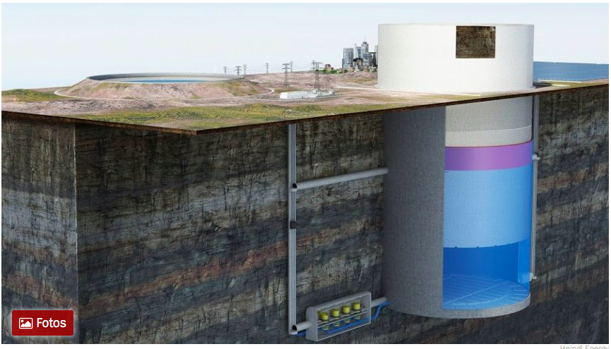

Slide 9
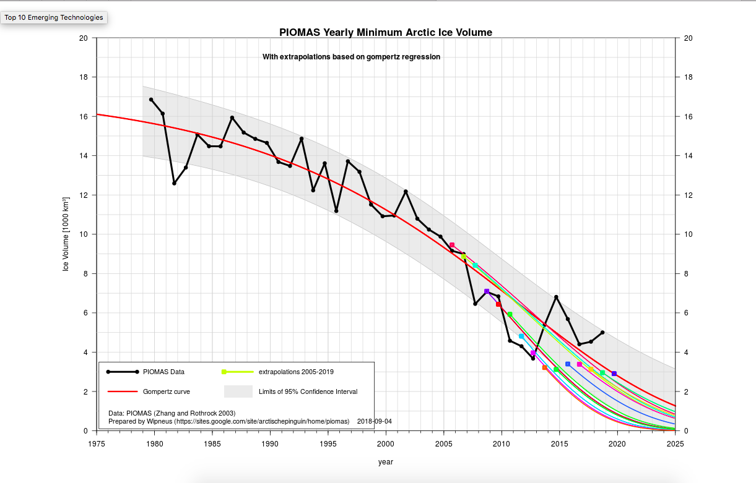

Slide 10
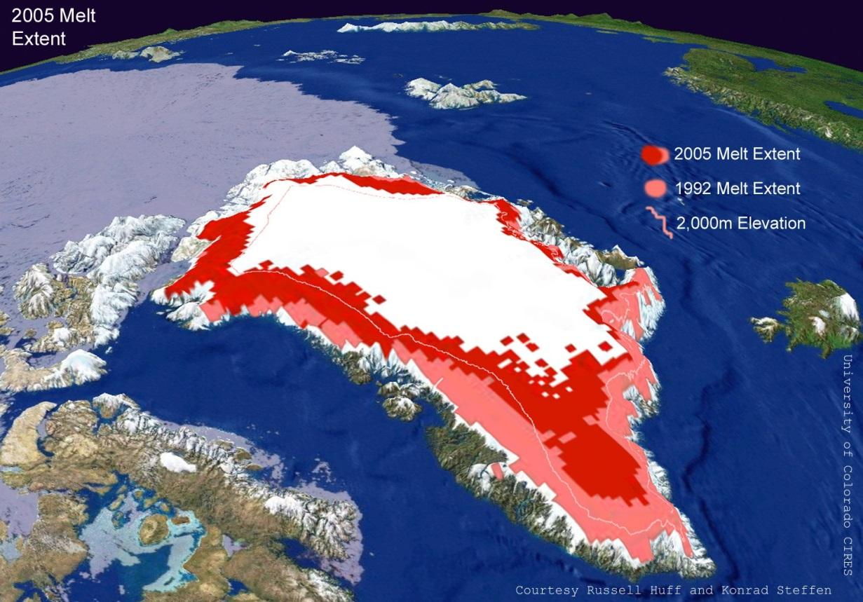
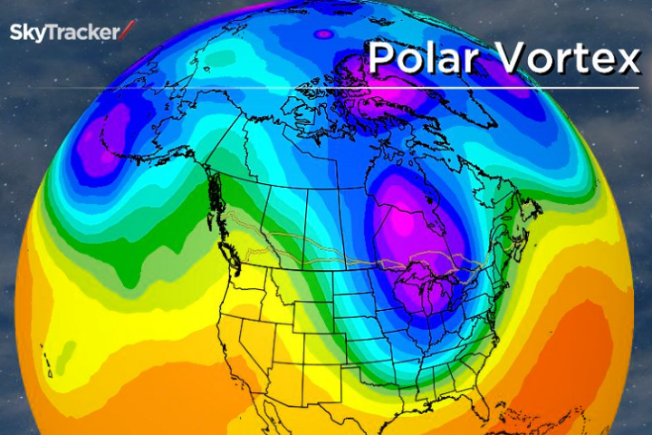
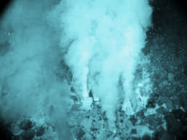
Consequences of Arctic Warming
Melting
Meandering
Methane
All Accelerating
Notes:
There is strong evidence of an established acceleration in:
· Rapid emissions of methane from the Arctic seabed, permafrost and tundra.
· Substantial ice loss in Greenland with potential massive loss due to unstable glaciers
· Disruption of jet stream behaviour, with abrupt climate change leading to crop failures, rising food prices and conflict in the Northern Hemisphere
(Note that methane is the main constituent of natural gas.)

Slide 11
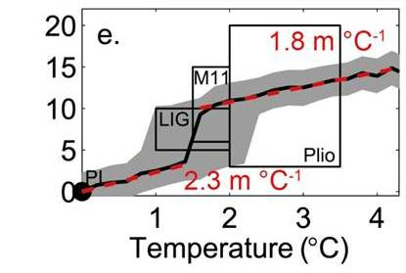

Long-term commitment to sea level rise

Slide 12
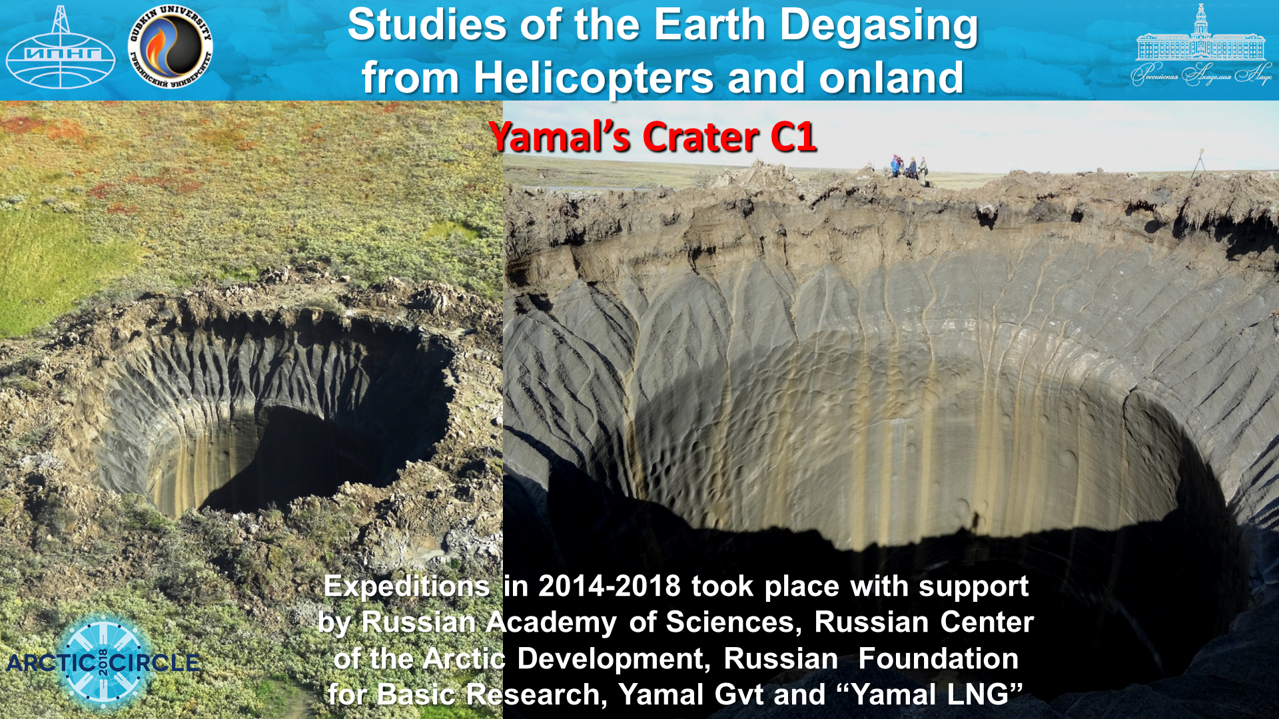

Slide 13
CENTRE FOR CLIMATE REPAIR AT CAMBRIDGE:
1. DEEP & RAPID EMISSIONS REDUCTION.
2. CREATE NEW CO2 SINKS.
OBJECTIVE: RESTORE THE ATMOSPHERE
TO <350 PPM GHG LEVEL.
3. RE-FREEZE THE POLES

Slide 14
Interventions
Ocean Surface Iron Fertilisation
Imitates the natural ocean fertilisation processes.
Creates a green layer with phytoplankton - co-benefit to CO2 uptake is increased ocean fishstocks
Calcium carbonate deposition into the earth’s crust: CO2 firmly sequestered.

