Slide 1
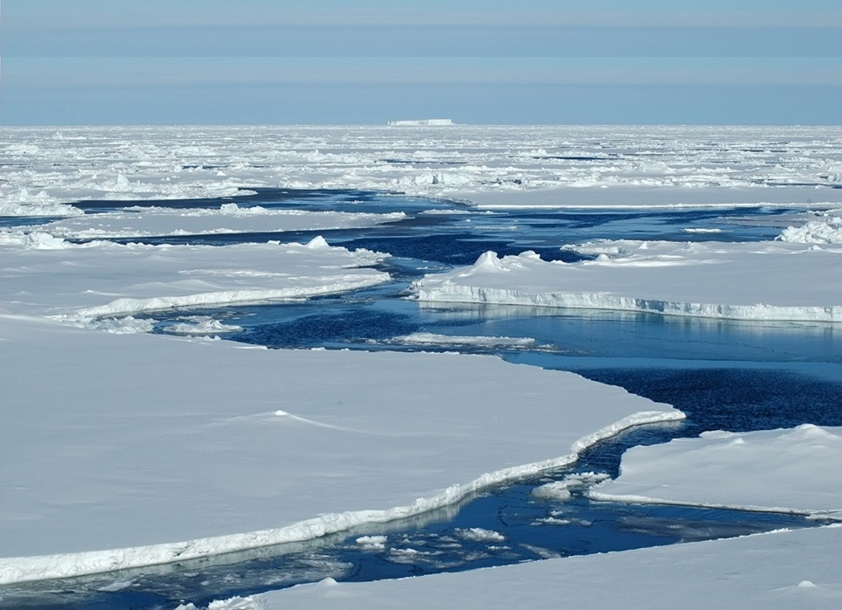
Climate Change:
Is there a Plan B?
Parliamentary and Scientific Committee
Hugh Hunt
@hughhunt
hemh1@cam.ac.uk
Cambridge University
Engineering Department
October 2019

Slide 2
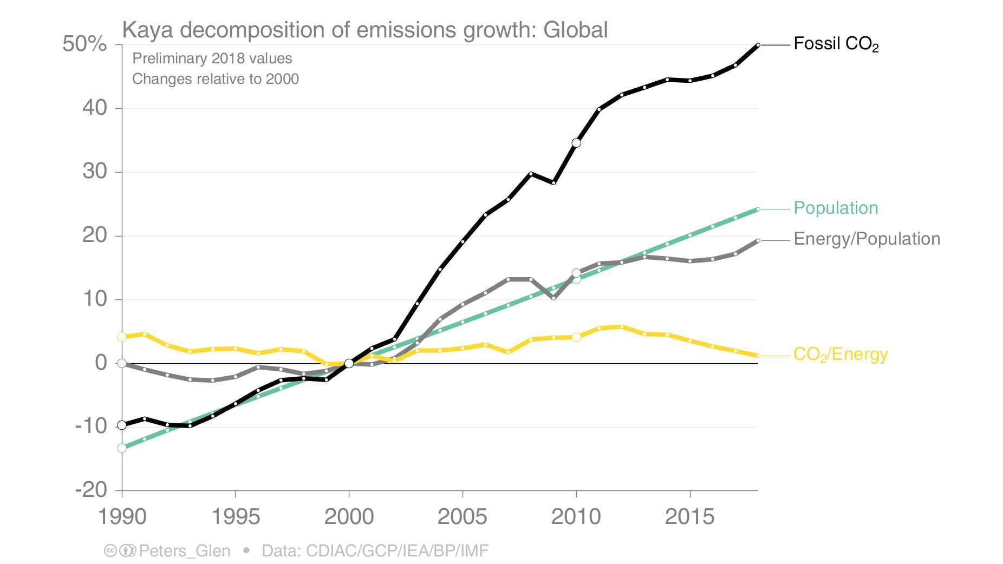
How well is “Plan A” working?
Fossil fuel use
rising
Population
rising
Energy use per capita
rising*
CO₂ per kWh
falling slowly*
* we are relying too much on technology to bring these down.
What about behaviour?

Slide 3
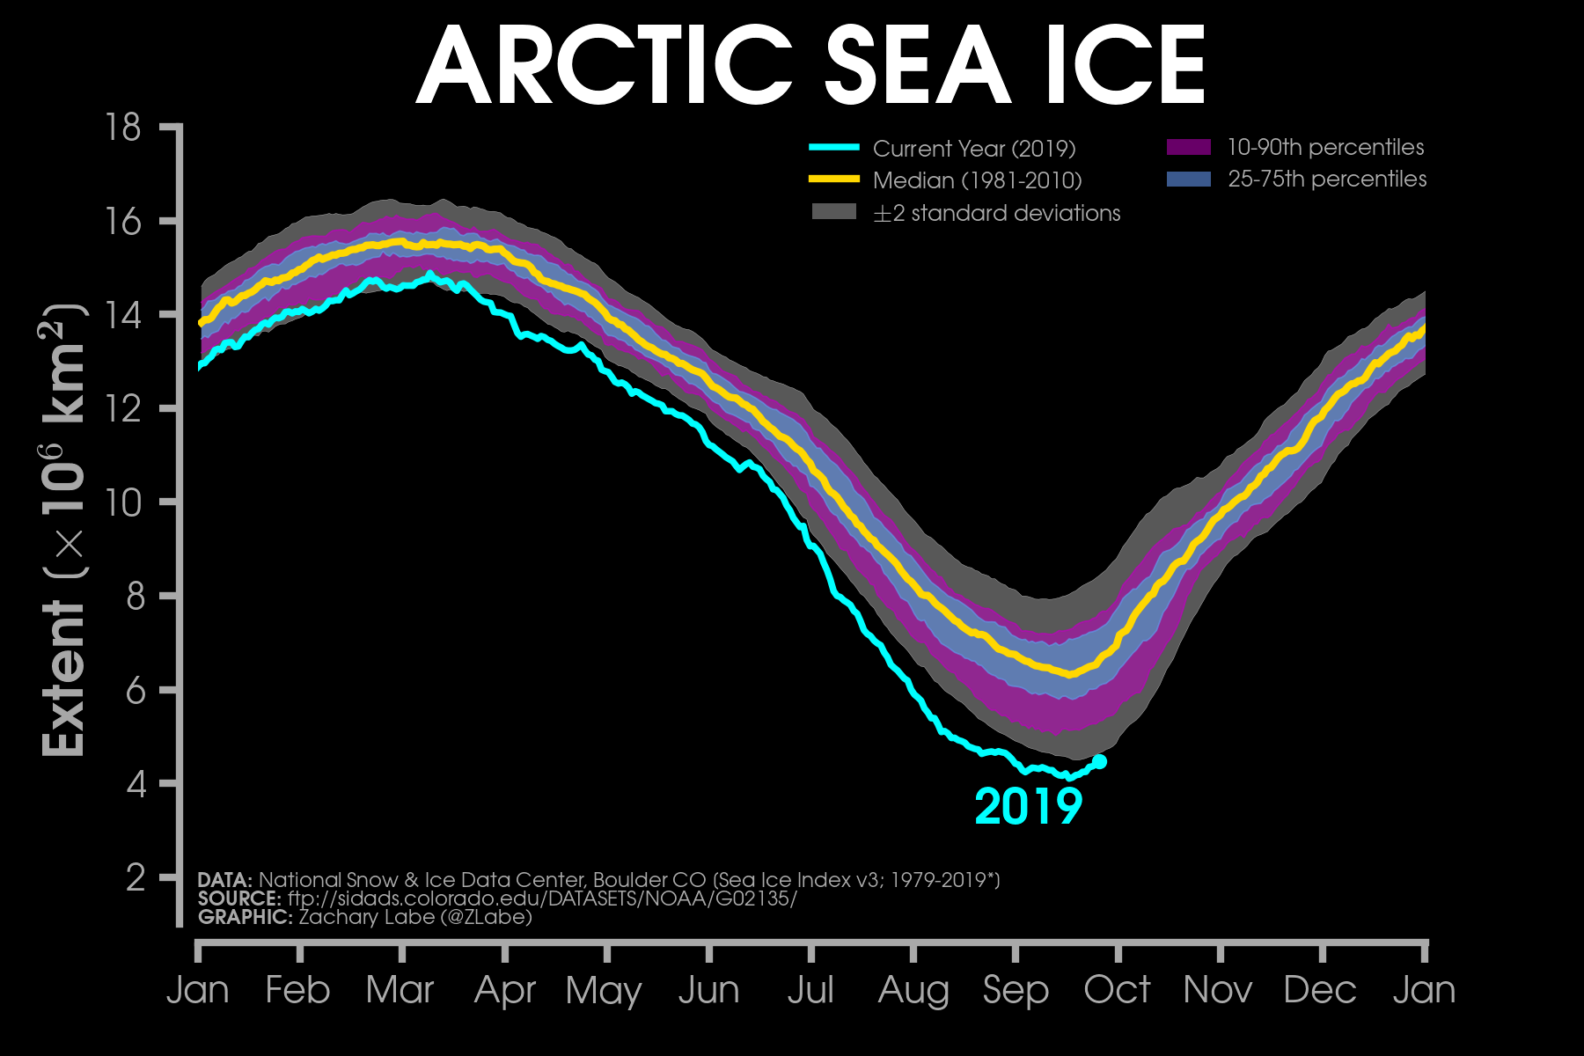
Arctic summer ice area : a good indicator

Slide 4
The Arctic problem
Arctic ice yielding to open water, albedo (reflectivity) drops from 0.6 to 0.1
Albedo loss from summer ice has the same warming effect as past 25 years of CO₂ emissions.
Arctic Ocean is shallow, surface warming extends to seabed, melts permafrost, triggers release of methane.
Methane is 20-80 times more potent a GHG as CO₂
Greenland ice shelf holds 2million km³ of ice.
If it melts → sea-level rise of 7.2m
Ice-free arctic will alter jet stream patterns and ocean circulations → changes in climate

Slide 5
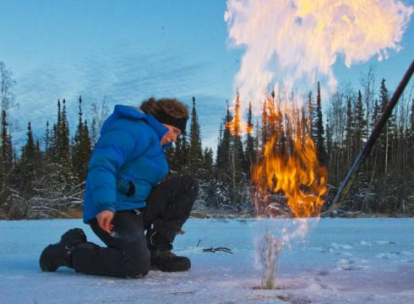
The Arctic problem
Arctic ice yielding to open water, albedo (reflectivity) drops from 0.6 to 0.1
Albedo loss from summer ice has the same warming effect as past 25 years of CO₂ emissions.
Arctic Ocean is shallow, surface warming extends to seabed, melts permafrost, triggers release of methane.
Methane is 20-80 times more potent a GHG as CO₂
Greenland ice shelf holds 2million km³ of ice.
If it melts → sea-level rise of 7.2m
Ice-free arctic will alter jet stream patterns and ocean circulations → changes in climate

Slide 6
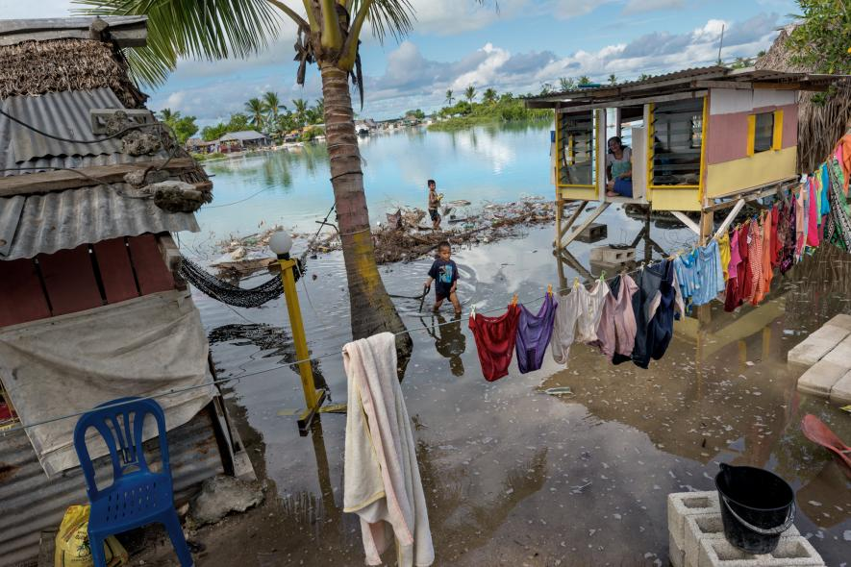
The Arctic problem
Arctic ice yielding to open water, albedo (reflectivity) drops from 0.6 to 0.1
Albedo loss from summer ice has the same warming effect as past 25 years of CO₂ emissions.
Arctic Ocean is shallow, surface warming extends to seabed, melts permafrost, triggers release of methane.
Methane is 20-80 times more potent a GHG as CO₂
Greenland ice shelf holds 2million km³ of ice.
If it melts → sea-level rise of 7.2m
Ice-free arctic will alter jet stream patterns and ocean circulations → changes in climate

Slide 7
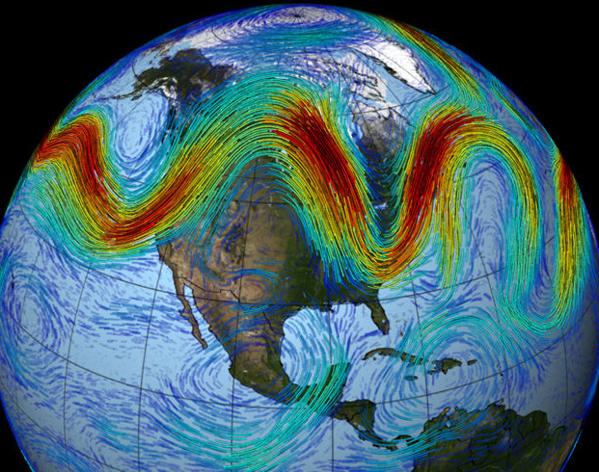
The Arctic problem
Arctic ice yielding to open water, albedo (reflectivity) drops from 0.6 to 0.1
Albedo loss from summer ice has the same warming effect as past 25 years of CO₂ emissions.
Arctic Ocean is shallow, surface warming extends to seabed, melts permafrost, triggers release of methane.
Methane is 20-80 times more potent a GHG as CO₂
Greenland ice shelf holds 2million km³ of ice.
If it melts → sea-level rise of 7.2m
Ice-free arctic will alter jet stream patterns and ocean circulations → changes in climate

Slide 8
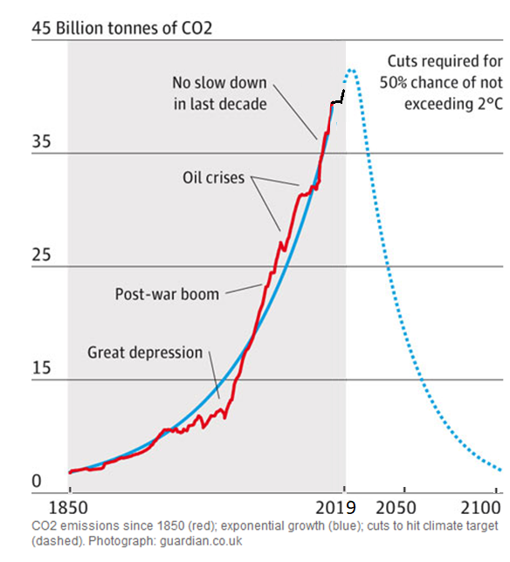

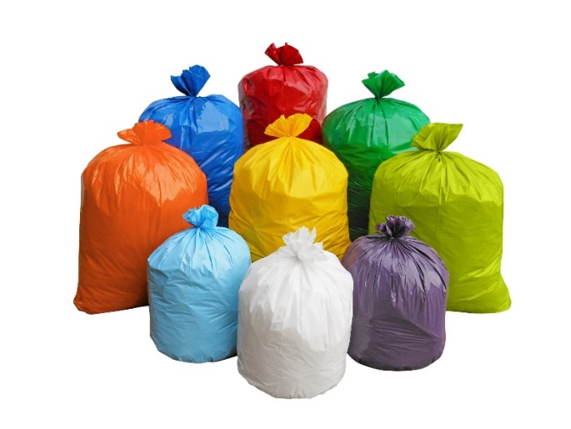
Global annual CO₂ emissions – 35 billion tonnes
35 billion tonnes/year
World pop = 7billion
Global average
5 tonnes/person/yr
My trash: 500kg/yr ?

Slide 9
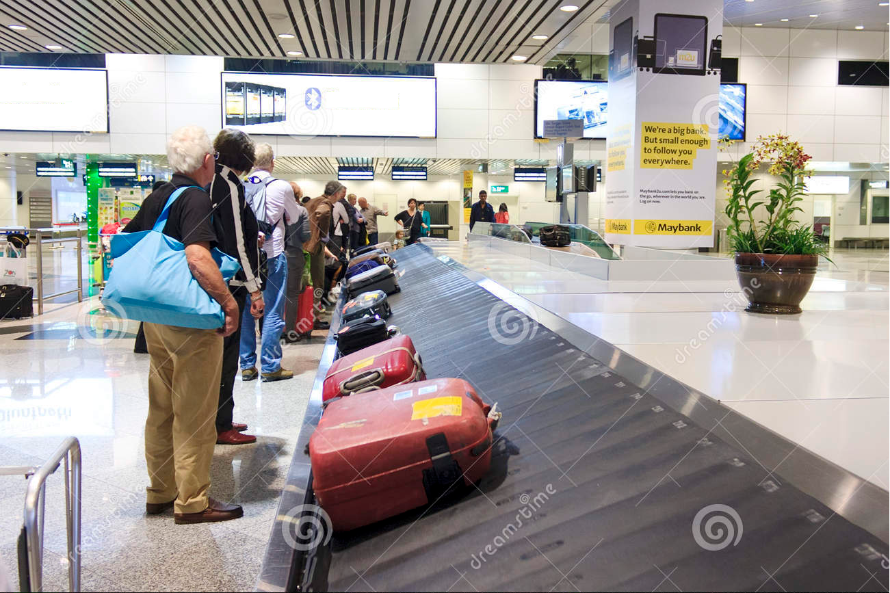
Arrival in Melbourne – how much CO₂ is my fair share?

Slide 10
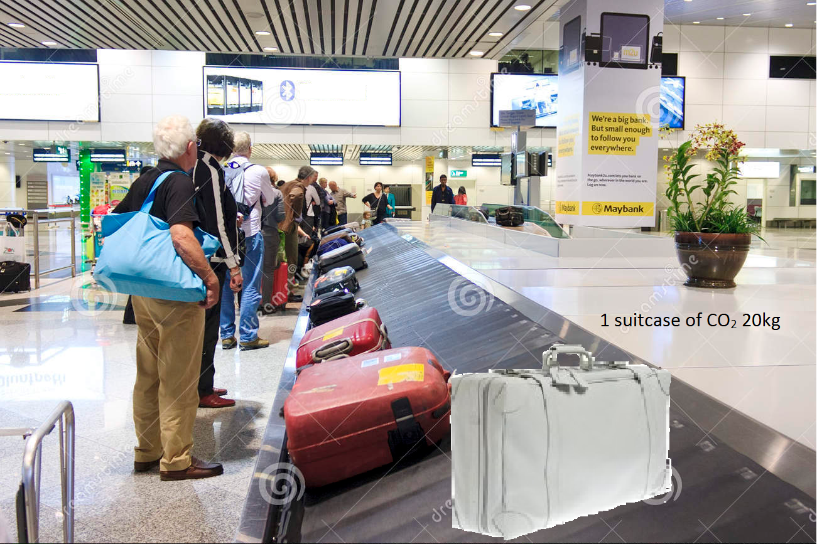
Imagine that each white suitcase contains 20kg of CO₂

Slide 11
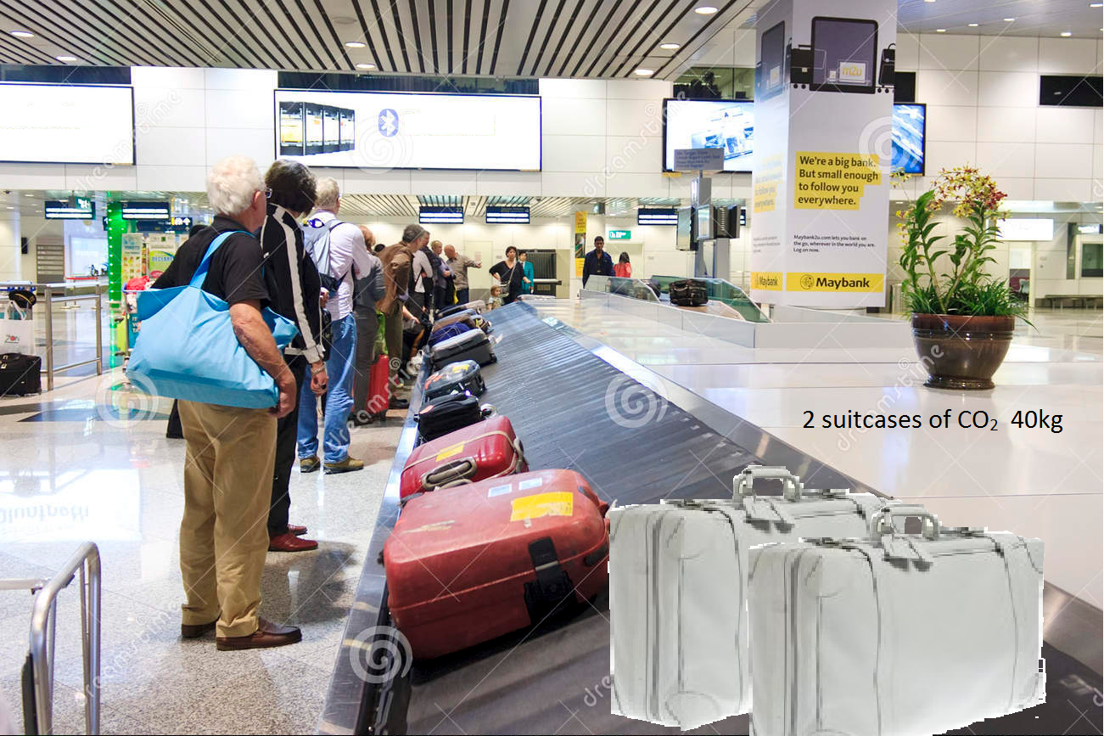
A Boeing 747 burns fuel at 4kg per second

Slide 12
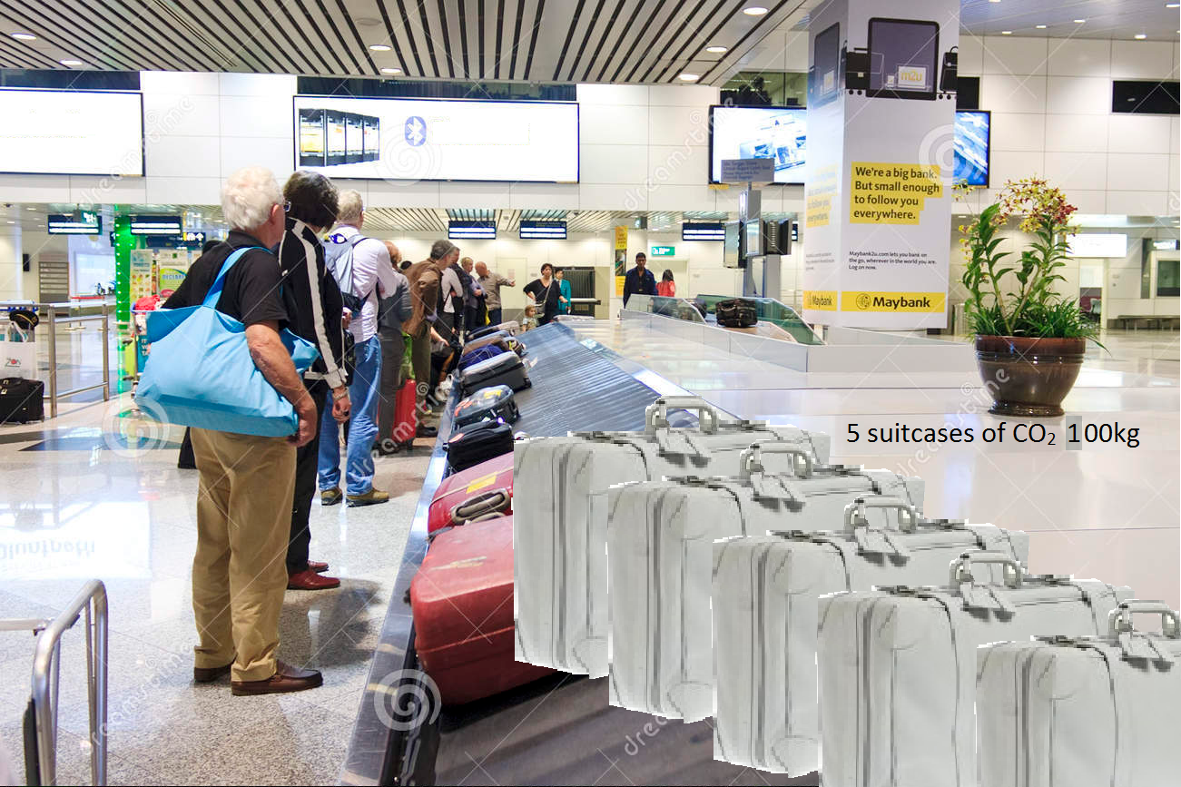
to Melbourne is a 20 hour flight

Slide 13
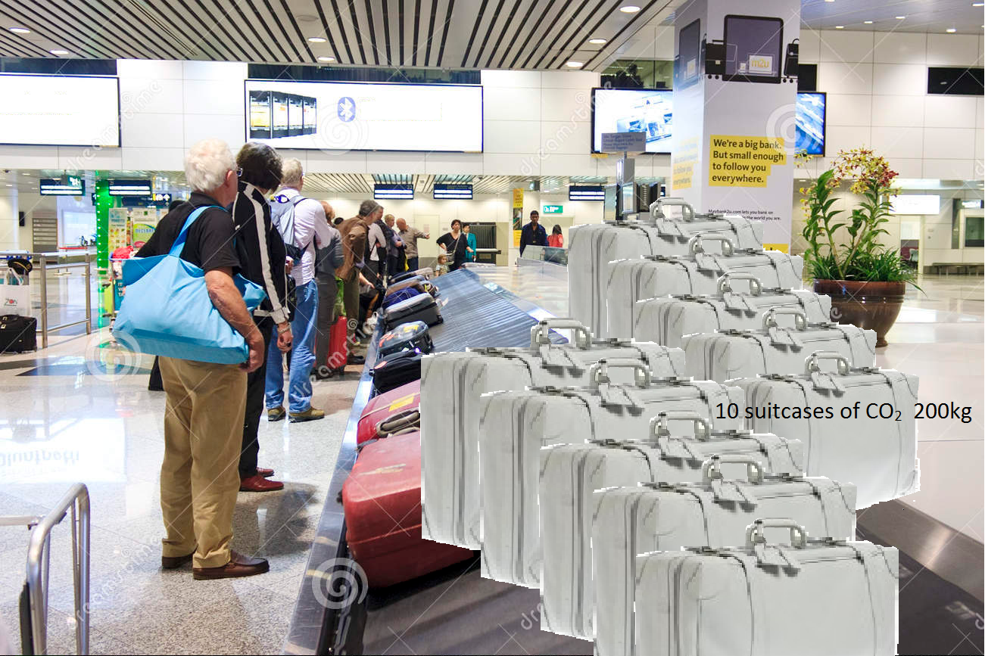
There are 350 passengers

Slide 14
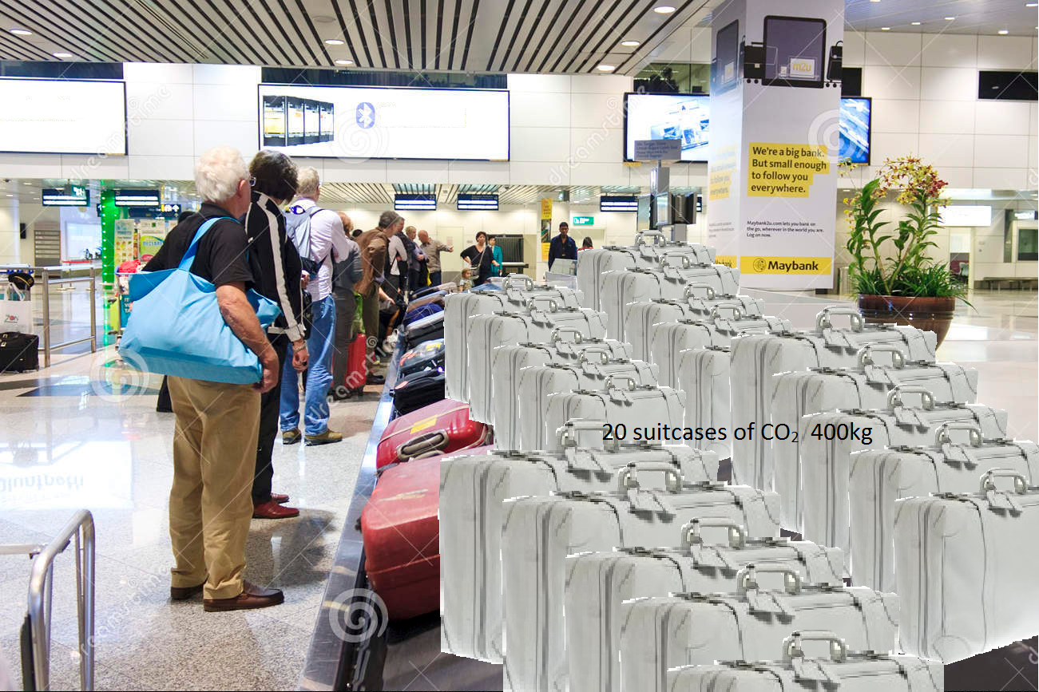
1kg fuel generates 3kg CO₂ (carbon + oxygen from air)

Slide 15
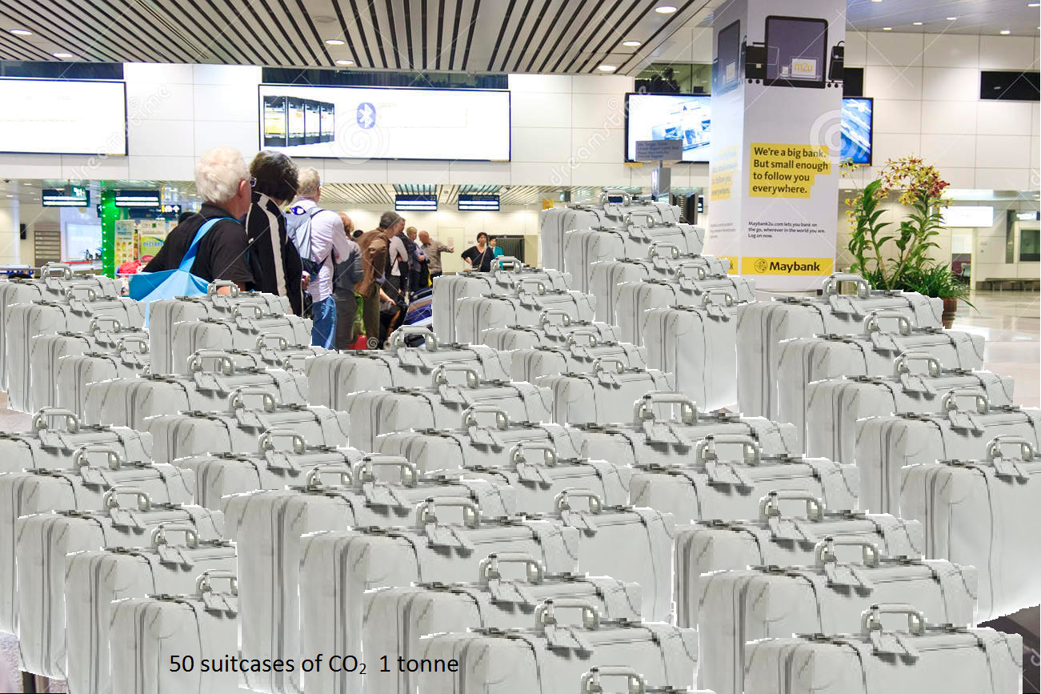
N_{suitcases} = 4 x 3 x 20 x 3600 / 350 / 20 = ???

Slide 16
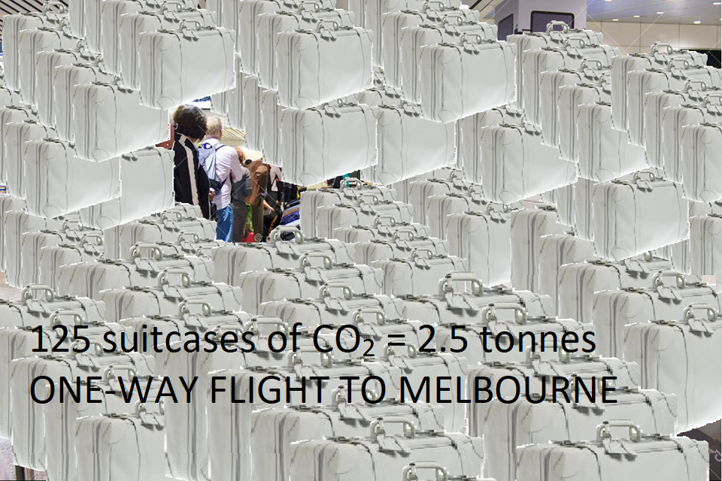
My share of CO₂ for a flight to Melbourne is 2.5 tonnes

Slide 17
OK – so what are our options ?

Slide 18
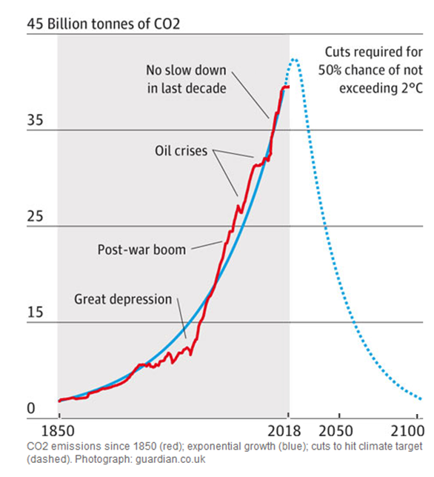
GEOENGINEERING – active control of climate
35 billion tonnes/year
World pop = 7billion
Global average
5 tonnes/person/yr
Industrial growth →
Return flight to Melbourne
5 tonnes/person
rule of thumb for
Air travel:
100kg CO₂ per hour of flying
Geoengineering ?? →
Net zero
by 2050 ?

Slide 19
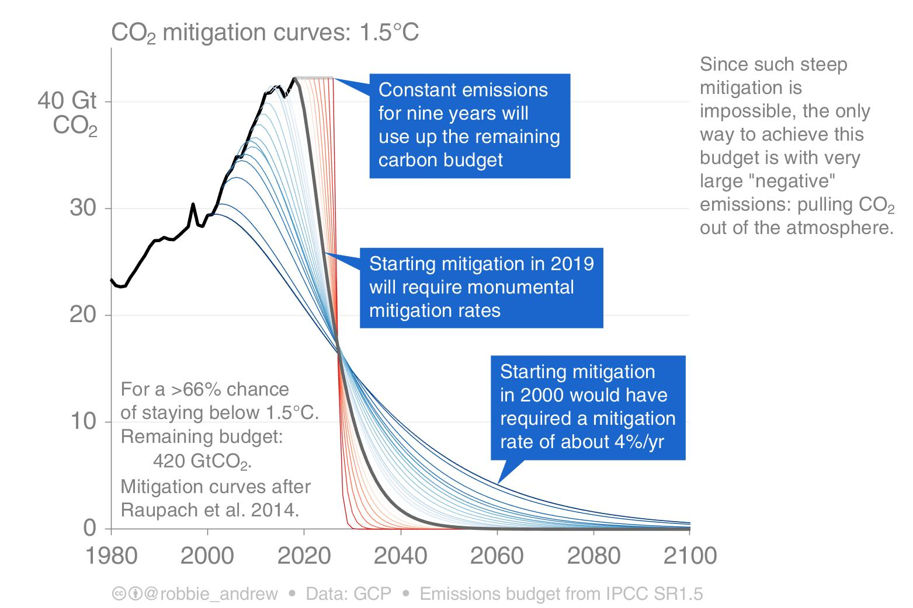
Steep mitigation is impossible.
Large-scale “Negative Emissions” required
ie suck CO2 out of the atmosphere.
NETs = Negative Emissions Technologies
CCS = Carbon Capture and Storage
BECCS = Biomass Energy with CCS
DAC = Direct Air Capture
But the SCALE required is eye-watering.

Slide 20
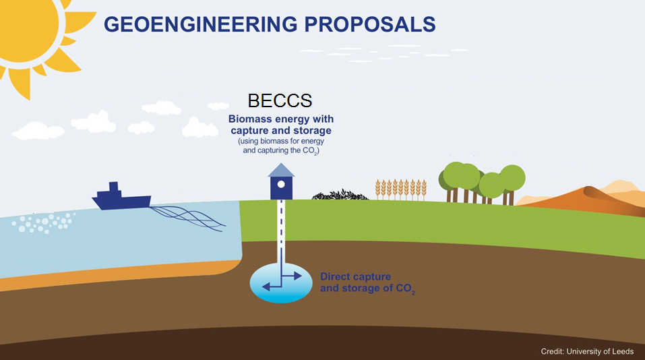

Implicit in Paris COP21 Agreement
Geoengineering:
BECCS = Bio-Energy with Carbon Capture and Storage
(NETs Negative Emissions Technologies)

Slide 21
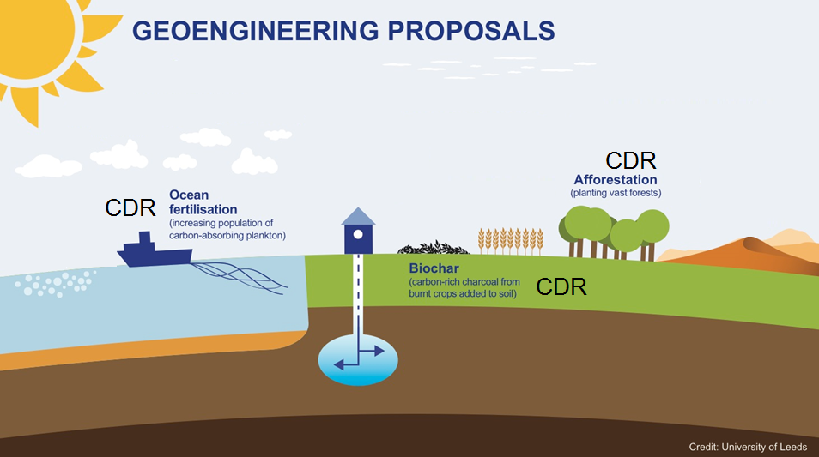
Geoengineering:
CDR = Carbon Dioxide Removal
BECCS = Bio-Energy with Carbon Capture and Storage

Slide 22
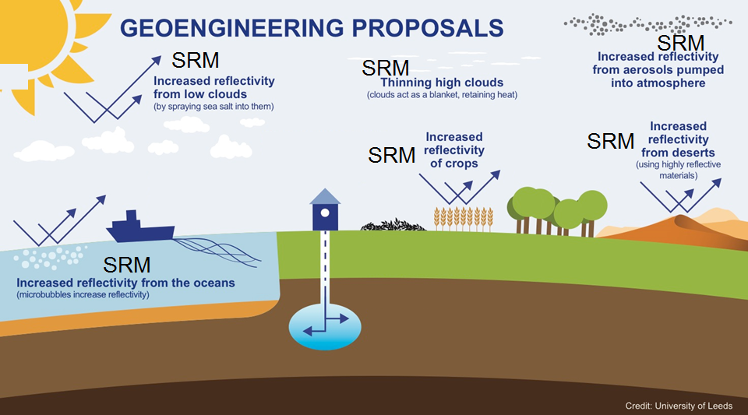
Geoengineering:
SRM = Solar Radiation Management
CDR = Carbon Dioxide Removal
BECCS = Bio-Energy with Carbon Capture and Storage

Slide 23
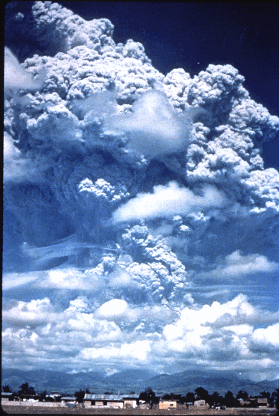
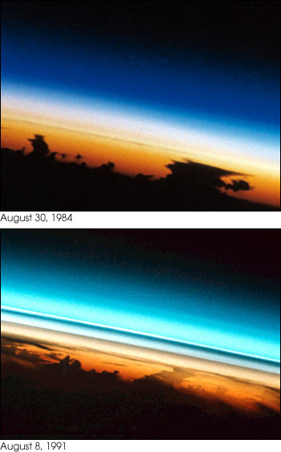

SRM – eruption of Mt Pinatubo, 1991

Slide 24
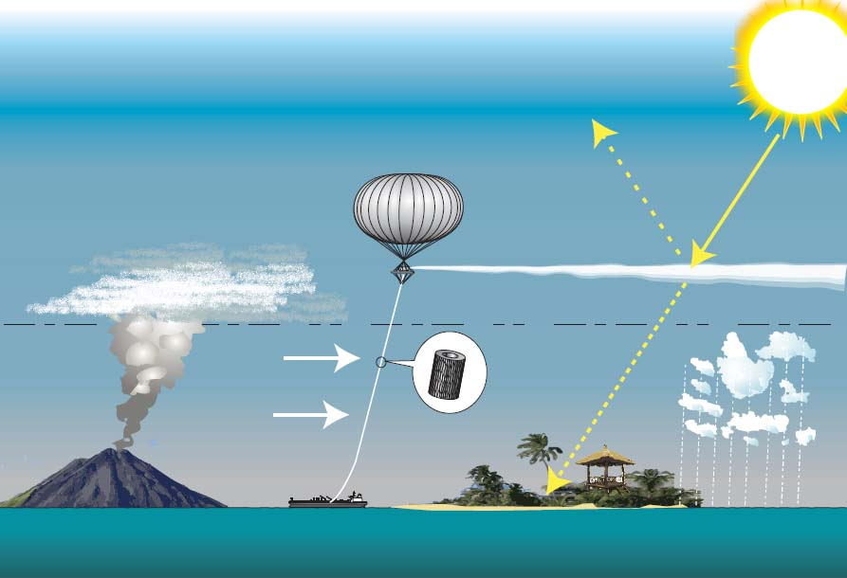
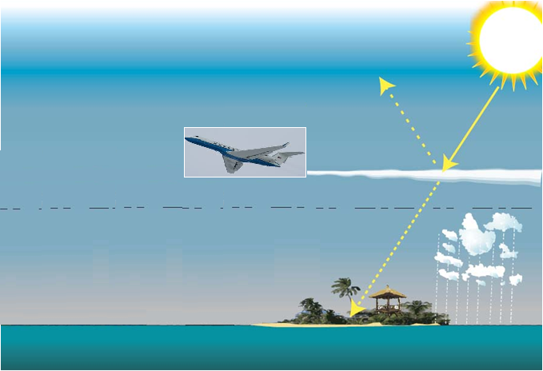
SPICE: aerosol delivery system for 2ºC cooling
Stratospheric Particle Injection for Climate Engineering
Tethered balloon – height 20km
maybe 10 balloons worldwide each delivering 30kg/s of aerosol
OPTIONS:
- Aircraft
- Airships
- Missiles
- Artillery
- Towers
- Tethered balloons
10m tonnes p.a. for 2 ºC cooling ? ? ?
20km optimum height ?
mid-latitude ?
Image: Peter Davidson Technologies

Slide 25
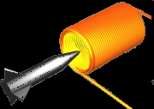
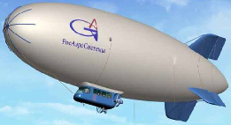
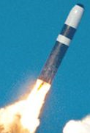
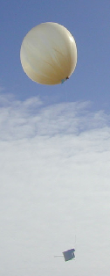
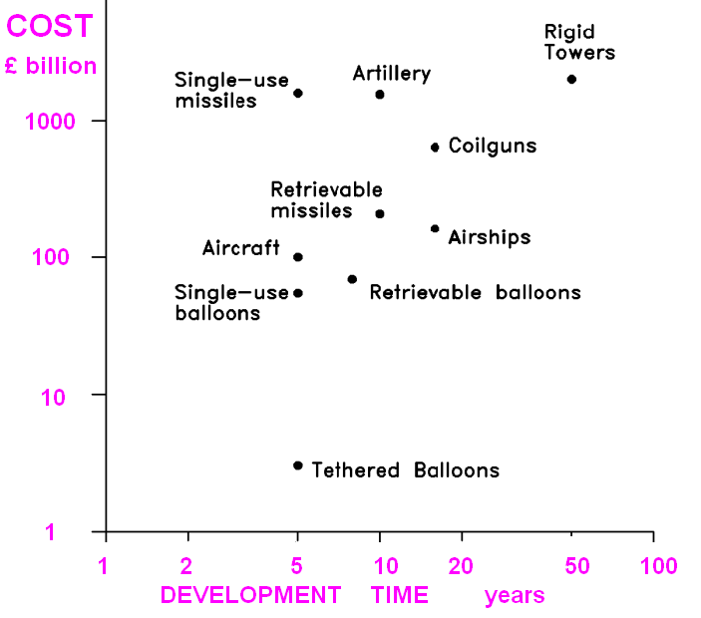
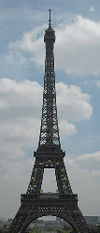
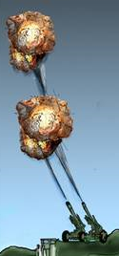
Particle delivery – costs & timescales
(target: 10 million tonnes per year )

Slide 26
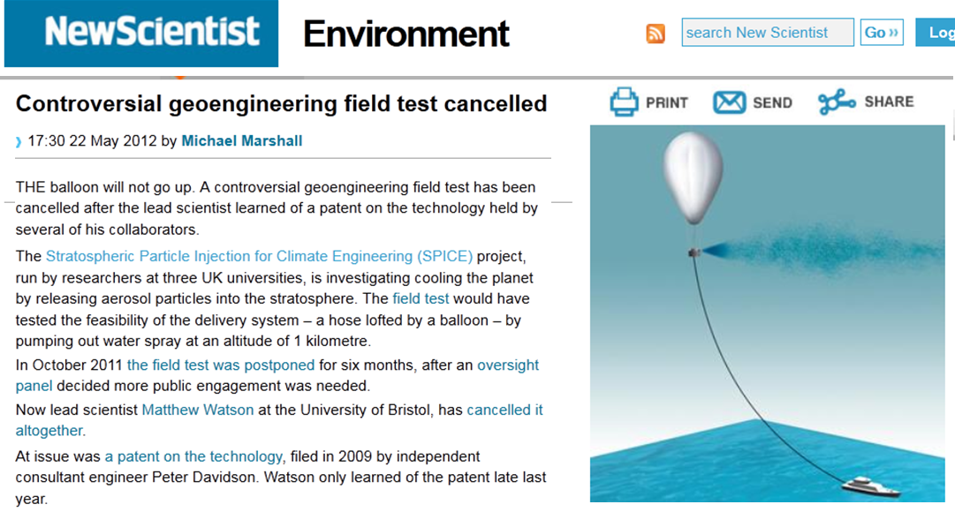
SPICE “cancelled” ? Controversial?

Slide 27
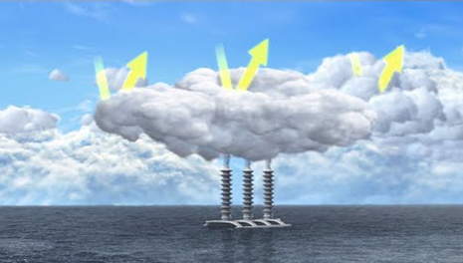
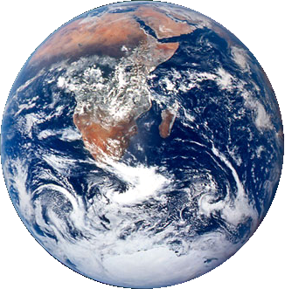
Other SRM: Marine-Cloud Brightening
Spray sea water into clouds to increase reflectivity

Slide 28
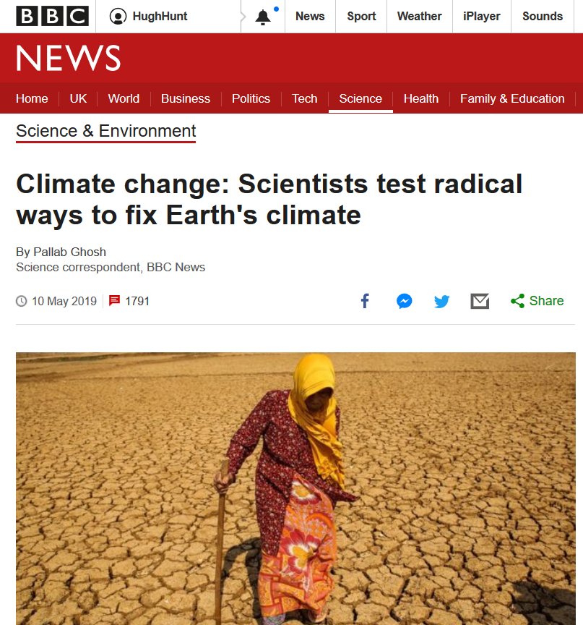
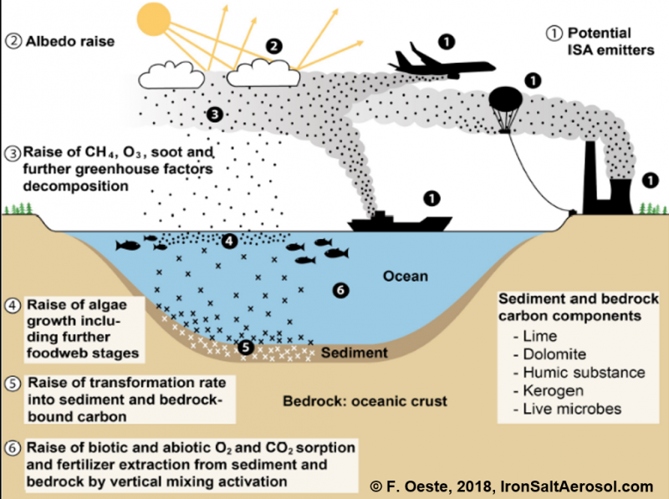
Centre for Climate Repair @ Cambridge (Sir David King)
Iron Salt Aerosol ISA

Slide 29
Is there a Plan B ?
Yes
(SPICE)
Yes
No
Maybe
Hmmm

Slide 30

Thank you!
hemh1@cam.ac.uk
www.hughhunt.com
@hughhunt
www.suggr.co.uk

