Slide 1
Sound and public health
Recent advances in the scientific evidence base
Current and future challenges and opportunities
Benjamin Fenech PhD MIOA
Environmental Hazards and Emergencies
Centre for Radiation, Chemical and Environmental Hazards
Public Health England

Slide 2
Sleep disturbance
Stress responses
Emotional responses
Sound
autonomous physiological reactions
Primary appraisal
Secondary appraisal
Coping
Authority
responsible
restoration
Healthy behaviours
Person / Situation / Environment
noise sensitivity, expectations, perceived control, perceived fairness, perceived threat, previous experience, time of day, …
chronic health outcomes
Model based on Lazarus’ transactional stress model (Lazarus and Folkman 1984; Lercher 1996), the link between stress and restoration (Ulrich et al. 1991; von Lindern et al. 2016) and the noise effects reaction scheme (Babisch 2014). Appraisal-coping figure from ANIMA D2.4 https://anima-project.eu/anima-deliverables/

Slide 3
Noise
…not just a nuisance
“…noise pollution is considered not only an environmental nuisance but also a threat to public health”
World Health Organisation (2011)

Slide 4
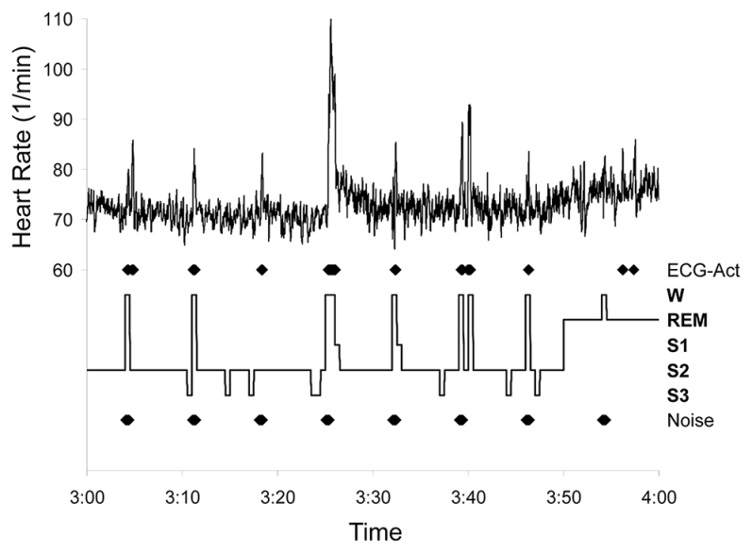
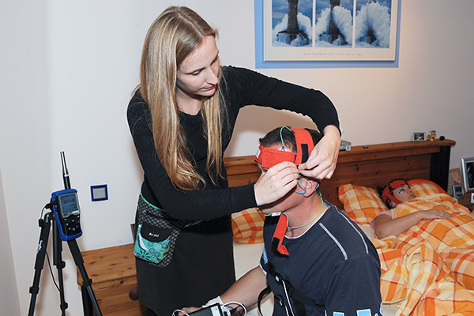
Sleep disturbance
http://www.laermstudie.de/aktuelles/news/
Muzet | Sleep Medicine Reviews (2007) 11, 135–142
Basner et al. | Noise Health 2012;14:321-9
McGuire et al. | SLEEP, Vol. 39, No. 5, 2016

Slide 5
Mechanisms
Münzel et al. | Annual Review of Public Helath 2020

Slide 6
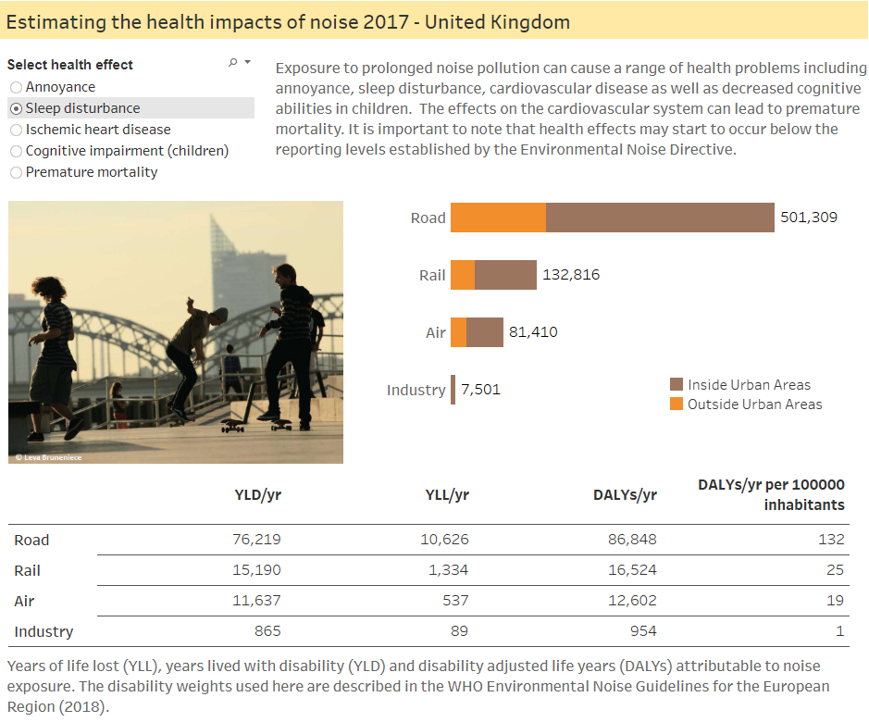
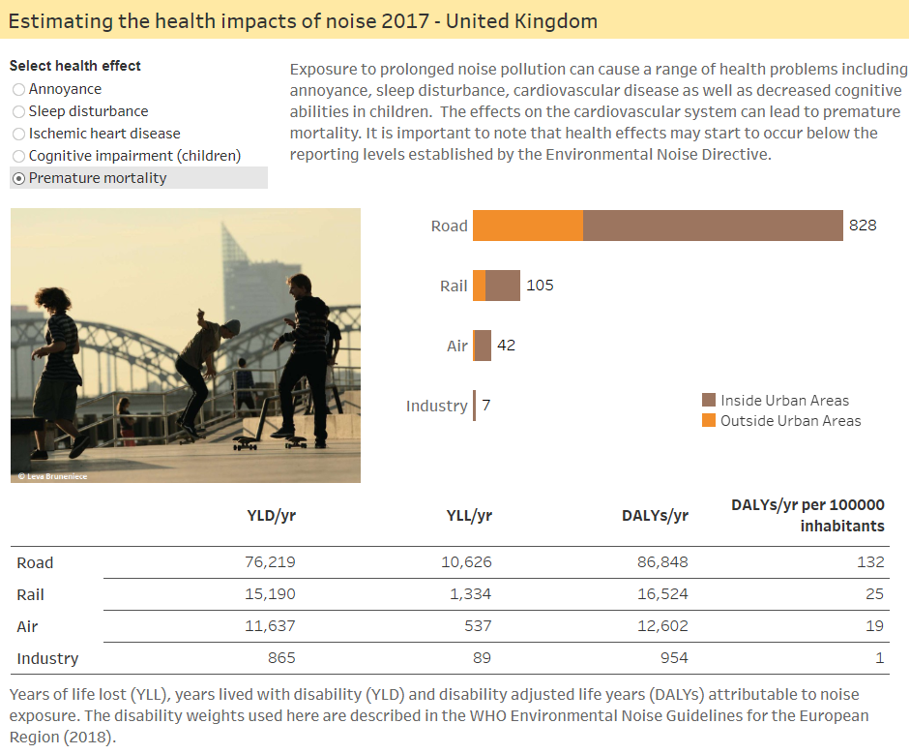
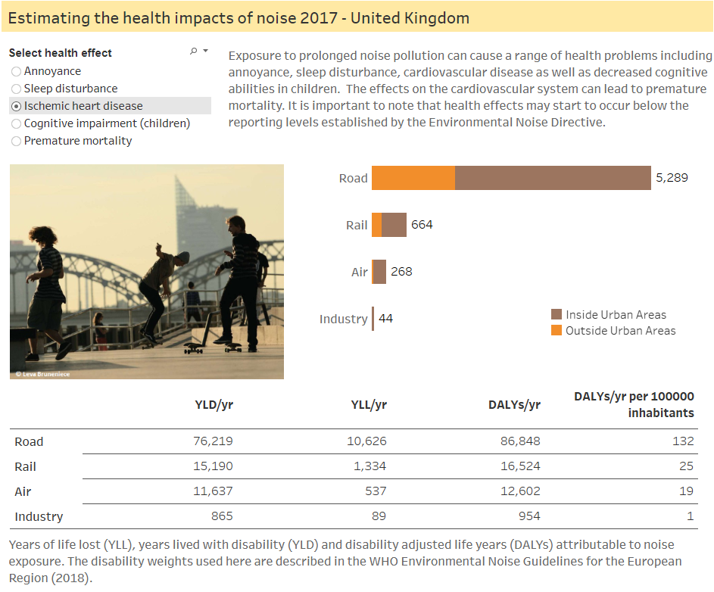
Health statistics
https://www.eea.europa.eu/themes/human/noise/noise-fact-sheets/noise-country-fact-sheets-2019/united-kingdom

Slide 7
UK contribution to body of evidence – long-term annoyance
Comparison of studies carried out in the UK vs rest of the world, based on number of participants
Only studies that met the inclusion criteria for the EU Position paper on annoyance (2002) and the annoyance systematic review for the WHO ENG 2018 are included.
Source:
Miedema and Oudshoorn | Environmental Health Perspectives 2001 109 (4)
Fields | NASA/CR-2001-211257
Guski et al. | Int. J. Environ. Res. Public Health 2017, 14, 1539
Guski et al. | Euronoise 2018

Slide 8
UK contribution to body of evidence – sleep disturbance
Comparison of studies carried out in the UK vs rest of the world, based on number of participants
Only studies that met the inclusion criteria for the EU working group position paper on night-time noise (2004) and the systematic review on sleep disturbance for the WHO ENG 2018 are included.
Source:
Miedema et al. | TNO Inro report 2002-59
Miedema & Vos | TNO Into report 2004-15
Basner & McGuire | Int. J. Environ. Res. Public Health 2018, 15, 519

Slide 9
Importance of local research
“…for noise annoyance, for which there is often considerable heterogeneity in effect sizes of studies because estimates …are to some degree dependent on the situation and context. Furthermore, cultural differences around what is considered annoying are significant, even within Europe. … data and exposure–response curves derived in a local context should be applied whenever possible …. If, however, local data are not available, general exposure–response relationships can be applied, assuming that the local annoyance follows the generalized average annoyance.”
WHO ENG2018 p.109
http://www.euro.who.int/en/health-topics/environment-and-health/noise/environmental-noise-guidelines-for-the-european-region

Slide 10
Housing
11% of UK population highly bothered, annoyed or disturbed by noise from neighbours and other people nearby
Noise levels from outside/neighbours and noise privacy consistently rank in top three most important aspects of a healthy home for occupants
Analysis of data from the British Household Panel Survey found that neighbour noise had the largest negative effect on both life satisfaction and happiness and was the second most important determinant of people’s desire to move house.

Slide 11
Sound insulation | Construction noise
Sound insulation requirements between dwellings largely based on social research carried out by BRS in 1940s and 50s, and by BRE in 1980s*.
(Façade) noise insulation regulations underpinned by evidence from pre-1975 (road), pre-1996 (rail)
Construction noise impact assessments still largely based on recommendations in the Wilson Report (1963)*, that noise:
    “should not exceed the level at which conversation in the nearest building would be too difficult with the windows shut”
    The report also recommended that construction noise outside 07:00-19:00 “should not be allowed to disturb people sleeping nearby”.
    No comprehensive evidence base on the effects of construction noise has been gathered since then (other than noise complaints)
*Source: R. Taylor. Defra Contract NO0234. Annexes 4, 6

Slide 12
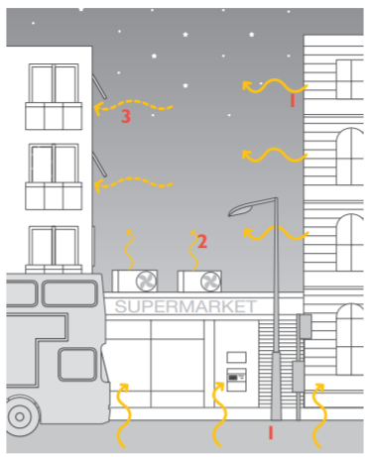

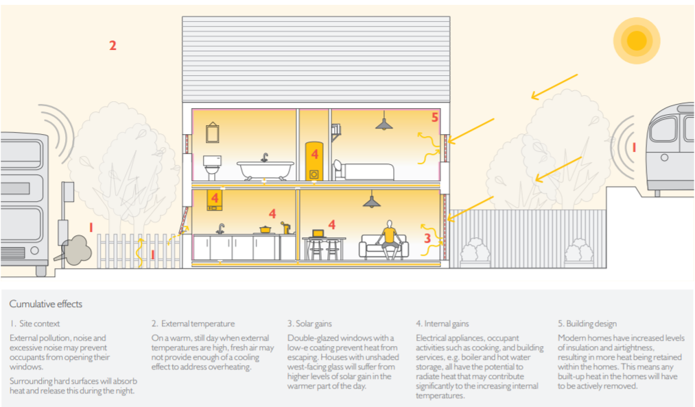



Indoor environment, climate change adaptation
adapted from NHBC Foundation NF44, 2012
https://www.association-of-noise-consultants.co.uk/acoustics-ventilation-and-overheating-guide/
NHBC Foundation NF44, 2012
“Of the applications reviewed, 122 out of the 160 applications had both noise and overheating assessments; in 85% of these the noise assessment assumed closed windows for reasonable noise conditions, while the overheating assessment assumed open windows to provide reasonable thermal conditions”
Conlan & Harvie-Clark | Proc. IoA 2018, 40 (1)

Slide 13
Sound
…an essential nutrient

Slide 14
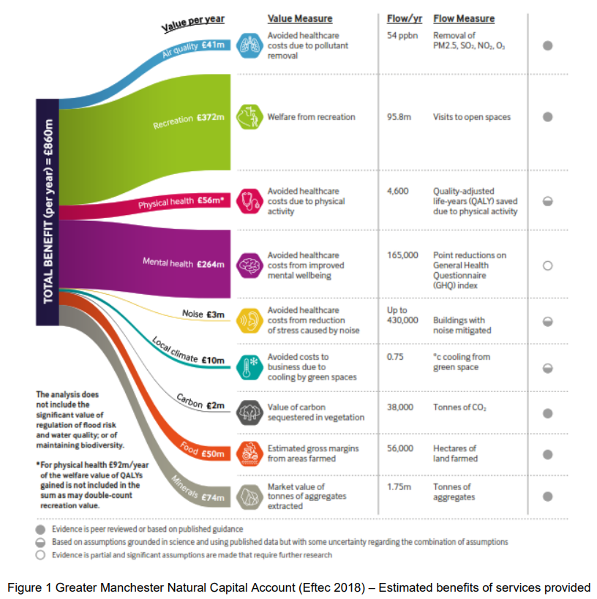
The social & economic case for sound
National Trust Spring 2020 front cover
https://www.greatermanchester-ca.gov.uk/media/1744/natural-environment-topic-paper-w-cover-web.pdf

Slide 15
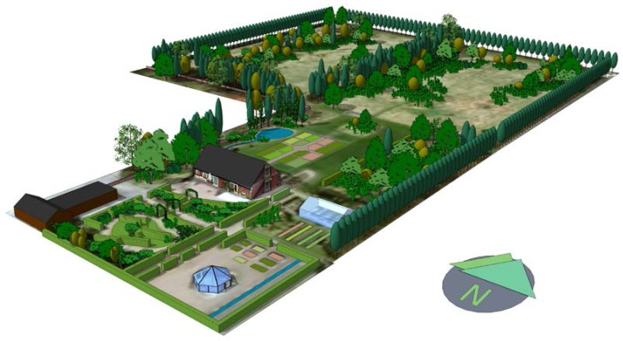
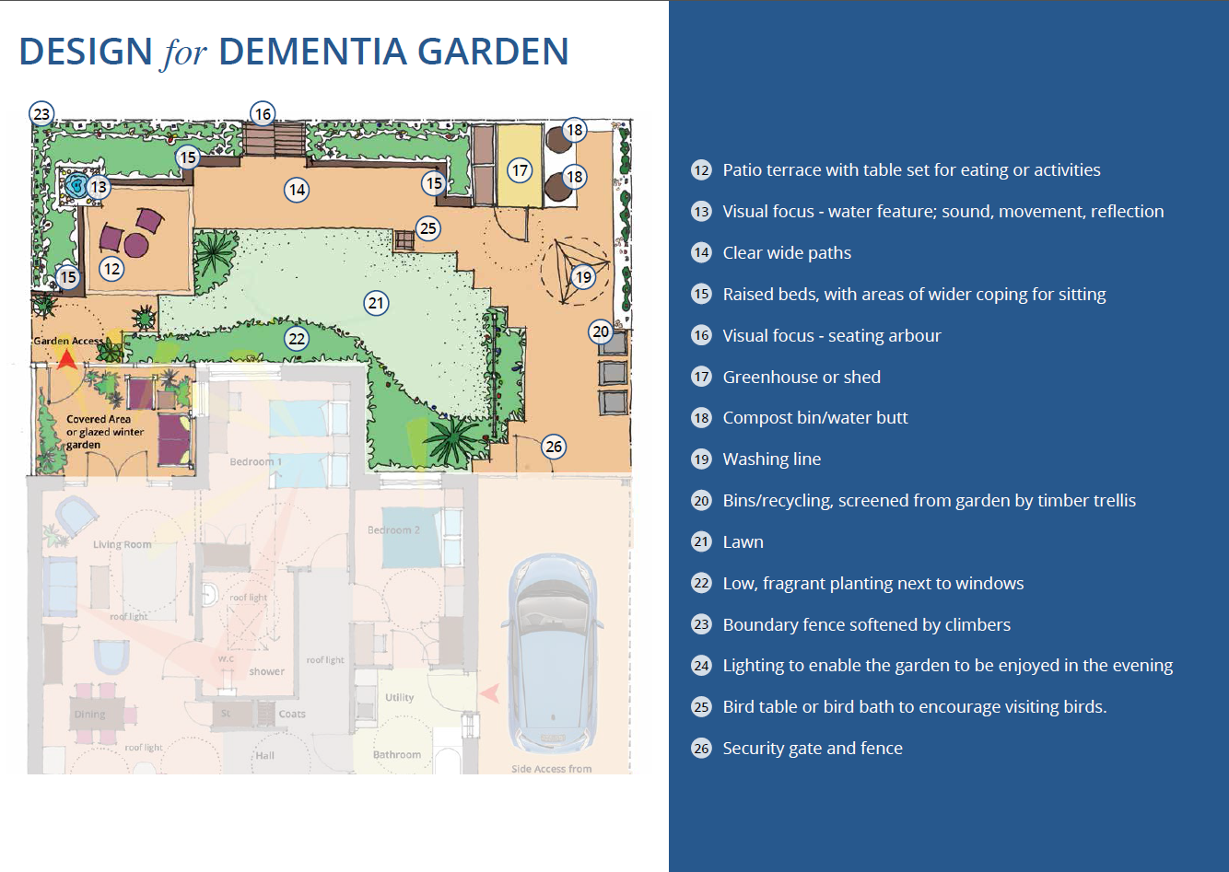
Heath-enhancing sound environments
Int J Environ Res Public Health. 2016 Dec; 13(12): 1229.
http://www.hlpdesign.com/our-publications/design-for-dementia

