Slide 1
Tackling Covid-19: Statistics in action
Sylvia Richardson MRC Biostatistics Unit (BSU) University of Cambridge

Slide 2
Little was known about the infection by Covid-19 in early February 2020 besides high infectivity, possibility of pre-symptomatic transmission and likely high disease burden
Many unanswered questions ranging from basic science to population burden
Progress achieved by melding scientific questions, data collection and analytical approaches

Slide 3
MRC Biostatistics Unit (BSU) COVID-19 Working Group
Spectrum of BSU methodological work on Covid-19
I- Immune response to Covid-19 infection
II Designing adaptive randomised trials to evaluate treatment
III Clinical and Resource Management
IV- Severity Burden
V-Nowcasting and Forecasting
Common threads to effective engagement
an established network of collaborators
a detailed understanding and critical appraisal of the data collection
a principled statistical analysis, accounting for data collection, and tailored to the questions investigated.

Slide 4
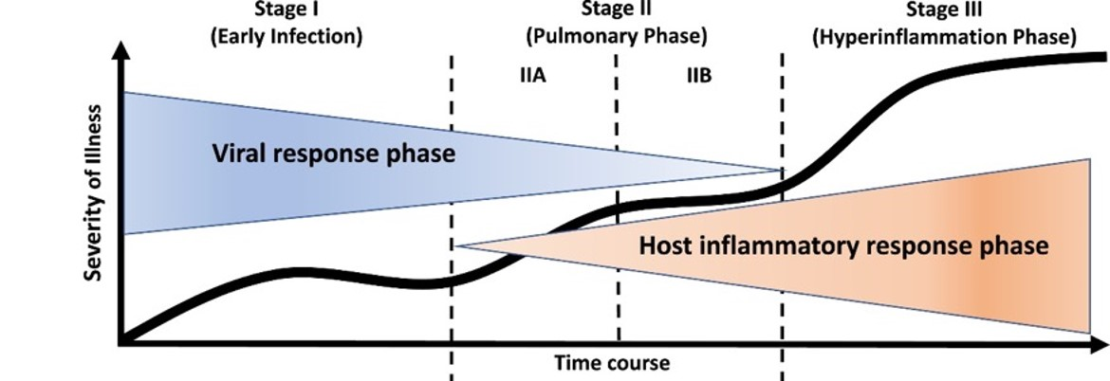
I Understanding immune response to Covid-19 infection
Aim is to understand the different phases of the immune and inflammatory response to Covid-19 to guide treatment development
Collaborative project with K Smith PI, NIHR Bioresources and CUH
anti-viral therapies
anti-inflammatory therapies

Slide 5
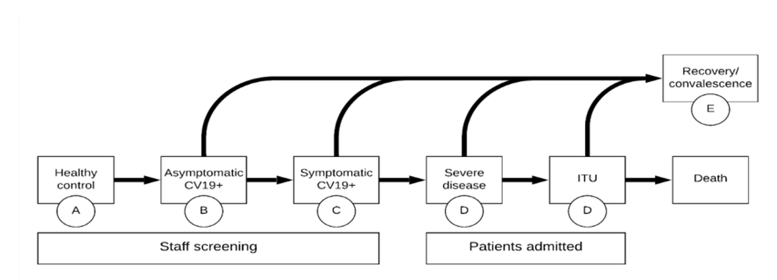
Study contrasts healthy controls, asymptomatics, mild and severe cases
> 220 patients recruited
Extensive set of biomarkers will be analysed

Slide 6
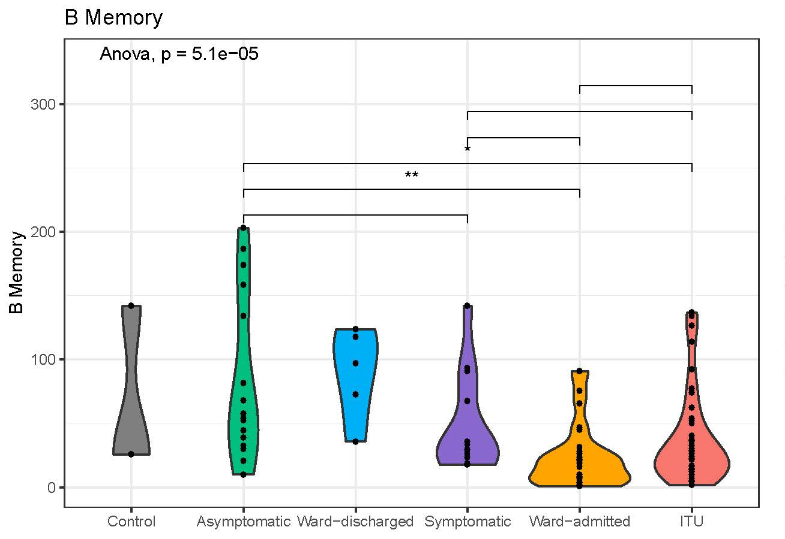
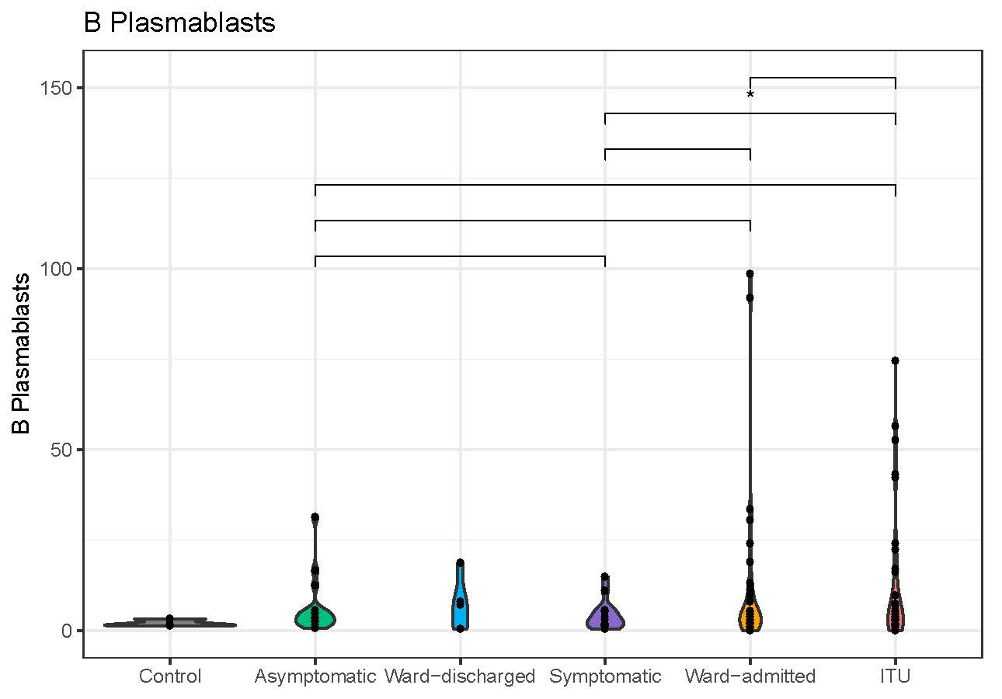
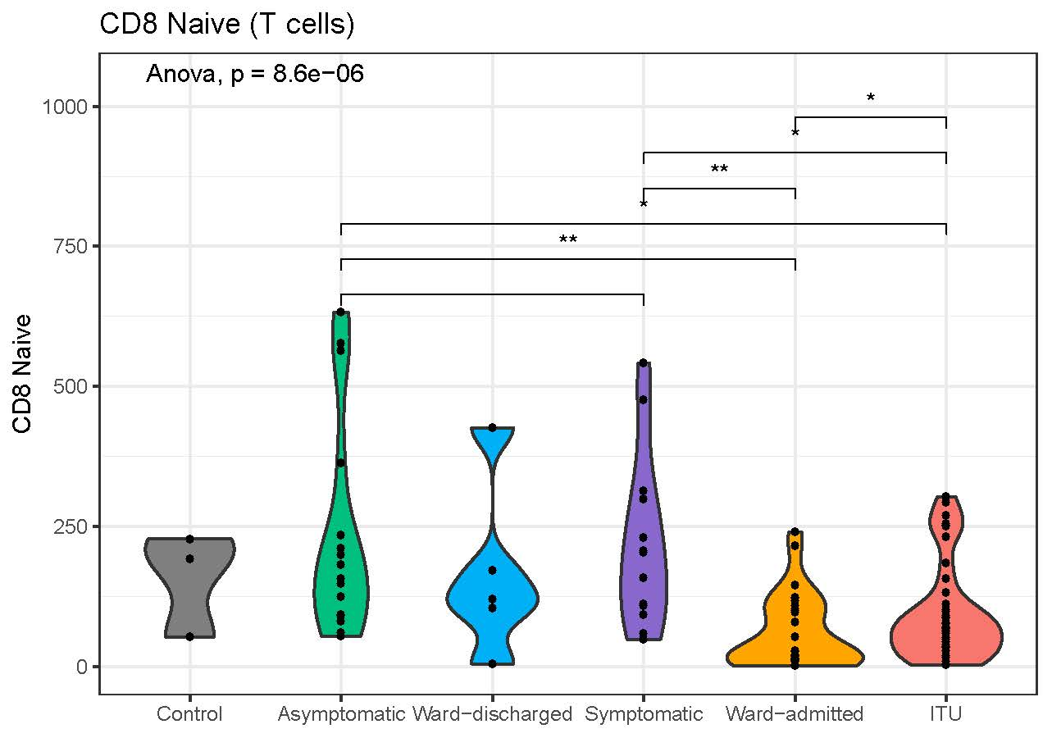
Study contrasts healthy controls, asymptomatics, mild and severe cases
> 220 patients recruited
Impact of Covid-19
infection on subpopulation
of immune cells in severe patients

Slide 7
Study contrasts healthy controls, asymptomatics, mild and severe cases
> 220 patients recruited
Impact of Covid-19
infection on subpopulation
of immune cells in severe patients
Multidimensional statistical analysis to characterise subgroups of patients with similar immune response
BSU lead Richardson
Protocol includes
extensive set of
immuno-phenotype
biomarkers

Slide 8
II Designing adaptive trials
In early 2020, there was no approved treatment for Covid-19
WHO and UK NERVTAG advised
that several potential treatments should be evaluated urgently
that other treatments will emerge
→ Randomised Clinical Trial (RCT) with multiple arms and flexible design
BSU methodological research on RCT has been focussed on adaptive designs
coordination of the working group on adaptive designs of the MRC-NIHR Trials Methodology Research Partnership

Slide 9
II Designing adaptive trials
In early 2020, there was no approved treatment for Covid-19
WHO and UK NERVTAG advised
that several potential treatments should be evaluated urgently
that other treatments will emerge
→ Randomised Clinical Trial (RCT) with multiple arms and flexible design
BSU methodological research on RCT has been focussed on adaptive designs
Adaptive designs: State of the art framework to efficiently evaluate novel treatments while ensuring that the integrity and validity of results is maintained
Key features: several arms compared to common control, treatments can be changed or stopped at interim analyses, dose-finding

Slide 10
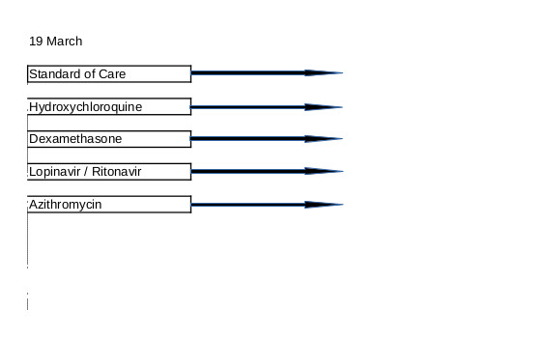
RECOVERY trial
175 NHS hospitals
BSU Lead Thomas Jaki
Co-Investigator and Member of Steering Group
Almost 1000 patients from 132 hospitals recruited in the first 15 days

Slide 11
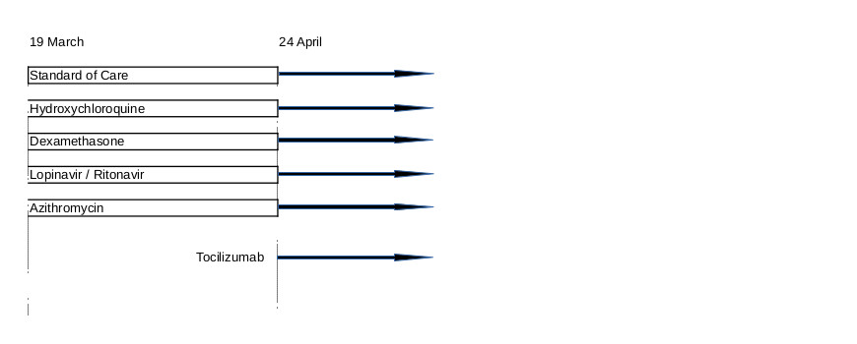
RECOVERY trial
175 NHS hospitals
BSU Lead Thomas Jaki
Co-Investigator and Member of Steering Group

Slide 12
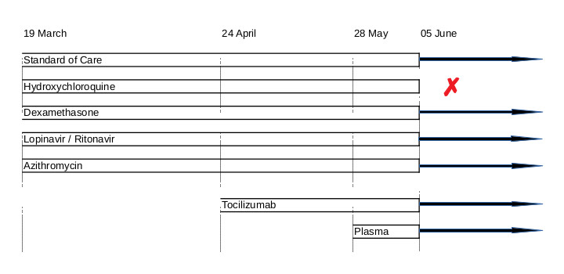
RECOVERY trial
175 NHS hospitals
> 11,000 patients recruited
BSU Lead Thomas Jaki
Co-Investigator and Member of Steering Group
1542 patients randomised to
hydroxychloriquine
3132 patients randomised to usual care
25.7% vs 23.5%, RR 1.11 [0.98-1.26] p=0.1 for 28 days mortality endpoint.

Slide 13
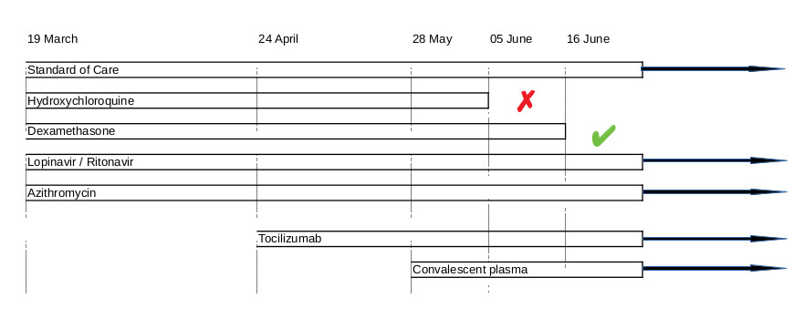
BSU Lead Thomas Jaki
Co-Investigator and Member of Steering Group
175 NHS hospitals
> 11,500 patients recruited
2104 patients randomised to dexamethasone
4321 patients randomised to usual care
RR 0.65 [0.48-0.88] p=0.0003 for 28 days mortality endpoint in ventilated patients.
RECOVERY trial

Slide 14
175 NHS hospitals
BSU Lead Thomas Jaki
Co-Investigator and Member of Steering Group
Evaluation of treatments at pace has been enabled
Integrity and validity of results has been maintained
Unpinning methodological research on adaptive designs was key
RECOVERY trial

Slide 15
III ICU Resource and Clinical Management
Covid-19 places a huge burden on health care resources, in particular on Intensive Care Units (ICU)
Knowing how to target care to patients in most need is important
Involvement in HDRUK- Alan Turing Institute DECOVID project with a BSU led team (Goudie)
The COVID-19 study of Electronic Care Records (BSU Lead Goudie) was initiated 10th March at Addenbrooke’s hospital
Focus on detailed follow up of ICU patients, e.g. ventilatory settings
The raw dataset involves more than 1 million rows of vital signs and time stamped ventilation data !
Start
10th March
Protocol
20th March
HRA approval
3rd April
Initial data extract
10rd April
Data in safe haven
4th June

Slide 16
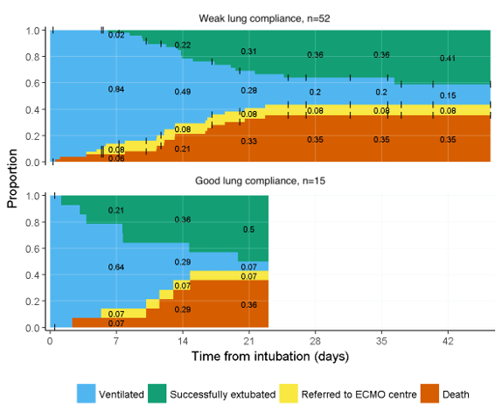
Ventilated Covid-19 patient trajectories
Question: Does compliance of the lung in the first 24 hours discriminates clinical trajectories of ventilated Covid-19 patients?
Data: 77 ventilated patients at Addenbrookes classified into 2 compliance groups (52 weak/15 good)
Results:
more than 2 weeks of ventilation was required by 49% of patients in one group vs 29% in the other group.
Surprisingly mortality at 21 days between the two groups is very similar (33% vs 36%).
Next project: identify in-hospital markers of COVID-19 severity
Competing-risks analysis of outcomes for COVID-19 patients using Epic EHR data

Slide 17
IV Evaluating severity
Aim is to quantify severity & characterise the disease course
Transitions and length of stay
Discharged
Recovered
Asymptomatic
Hospitalised
after ICU
Infected
Symptomatic
Hospitalised
ICU
Death

Slide 18
IV Evaluating severity
Aim is to quantify severity & characterise the disease course
Transitions and length of stay
Discharged
Recovered
Asymptomatic
Hospitalised
after ICU
Infected
Symptomatic
Hospitalised
ICU
BSU lead investigators
De Angelis Presanis Tom
Death
Analysis of hospital records

Slide 19
Imperfect observational data to quantity severity
Most information on covid-19 disease course for hospitalised patients comes from observational data collected for other purposes (e.g. audit, hospital management)
CHESS (COVID-19 Hospitalisation in England Surveillance System) with a subgroup of sentinel hospitals (acute trusts)
CO-CIN (Covid-19 Clinical Information Network)
As these data sources are not purpose built, important to consider issues related to inconsistencies, missing data, censoring, population selection and their impact on interpretation

Slide 20
Imperfect observational data to quantity severity
Discharged
Hospitalised
after ICU
Most information on covid-19 disease course for hospitalised patients comes from observational data collected for other purposes (e.g. audit, hospital management)
CHESS (COVID-19 Hospitalisation in England Surveillance System) with a subgroup of sentinel hospitals (acute trusts)
CO-CIN (Covid-19 Clinical Information Network)
As these data sources are not purpose built, important to consider issues related to inconsistencies, missing data, censoring, population selection and their impact on interpretation
Hospitalised
ICU
Death

Slide 21
Raw data exhibit inconsistencies !
Imperfect observational data to quantity severity
Most information on covid-19 disease course for hospitalised patients comes from observational data collected for other purposes (e.g. audit, hospital management)
CHESS (COVID-19 Hospitalisation in England Surveillance System) with a subgroup of sentinel hospitals (acute trusts)
CO-CIN (Covid-19 Clinical Information Network)
As these data sources are not purpose built, important to consider issues related to inconsistencies, missing data, censoring, population selection and their impact on interpretation
For the CO-CIN data set
(47370 confirmed cases)
we found approximately 11%
Inconsistent records

Slide 22
Imperfect observational data to quantity severity
Age distribution of hospitalised patients
differs between CHESS and CO-CIN
Most information on covid-19 disease course for hospitalised patients comes from observational data collected for other purposes (e.g. audit, hospital management)
CHESS (COVID-19 Hospitalisation in England Surveillance System) with a subgroup of sentinel hospitals (acute trusts)
CO-CIN (Covid-19 Clinical Information Network)
As these data sources are not purpose built, important to consider issues related to inconsistencies, missing data, censoring, population selection and their impact on interpretation

Slide 23
Case-severity probabilities across different datasets
Discharged
Hospitalised
after ICU
Hospitalised
ICU
Death
CHESS dataset - all acute trusts
CHESS dataset - only sentinel trusts
COCIN dataset - participating hospitals
Transition probabilities from admission to hospital

Slide 24
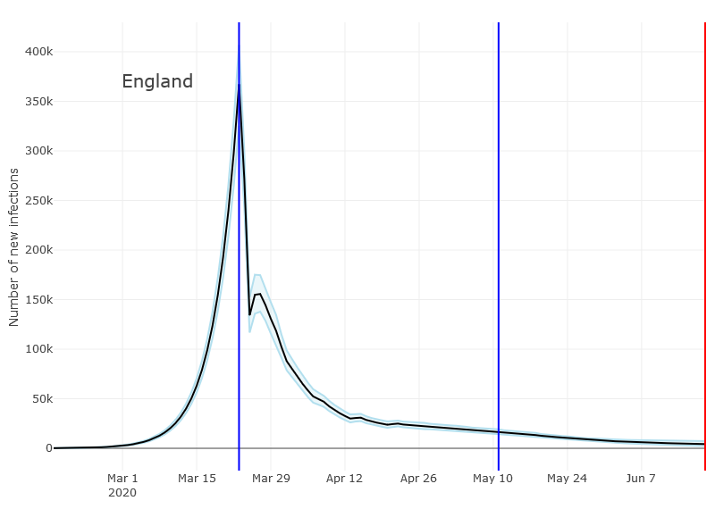
V Nowcasting and Forecasting
BSU-PHE lead De Angelis
Aim: Real time nowcasting and forecasting the burden of Covid-19 and tracking the effect of control policies
Covid-19 forecasts started early March 2020, building on a well-established model of flu epidemic by BSU-PHE
One key input to the model is the current number of deaths from Covid-19, which need to be estimated because of reporting delays
Modelling, Nowcasting and Forecasting will be presented in details in Daniela De Angelis’s talk

Slide 25
The role of statistics
Producing evidence from data and quantifying uncertainty are key inputs for policy decisions
Availability and quality of data are of paramount importance
Huge mobilisation of the scientific community on Covid-19: statisticians are involved in the whole spectrum of projects
Exploiting/repurposing routine data collection is useful but observational data has its limitations and needs careful analysis
The importance of being nimble in setting up well designed and well conducted studies as fast as possible cannot be understated
Preparedness for the future includes
comprehensive, well designed and aligned data streams for surveillance,
methods to triangulate evidence in the context of surveillance,
evaluation of operational systems and policies.

Slide 26
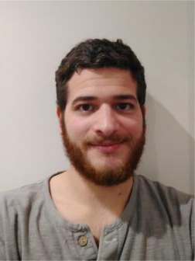
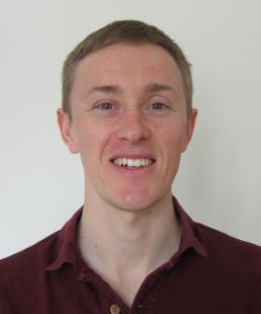
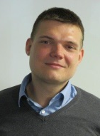
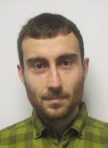
BSU COVID-19 Working Group and network
Daniela
De Angelis
Thomas Jaki
Sylvia Richardson
Brian Tom
Joshua Blake
Paul Birrell
Robert Goudie
Chris Jackson
Peter Kirwan
Kevin Kunzmann
Anne Presanis
Pantelis Samartsidis
Shaun Seaman
Helene Ruffieux
Martin Wiegand

