Slide 1
Data and information:
pathology as a model system
Professor Jo Martin
The Royal College of Pathologists
Queen Mary University London
@JoMartin_path

Slide 2
Why it matters to you...
The big data
The big secrets
The big future

Slide 4
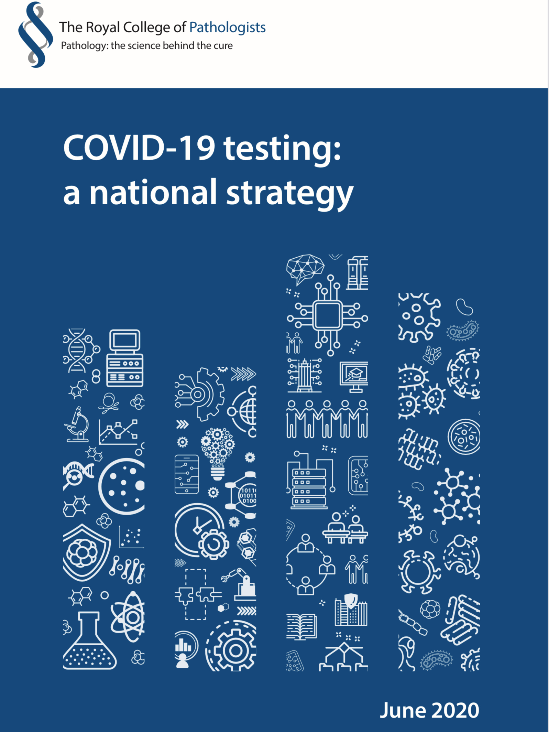
“Testing is not something that is just done and counted.
It is a process with clinical purposes for individual patients, for those who care for them and for the population at large.
It is a conscious and targeted use of valuable materials and skilled professionals within the context of a pathway and purpose.”

Slide 6
Why it matters to you...
The big data
The big secrets
The big future

Slide 7
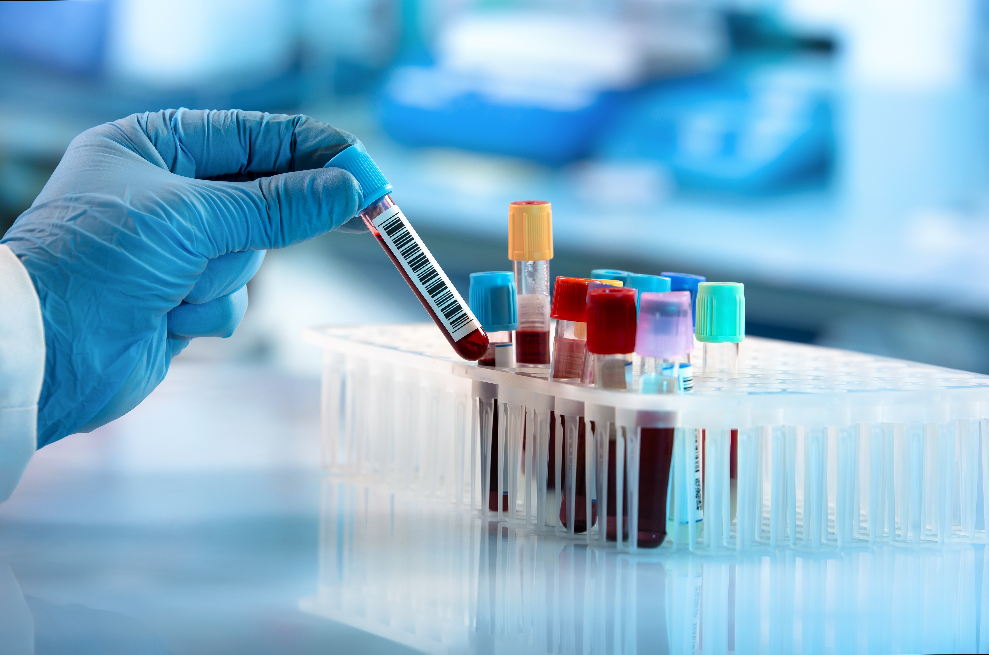
15 tests per person annually
630m blood sciences
26m tests a year in large trusts
1 billion+ tests per year
£2.2 billion

Slide 8
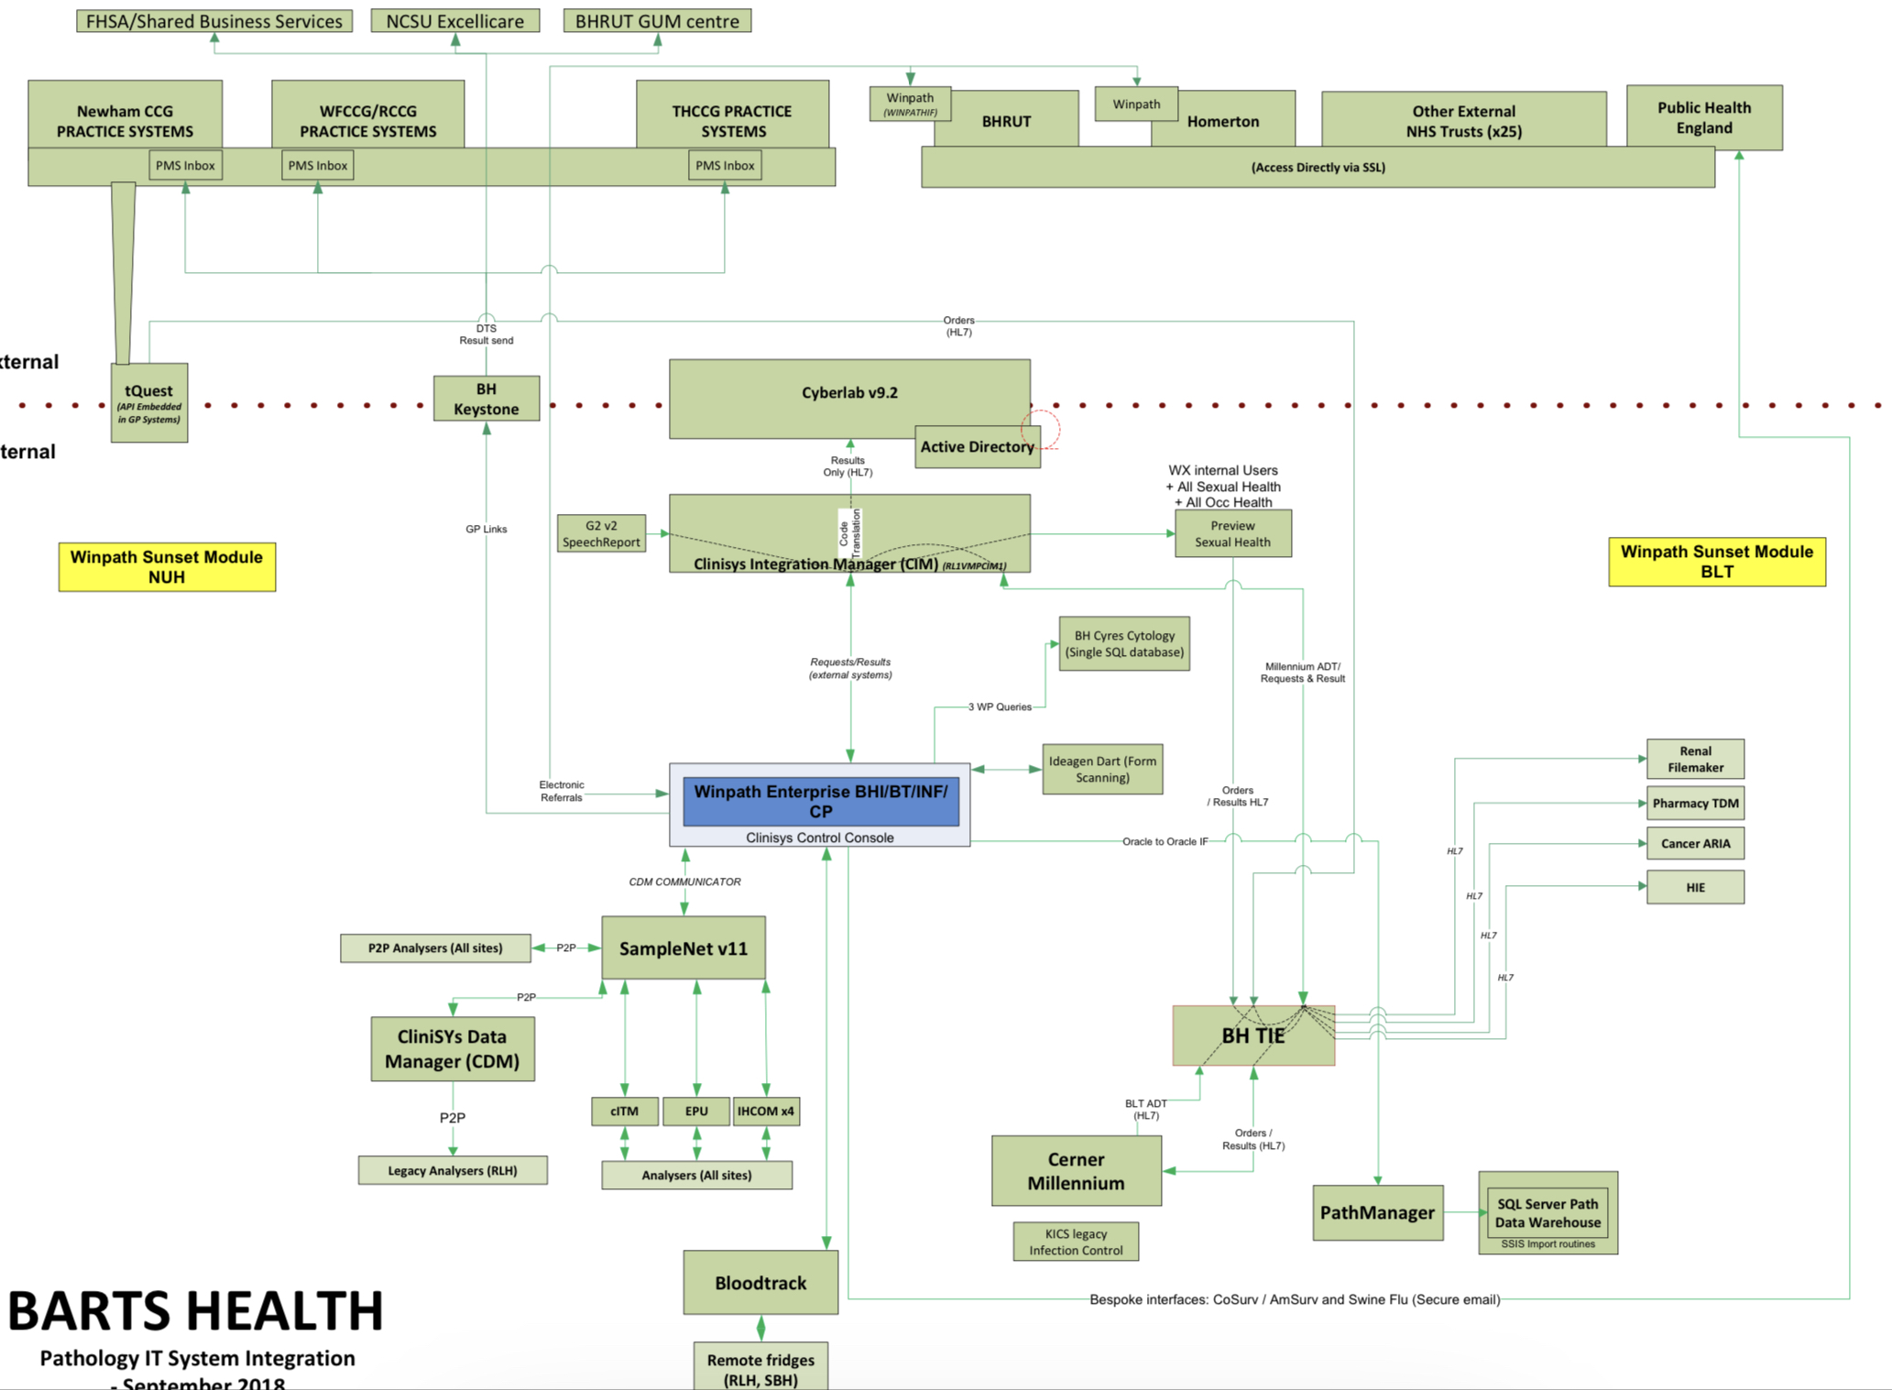

Slide 9
Why it matters to you...
The big data
The big secrets
The big future

Slide 10
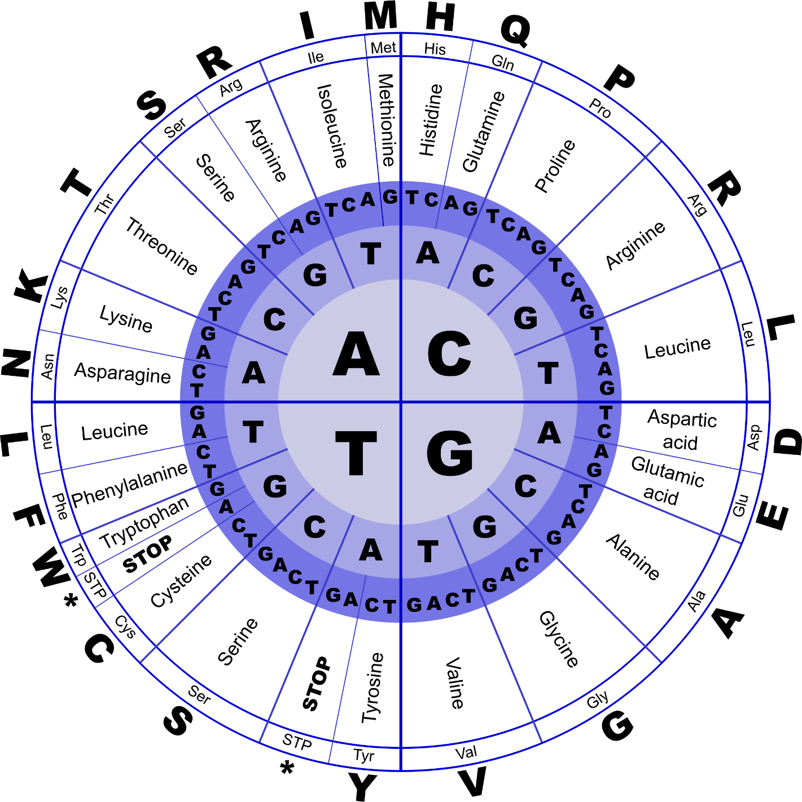
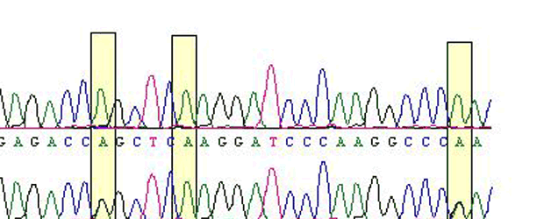

Slide 13
MDTs
Audit
User
feedback
Peer
review
Guidelines
Quality
Standards
Proficiency
test EQA
Training
Surveillance
Accreditation
Workforce
development
Performance
Indicators
Oversight

Slide 14
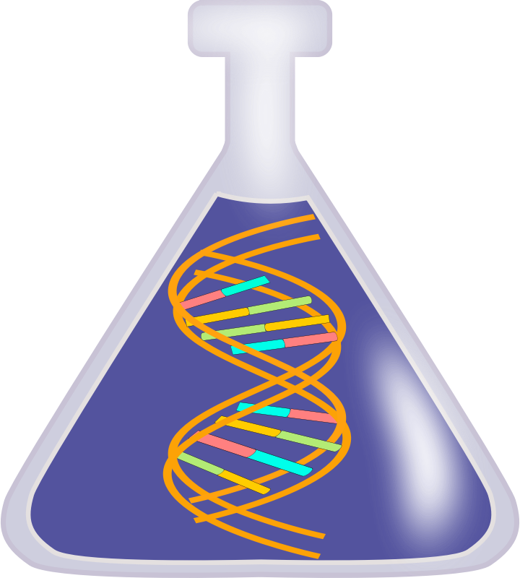
Sample from the right patient?
Accuracy of data in database?
Contaminated sample?
Could this be a mosaic?
Analysis from a database relevant to that patient?
Could the lab have mixed up the samples?
Is there confirmatory data from other tests or supporting information?
Is the technical processing of the sample reliable?
Is the base calling software consistent and reliable?
Would that result be reproducible in another centre?

Slide 15
Why it matters to you...
The big data
The big secrets
The big future

Slide 17
