Slide 1





Raising awareness of corrosion
Prof. Gareth Hinds FREng FIMMM FICorr FNACE
Senior NPL Fellow, Electrochemistry
National Physical Laboratory
President, World Corrosion Organization
Vice President, European Federation of Corrosion
Past President, Institute of Corrosion
Tuesday 15th October 2024

Slide 2
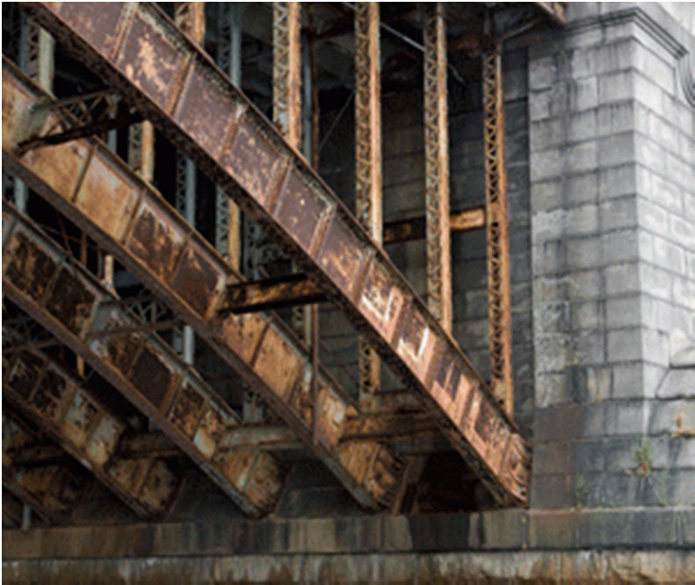
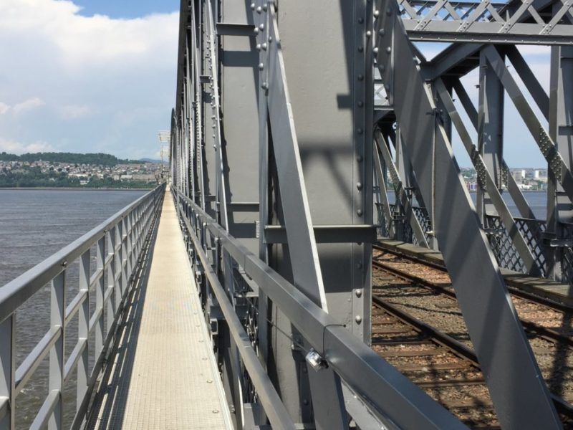
UK Cost of Corrosion
Parliamentary & Scientific Committee APPG
£80bn per year
Up to 35% of these costs could be saved by application of existing corrosion control practices
Saving £28bn per year
Tuesday 15th October 2024

Slide 3


WCO Mission & Objectives
Parliamentary & Scientific Committee APPG
To promote education and best practices in corrosion control for the socio-economic benefit of society, preservation of resources, and protection of the environment
To communicate how the United Nations Sustainable Development Goals can be advanced through best practice in corrosion protection
To enhance public awareness of the importance of corrosion control via the annual World Corrosion Awareness Day (April 24) and other activities
To facilitate influencing of policy makers with respect to consideration of sustainable use of materials in a circular economy
Tuesday 15th October 2024

Slide 4

United Nations Sustainable Development Goals
Parliamentary & Scientific Committee APPG
Tuesday 15th October 2024

Slide 5
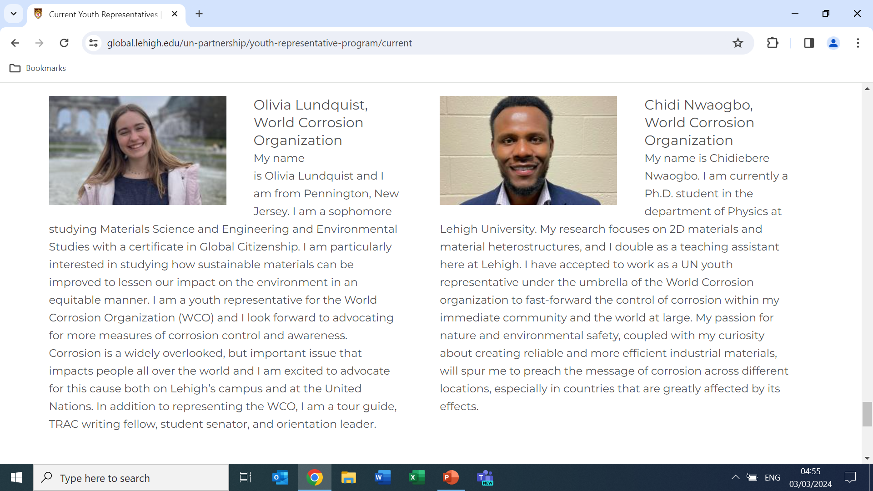

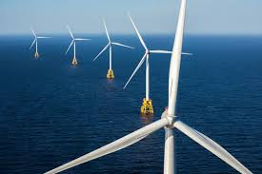



WCO focus areas
Parliamentary & Scientific Committee APPG
Low carbon energy technologies
Empowering young people
Raising awareness of corrosion globally
Supporting developing countries
Tuesday 15th October 2024

Slide 6
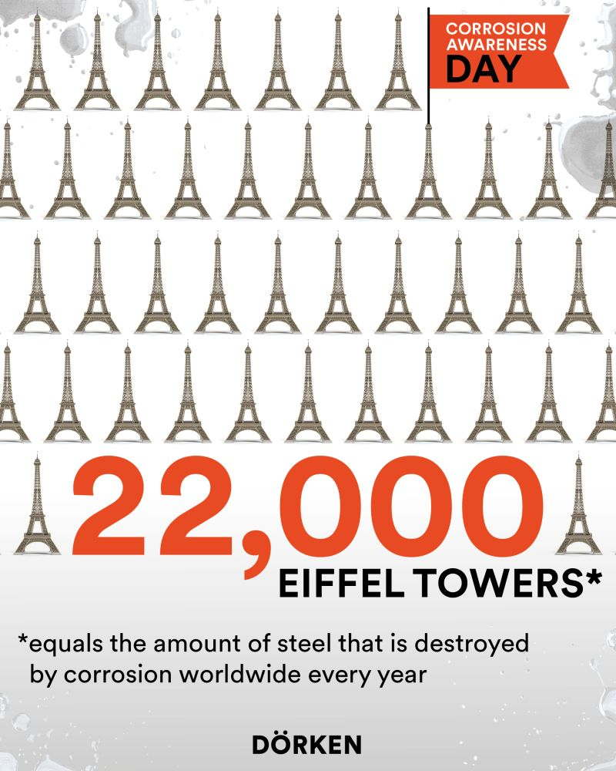
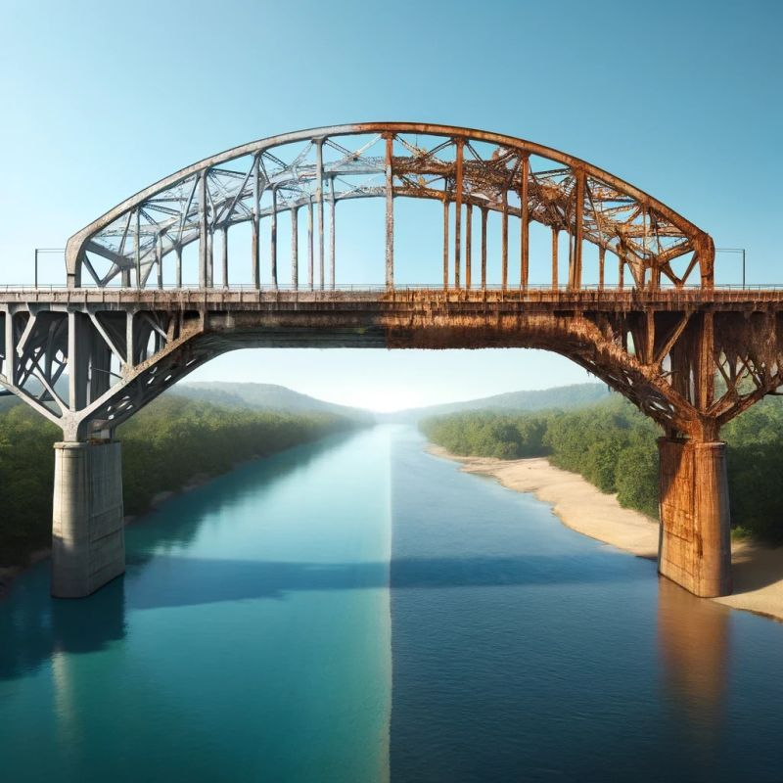
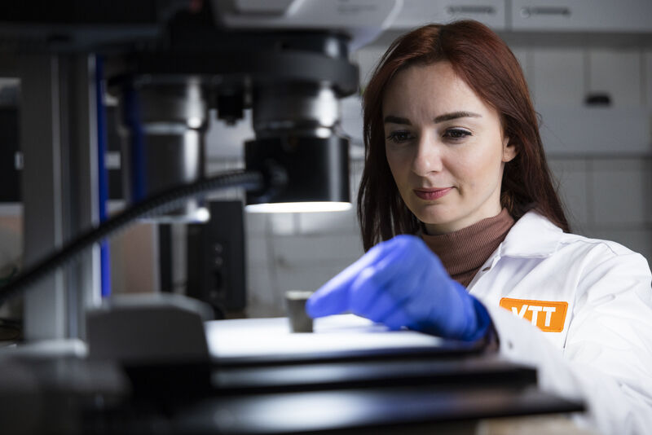
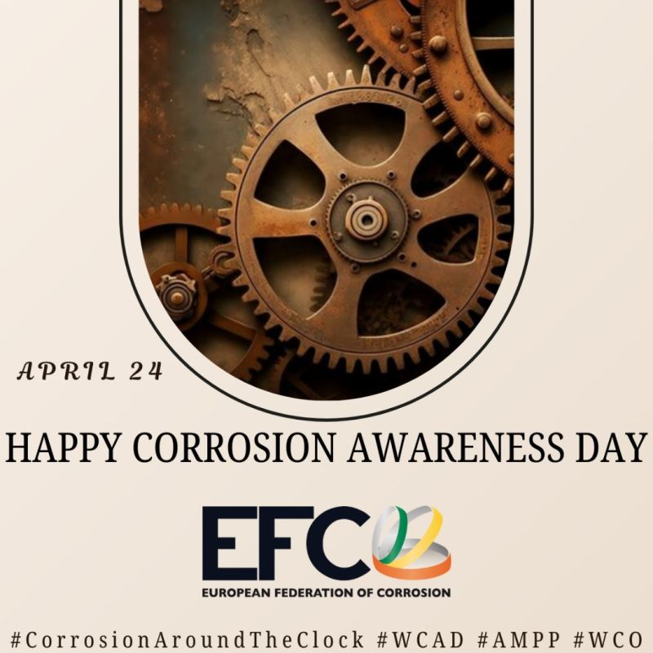
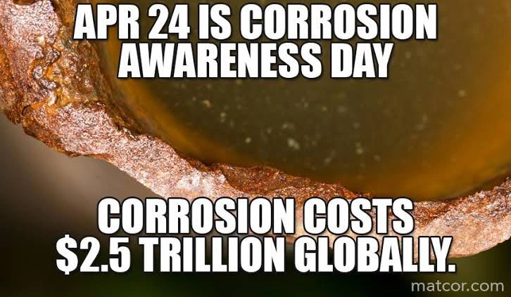
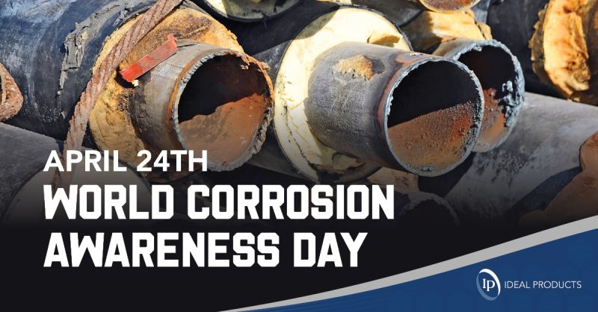
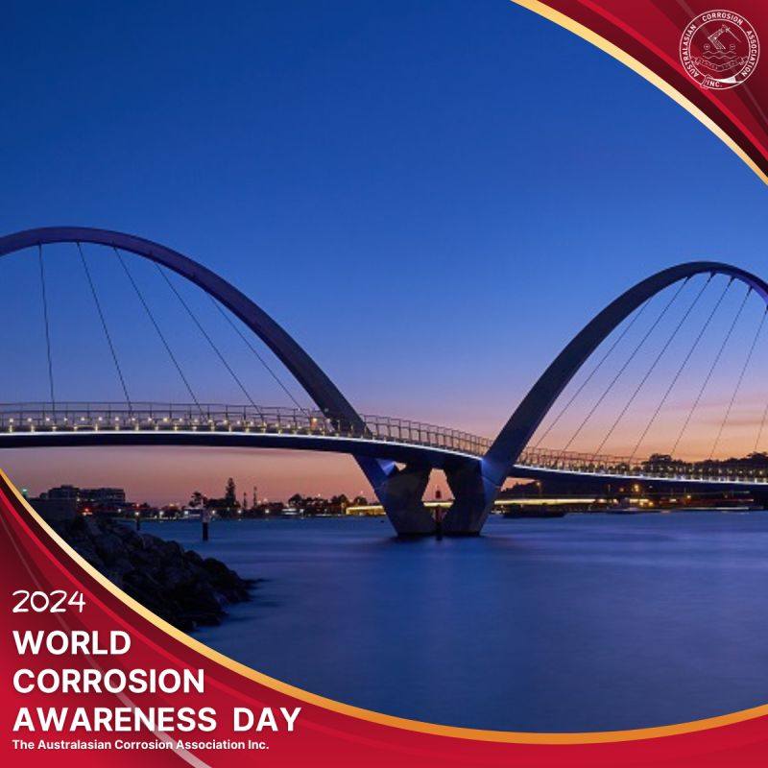
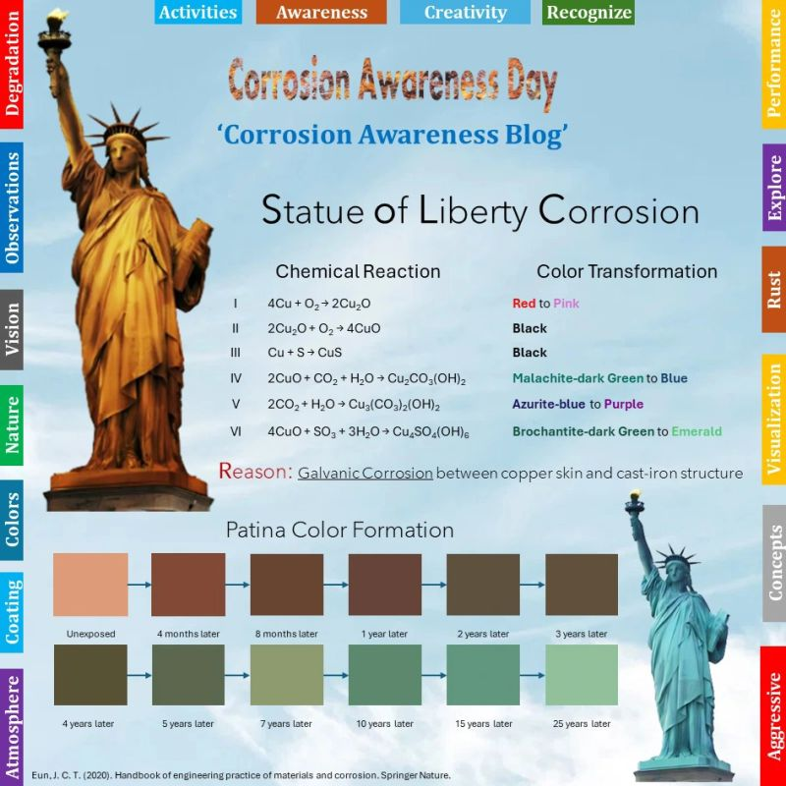
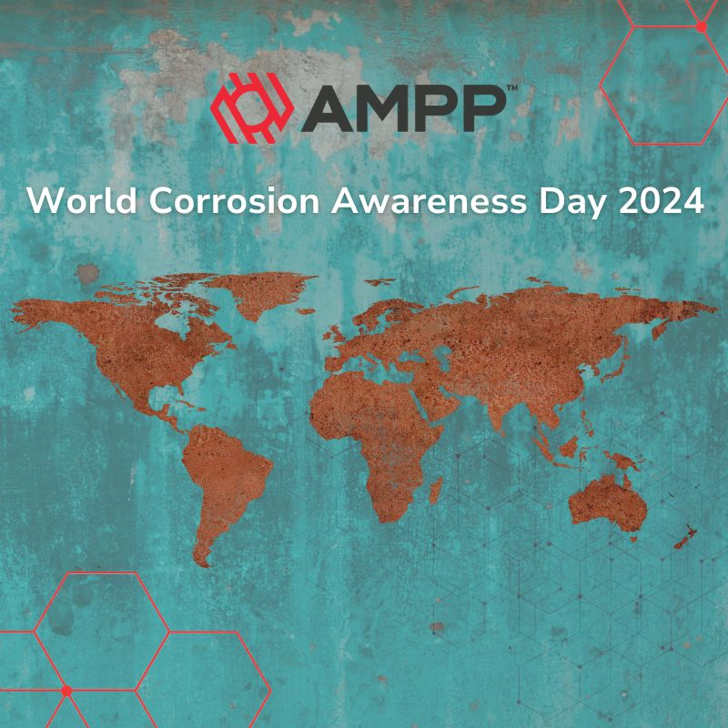

World Corrosion Awareness Day
Parliamentary & Scientific Committee APPG
Tuesday 15th October 2024

Slide 7
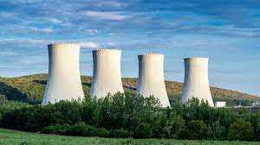

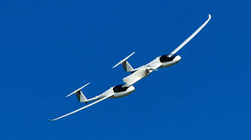

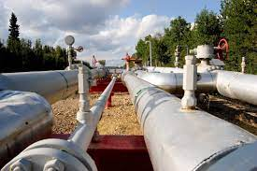
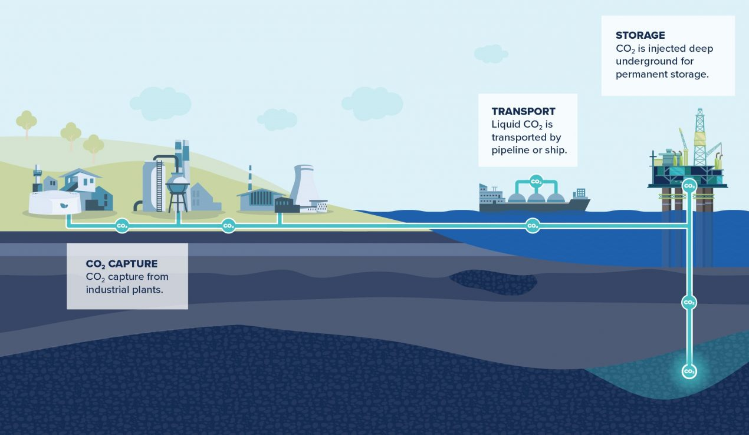
Looking ahead
Parliamentary & Scientific Committee APPG
Tuesday 15th October 2024

Slide 8
Thank You

