Slide 1

Parliamentary & Scientific Committee APPG
In-Person Meeting – Tuesday 15th October 2024
Tuesday 15th October 2024

Slide 2
The potential of
Value Retention Processes (VRPs)
David Parker, MBA, MSc, BA, MIChemE, CEnv
Sustainability Consultant david.parker.assoc@oakdenehollins.com
Tuesday 15th October 2024

Slide 3






If you saw something that…
Carbon
Commodity +
Critical Materials
Jobs
Skills
Re-shoring
Value Retention Processes
Would you be interested
Tuesday 15th October 2024
Notes:
Renewable energy sources can help address 55% of global greenhouse gas (GHG) emissions.
It is imperative to tackle the remaining 45% carbon emissions that are embodied in manufactured products and materials consumed. A key potential enabler for prosperity of UK manufacturing is high value products, associated services and materials through concerted efforts to maximise the "Value" that can be retained. In this study, the "Value" available to be retained includes the embodied energy, greenhouse gas emissions, economic value, and labour.

Slide 4
Value Retention Processes
Remanufacturing Comprehensive refurbishment Refurbishment Repair Re-use
Parliamentary & Scientific Committee APPG
Activities which keep products in use for longer – remaining life, or whole new life.
Product re-use is waste prevention.
<< Adds whole new life Maximises first life >>
<< Fixes whole Fixes a problem Works fine >>
<< Industrial process No industrial process >>
<< Higher Skills Lower >>
<< Higher Avoided CO_{2e} per extra life Lower >>
Tuesday 15th October 2024
Notes:
Replacing energy and materials with manpower

Slide 5

We investigated 10 sectors
  Aerospace
  Automotive
  Heavy-duty and off-road
  Electronics
  Home Appliances
  Furniture
  Marine
  Medical devices
  Industrial equipment
  Rail
Importance
State of the art
Business and consumer
Potential
Alignment to other studies
Tuesday 15th October 2024
Notes:
Same barriers
Similar potentials
Similar possible tactics to boost
Different state of advancement
Different tactical mix

Slide 6
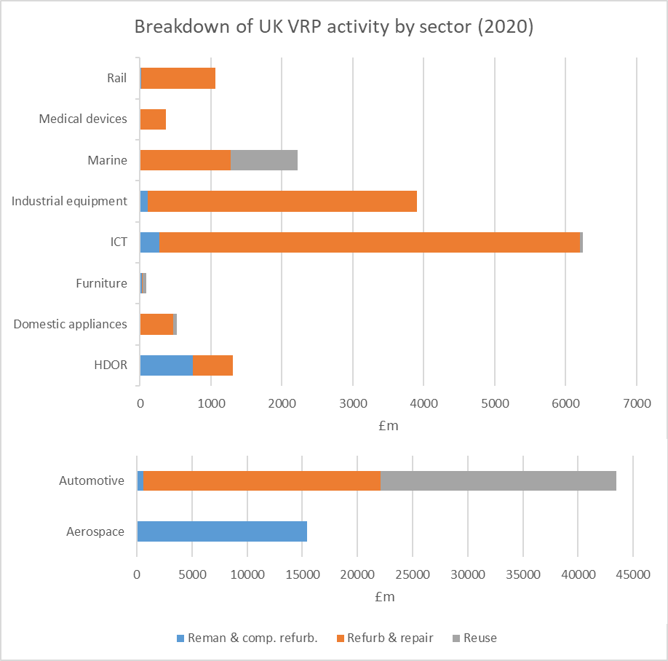
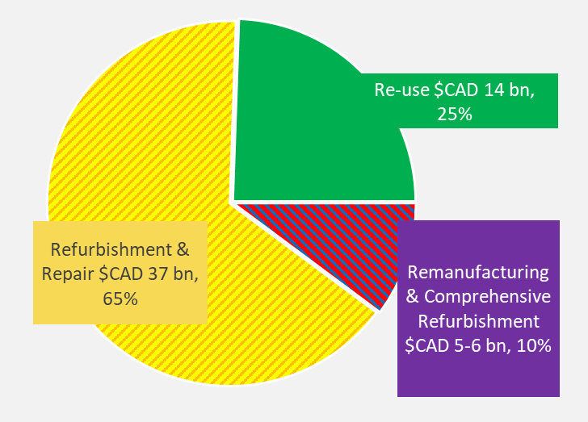
Size of UK market (2020)
Parliamentary & Scientific Committee APPG
GDP per tonne or per person outstrips recycling by multiple factors of 10
Re-use
£50-75 bn
Remanufacturing & Comprehensive Refurbishment
Refurbishment & Repair
Tuesday 15th October 2024
Notes:
Growing market

Slide 7
Impacts in context
Parliamentary & Scientific Committee APPG
    Employment
    Across 6 sectors, over 500 000 jobs in VRPs
    Higher employment per £ revenue than manufacturing
    1.5 -2 ratio (see annex slide)
    Higher skilled jobs
    Carbon avoided
    Across 10 sectors, 4-6 Mt carbon avoided p.a.
    2 x impact of steel recycling kg per kg
    Materials wastage prevented
    More than 600 kt material p.a.
    Potent materials saving tactic esp. CRMs
Tuesday 15th October 2024
Notes:
Icons

Slide 8
Transformation potential
Parliamentary & Scientific Committee APPG
We asked stakeholders for their views on the potential of remanufacturing
Currently
Reman is around 2% of manufacturing
Stakeholders said
Remanufacturing could be at least 20%
Reality check
Aerospace is at least 20% now
Equivalent to 13% of the 2050 net-zero target for industry
Tuesday 15th October 2024

Slide 9
Barriers
Across all studies, the most common barriers faced in growing VRP activities include:
Regulatory and trade barriers, particularly related to definitions of waste.
Cost pressures relating to reverse logistics and competition.
Technological barriers relating to the value retention processes themselves.
Tuesday 15th October 2024

Slide 10
Summary
Re-use activities are largely behind the scenes, large but could be hugely increased
The are central to the Circular Economy
They increase high-skill employment whilst lowering carbon emissions and materials consumption
They have £/person and £/t benefits vastly outstripping recycling
An aggressive expansion could yield carbon emissions benefits equivalent to 13% of the 2050 manufacturing Net Zero reduction target
Tuesday 15th October 2024

Slide 11



Prime resources
Parliamentary & Scientific Committee APPG
Re-defining Value – The Manufacturing Revolution: Remanufacturing, Refurbishment, Repair and Direct Reuse in the Circular Economy (2018)
For: UNEP-IRP
Link: Reports web page
Final Synthesis Report of the Socio-Economic and Environmental Study of the Canadian Remanufacturing Sector and Other Value-Retention Processes in the Context of a Circular Economy (2021)
For: Environment & Climate Change Canada
Link: Report Summary web page
Full report also at web site
Presentation available from Oakdene Hollins
Full report also available from Oakdene Hollins
A study of the Potential of VRPs for Resource Efficiency (2022)
For: Innovate UK
Contact: David Elson @Innovate UK
Also of interest:
Study for Scottish Government (via ZWS) of National CE Metrics Framework
Report for Welsh Government on VRP skills gaps
Tuesday 15th October 2024
Notes:
UNEP – full report, summary for policymakers, summary for industry.
Innovate UK – state of play, potentials, interventions, technologies; 5 case model for invention.
ECCC – full VRP analysis, state of play, barriers, co2/material/plastics impacts, potentials, federal/provincial action map.

Slide 12
Barriers
Parliamentary & Scientific Committee APPG
There are distinct barrier clusters
Distinction also by B2B/B2C
Barriers | Aerospace | Automotive | HDOR | Electronics | Home Appliances | Furniture
Foreign legislation | Yes
Customer recognition | Yes | Yes |  |  |  | Yes
Product knowledge | Yes | Yes | Yes | Yes | Yes
Skilled personnel availability | Yes | Yes | Yes | Yes | Yes | Yes
Labour costs | Yes | Yes | Yes | Yes | Yes | Yes
Scale economies |  | Yes
Feedstock quality/volume |  | Yes | Yes | Yes | Yes | Yes
Lack of sales channels |  | Yes | Yes |  |  | Yes
Product design |  | Yes |  | Yes | Yes
Foreign import restrictions |  |  |  | Yes | Yes | Yes
Capital requirements
Tuesday 15th October 2024
Notes:
Distil into barriers

Slide 13
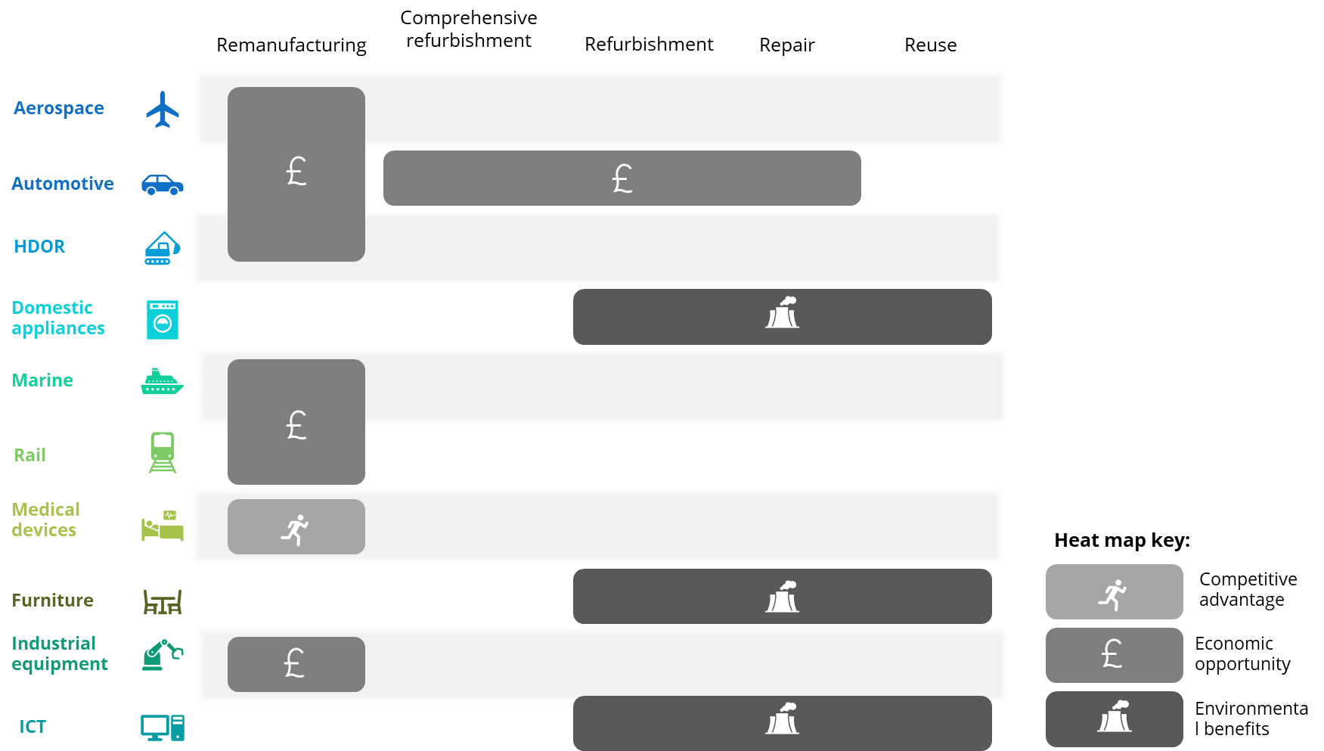
Sector tactical priorities and motives
Parliamentary & Scientific Committee APPG
Tuesday 15th October 2024

Slide 14
Strategic approach
Parliamentary & Scientific Committee APPG
We identified 16 actions arranged into 5 clusters
10 actions are high priority
1
2
Direction & control
Framework
Market pull/ confidence building
Action under local control
International
3
4
Overall strategy, coordinate approaches
Sector focus groups
Terminology & standards
Rebalance EoL and purchasing tariffs
Update NAO metrics/reporting
Embed right to repair
Use public purchasing
Support community reuse and repair
Public messaging and trust building
International VRP recognition protocols
10
5
6
8
9
7
Tuesday 15th October 2024

Slide 15
SWOT
Parliamentary & Scientific Committee APPG
VRPs are a source of international competitive advantage for the UK
STRENGTHS | UK resources or capabilities that enable the UK-wide adoption of VRPs: Strong engagement in standards development. Strong research activity – key universities. Well-established VRP industries in aero, auto, industrial equipment. Strong circular economy focus (NICER programme, Defra working group on circular economy for Net-Zero). Advanced manufacturing capabilities (that could be applied to VRPs). | OPPORTUNITIES | Favourable situations in the environment that enable the UK-wide adoption of VRPs: International focus on emissions reduction (policy level) – would increase awareness of VRP activities for consideration in trade policy Increasing feasibility/acceptance of carbon tax measures – would increase competitiveness of VRP activities. Increasing interest internationally e.g. Canada – VRP strategy, EU – Circular Economy Action Plan, USA – Circular Economy, China – 5-year strategy, Wales and Scotland – opportunities to collaborate. New markets, such as renewables and EVs. Leveraging existing business advisory services.
WEAKNESSES | Limitations, faults or defects that may hinder the UK-wide adoption of VRPs: Declining manufacturing base. Ageing manufacturing/VRP work force. Absence from public procurement. High labour costs. Weak industry-academia engagement on VRP topics. Restrictive policies on waste. Lack of visibility (industry statistics, consumer awareness). Unfavourable perceptions of VRP activities. | THREATS | External barriers and challenges to the UK-wide adoption of VRPs: Competition from low-cost imports. Development of remanufacturing hubs outside the UK. Uncertainty in trade/tariffs. Post-Brexit customs challenges.
Tuesday 15th October 2024

Slide 16
Economic multipliers
Parliamentary & Scientific Committee APPG
N.B. expressed as
jobs per $CAD 1m
Multiplier Type | Output | GDP at Market Prices | Labour Income | Taxes on production | Jobs
Automotive Repair and Maintenance
Direct | 1 | 0.598 | 0.459 | 0.011 | 10.398
Indirect | 0.487 | 0.267 | 0.147 | 0.014 | 2.606
Induced | 0.492 | 0.325 | 0.133 | 0.022 | 2.772
Simple | 1.487 | 0.865 | 0.606 | 0.025 | 13.003
Total | 1.979 | 1.190 | 0.739 | 0.047 | 15.775
Repair and Maintenance (except automotive)
Direct | 1 | 0.608 | 0.463 | 0.008 | 8.858
Indirect | 0.497 | 0.270 | 0.149 | 0.014 | 2.660
Induced | 0.495 | 0.327 | 0.134 | 0.022 | 2.787
Simple | 1.497 | 0.878 | 0.613 | 0.022 | 11.518
Total | 1.992 | 1.205 | 0.747 | 0.044 | 14.305
N.B. Subsequent work for Metro Vancouver B.C. differentiated Reman, Repair, Reuse and Recycling multipliers ($ and jobs)
Tuesday 15th October 2024

Slide 17
Thank You for Attending

