Slide 1



Mentoring the Next Generation Towards Corrosion Prevention
Izabela Gajewska, MSc (Eng) AMEI MICorr
Corrosion Engineer
Tuesday 15th October 2024

Slide 2
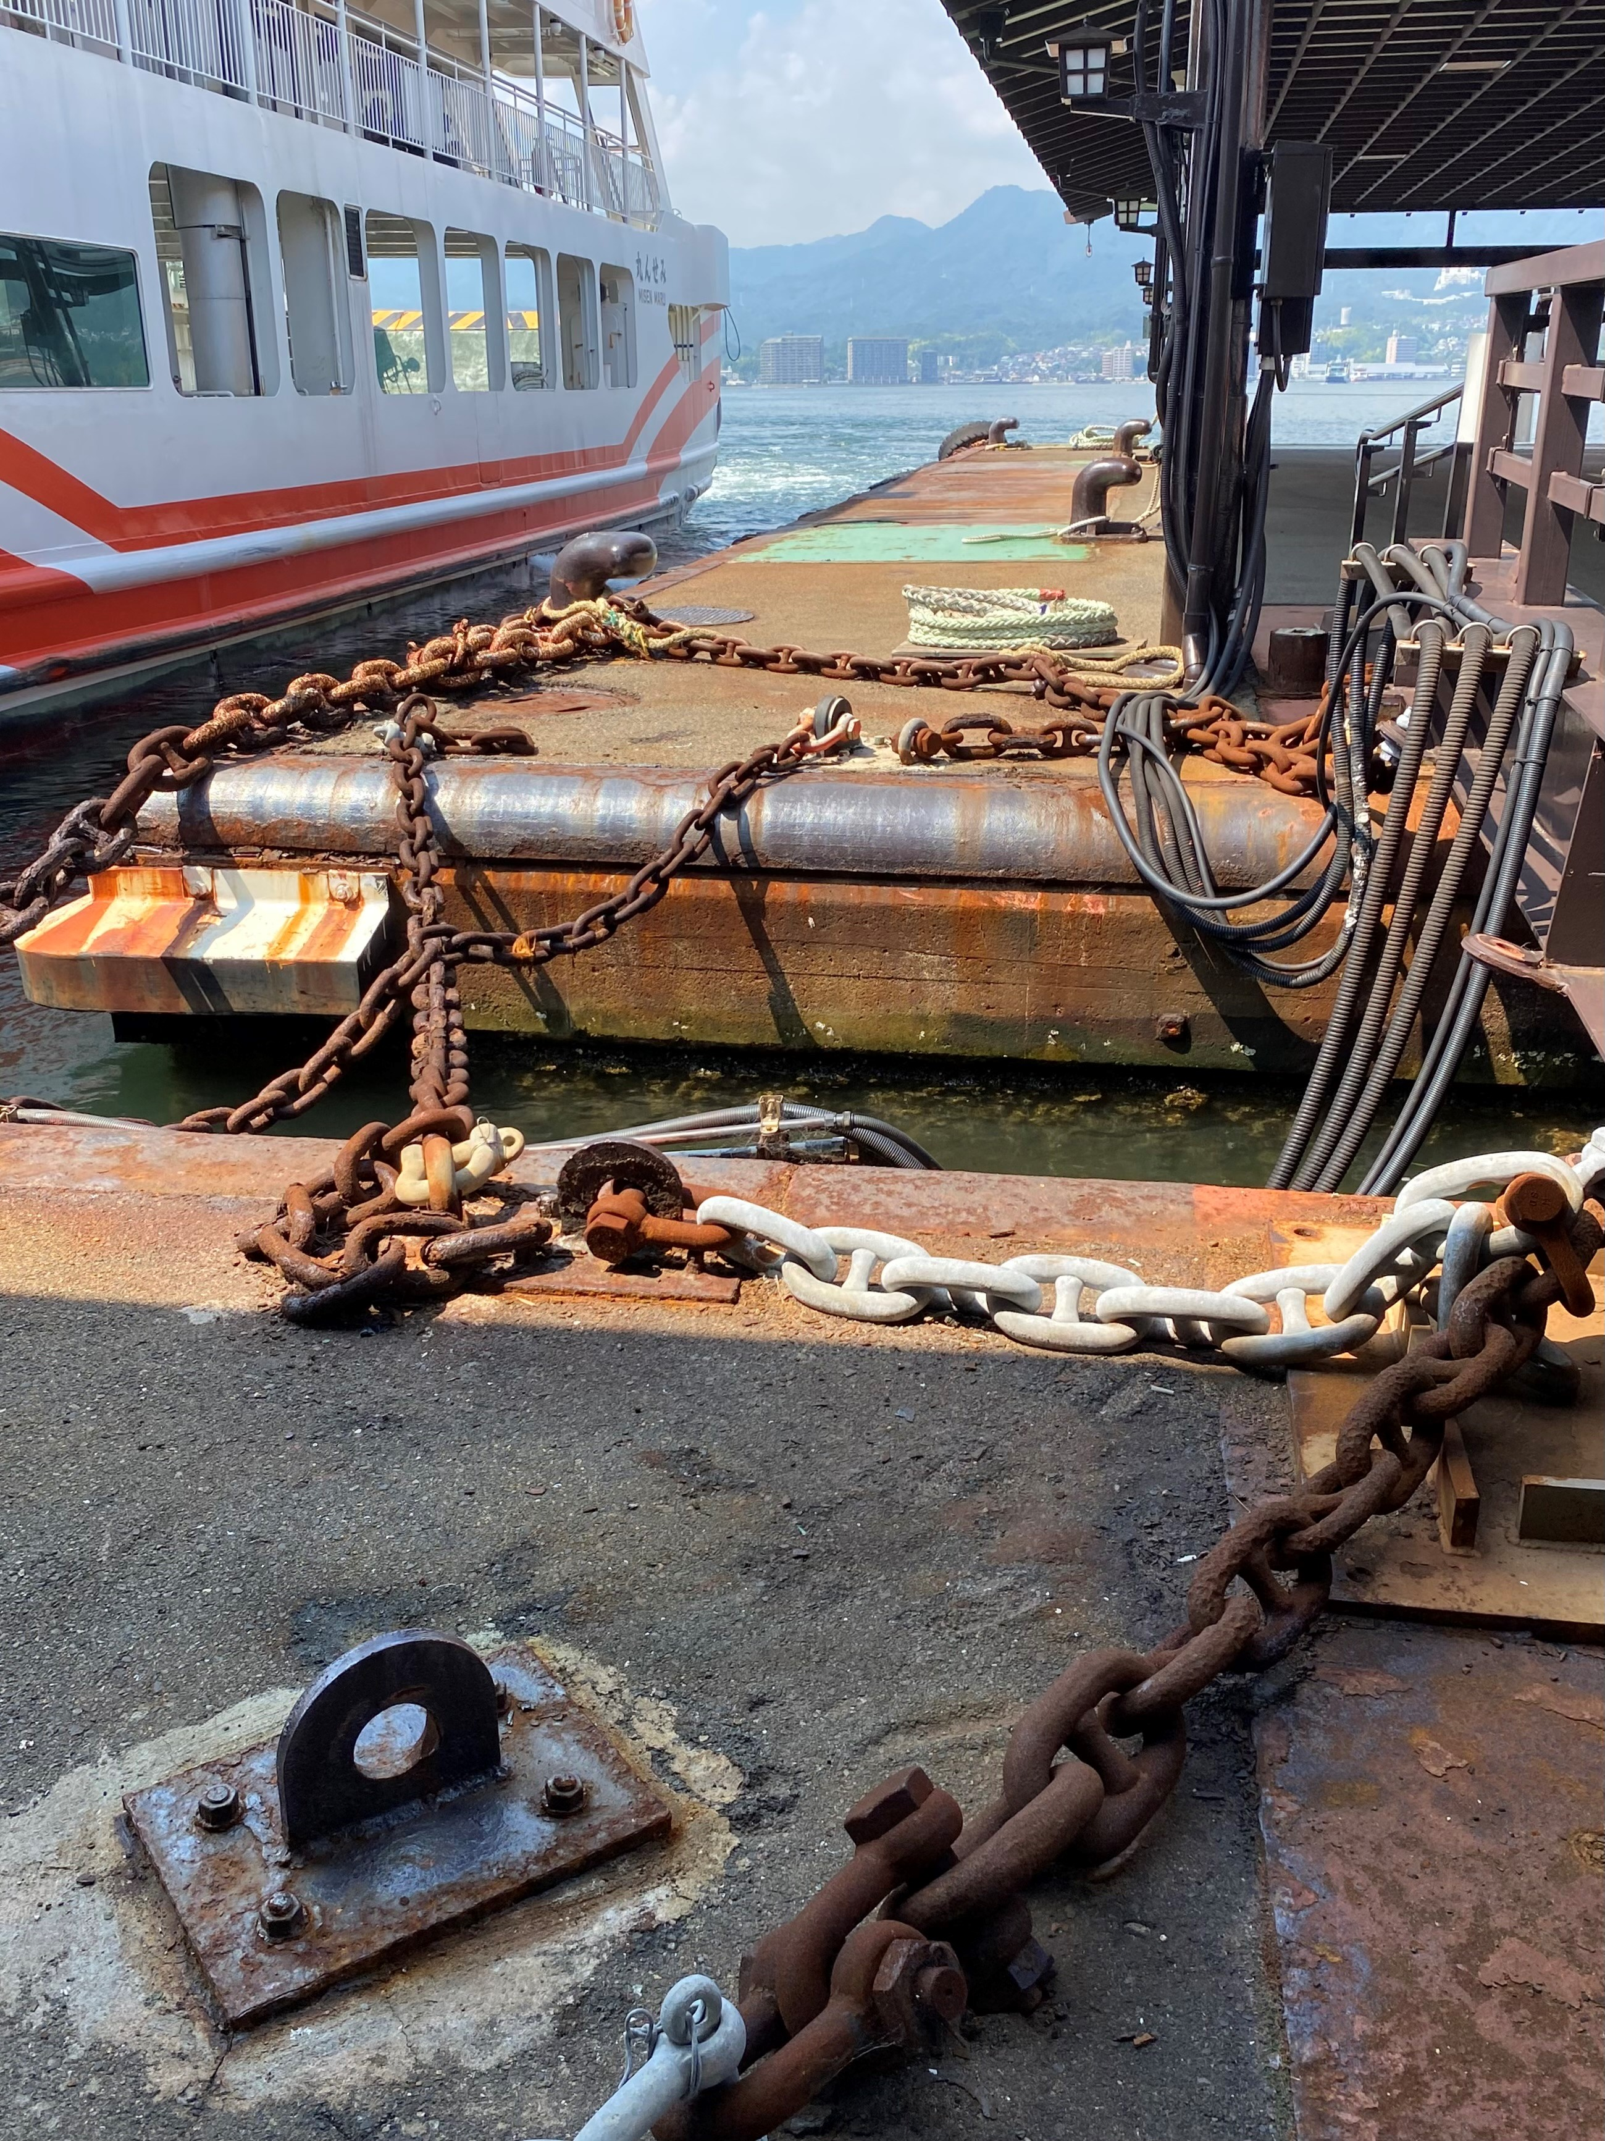
Agenda
Parliamentary & Scientific Committee APPG
What is Corrosion?
Safety Impact of Corrosion
Financial Impact of Corrosion on Society
Environmental Impact of Corrosion
Solutions to Corrosion Problems
Role of Corrosion Professionals
Role of Education & Mentoring
Summary
Shiny and rusted metal chains (source: personal collection)
Tuesday 15th October 2024

Slide 3
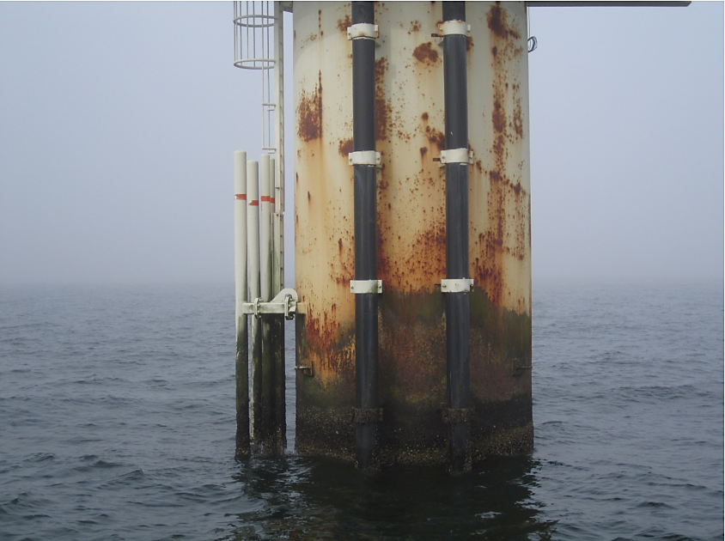
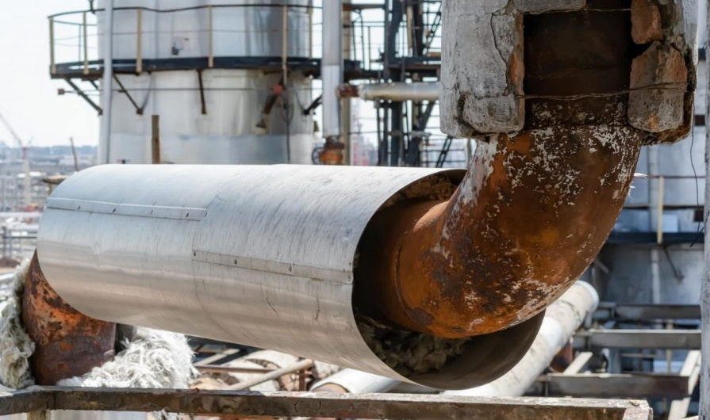
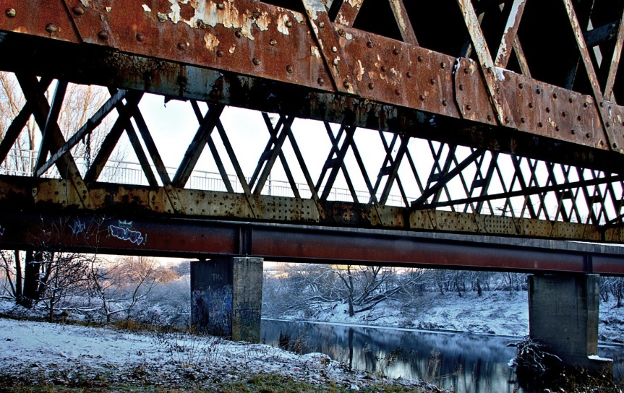
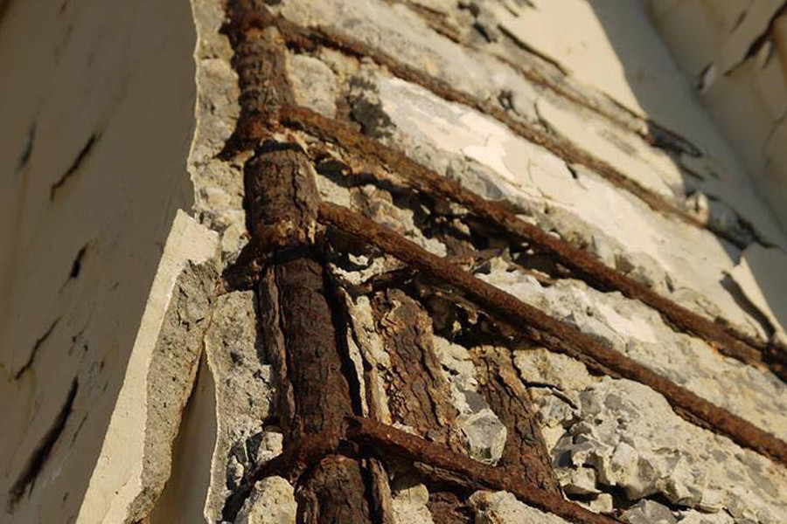
What is Corrosion?
Parliamentary & Scientific Committee APPG
Corrosion – material deterioration, usually a metal, due to a chemical reaction with its environment
It can occur in a variety of environments: marine, industrial, atmospheric:
Corrosion
Triangle
Offshore Wind Farms
Process Plants
Water
Oxygen
Rust
Metal
Bridges
Buildings
Photo acknowledgements:
www.flickr.com, www.powertherm.co.uk, www.linkedin.com/pulse/penetron-protection-against-corrosion-reinforcement-steel-klouda, www.steelfabservices.com.au, www.safinah-group.com
Tuesday 15th October 2024

Slide 4

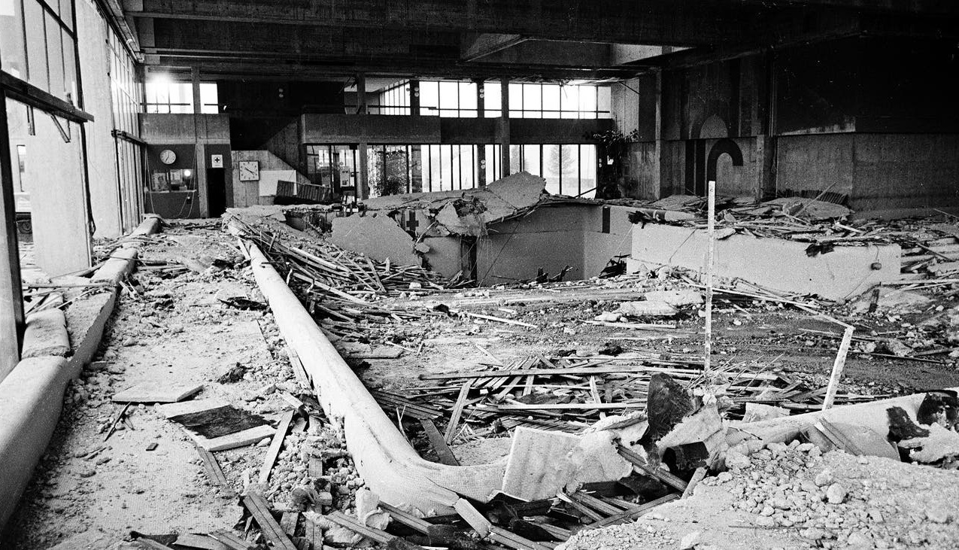
1985 – Swimming Pool Roof Collapse in Switzerland 12 people died, cause – Chloride Stress Corrosion Cracking of stainless steel rods (source: HSE)
Photo acknowledgement:
www.reddit.com

Slide 5
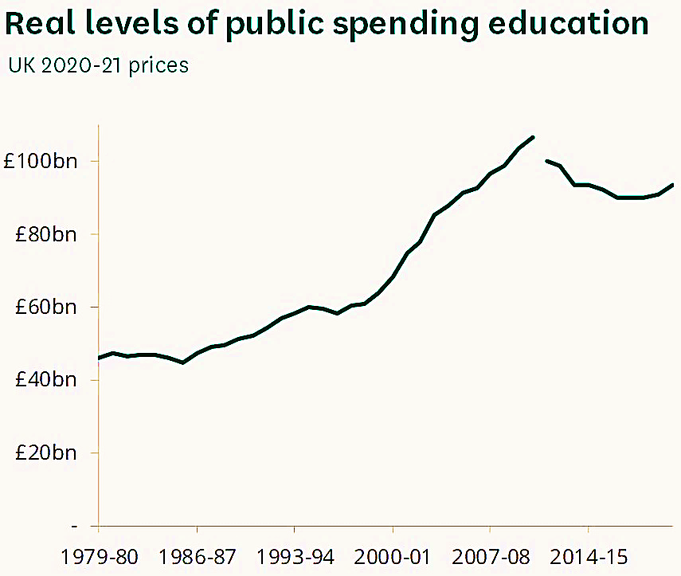
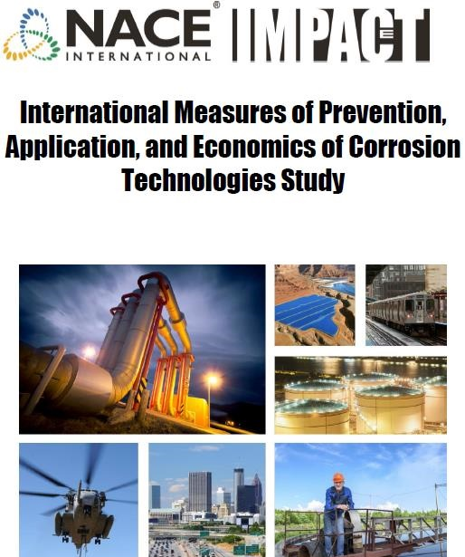
Financial Impact of Corrosion on Society
Parliamentary & Scientific Committee APPG
Global cost of corrosion is ~$2.5 trillion annually (source: NACE 2016 Study)
~3.4% of the global Gross Domestic Product
2023 – UK GDP was £2,690 billion (source: House of Commons Library on-line)
  Assuming 3.4% of GDP is the UK’s cost of corrosion, corrosion costs UK Plc ~£90 billion / year
  ~15 to 35% of annual corrosion costs could be saved (source: NACE 2016 Study)
2022 – average disposable income in UK was ~£39,328 (source: Office for National Statistics)
  Annual cost of corrosion per average UK household ~£1,300
  Potential 35% savings would reduce this cost to ~£850
Annual cost of corrosion in UK
Annual budget for UK education
≈
UK education costs over the years (source: House of Commons Library on-line)
Tuesday 15th October 2024

Slide 6
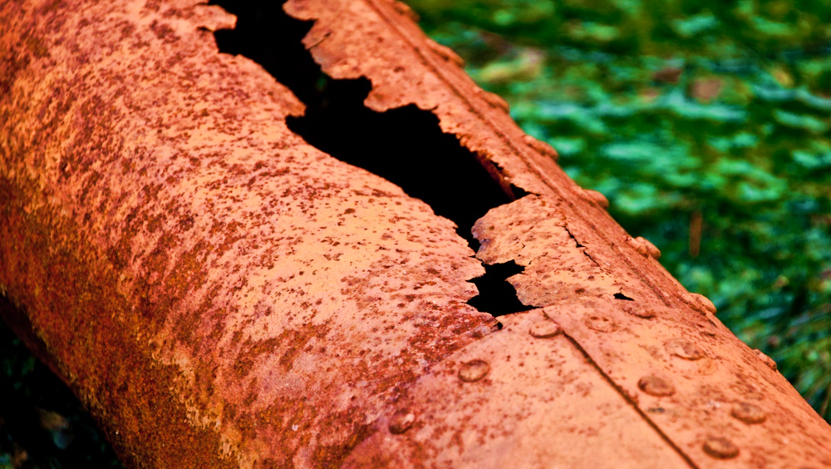
Parliamentary & Scientific Committee APPG
Corrosion can cause leaks and spills, leading to environmental pollution
Steel replacement due to corrosion could contribute 4–9% of global CO₂ emissions by 2030 if appropriate mitigation actions are not taken (Source: Iannuzzi M. and Frankel G. S., 2022)
Photo acknowledgement:
www.flickr.com

Slide 7
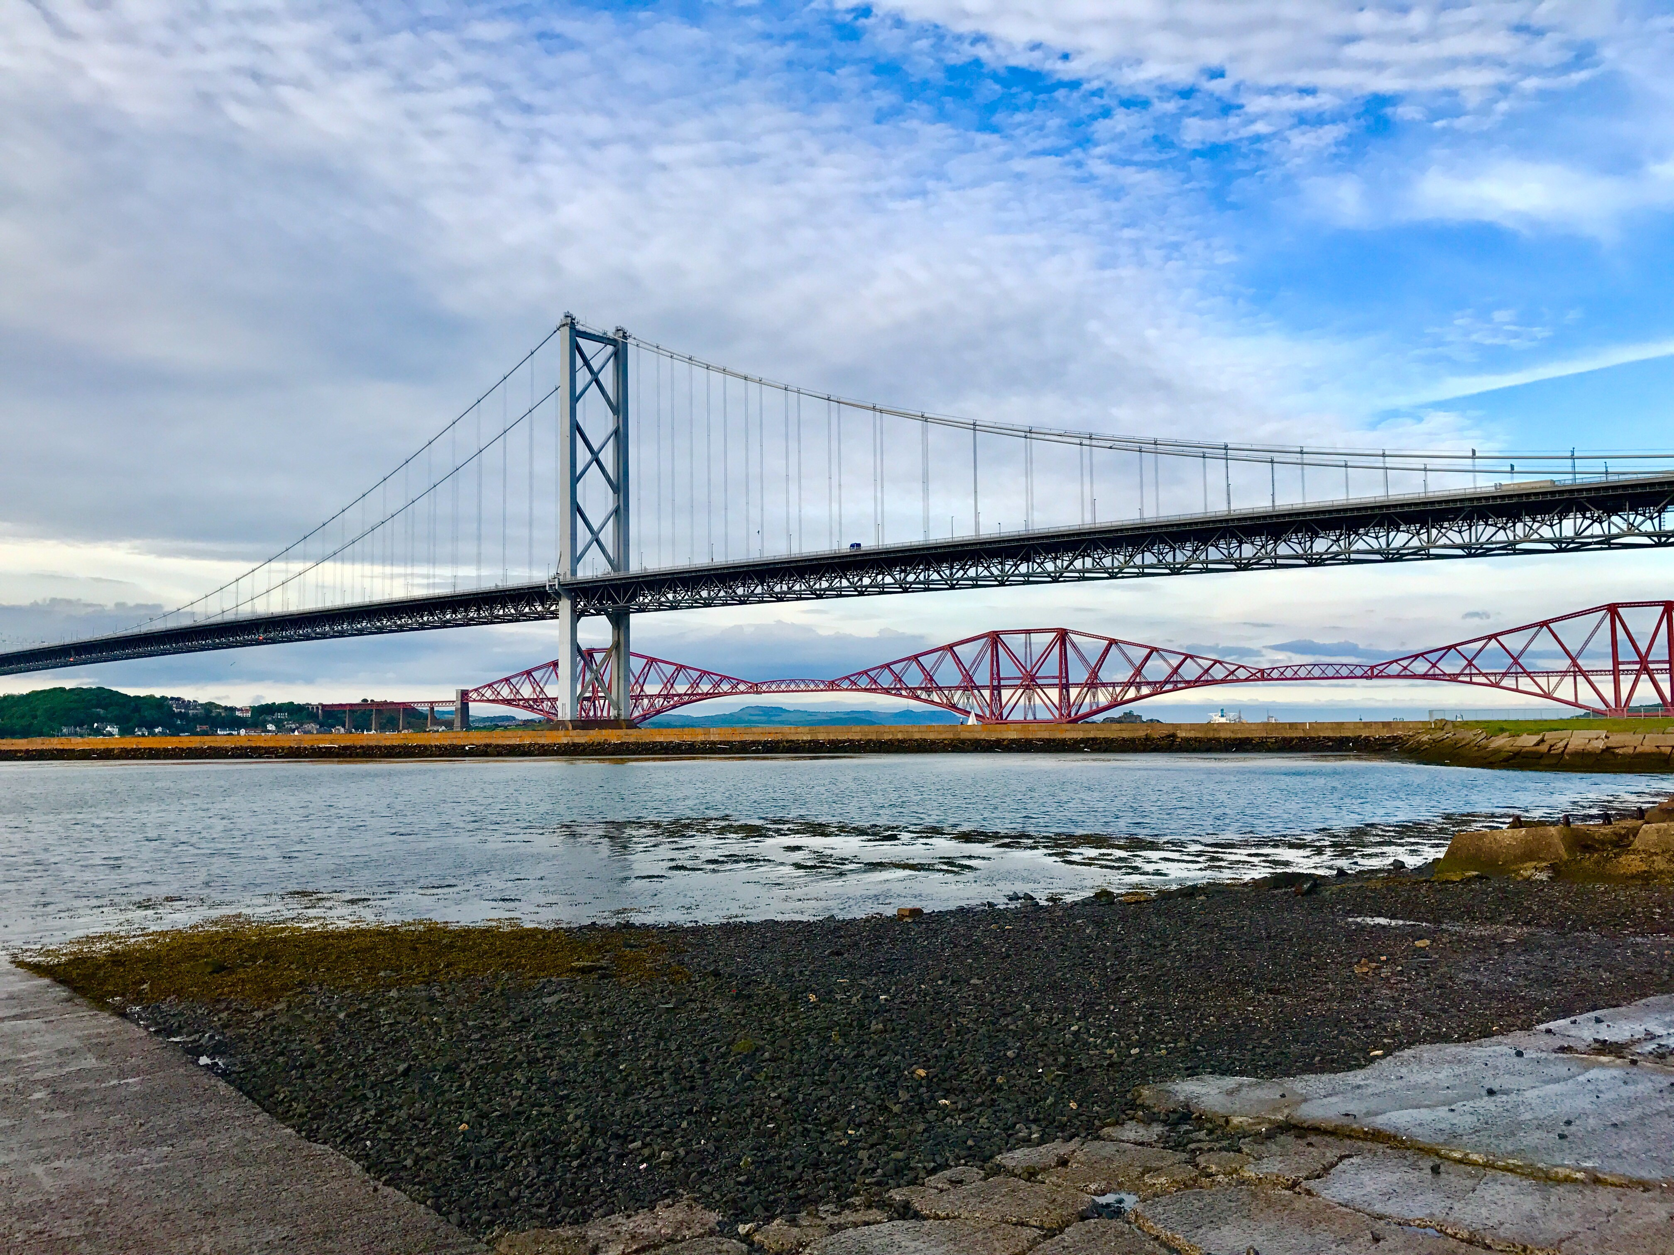
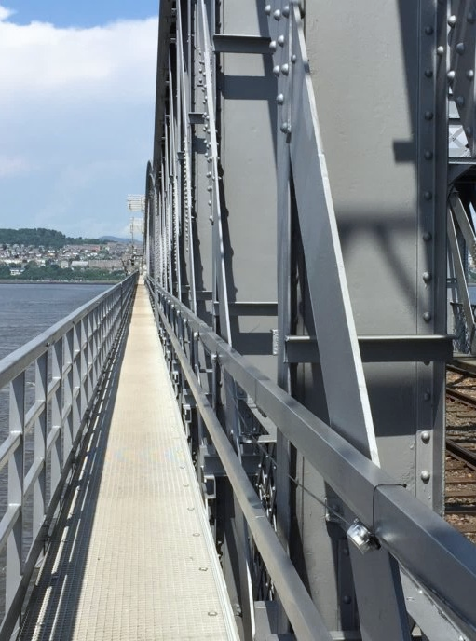
Corrosion Management
Parliamentary & Scientific Committee APPG
Corrosion and associated costs cannot be eliminated completely
~£10 to £30 billion / year could be saved in the UK
Optimised corrosion prevention practices can:
  Improve safety
  Protect the environment
  Save a lot of money
  Reduce inconvenience to the Public:
    Prevent or reduce water and gas leaks
    Enable more reliable journeys
    Extend life of public infrastructure
Forth Road Bridge (South Queensferry, Scotland),
cable corrosion caused wires to fail – bridge replacement cost: £1.4 billion (source: personal collection)
Refurbished Tay Bridge (Dundee, Scotland),
UK's longest rail structure – restoration cost:
£75 million (source: www.networkrail.co.uk)
Tuesday 15th October 2024

Slide 8

Solutions to Corrosion Problems
Parliamentary & Scientific Committee APPG
    Cost-effective materials selection to match asset life cycle and improve safety & reliability
    Effective corrosion risk management
    Communication between Materials and Corrosion Specialists, Government bodies and communities
    Appropriate education, training and mentoring to increase competency and corrosion awareness
Photo acknowledgements: www.fk-instrument.com
Tuesday 15th October 2024
https://fk-instrument.com/

Slide 9

Role of Corrosion Professionals
Parliamentary & Scientific Committee APPG
  Fundamental Research
  Development of Products (alloys, coatings, inhibitors)
  Design
  Engineering
  HSE Compliance – COMAH and Safety Cases
  Asset Integrity Management
  Plant & Equipment Engineering
  Plant & Equipment Inspection
  Plant & Equipment Safety
Tuesday 15th October 2024

Slide 10


Role of Education, Mentoring, Knowledge Transfer
Parliamentary & Scientific Committee APPG
    Knowledge – one of the most powerful competitive advantages in today's markets
    Insufficient competent * Engineers in the UK * Competency = Qualifications + Training + Experience
    Knowledge transfer (KT) is especially important when experienced UK personnel near retirement
  Our universities are training students from around the world, many supported by their governments
  The need to enable and encourage home-grown students into Corrosion Science & Engineering
  e.g., ICorr 5 Year Funding for 6 Student Scholarships at the University of Manchester
Photo acknowledgements: www.wikipedia.org, www.forbes.com
Tuesday 15th October 2024

Slide 11
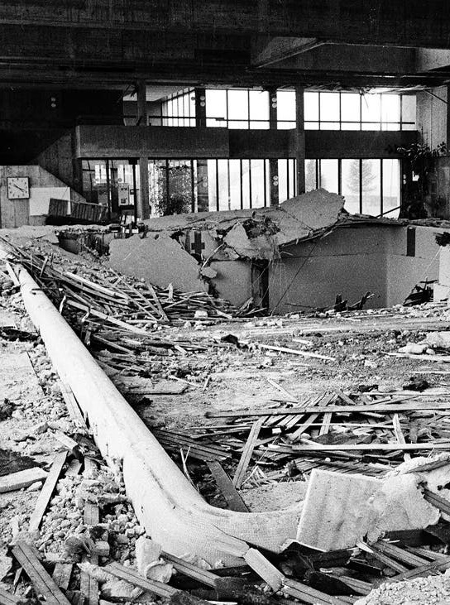
Summary
Parliamentary & Scientific Committee APPG
  Corrosion degradation:
  Potentially significant safety and environmental threat
  Adds significant costs to people and society
  Indirectly adds to the tax burden
  Chance to save ~£10-30 billion / year corrosion costs
  Shortage of home-grown Corrosion Professionals in the UK – relatively few training programmes available
  Effective corrosion management requires competent Corrosion Engineers and Scientists
  Mentoring the future generation of corrosion professionals & fundamental academic R&D – key to combating corrosion, thereby improving safety, reducing costs, and promoting sustainability
Swiss Swimming Pool Roof Collapse in 1985 (source: www.reddit.com)
Tuesday 15th October 2024

Slide 12
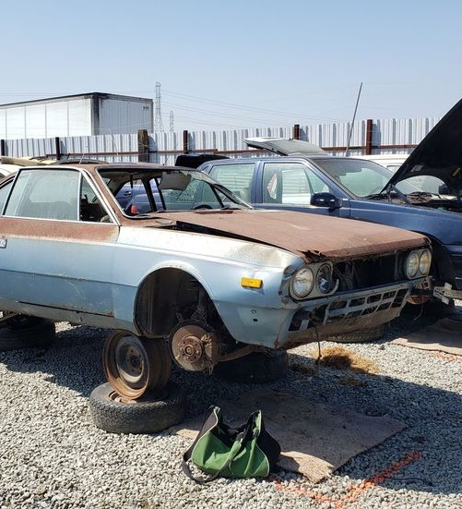
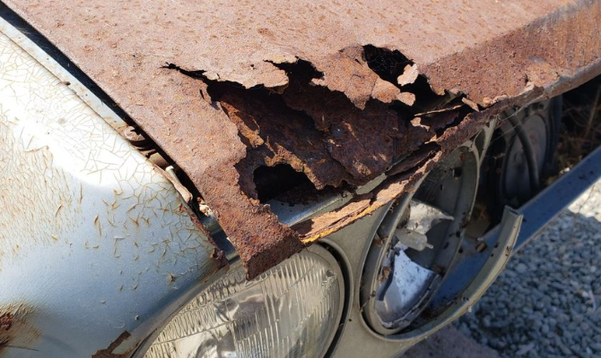
Final Comment
Parliamentary & Scientific Committee APPG
  Advances by Corrosion Engineers / Scientists / Chemists mean that your car no longer looks like this after a few years
Photo acknowledgements:
www.autoweek.com/car-life/classic-cars/a2143171/junkyard-treasure-1976-lancia-beta-coupe
Tuesday 15th October 2024

Slide 13



Thank You for Your Attention
Izabela Gajewska, MSc (Eng) AMEI MICorr
Corrosion Engineer – Consultancy Services
Intertek CAPCIS, Manchester, United Kingdom
izabela.gajewska@intertek.com

Slide 14
Appendix
Tuesday 15th October 2024

Slide 15
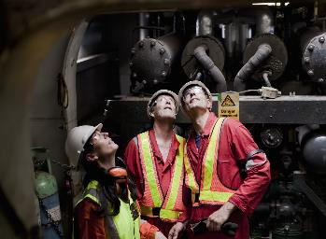


Approaches to Knowledge Transfer
Parliamentary & Scientific Committee APPG
Projects
Mentoring
Technical books
Work meetings
Taking notes
Site visits
Appraisals
Feedback
Codes & standards
Training courses
E-learning
Conferences
Work experience
Informal Learning
Formal Learning
Figure 5: 70:20:10 Model for Learning and Development (Eichinger, R. and Lombardo, M.,1990s)
Monday 1st July 2024

Slide 16
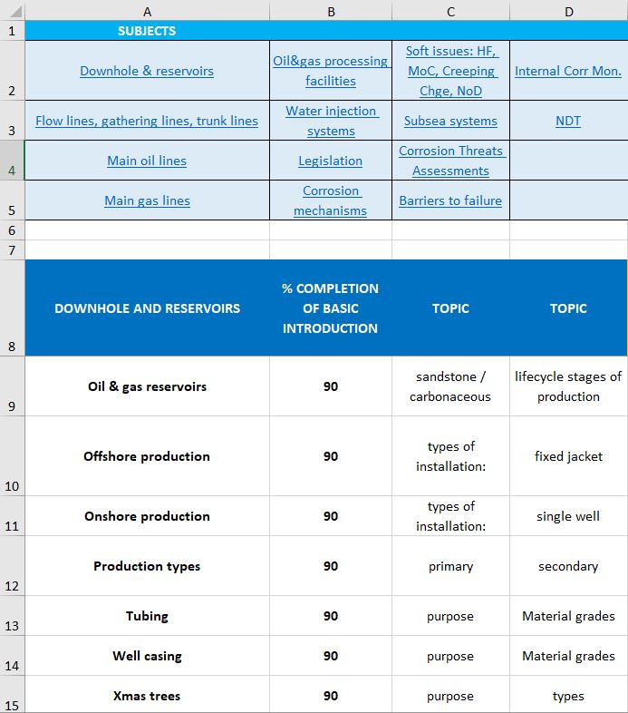
Mentoring Future Generation of Corrosion Professionals for UK Plc
Parliamentary & Scientific Committee APPG
  Mentoring – one of the solutions to corrosion issues
  Mentors matched with development needs of mentees
  Clearly defined schedule, regular meetings
  Technical presentations + talks about corrosion problems and solutions using sketches, images, videos + site-based learning
  Customised subject-based curriculum – mentoring tool
  Sharing experience-based knowledge is critical
  Mentor’s support to be assured, including discussions about issues related to ongoing projects
  Evaluation of KT, e.g., presentations, tests, exams
Customised subject-based curriculum (source: personal collection)
Tuesday 15th October 2024

