Slide 1




Advanced Corrosion Management Techniques to Reduce Cost and Risk in Our Built Environment
Christian Stone, M.Phys (Physics) M.S (Mat Sci & Eng),
Lead Materials Scientist, Concrete Preservation Technologies
Tuesday 15th October 2024

Slide 2

Cost of Building New
60% of waste and 25% of CO₂ can be attributed to the construction industry in the UK according to 2022 government reports.
- Much of this is attributed to the production of cement and steel.
The cost of new builds in both CO₂ and budget is much greater than the refitting and rehabilitation of existing infrastructure.
Tuesday 15th October 2024

Slide 3
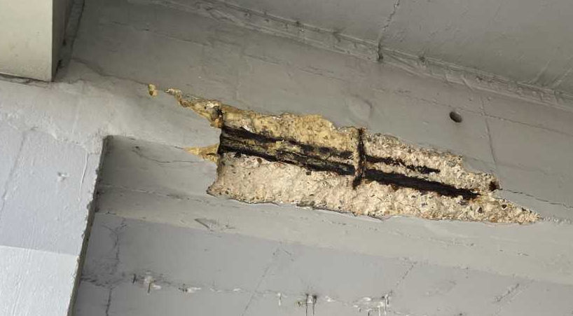
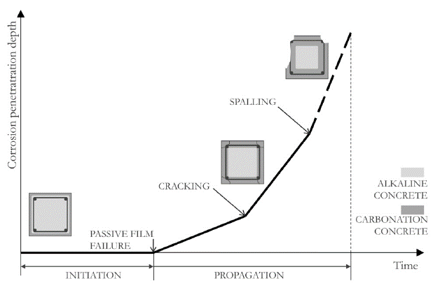
Corrosion is a Major Factor Limiting Service Life
Reinforced concrete makes up much of our built environment.
Over time corrosion of the reinforcement initiates.
Corrosion issues accelerate unless they are managed correctly
Corrosion of steel is often a dominant factor that determines service life.
Loreto, Giovanni & Di Benedetti, Matteo & Iovino, R. & Nanni, Antonio & Gonzalez, M.. (2011). Evaluation of corrosion effect in reinforced concrete by chloride exposure. Proceedings of SPIE - The International Society for Optical Engineering. 10.1117/12.880156.
Tuesday 15th October 2024

Slide 4

Delays to Essential Repairs Cause Further Issues
Roof leaks, damage to concrete cover and corrosion often have accelerating costs if left unchecked.
Much of the UK public infrastructure is struggling with tight budgets.
Intervention is required for many mid-century structures.
Tuesday 15th October 2024

Slide 5
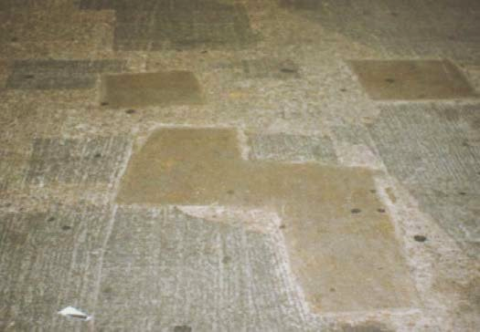
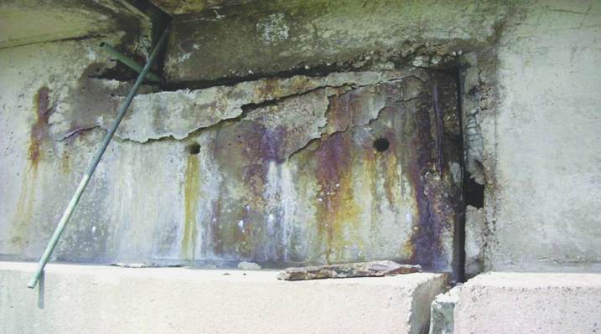

Current Repair Strategies are Often Lacking
A man who could afford fifty dollars had a pair of boots that'd still be keeping his feet dry in ten years’ time, while the poor man who could only afford cheap boots would have spent a hundred dollars on boots in the same time and would still have wet feet.
- Sir Terry Pratchett
Tuesday 15th October 2024

Slide 6
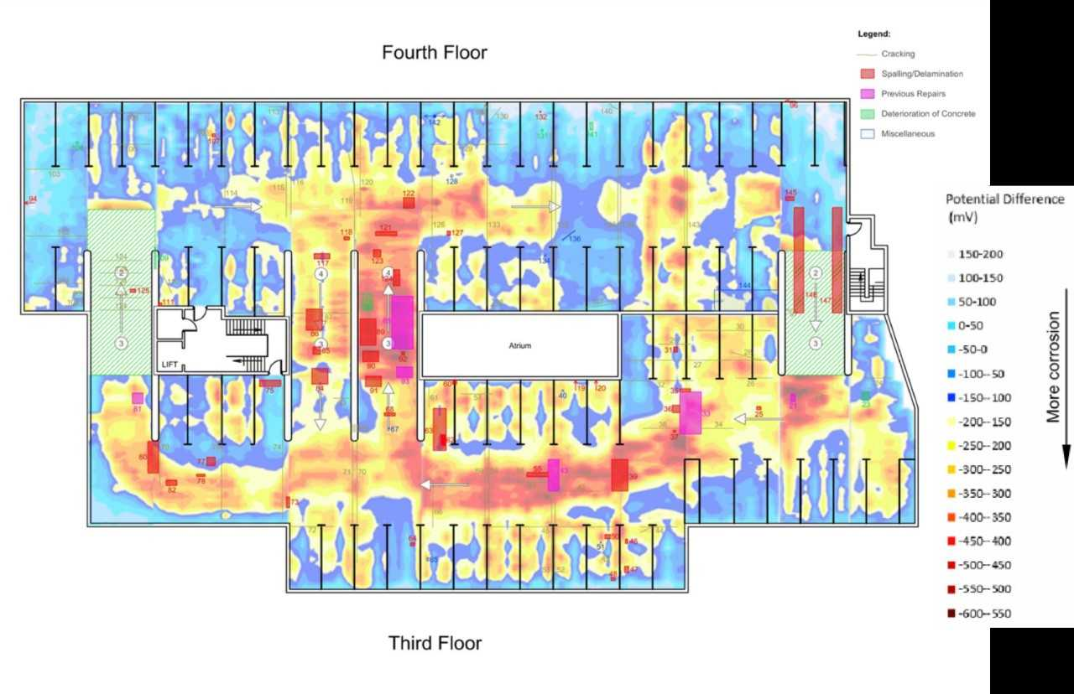
Corrosion Surveys
The UK is world-leading in corrosion surveying and management expertise.
Electrochemical surveys can pinpoint corrosion issues.
This leads to cost savings as corrosion management can be localised and tailored to the problem.
Low Risk
Severe Risk
Tuesday 15th October 2024

Slide 7
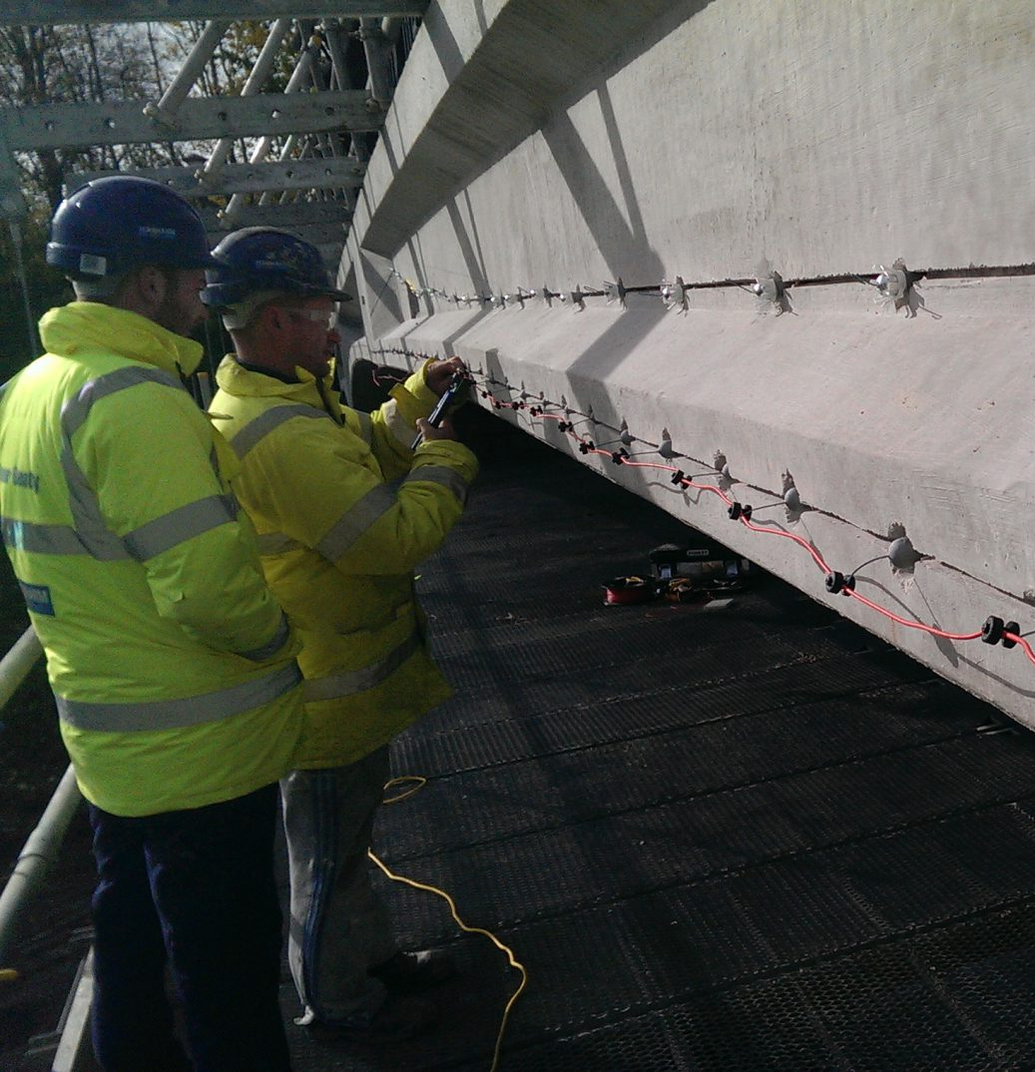
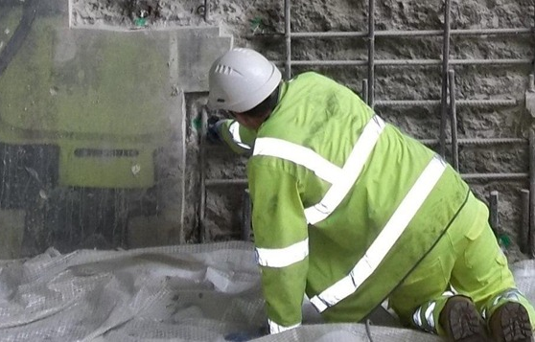
Corrosion Management
Galvanic and Hybrid corrosion management techniques are British inventions, with UK manufacturers protecting structures globally.
Many of these techniques have decades of data backing up their use and are largely maintenance-free once installed.
These systems increase the life of structures and reduce repair costs, as well as the disruption caused by routine maintenance.
Tuesday 15th October 2024

Slide 8
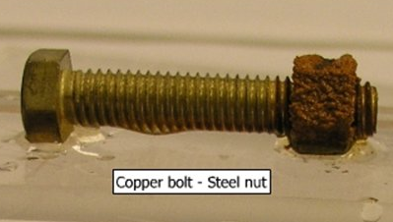
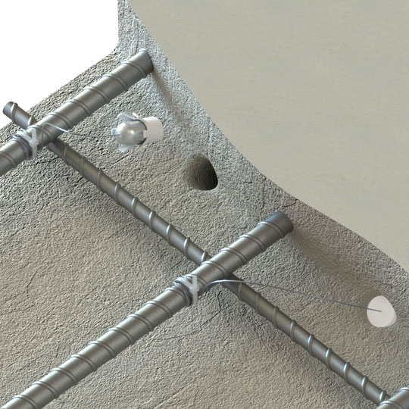
Galvanic Anodes
Sir Humphrey Davey in 1824 discovered that two dissimilar metals in the presence of moisture create an electric current that corrodes the less noble metal to protect the more noble metal.
This same electrochemistry has been adapted with modern chemistry, engineering and materials science to protect reinforced concrete structures.
This industry is now well developed with decades of experience and real-world data supporting their use.
Tuesday 15th October 2024

Slide 9
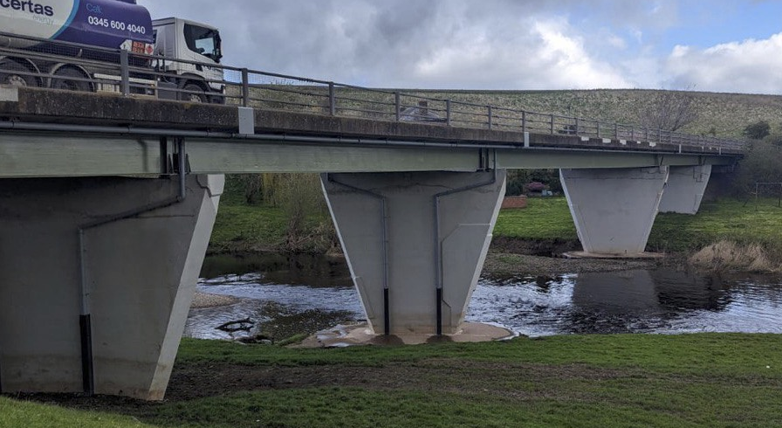
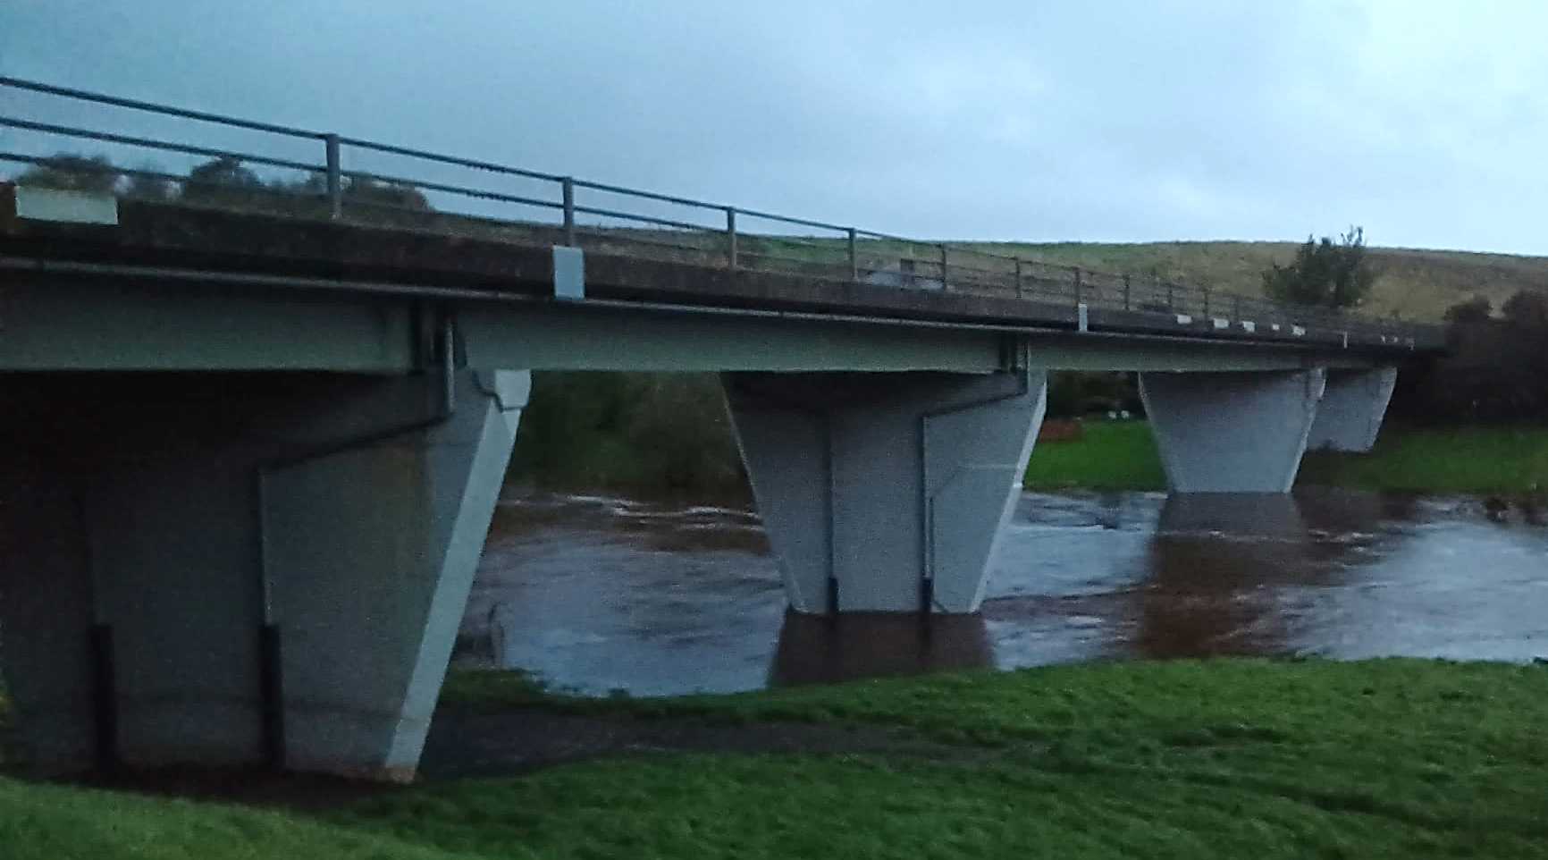
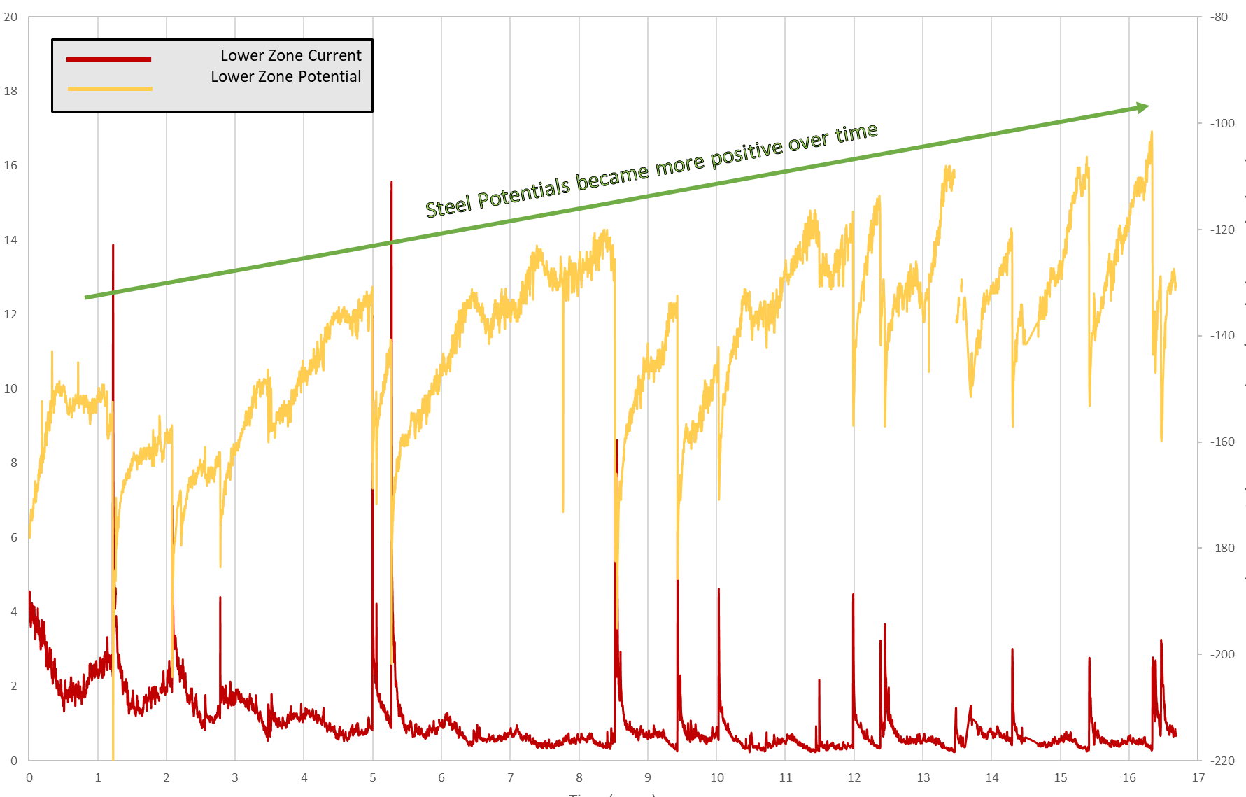
Self-Regulating Protection
Current
Potential
First Hybrid Galvanic Protection.
  Impressed phase followed by galvanic protection
Flooding of the river caused increased risk
De-icing salts used in the roadway above allow aggressive chloride ion ingress
Around 18 years of maintenance-free protection
  Approximately 7% of the anodes have been consumed
  On track to surpass the 25-year design life by some margin.
Extending the service life of the elements
Current output of anodes (mA)
Polarised steel potential vs Ag/AgCl (mV)
Time (years)
Tuesday 15th October 2024

Slide 10
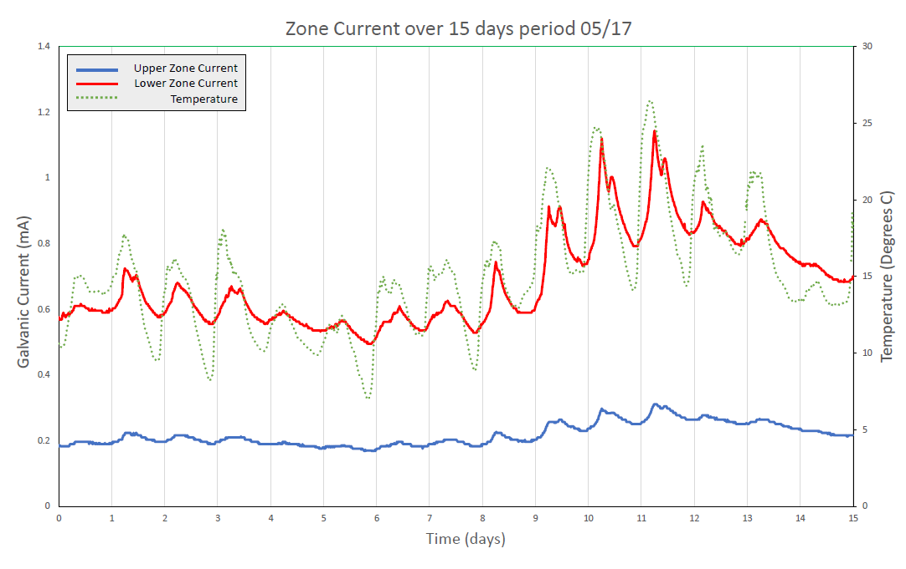
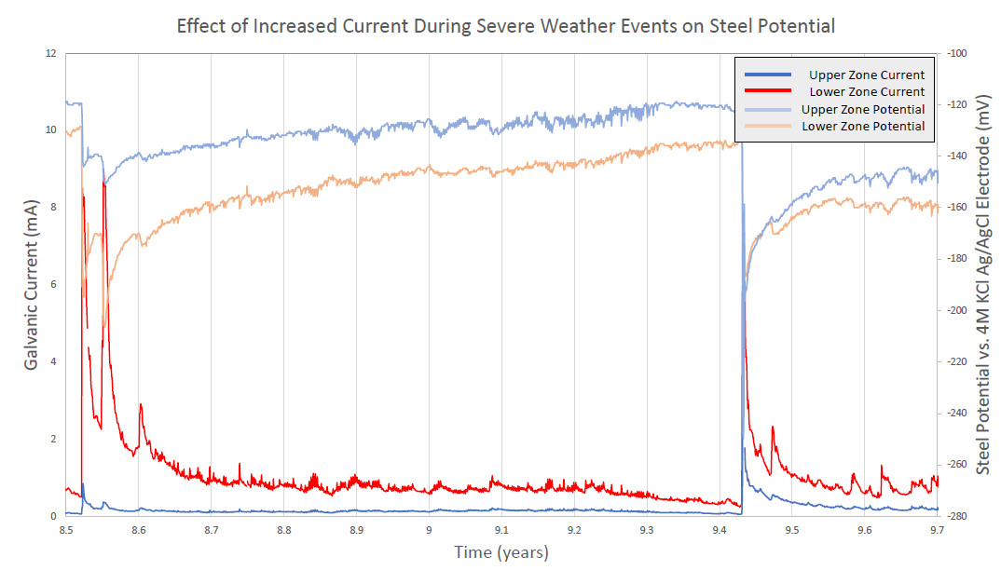
Climate Risk
Bright Blue think tank expressed concerns over the readiness of our structures in the face of a changing climate.
Zinc-based galvanic systems react to increased temperature and moisture giving more protection during periods of heightened risk.
Anode response to temperature
Anode response to moisture/flooding
temperature
Galvanic Current (mA)
Galvanic Current (mA)
Temperature Degrees C
Polarised steel potential vs Ag/AgCl (mV)
wet-zone current
dry-zone current
Time (days)
Time (years)
Tuesday 15th October 2024

Slide 11
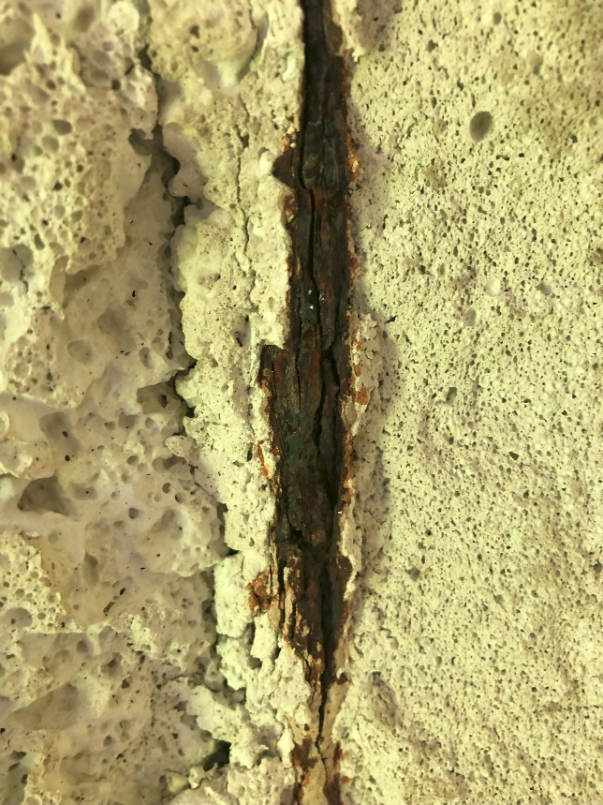
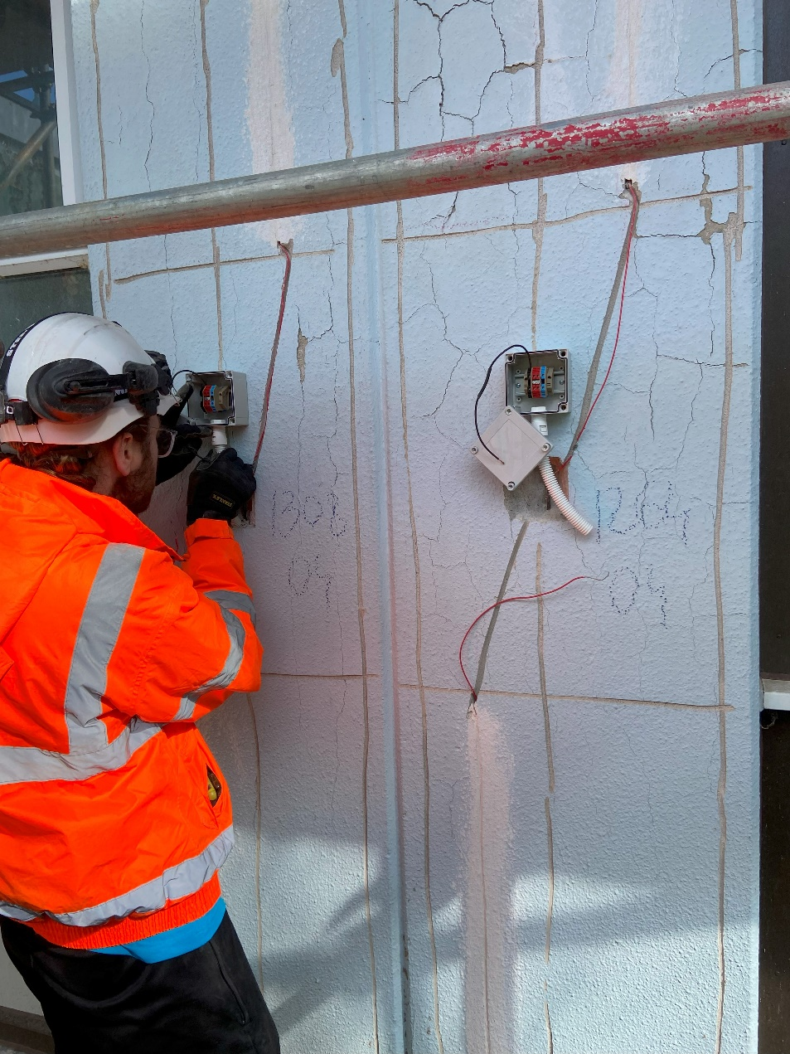
Corrosion in RAAC
Reinforced Aerated Autoclaved Concrete (RAAC) is vulnerable to reinforcement corrosion.
Advancements in technology have allowed for RAAC-specific survey methods and anodes to be developed.
These anodes are now protecting thousands of vulnerable elements within the NHS
Corrosion in RAAC
Installation of RAACGuard Anodes
Tuesday 15th October 2024

Slide 12

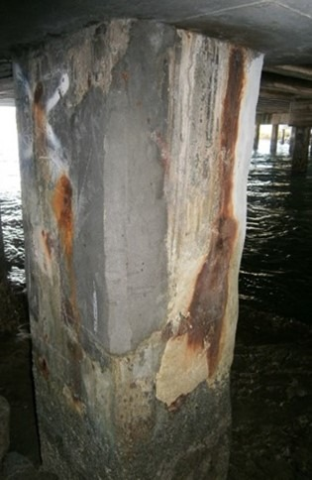
Thank you for your time.
For more information on corrosion or RAAC concrete:
christian@cp-tech.co.uk
Tuesday 15th October 2024

Slide 13
REFERENCES:
[1] IEA (2019), Global Status Report for Buildings and Construction 2019, IEA, Paris
[2] Y. Schwartz, R. Raslan, D. Mumovic, Refurbish or replace? The Life Cycle Carbon Footprint and Life Cycle Cost of Refurbished and New Residential Archetype Buildings in London, Energy, Volume 248, 2022, 123585, ISSN 0360-5442,
[3] R. Rodrigues, S. Gaboreau, J. Gance, I. Ignatiadis, S. Betelu, Reinforced concrete structures: A review of corrosion mechanisms and advances in electrical methods for corrosion monitoring, Construction and Building Materials, Volume 269, 2021, 121240, ISSN 0950-0618,
[4] M. G. Alexander, Service life design and modelling of concrete structures - background, developments, and implementation. Revista ALCONPAT, 8(3), p224 – 245, 2018
[5] N. Krishnan, D. K. Kamde, Z. D. Veedu, R. G. Pillai, D. Shah, R. Velayudham, Long-term performance and life-cycle-cost benefits of cathodic protection of concrete structures using galvanic anodes, Journal of Building Engineering, Volume 42, 2021, 102467, ISSN 2352-7102,
[6] K. J. Boam, Durability of Concrete Structures. Investigation, Repair, Protection, Transport Research Laboratory, E and F Spon Limited, p188-205, 1992, ISBN: 0-419-15620-8
[7] C. Stone, D. Bewley, G. Glass, The performance and Assessment of Galvanic Anodes in Concrete Structures, Corrosion Management, Jan/Feb, p25-29, 2024
[8] S.P. Holmes, G.D. Wilcox, P. J. Robins, G.K. Glass and A.C. Roberts, Responsive behaviour of galvanic anodes in concrete and the basis for its utilisation, Corrosion Science, 53(10) (2011). 3450
[9] N. Davison, G.K. Glass, A.C. Roberts, Hybrid Electrochemical treatment applied to corrosion damaged concrete structures. Construction Materials, 161, Issue CM4, p163–172, 2008
[10] C. Stone, S. Wheelhouse, N. Davison, G. Glass, Purely Galvanic Corrosion Management of Larger Structures, Structural Faults and Repairs, 2022
[11] J. Axworthy, How critical infrastructure can be made more climate-resilient, Raconteur, 20/07/2022
[12] C. Stone, M. Donadio, C. Christodoulou, N. Davison, Case studies of hybrid and galvanic systems on bridge structures, Concrete Solutions, MATEC Web of Conferences 289, 03013 (2019)
[13] S.R. Sharp, M.C. Brown, Survey of Cathodic Protection Systems on Virginia Bridges, Virginia Transport Research Council, Final Report VTRC 07-R35, June 2007
[14] ISO 12696:2022
[15] W. Green, S. Windred, J. Katen, Acidification induced deterioration of concrete cathodic protection systems and its management. Deakin University. Journal contribution, 2023.
[16] IP7/02 Reinforced autoclaved aerated concrete panels test results, assessment of design, BRE 2002
[17] Failure of Reinforced Autoclaved Aerated Concrete (RAAC) Panels SCOSS May 2019
[18] Reinforced Autoclaved Aerated Concrete (RAAC) Investigation and Assessment – Further Guidance, iStructE, April 2023
[19] C. Stone, C. Goodier, M. Liddel, Survey Report on the Condition of RAAC Roof Elements in NHS Properties, Loughborough University RAAC Research Group, 2023
[20] C. Stone, Solutions to Corrosion in RAAC Panels, Concrete, November 2023
Tuesday 15th October 2024

