Slide 1



2024 Parliamentary and Science Committee
The Role of the Institute of Corrosion in Corrosion Management
Stephen Tate – ICorr President
www.icorr.org
Tuesday 15th October 2024

Slide 2
Corrosion Management and ICorr - History
ICorr History 65 yrs old this year.
Founded in 1959 as the British Association of Corrosion Engineers and now the Institute of Corrosion (ICorr), to promote the dissemination of technical information about corrosion matters.
ICorr provides between 70-80 Technical Presentations / Seminars every year across its Branches/Divisions that contribute to an individual member’s Professional Development (CDP) requirements for Chartered Engineer status.
Extensive Classroom and Online Training offerings - Refer: https://www.icorr.org/training-qualifications/
Tuesday 15th October 2024

Slide 3
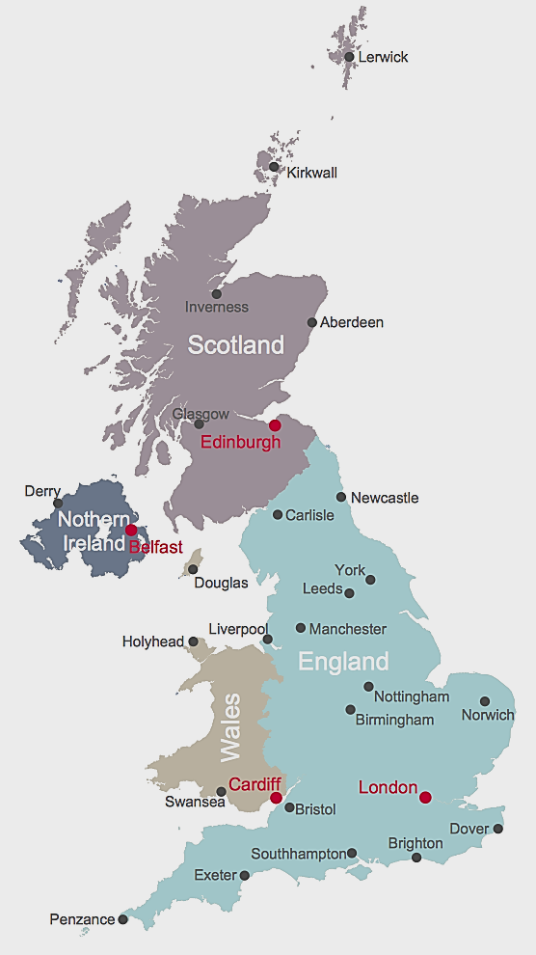

Corrosion Management and ICorr – UK Branches
Aberdeen - Largest
Grangemouth (New 2024)
Newcastle
Sheffield
Manchester
Birmingham
Swansea (New 2024)
London
Future (NI)
Grangemouth
Future
Sheffield
Tuesday 15th October 2024

Slide 4
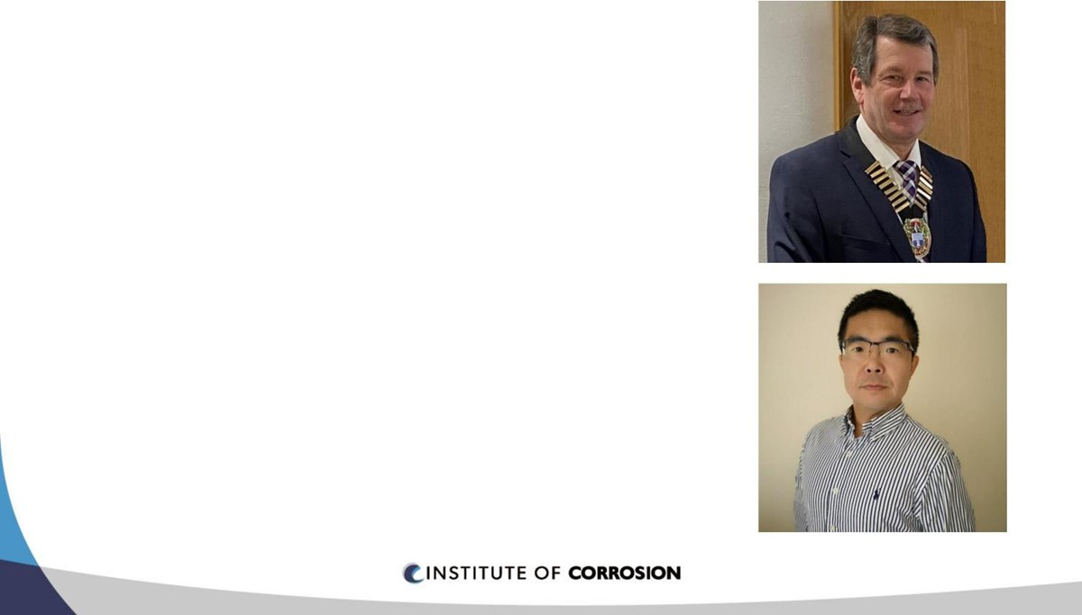
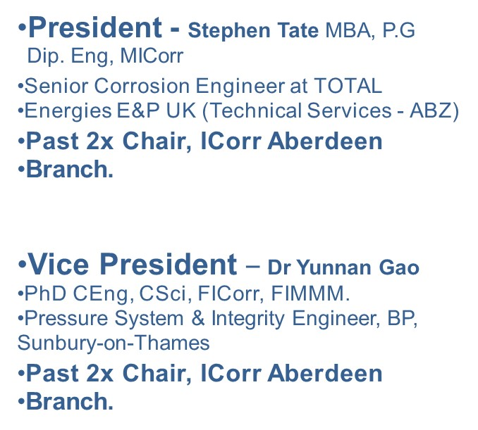
Corrosion Management and ICorr – Trustees and Council
President and Vice President
Trustees (4) and Council (20)
Tuesday 15th October 2024

Slide 5
Corrosion Management and ICorr - Membership Breakdown
Total Members 2024: around 1,500 members (UK and Overseas based).
Includes:
Student Members: 20%
Company Members: 35%
Local Branch Committees: 5%
Balance Individual Members: 40%
Tuesday 15th October 2024

Slide 6
Corrosion Management and ICorr - Education and Skills Training
The role of ICorr within the Corrosion Management field, is primarily one of Corrosion Awareness education together with ‘specific skills training’ to improve competency in Corrosion Prevention.
Every year the Institute in conjunction with its authorised training partners delivers approved training courses to many thousands of Apprentices, Applicators, Engineers, Technicians, Inspectors and Supervisors working in the Corrosion Prevention industries.
Tuesday 15th October 2024

Slide 7
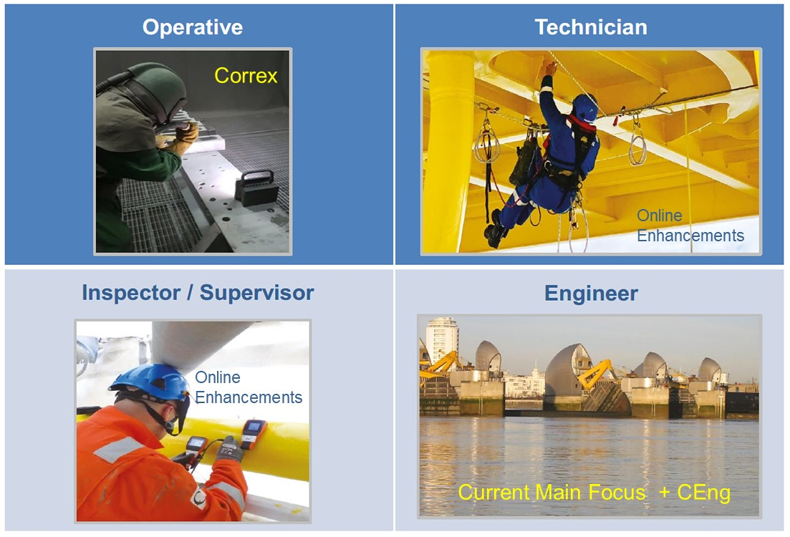
Corrosion Management and ICorr - Training Types
Tuesday 15th October 2024

Slide 8
Corrosion Management and ICorr – Recent Training Expansion
Cathodic Protection
40x CP Courses expected
to run in 2025
Buried, Concrete and
Marine CP
Tuesday 15th October 2024

Slide 9
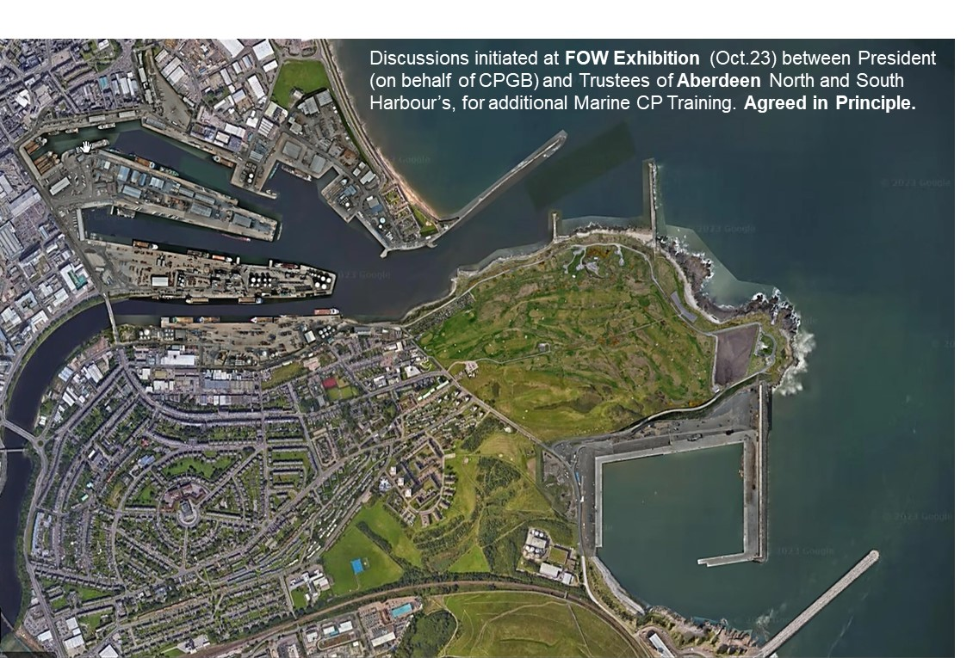
ICorr - New Marine Training Centre (2025) – Port of Aberdeen
Tuesday 15th October 2024

Slide 10
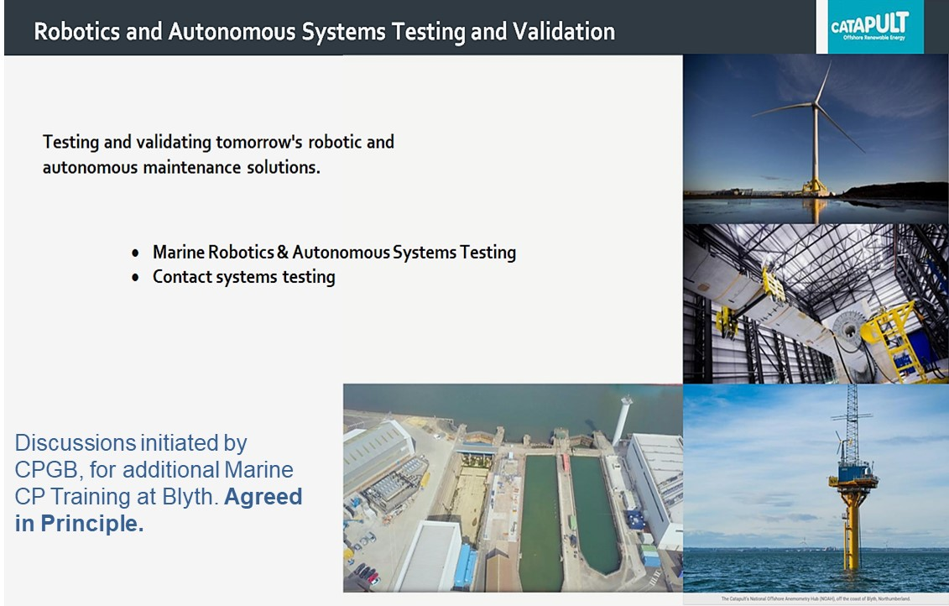
ICorr - New Marine Training Centre (2025) – Port of Blyth
Tuesday 15th October 2024

Slide 11
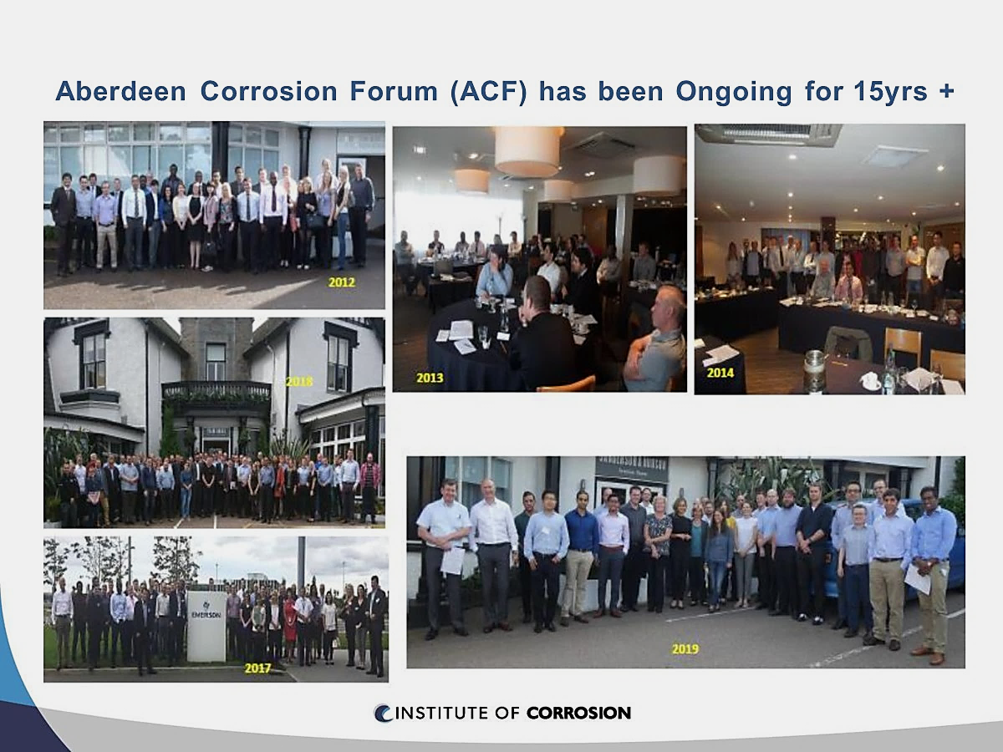
Corrosion Management and ICorr – Corrosion Awareness Forums
Tuesday 15th October 2024

Slide 12
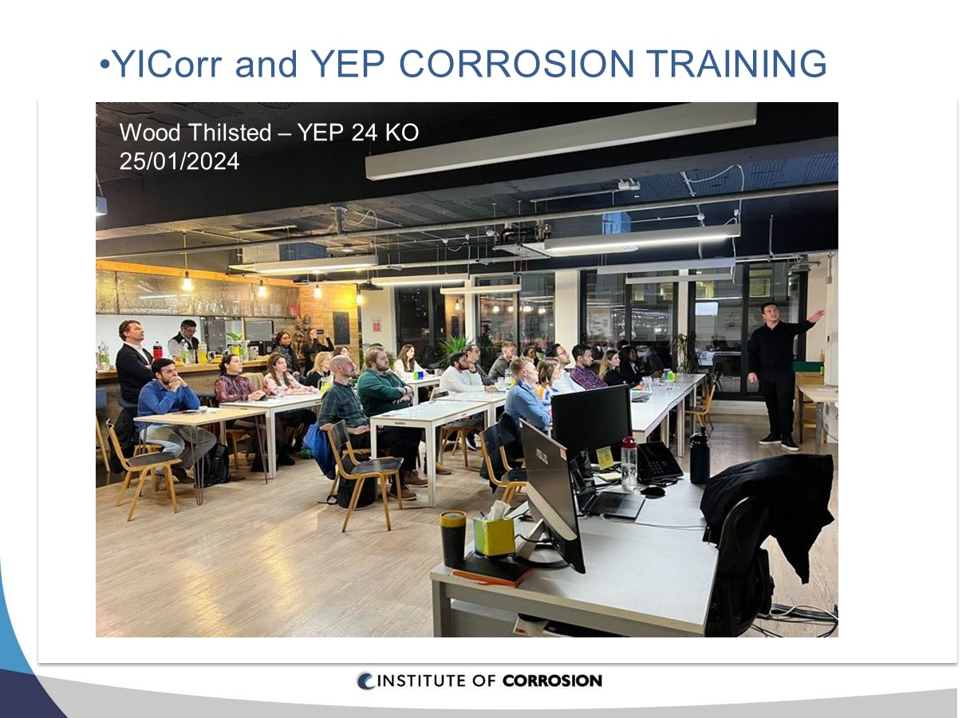
Corrosion Management and ICorr – Young ICorr
Work of YICorr/YEP
Young ICorr
Tuesday 15th October 2024

Slide 13

Corrosion Management and ICorr – New University Bursaries
New Bursaries
Tuesday 15th October 2024

Slide 14

Thank You for your Attention
Presenter Details
Stephen Tate
Email: president@icorr.org

