Slide 1
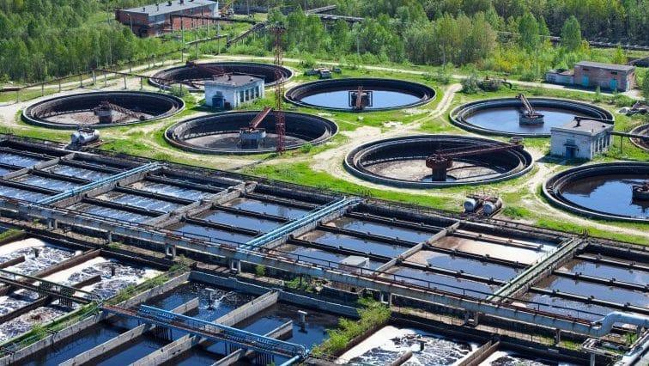



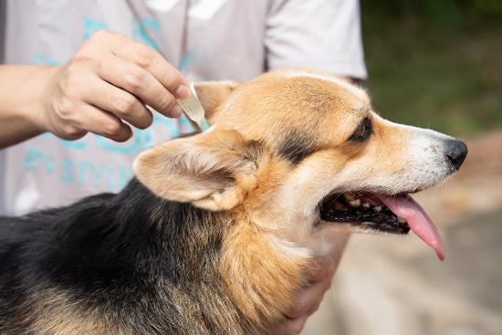
Pet Parasiticides in Water
Potential solutions to this hidden
‘One Health’ chemical threat
Leon Barron
MRC Centre for Environment and Health, Environmental Research Group, School of Public Health, Faculty of Medicine, Imperial College London, United Kingdom
Email: leon.barron@imperial.ac.uk

Slide 2
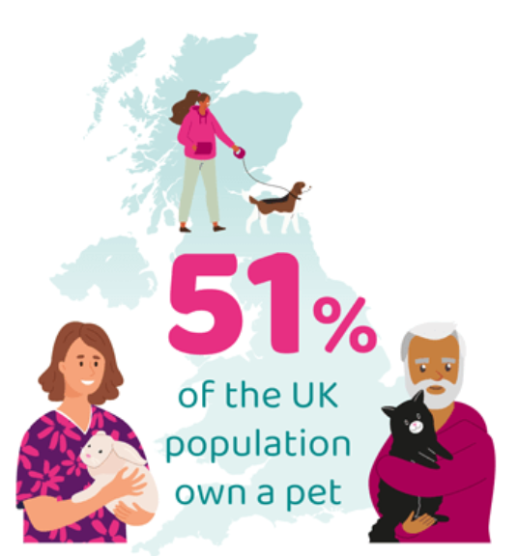

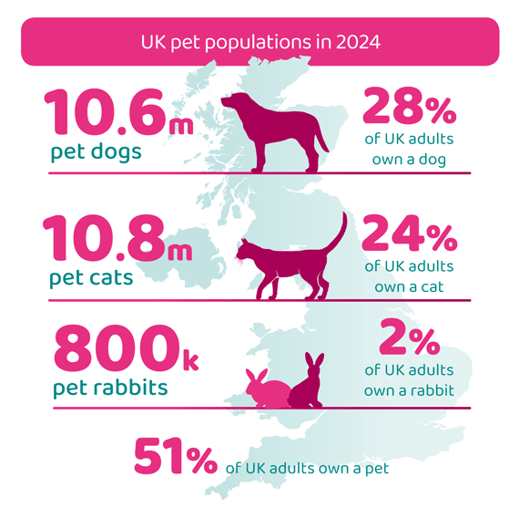
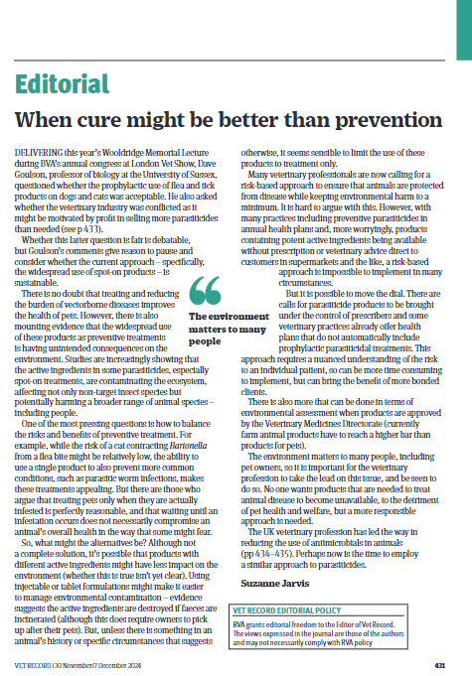
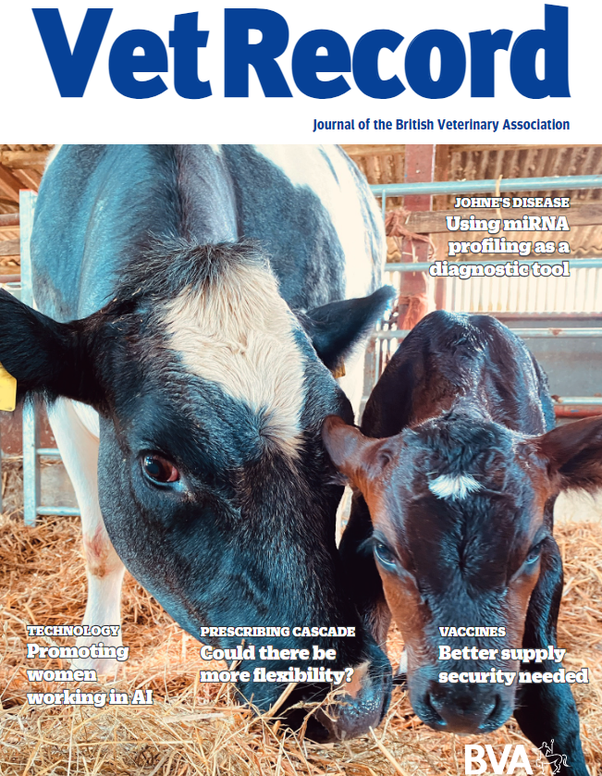

Pets and Flea Treatments in the UK PDSA PAW Report 2024
“Spot-ons”
Chewables and Tablets
Collars
Source: https://www.pdsa.org.uk/what-we-do/pdsa-animal-wellbeing-report/paw-report-2024

Slide 3
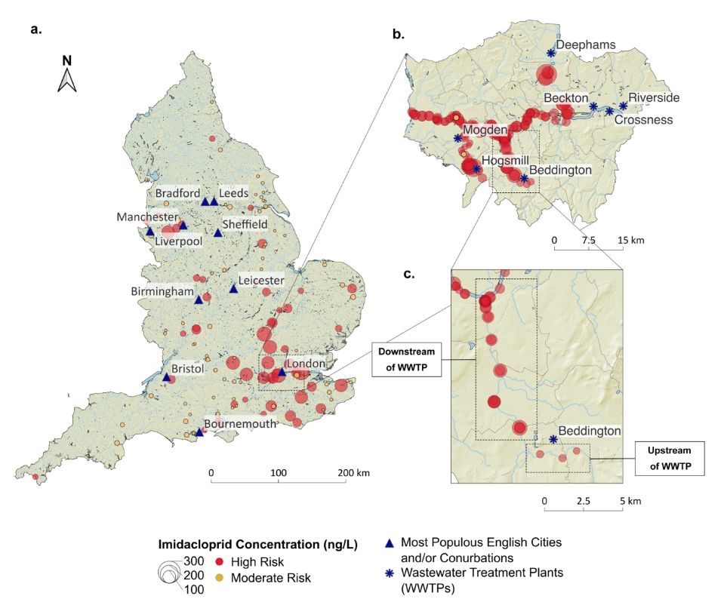

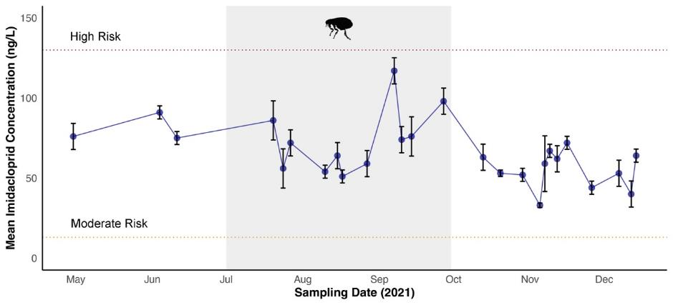
Sources Wastewater
Perkins et al., STOTEN, 917, 2024, 170175
Untreated Wastewater
n=423 x 24-h composite samples
Egli, Env. Int.,
180, 2023, 108210
Richardson et al.,
STOTEN,
839, 2022, 156260
Treatment ineffective!
River Water
Woodward et al., 2024
Source: https://www.data.gov.uk/dataset/0c63b33e-0e34-45bb-a779-16a8c3a4b3f7/water-quality-monitoring-data-gc-ms-and-lc-ms-semi-quantitative-screen

Slide 4
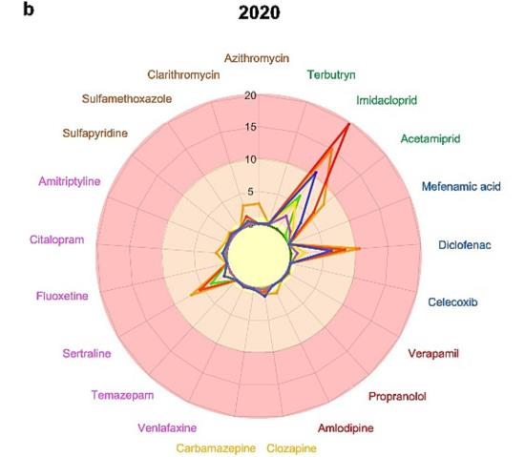
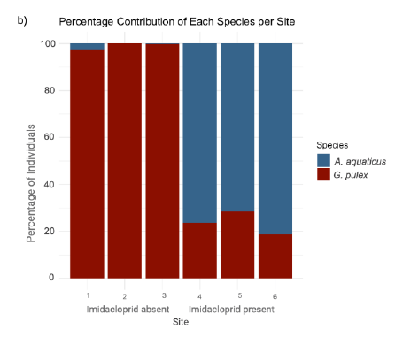
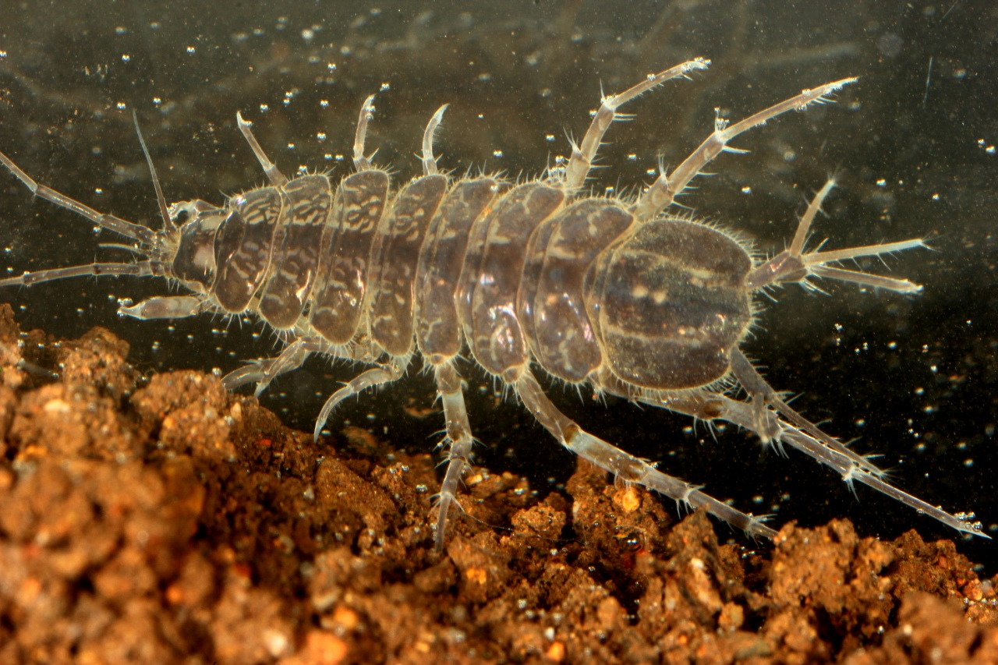
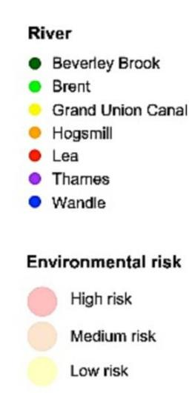

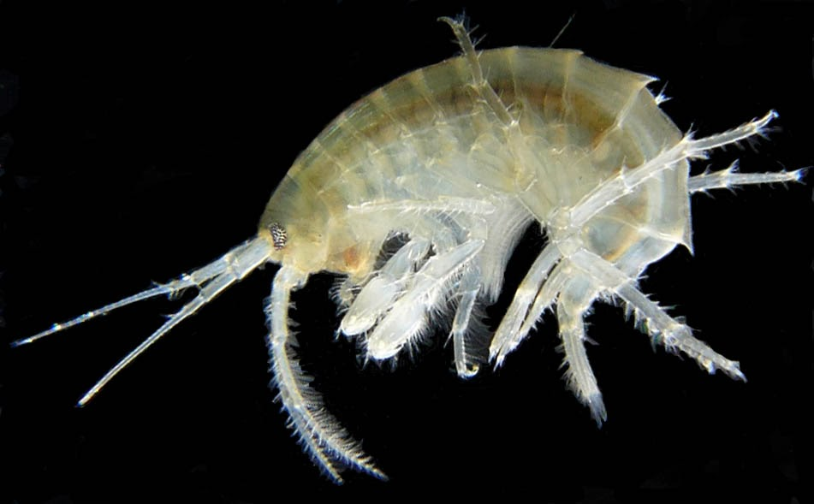
Risk Assessment
Imidacloprid
Highest Risk!
High risk
Medium
Low
Roseline O’Kelly
Guy Woodward, 2024
Egli et al., Environment International, 180, 2023

Slide 5
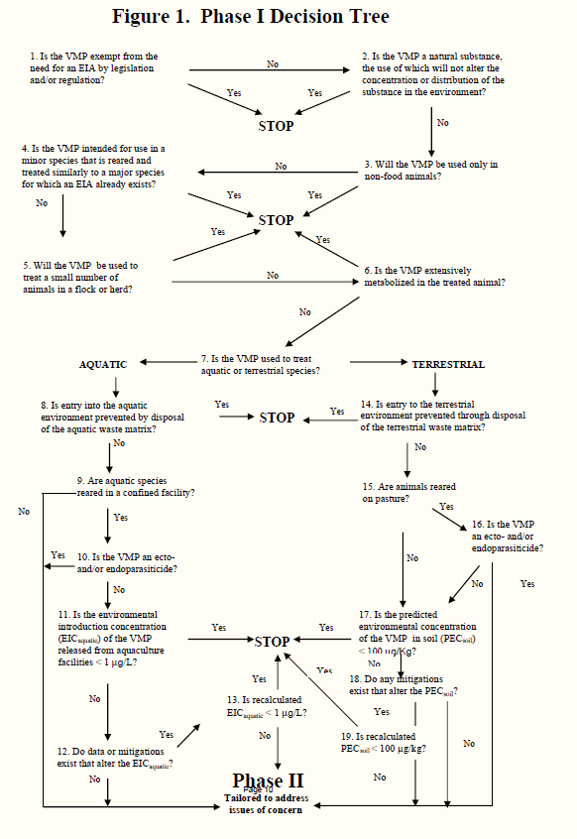
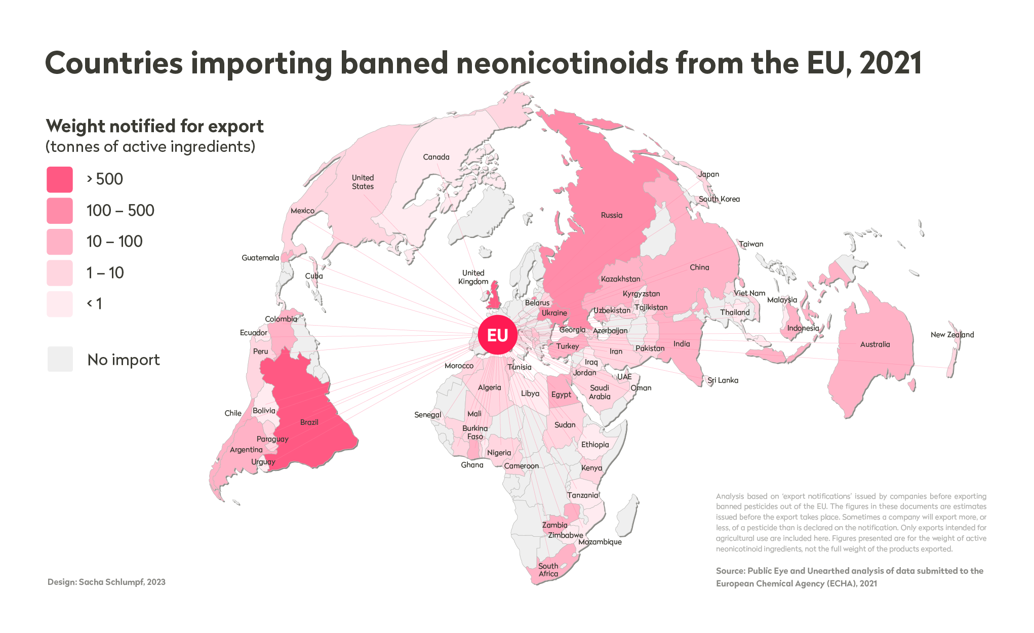
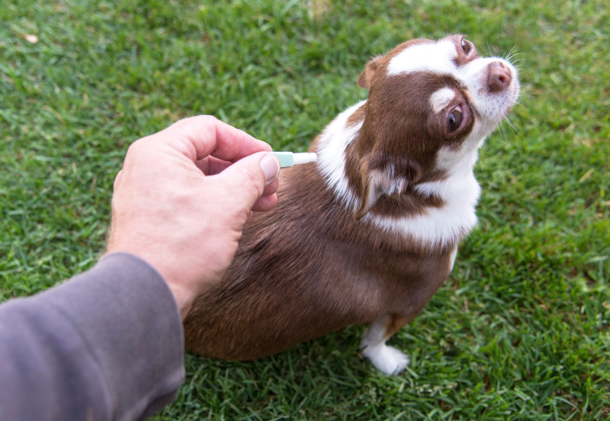
Why is this happening?
Market Repositioning and Policy Gaps
RA Stops Here!
Dowler, C. & Gaberell, L. EU Sending Huge Quantities of Banned, Bee-Killing Pesticides to Poorer Countries, Documents Reveal, https://www.publiceye.ch/en/topics/pesticides/eu-sending-huge-quantities-of-banned-beekilling-pesticides-to-poorer-countries-documentsreveal

Slide 6
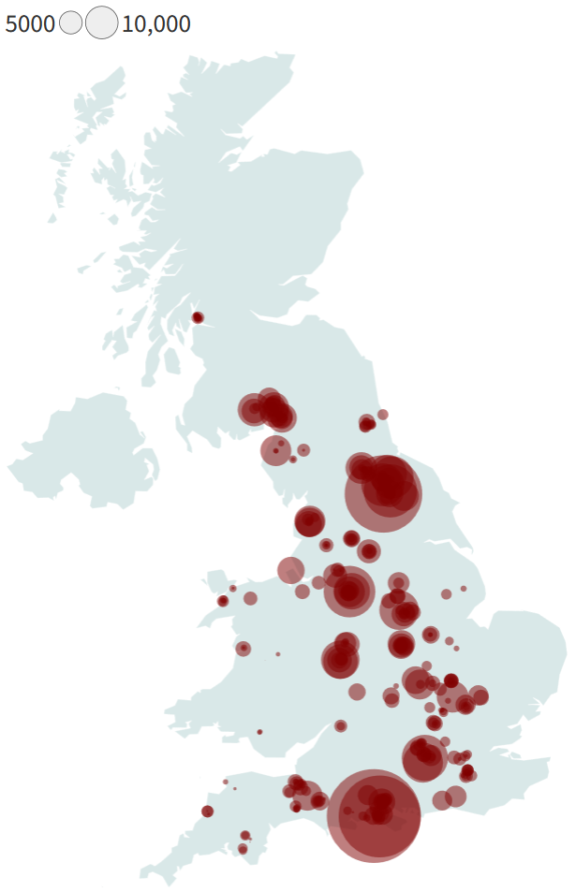
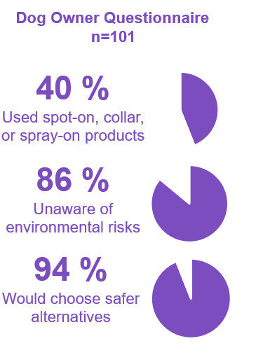
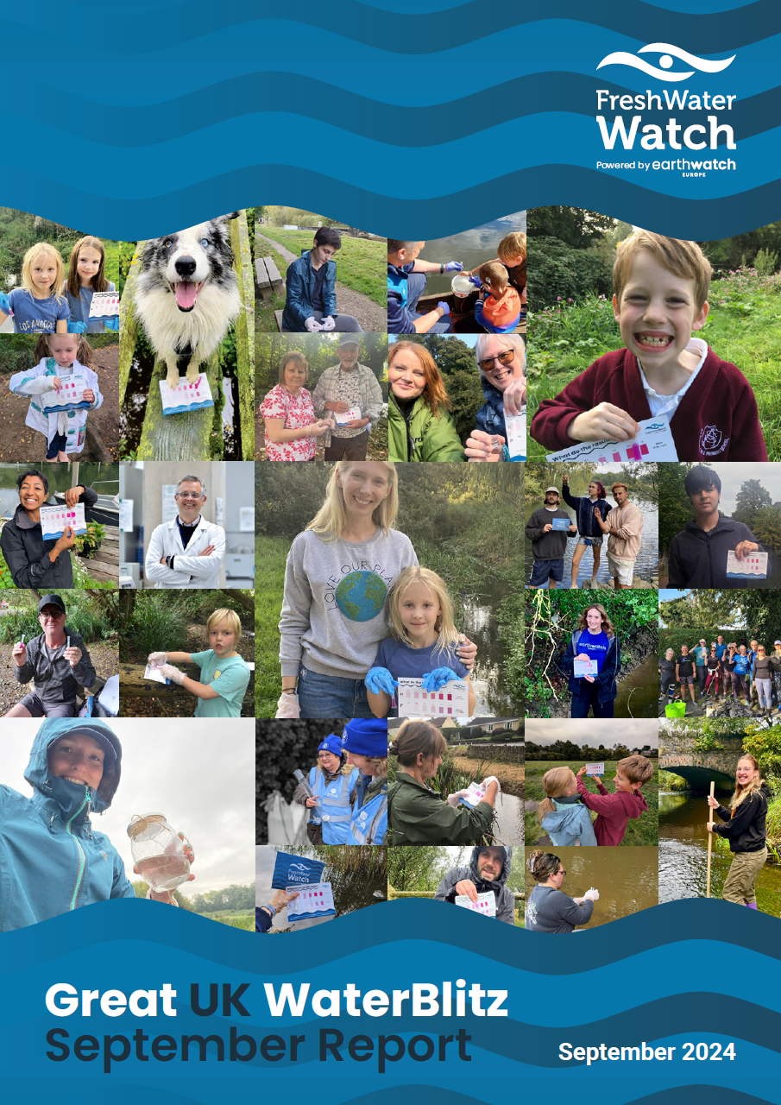
Empowering Communities
Large-Scale Chemicals Monitoring
led by the General Public
Sept 2024
Yoder et al., STOTEN, 955, 2024, 176686
https://www.freshwaterwatch.org/pages/great-uk-waterblitz-results

Slide 7


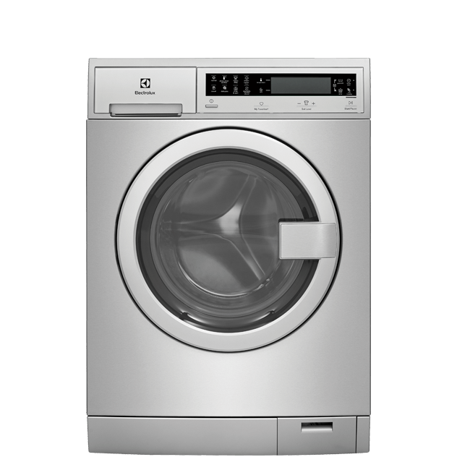
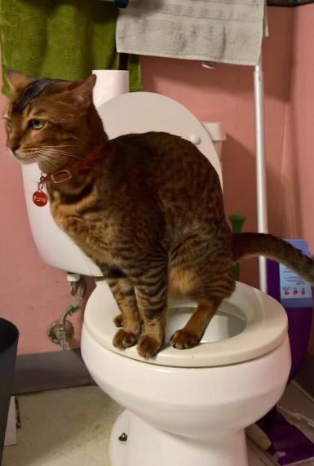
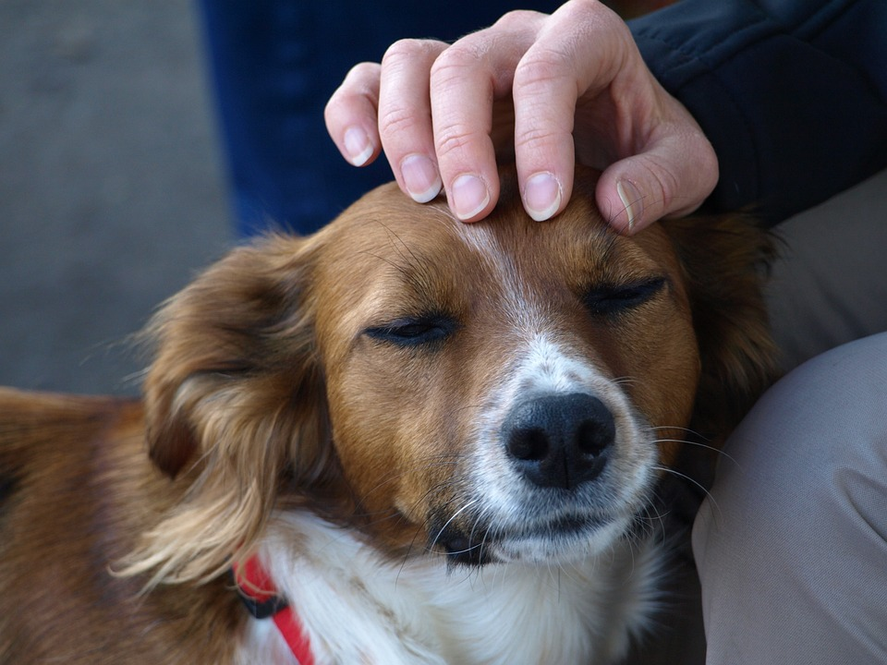
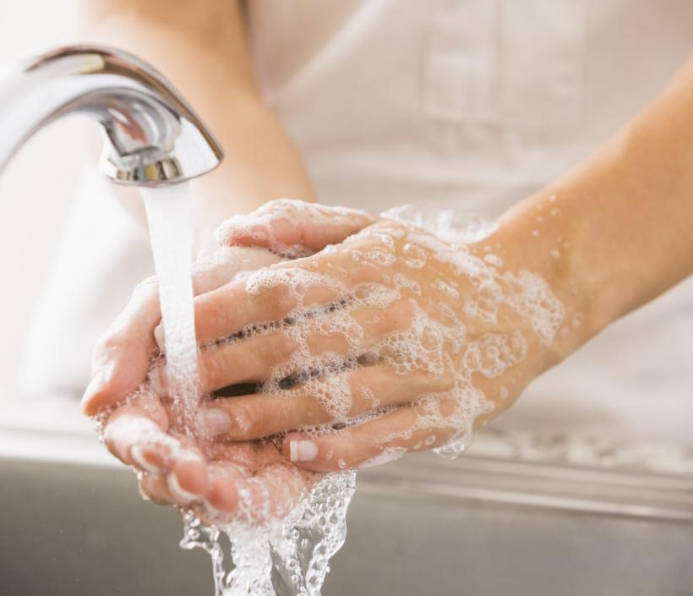

In the Home
  98 dogs with spot-on treatment over 28 days
Perkins et al., STOTEN, 917, 2024, 170175

Slide 8
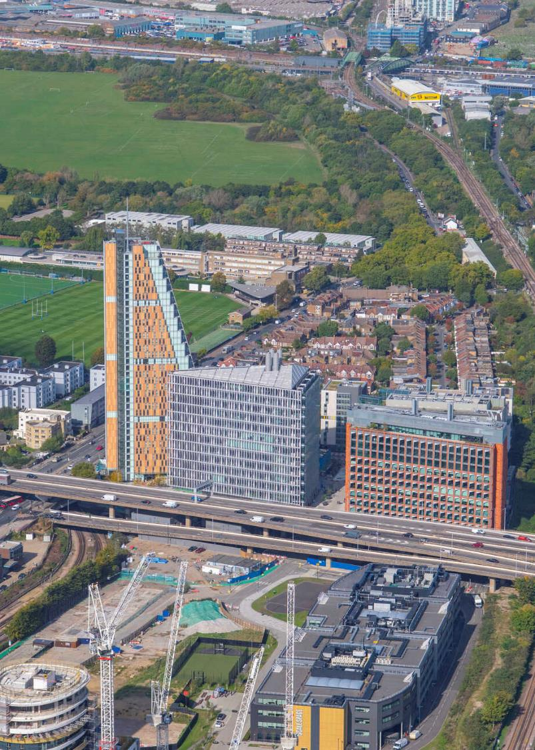
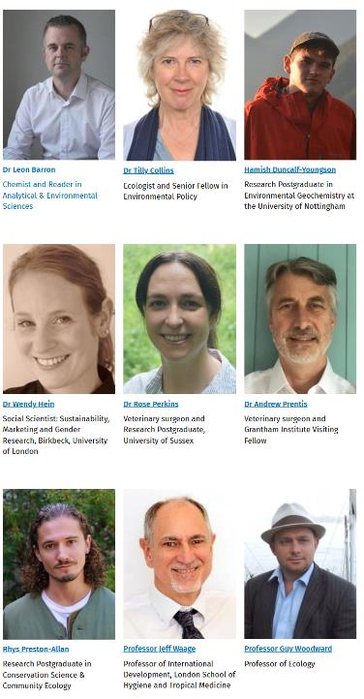
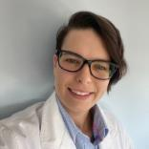
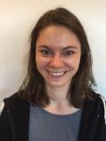


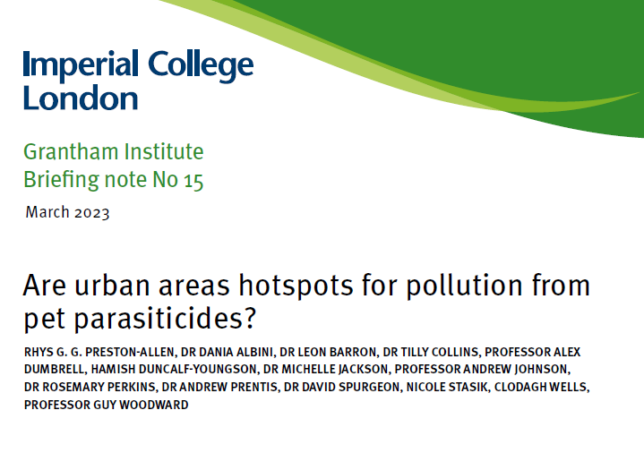





Thank you for listening!
Any questions?
Solutions
Regulatory system review
Engage vets and local communities to raise awareness
Match use to the real treatment needs
Phase out continuously failing treatments
Safe disposal scheme
New wastewater treatment technologies needed
Reduce sewage overflows
Catchment-scale management strategies
PREPP - Producing Rational Evidence for Parasiticide Prescription
ECC Research Group
Alex Richardson
Mel Egli
Stav Friedman
Are urban areas hotspots for pollution from pet parasiticides? [PDF]

Slide 9
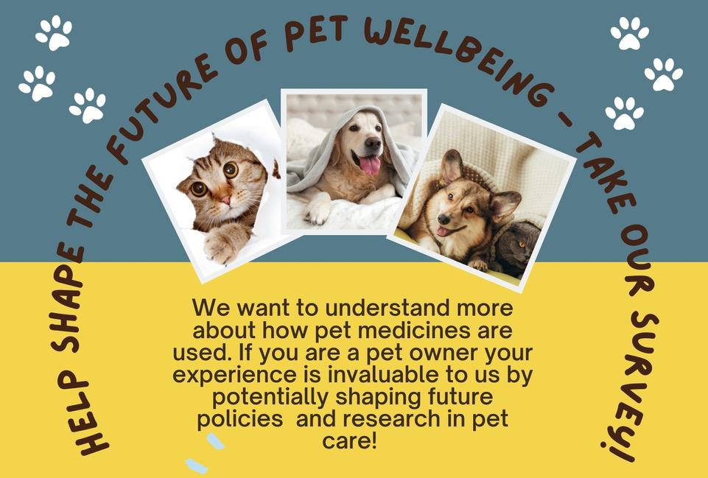

Get involved!

