Slide 1



First Do No Harm:
Addressing the Communication of Risk in Healthcare and MedTech
Presented by
Prof. Helen Meese CEng MIMechE MIPEM MWES FRSA
CEO, The Care Machine Ltd

Slide 2

The Role of Scientists & Engineers
Simplify without distorting complex data
Contextualise risks using relatable examples
Acknowledge uncertainties to build trust

Slide 3
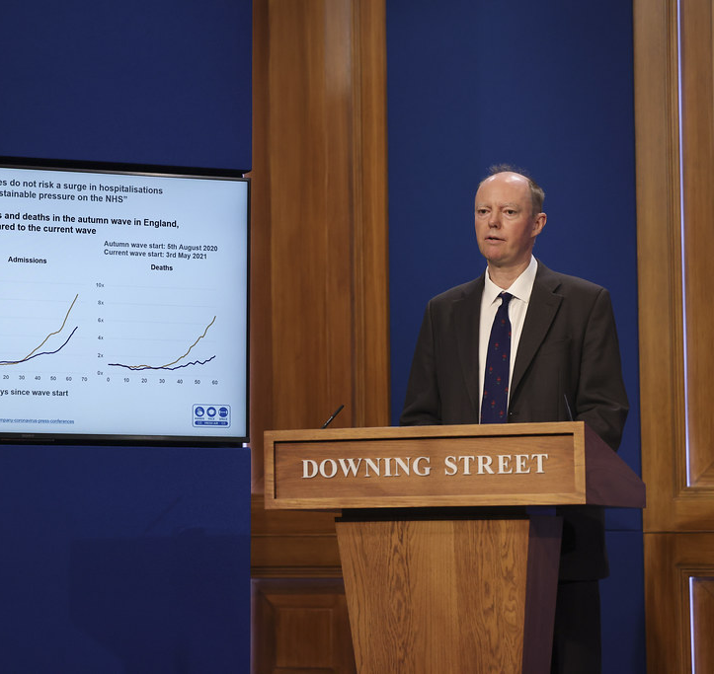
How Parliamentarians Should Communicate Risk
Prioritise clarity in presenting healthcare data
Ask the right questions to ensure comprehensive oversight
Avoid sensationalism to maintain public trust

Slide 4


Trade-Offs in Risk & Timeframes
Every decision carries life-or-death implications
Immediate risks often overshadow long-term consequences
Transparency and acknowledgment of uncertainties
Strive for consistency in risk management practices

Slide 5
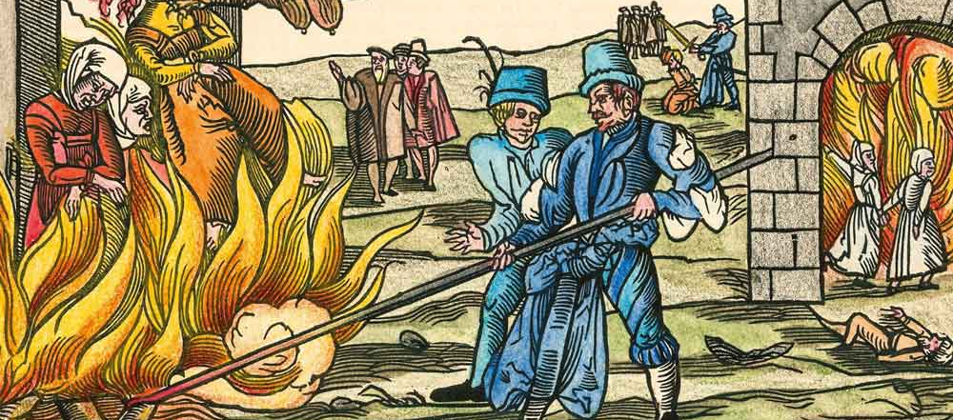
Societal Tolerability of Risk
Perception of 'dread risks' vs. statistical risks
Addressing public concerns through relatable communication
Bridging the gap between expert analysis and public sentiment

Slide 6

The Difference Between Uncertainty & Risk
Risk: Known probabilities (surgery complication rates)
Uncertainty: Unknown probabilities (long-term effects of new treatments)
Strategies: Ongoing research and adaptive strategies

Slide 7
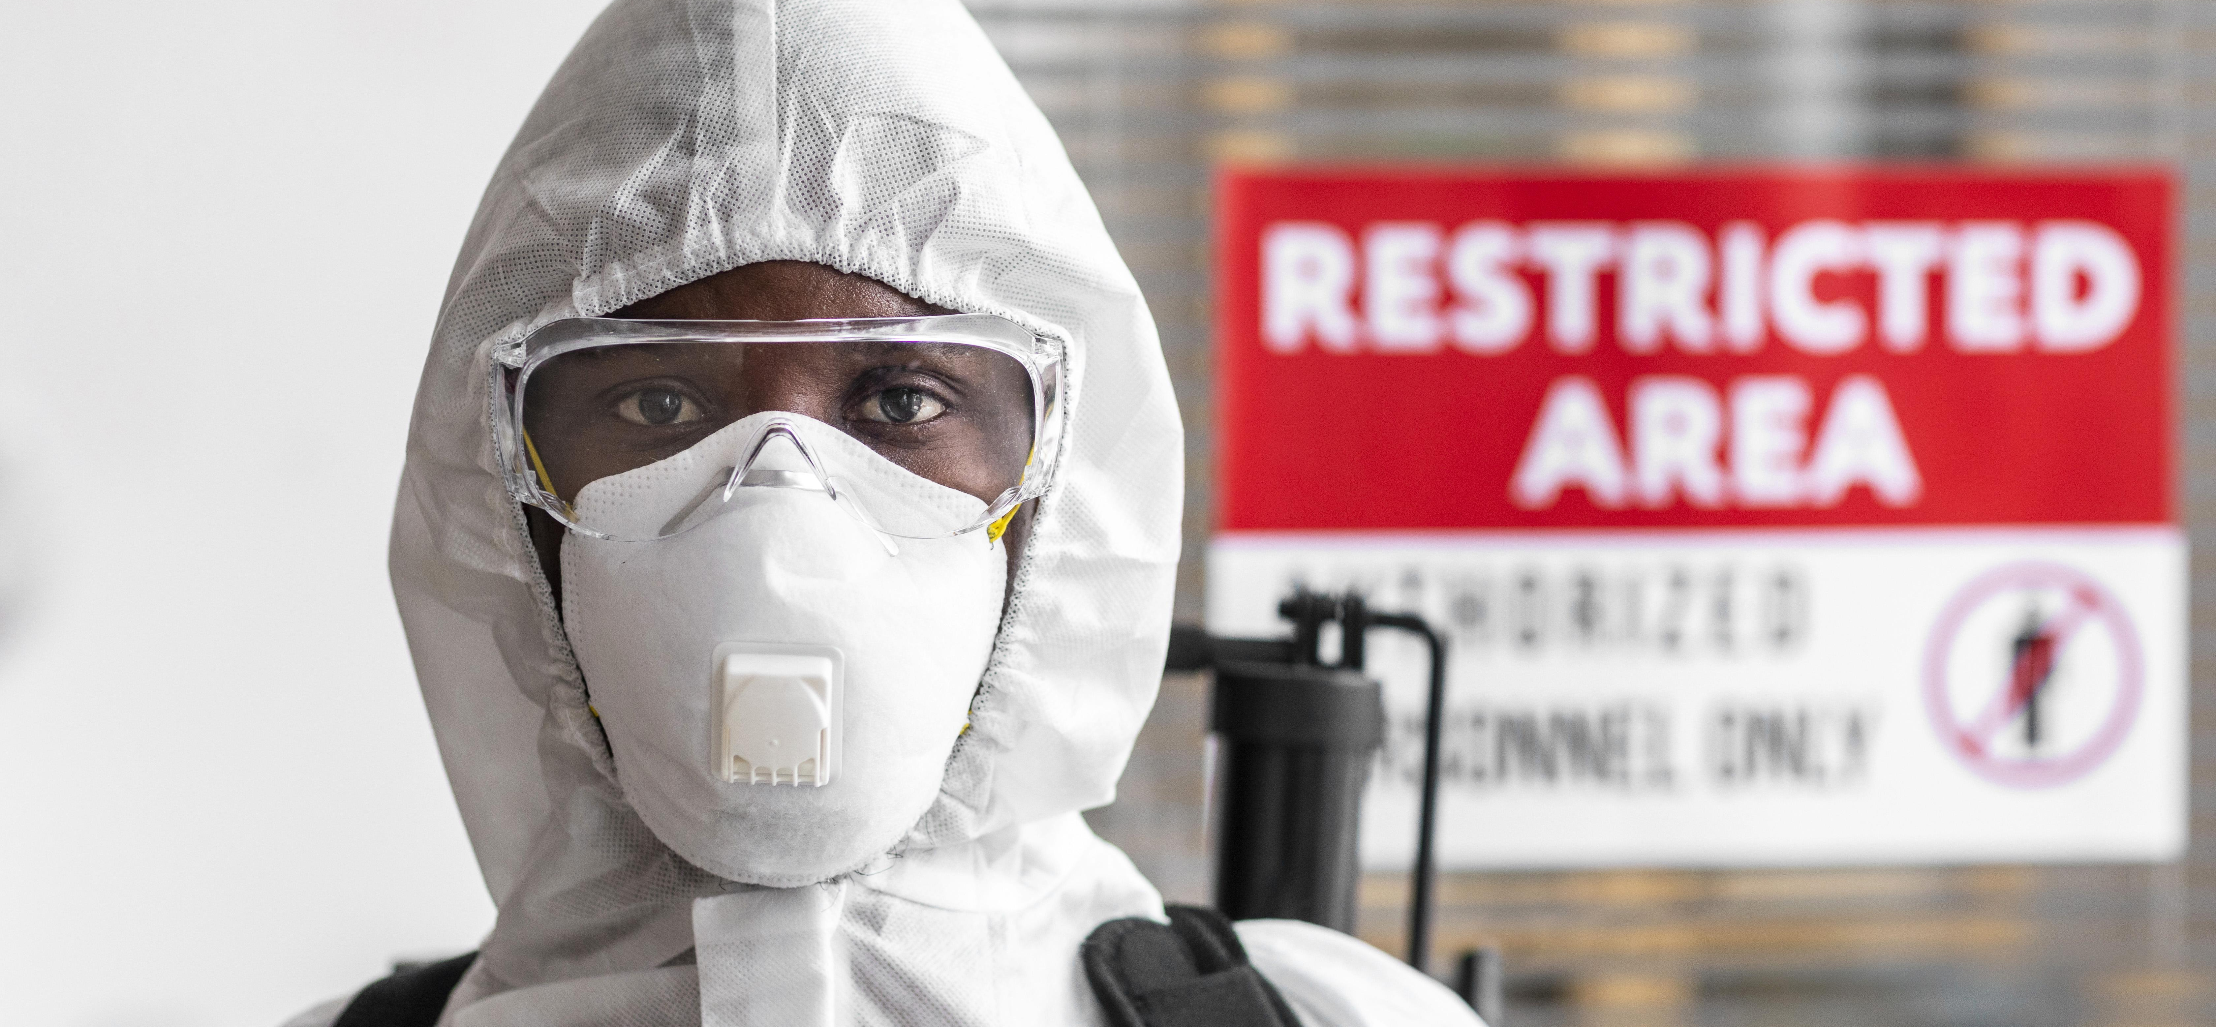
There Is No Such Thing as Zero Risk
Every intervention carries some level of risk
Minimize risk to acceptable levels while maximizing benefits

Slide 8
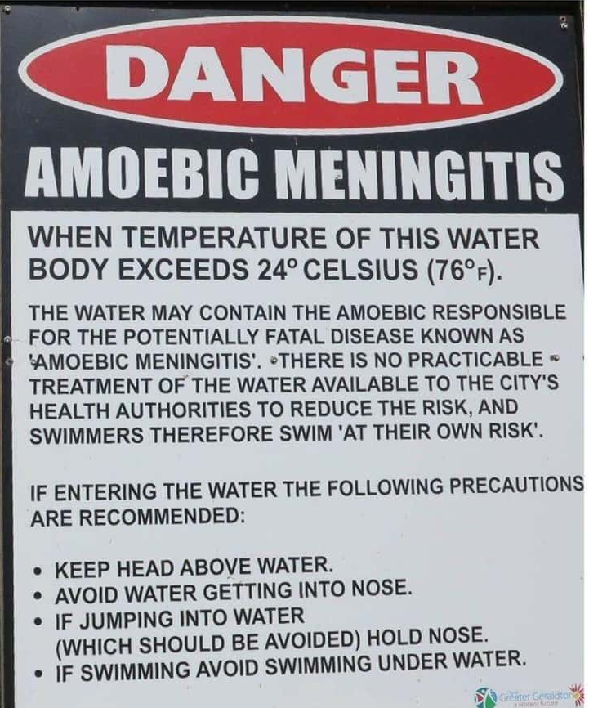
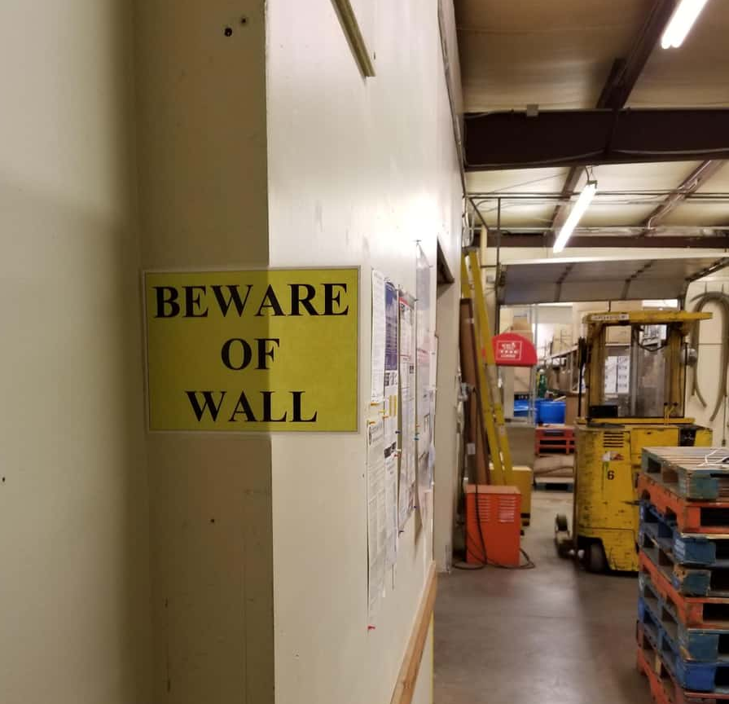

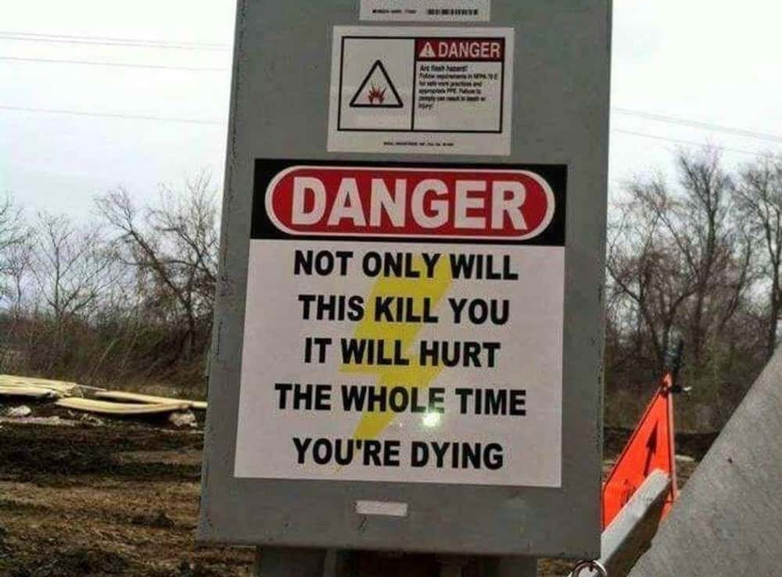
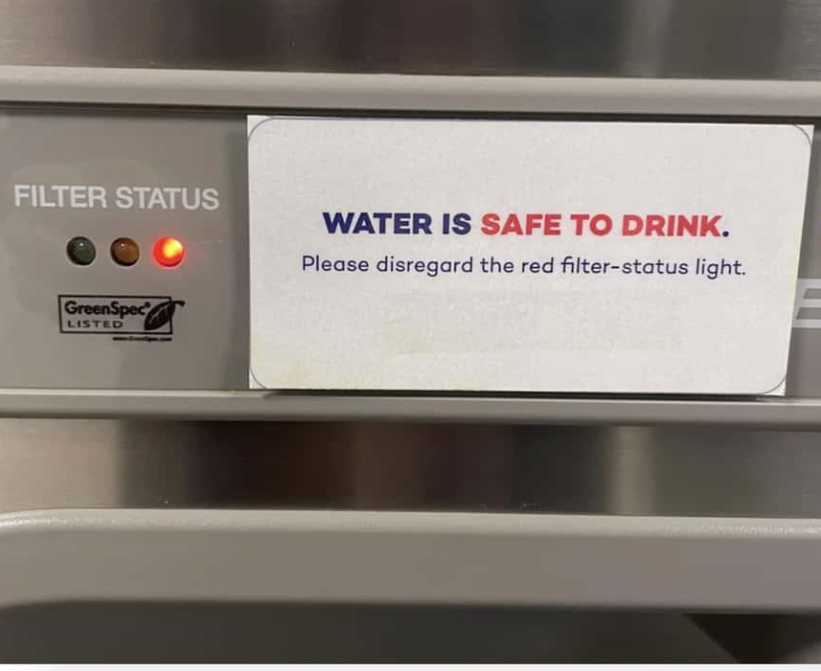
The Language of 'Safety'
Avoid oversimplified declarations of safety
Highlight adherence to rigorous standards such as ISO 13485
Build trust by explaining benefits vs. risks

Slide 9
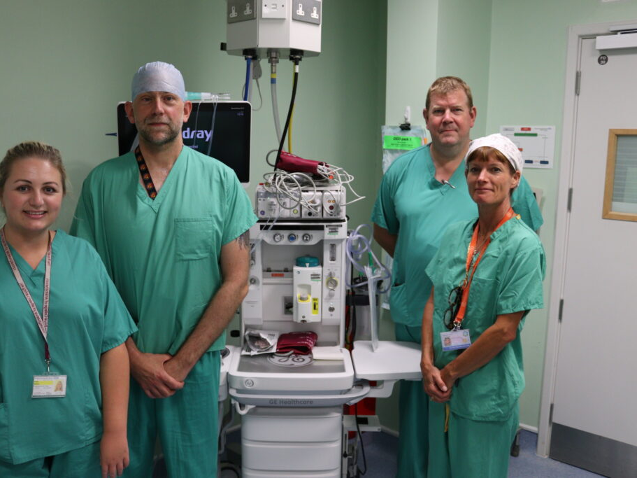
Conclusion
Effective risk communication in healthcare requires:
  Clarity, transparency, and empathy
  Addressing trade-offs and uncertainties
  Empowering informed decision-making

Slide 10


FOR MORE INFORMATION:
 | www.thecaremachine.com
 | info@thecaremachine.com
 | www.linkedin.com/company/thecaremachine/

