Slide 1
Ten to the minus six… like that’s ever going to happen!
Reflections on the internal and external language of risks, tolerability and trade-offs from Hazards Forum’s interest groups
Richard Roff, January 2025
Notes:
The interest groups cover:
Natural hazards
Engineered systems hazards
Emerging technology hazards
Sectors and personal experiences cover:
Meteorology, climate, medicine, nuclear energy and fuels, military, oil – gas – chemicals- pharmaceuticals, steel-making, construction, human and behavioural factors, transport systems, and more…

Slide 2


Risk
Hazard ≠ Risk
Consequence and likelihood need to be combined
Uncertainty can be difficult to model
How
bad?
RISK
Statistical view
Philosophical view
How often?
Notes:
High hazard activities my have low risk and vice versa
Understanding uncertainty – (archived webpage, an output of the Winton programme for the public understanding of risk, Cambridge)

Slide 3
The language of risk
Numerical vs word-models
Catastrophic
Extremely serious
Major
Serious
Minor
Not significant
Foreseeable event but chance of occurring is very low - requires the failure of many layers of protection
1 in 10
per day, year, operation?
1 in a million…
10⁻⁶
And how sure are we?
Extremely unlikely
Very unlikely
Unlikely
Possible
Probable
Regular
Could occur during remaining lifetime of installation. Root causes have been seen during lifetime of the installation
Notes:
Numerical – word-models
Scenario-based – not just ‘someone is hurt at work’, but ‘release of energy from X equipment and someone nearby = injury this bad’
May focus on high-hazards or high-consequence events
w.r.t. H&S (at work) and E there are legal requirements
SFAIRP
Tolerability of risk

Slide 4
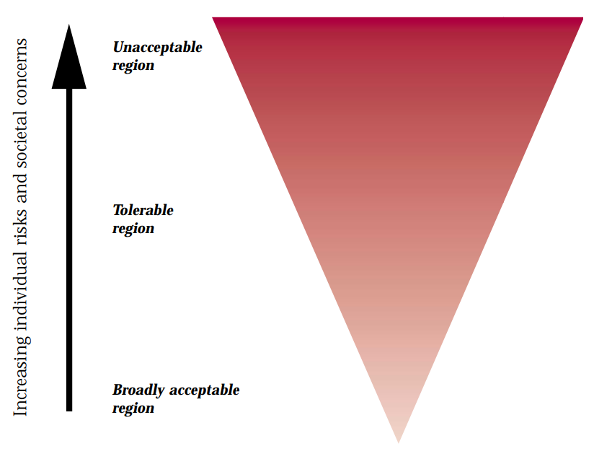
The language of risk
Legal requirements to manage risks
Individual vs societal tolerability of risk
May be different between sectors
*HSE – R2P2
Notes:
Numerical – word-models
Scenario-based – not just ‘someone is hurt at work’, but ‘release of energy from X equipment and someone nearby = injury this bad’
May focus on high-hazards or high-consequence events
w.r.t. H&S (at work) and E there are legal requirements
SFAIRP
Tolerability of risk

Slide 5


Communicating risk
High – medium – low
Red – amber – green
Risk ‘equivalence’?
What audience?
How
bad?
How often?
Winton Centre for Risk and Evidence Communication
John Aston – Harding Professor of Statistics in Public Life
Notes:
What does high risk or low risk mean to you?
Colours are culturally significant – is amber ok?
If some monetary calculation is done – perhaps actuarially converting likelihood & consequence to a value in pounds, then it is very easy to misrepresent the high consequence events: a major structural collapse will cost whatever it costs whenever it occurs.
See trade-off later
Audience (consider between practitioners, with other parties) – is this type of output suitable
Winton Centre Cambridge fixed term project…(links within for journalists, policymakers and practitioners but not so much for hi-haz (though risk matrix leaflets))
John Aston – Harding Professor of Statistics in Public Life

Slide 6
Communicating risk
The danger of ‘zero’ …
Need to consider resilience in some areas and not just risk
How
bad?
How often?
Notes:
Zero and Never – see normal accidents (next slide)
Need to consider resilience in some areas and not just risk (e.g. prevent flood or be resilient to flood)
Blue risk with more resilience may be less impactful than the pink at the same level of consequence

Slide 7
Complexity: normal accidents
Preconditions for ‘normal accidents’ are:
The system is complex
The system is tightly coupled
The system has catastrophic potential
Cascading risks may be difficult to model
Must watch out for ‘creeping’ change
*Charles Perrow
Notes:
Normal Accidents – Wikipedia
Charles Perrow (1984)
Spider’s web of blame from Grenfell inquiry – an example of a ‘normal accident’?
Modern, interconnected systems like banking, communications, power, transport systems…
Cascading risks
e.g. weather-power generation/energy distribution, essential service operation…
And these may be owned, operated by different organisations so who should take the overview.

Slide 8
Trade-offs
Dissimilar risks
Conversion of risk to cost
  is that helpful if the event is catastrophic
Tolerability
  may be different prospectively to retrospectively
  may be different based on knowledge and experience of viewer
Dread-risks
Notes:
Dissimilar risks
Safety – environmental protection
Safety – embedded carbon
Energy trilemma (cost/green-ness/resilience)
Conversion of risk to cost – is that helpful if…
UK gov Green Book (makes ref to biases)
Tolerability may be different prospectively to retrospectively and also based on knowledge and experience
Dread-risks
are they amenable to estimation
May have non-linear tolerability across a population and with respect to effects
need to take consequence-led approach to resilience and emergency planning

Slide 9
Risk crystallisation – it will…
But where and when?
Weather – climate
Activity – exposure
Individual risks – population risks
Immediate system – cascading risks
Notes:
Organisations must not forget to look after the barriers (also next slide)
There may be trade-offs in time
There may be trade-offs in the number of times an activity is carried out
The location of the (worst) consequence might be different to the initiator
Perso
Risks crystallise - But where and when?
Weather – climate [timescale difference]
Activity – exposure [heightened risk and timescale differences]
Individual risks – population risks [personal choice, policy choice
Immediate system – cascading risks [location of risk, spread of risk outcomes]
nal choices may affect societal good and vice versa

Slide 10
Risk as calculated vs risk today
Unprotected risk vs final risk
Inherently safer – a better choice
Barrier status
HAZARD
LOSS
BARRIERS
Notes:
Unprotected risk
If too high then add barriers but…
Inherently safer is better (simpler, maybe cheaper, easier to maintain, build etc. so we may need to challenge a rush to ever more complicated risk controls – see next slide)
Then if risk controls are needed they have become critical
So: are they working?
What can go wrong? what must go right? what do we know about that?

