Slide 1
Building a Healthcare Science Workforce Equipped to Face the Grand Challenges

Slide 2
Institute of Physics and Engineering Medicine
The Institute of Physics and Engineering in Medicine (IPEM) and is the professional organisation that represents and provides scientific leadership to:
Physicists
Engineers
Technologists
We are a charity with more than 4,600 members drawn from
Healthcare
Academia
Industry

Slide 3
Medical Physics and Clinical Engineering Guy’s and St Thomas’ NHS Foundation Trust: an exemplar
200+ members of staff
Supports – ~ 3 million patients per year through
Diagnostic tests and treatments
4200 patients received radiotherapy treatments and Brachytherapy was about 100 of those patients, but some of the most complex.
Supports – Responsible for £300 million of equipment at the trust.
Therefore even a small increase in established posts can have a huge impact on the volume and quality of services we provide and support

Slide 4
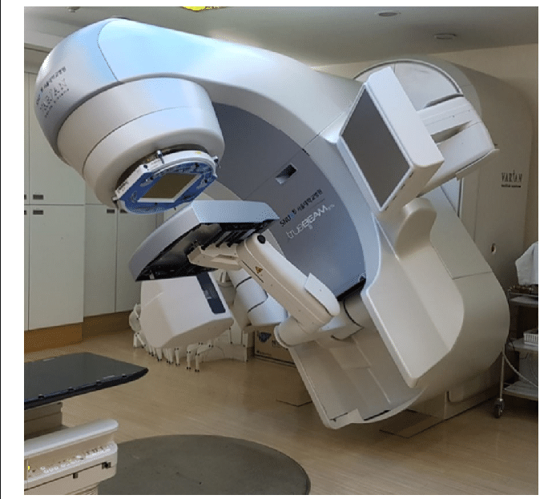
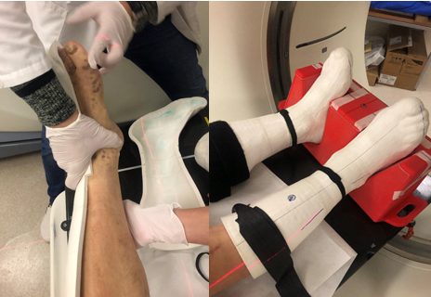
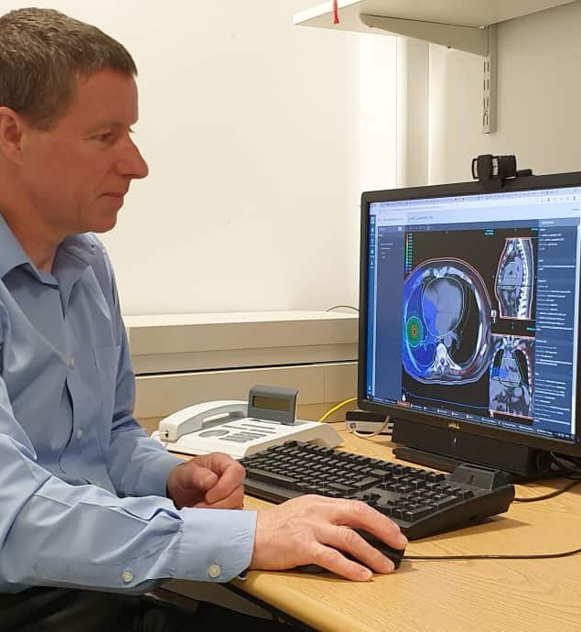
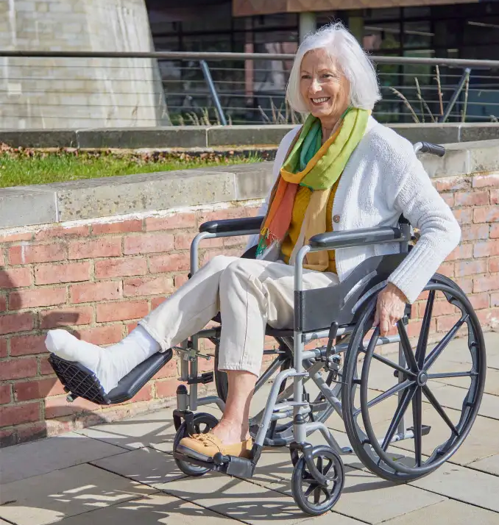
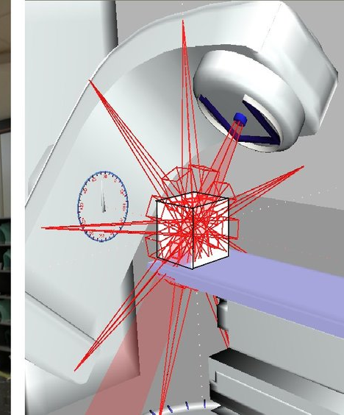
Radiotherapy: A patient story
Radiographer
Administrator
IT/Estates
MDT
oncologist
nurse
Physicist/engineer

Slide 5
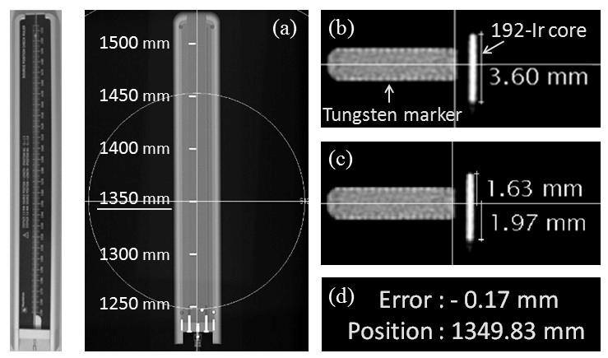
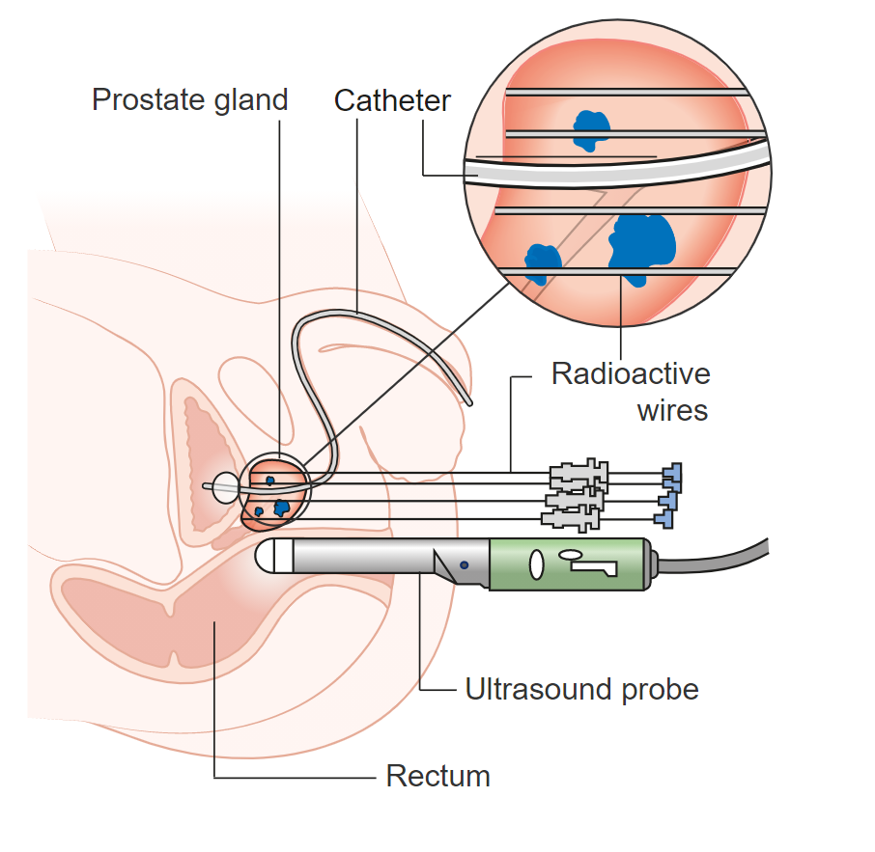
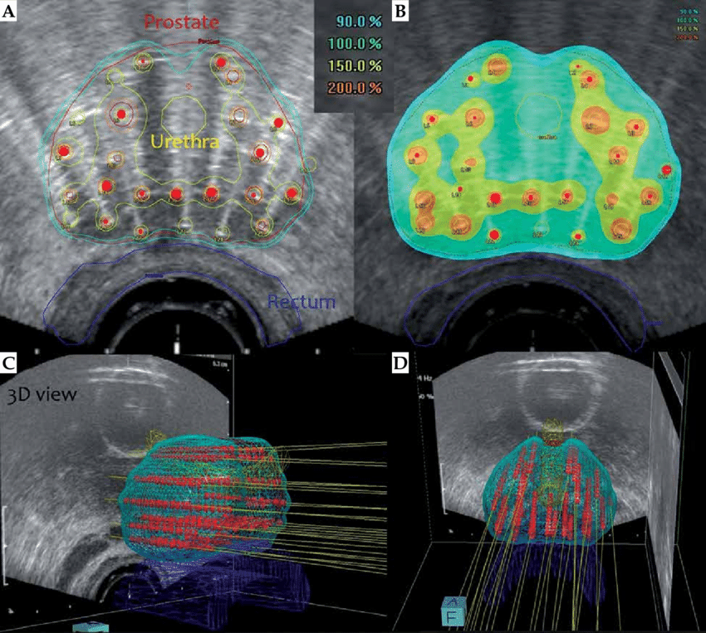
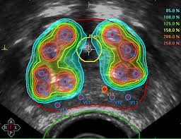
Brachytherapy: A patient story
Radiographer
Administrator
IT/estates
MDT
oncologist
nurse
Physicist/engineer

Slide 6
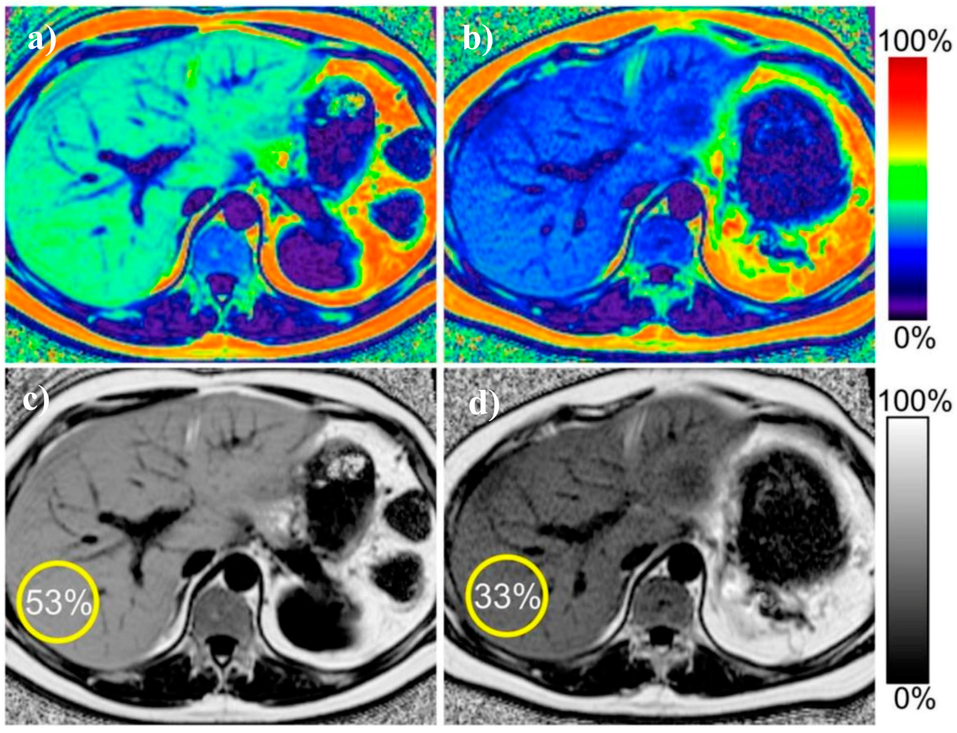
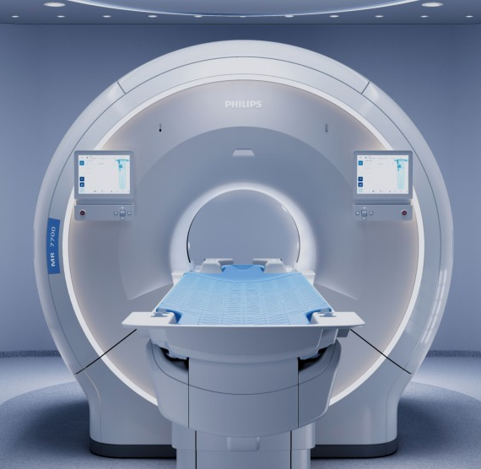
Obesity and Diabetes: A patient story
BEFORE TREATMENT
AFTER TREATMENT
MRI Physics and Engineering
Specification & procurement
Installation
Optimisation
deployment
0.5T
1.5T
3T
7T
Different strength magnets

Slide 7
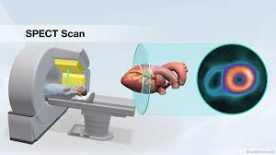
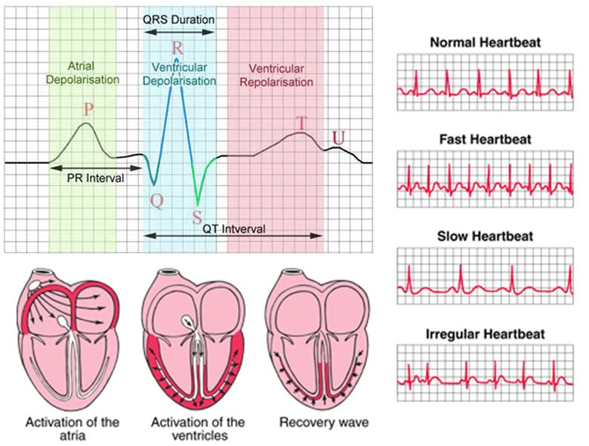
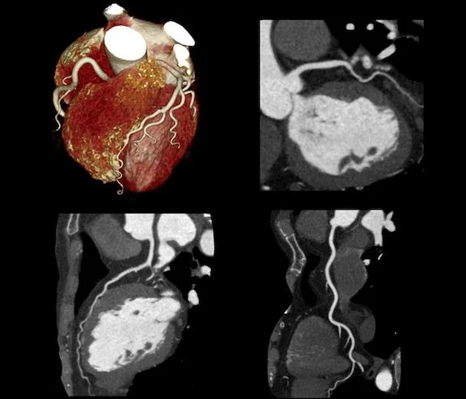
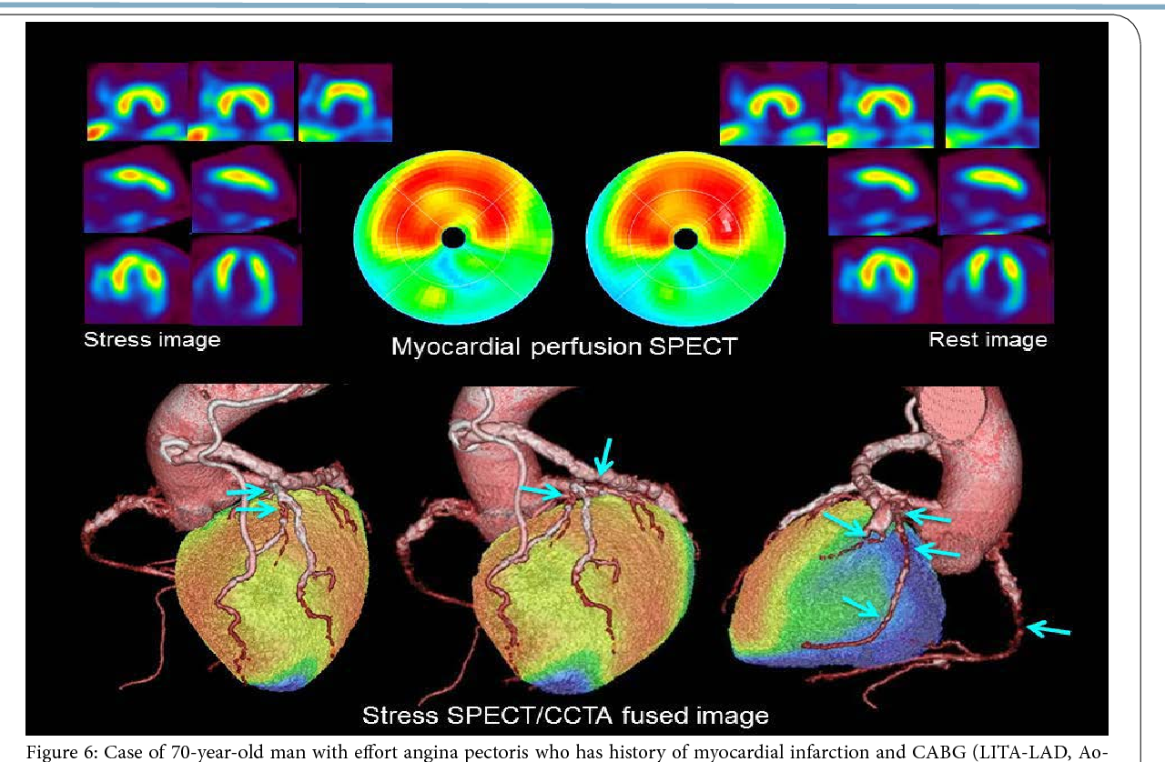
Cardiovascular Disease – Heart: A patient story
Radiographer
Administrator
IT/estates
MDT
cardiologist
nurse
Physicist/engineer

Slide 8
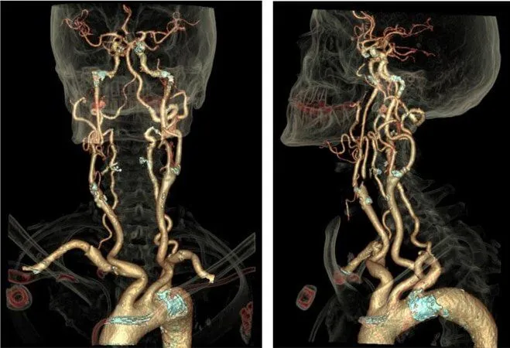
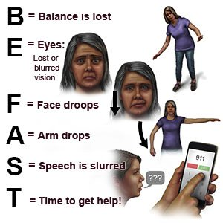
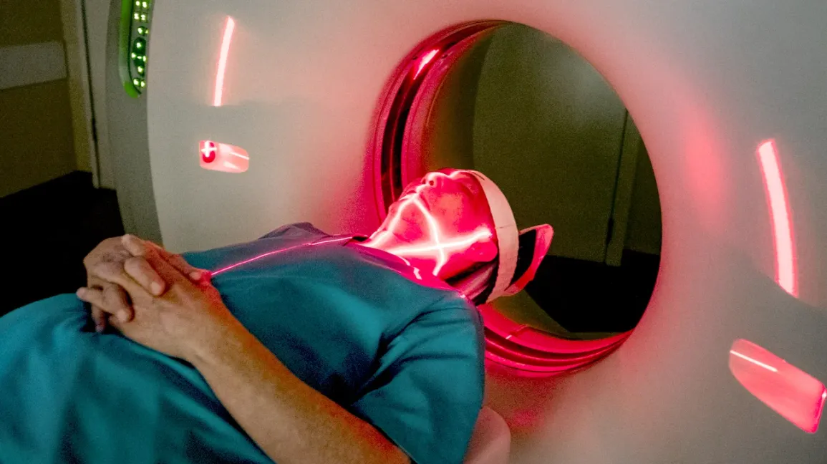
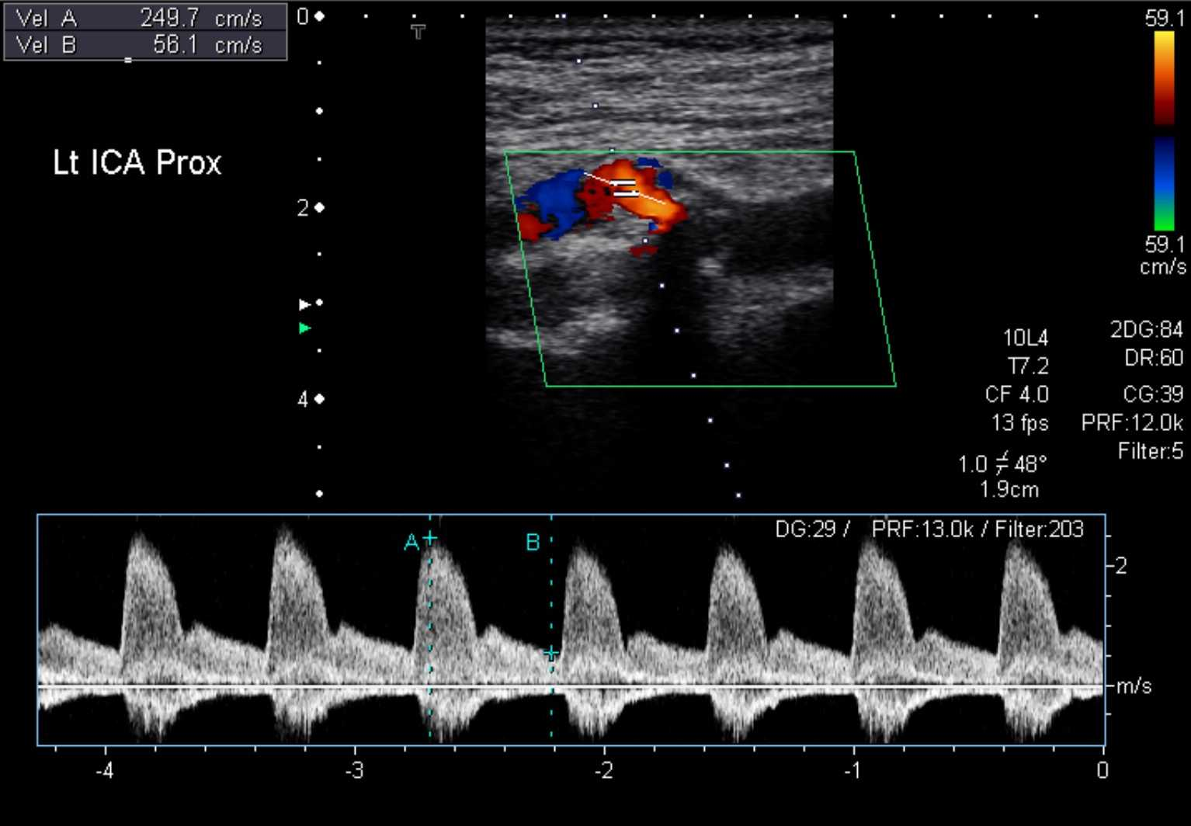
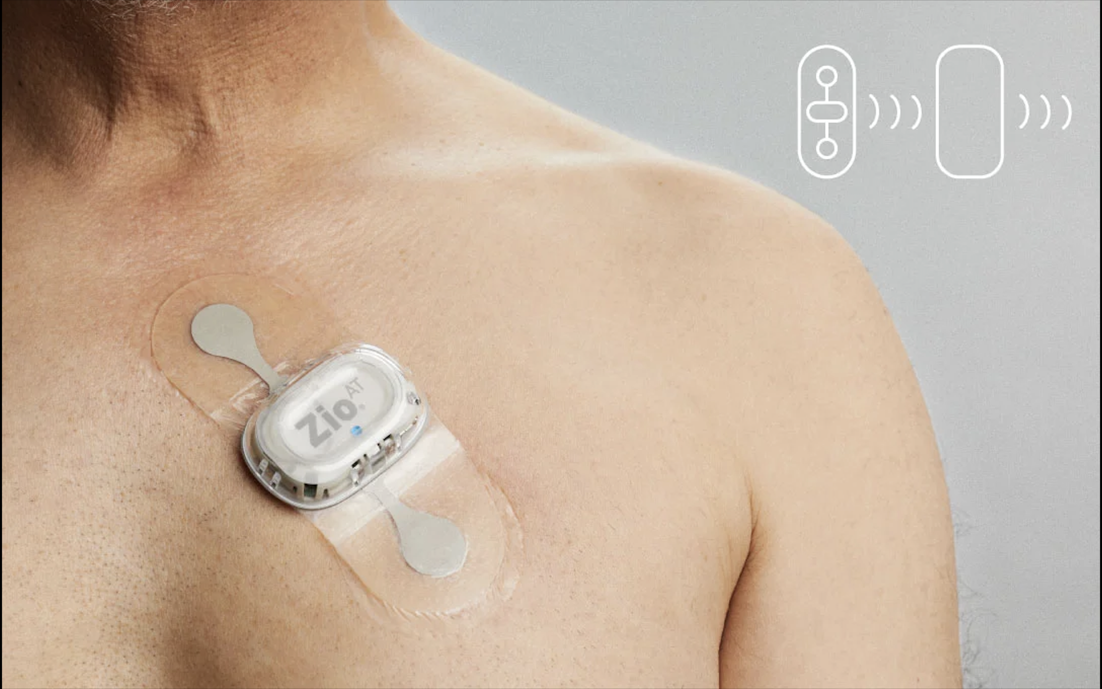
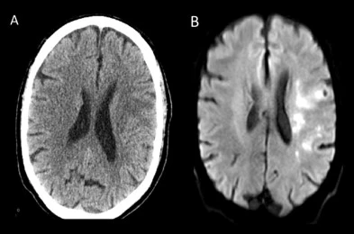
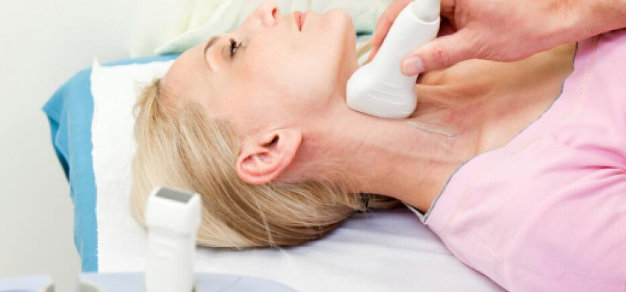
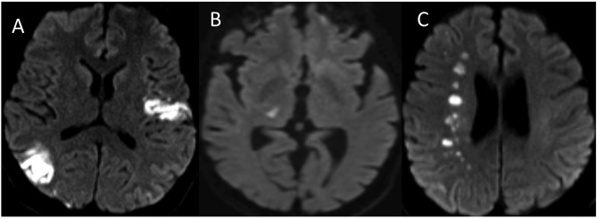
Cardiovascular Disease – Stroke: A patient story
Radiographer
Administrator
IT/estates
MDT
neurologist
nurse
Physicist/engineer

Slide 9
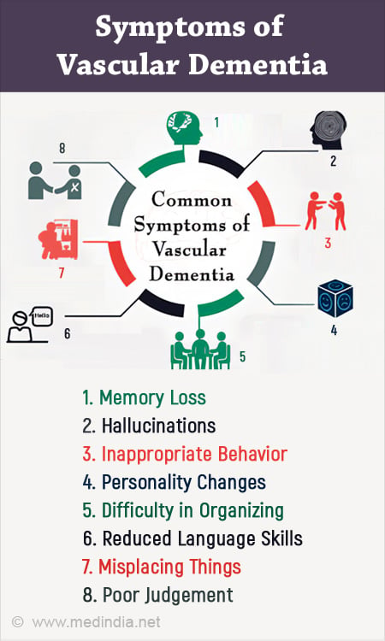
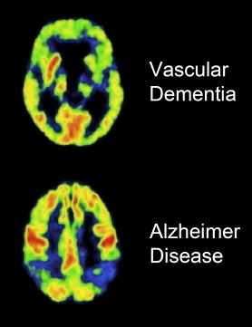
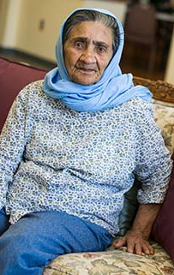
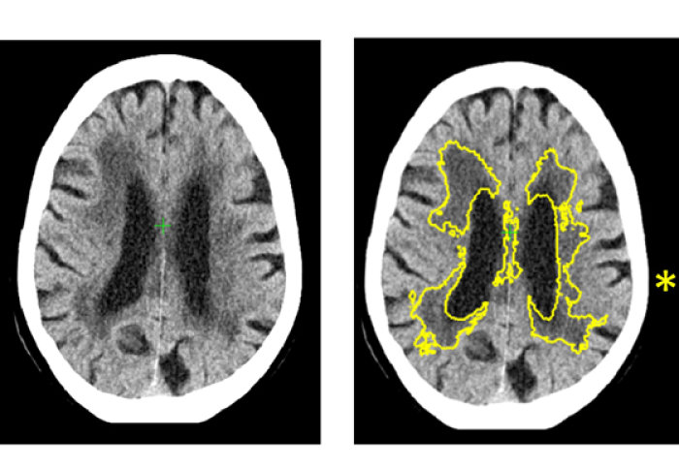
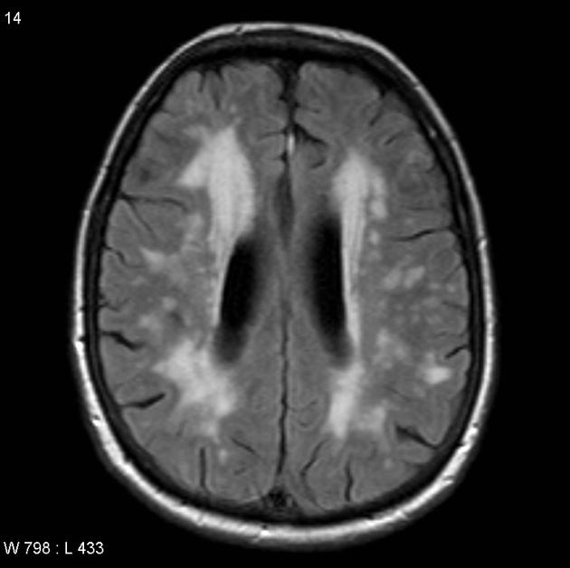
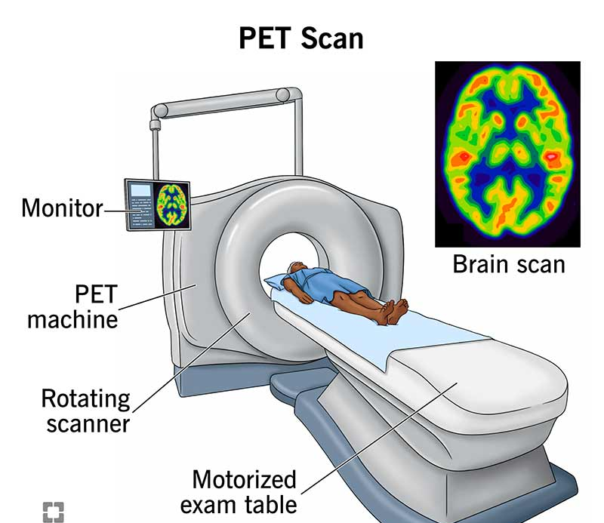
Cardiovascular Disease – Vascular Dementia: A patient story
Radiographer
Administrator
IT/estates
MDT
neurologist
nurse
Physicist/engineer

Slide 10
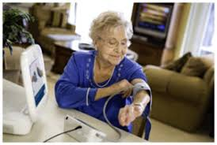
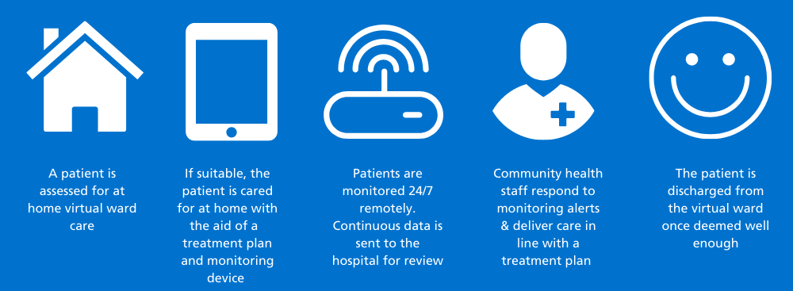
Virtual Wards: A patient story
Physio/OH
Administrator
IT/estates
MDT
doctor
nurse
Clinical engineer

Slide 11
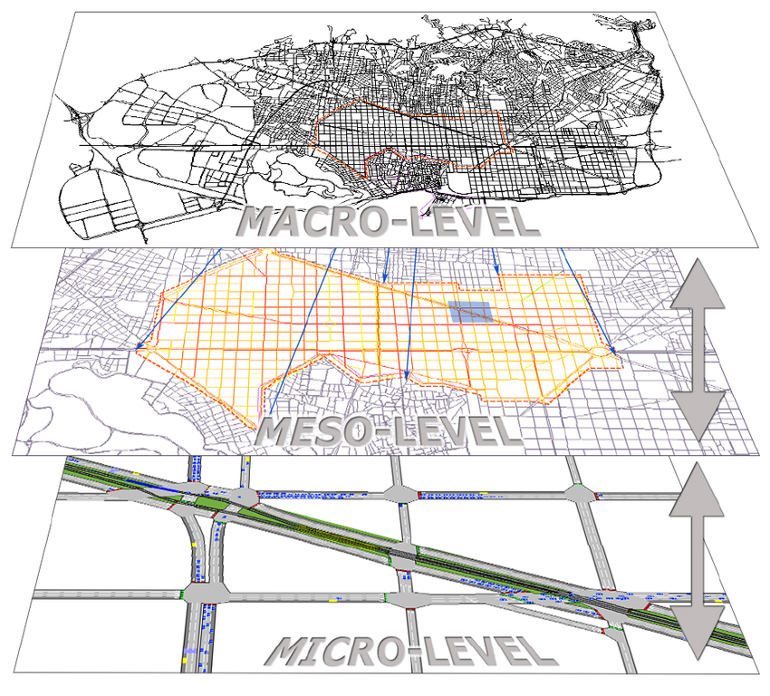
Patient care is complex and multi-disciplinary
Community
Hospital
Department
Treatment
Diagnosis
Care
Allied Health Professionals
Healthcare Scientists
Successful implementation and use of Healthcare Technology
Medical Physicists and Clinical Engineers
Medical Doctors
administrators
Community
Carers
Nurses

Slide 12
Ask No 1 Funding for Education and Training
10 % vacancy rate – accelerated training through
Apprenticeships – Level 4 – Level 7 (current funding at risk)
Scientists Training Program – increase the number of funded places
Higher Scientists Training Program – increase the number of funded places
In-service training – Allow establishment of new training posts

Slide 13
Ask No. 2 Champion the MPCE workforce as Technology
Support ICB’s to fund the establishment of new MPCE posts specifically for the deployment and roll out of new healthcare technologies such as AI.
Champion the MPCE NHS workforce to lead the
Evaluation and procurement of AI enabled tools for diagnosis and treatment
Implementation and deployment of AI enabled tools for service quality improvement

