Slide 1

Current and future impact of
AI for law
Professor Katie Atkinson
University of Liverpool

Slide 2
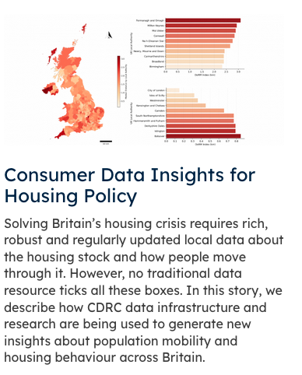

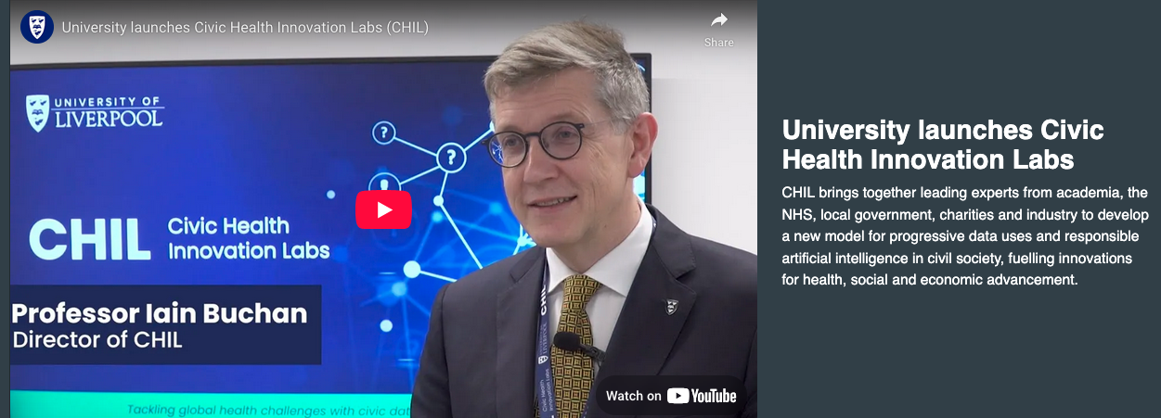
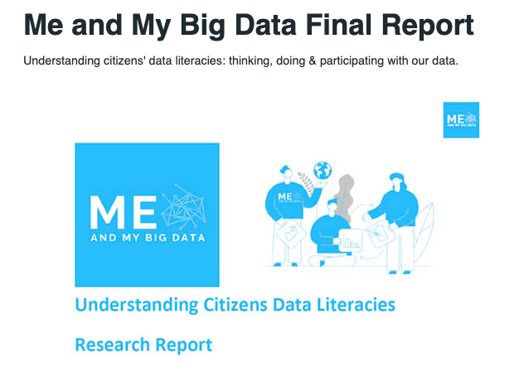

AI is now relevant for a wide range of disciplines

Slide 3
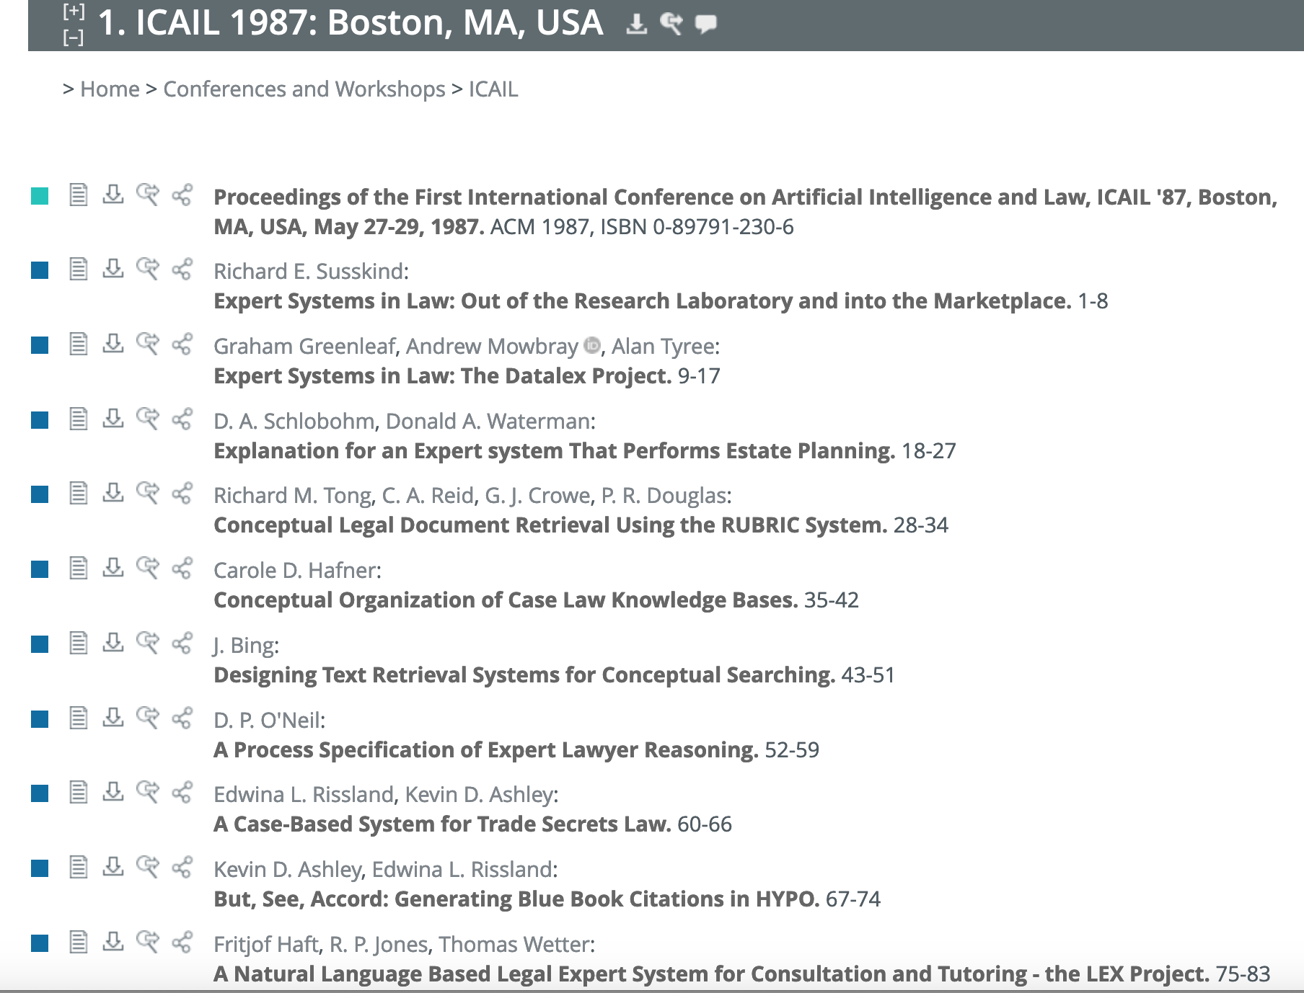
AI for law is NOT a new research topic
…
but deployable applications have only become viable in recent years

Slide 4

Data-Driven Predictive Systems for Legal Applications
Machine learning approaches for legal case prediction have become more popular recent times
Success rates in correctly classifying cases vary, from 70% upwards
Explanation is lacking

Slide 5
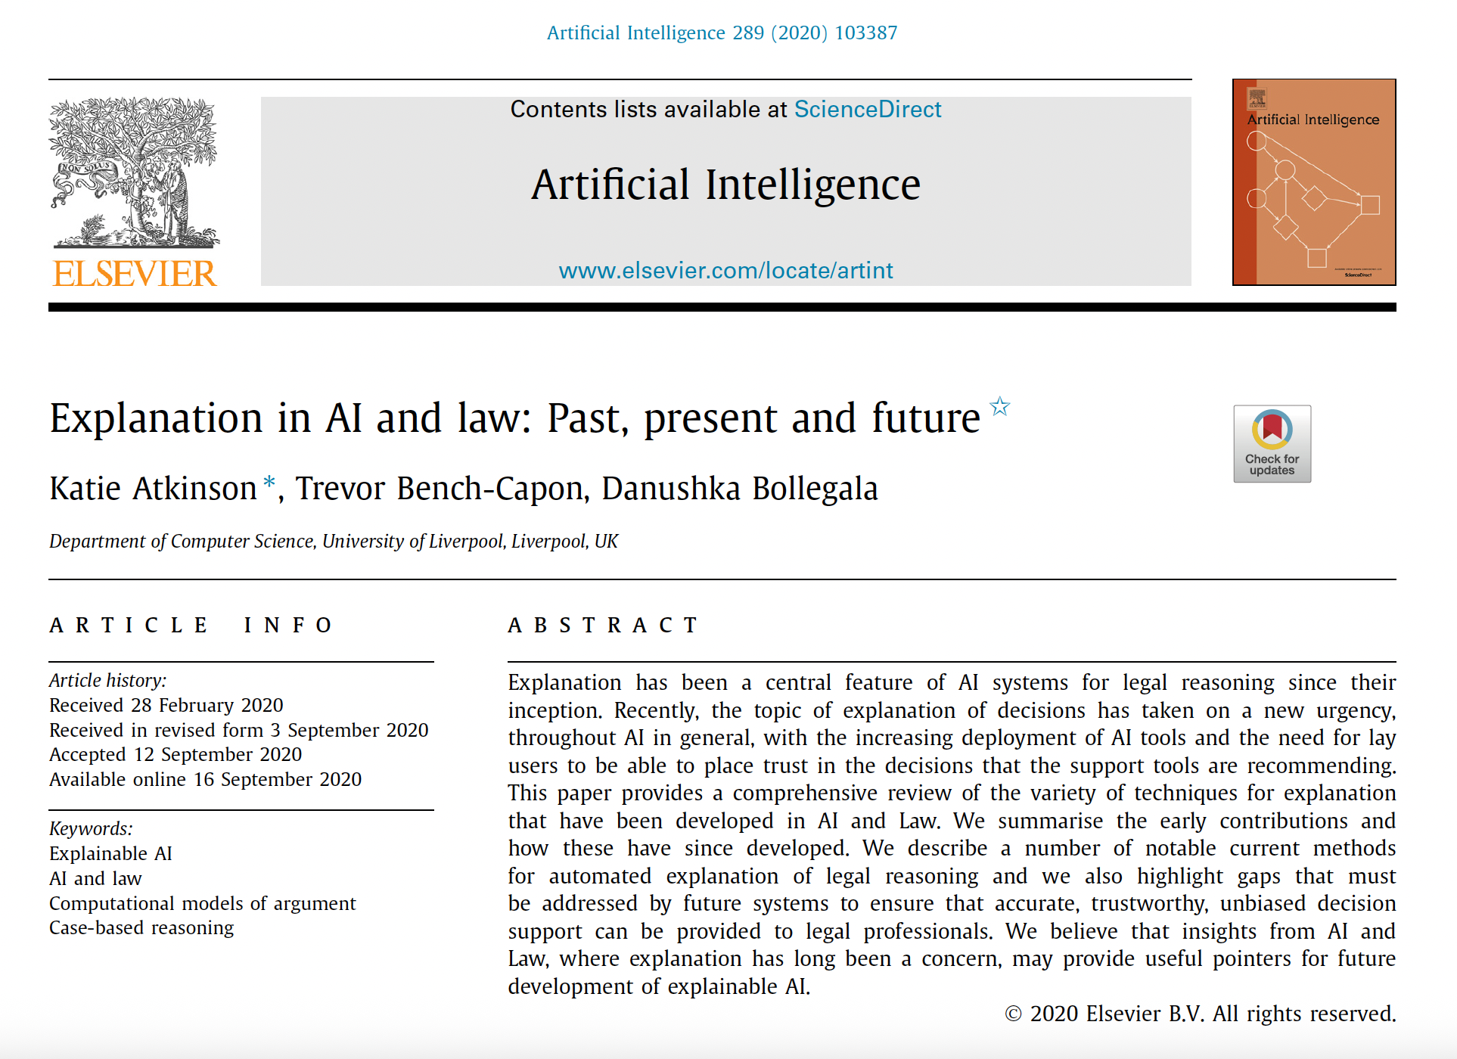
‘Explainable AI’ is a current focus topic of research

Slide 6

Modelling legal reasoning
Can we automate the reasoning that is undertaken in legal cases, using AI techniques?
How to do this in an ethical, trustworthy manner?

Slide 7
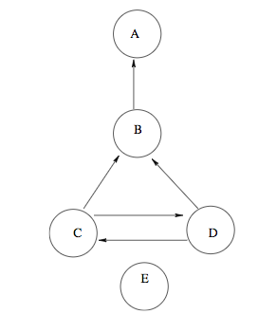
Computational Models of argument
Argumentation: the exchange of arguments concerning matters of belief or matters of action
Computational models of argument are used to model debates involving competing arguments to enable the debates to be executed in a computer program

Slide 8
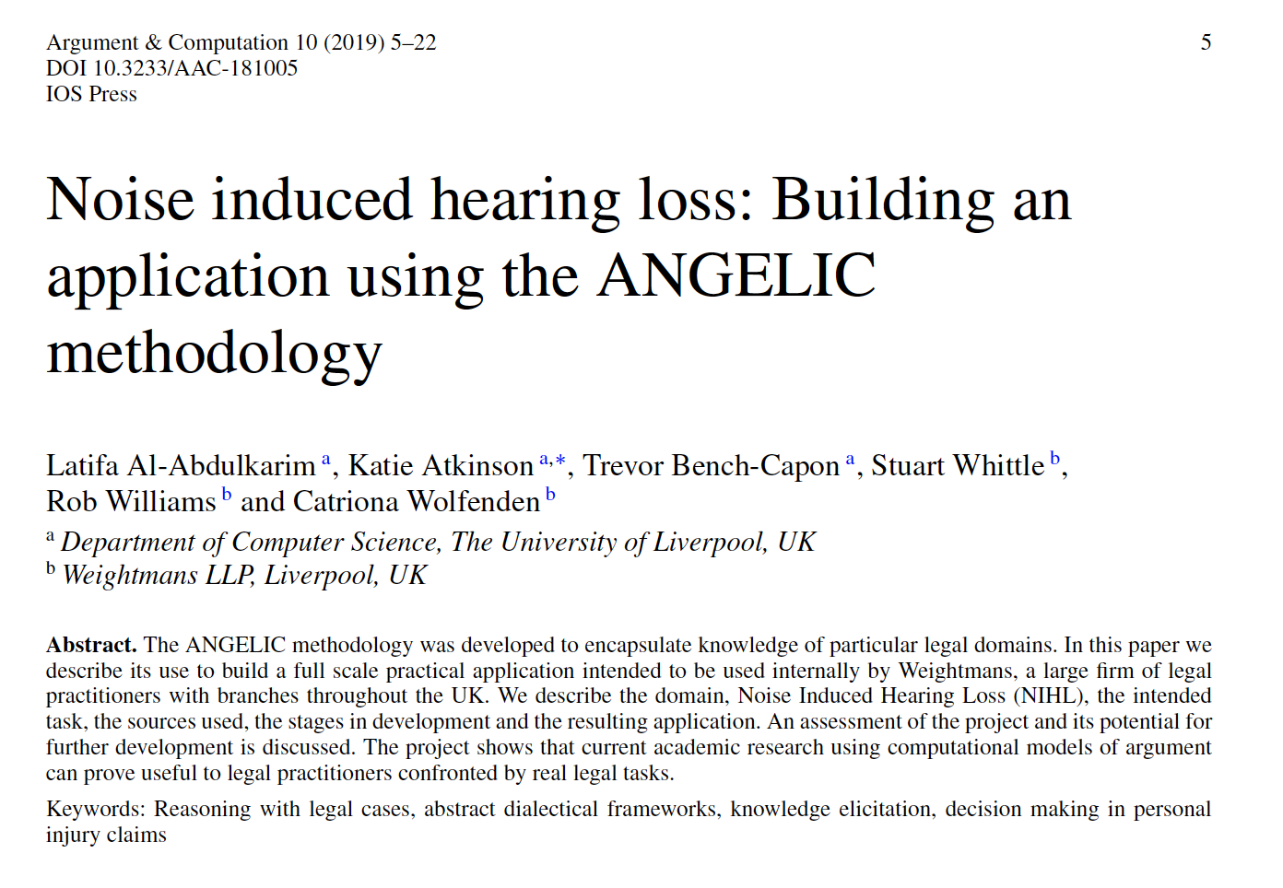

Real World legal Application using argumentation
https://www.weightmans.com/

Slide 9

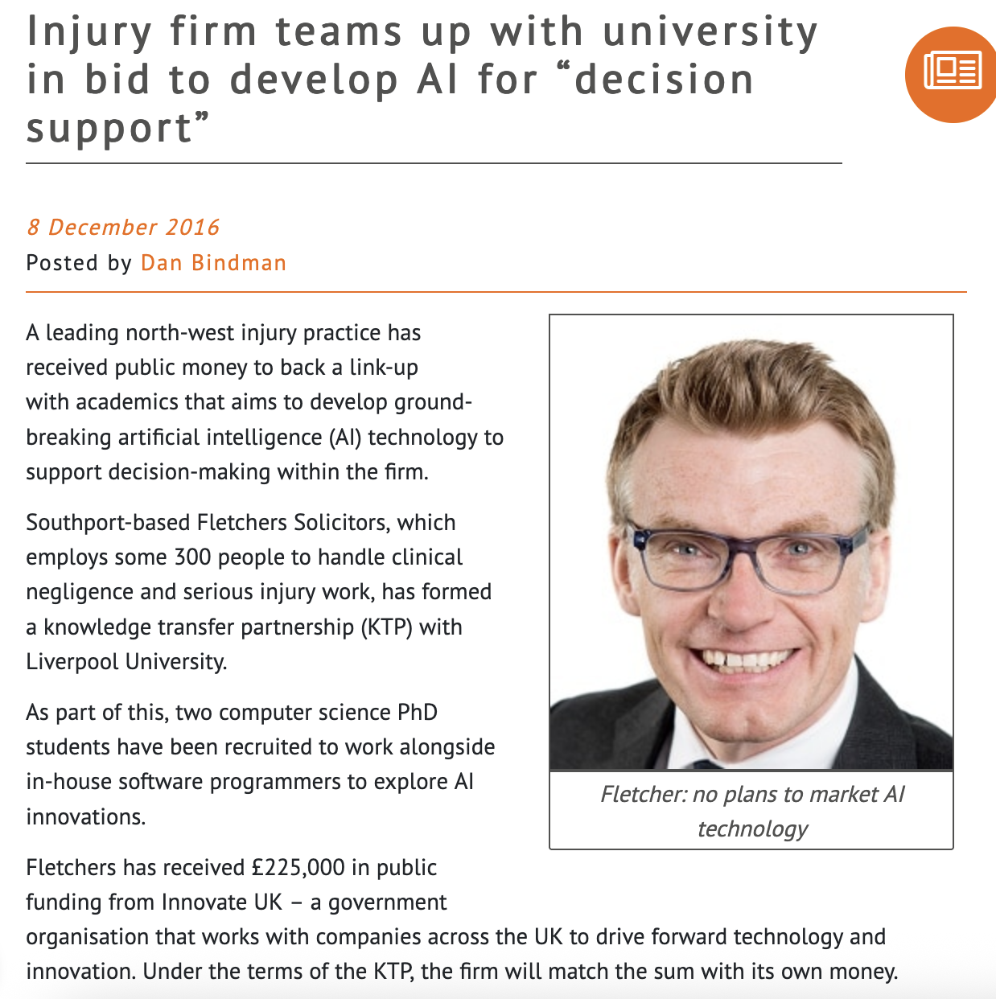


Knowledge transfer into a Real World Application
https://www.legalfutures.co.uk/latest-news/injury-firm-teams-university-bid-develop-ai-decision-support

Slide 10
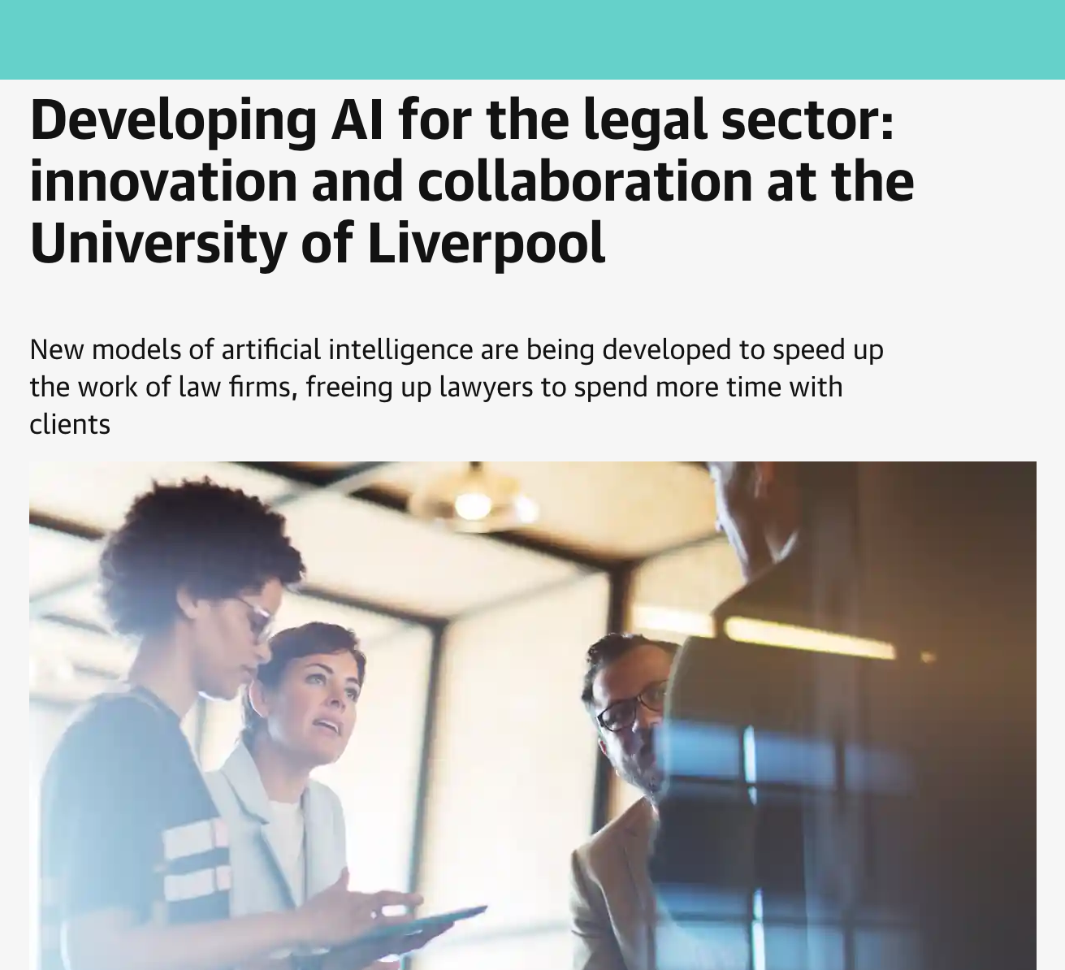
Knowledge transfer into a Real World Application
theguardian.com, 23 March 2023
“The digital assistant is used every day in business, freeing up lawyers to spend more time with more clients. Lawyers interviewing clients can now cross-reference their data against thousands of similar cases and tell them whether they have a decent case and their chances of success within minutes.”
Dan Taylor, Director of Integration

Slide 11
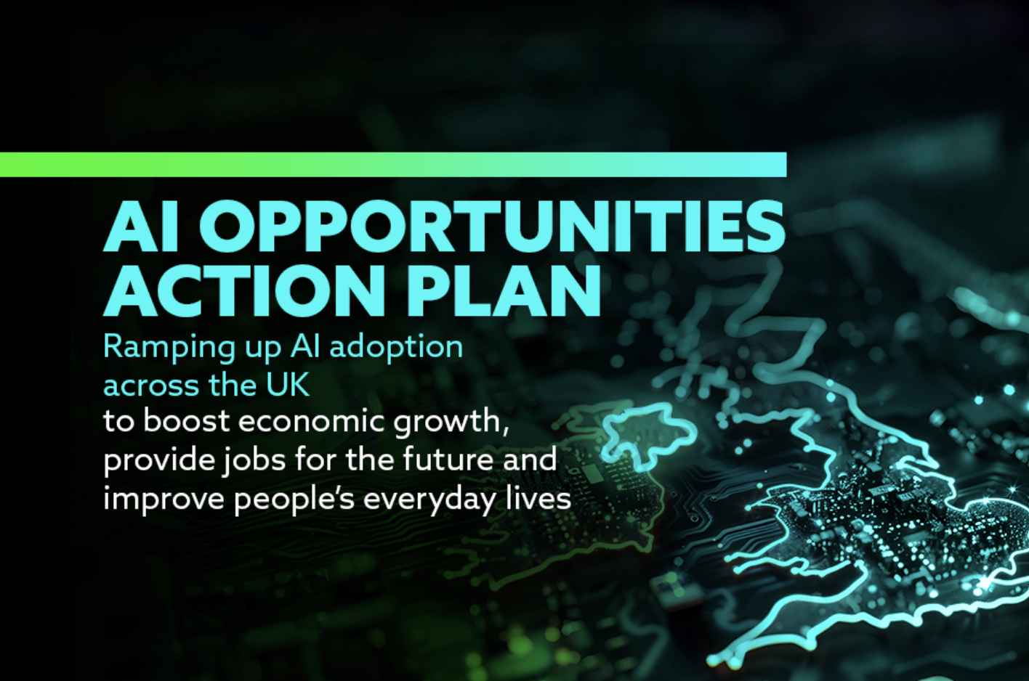
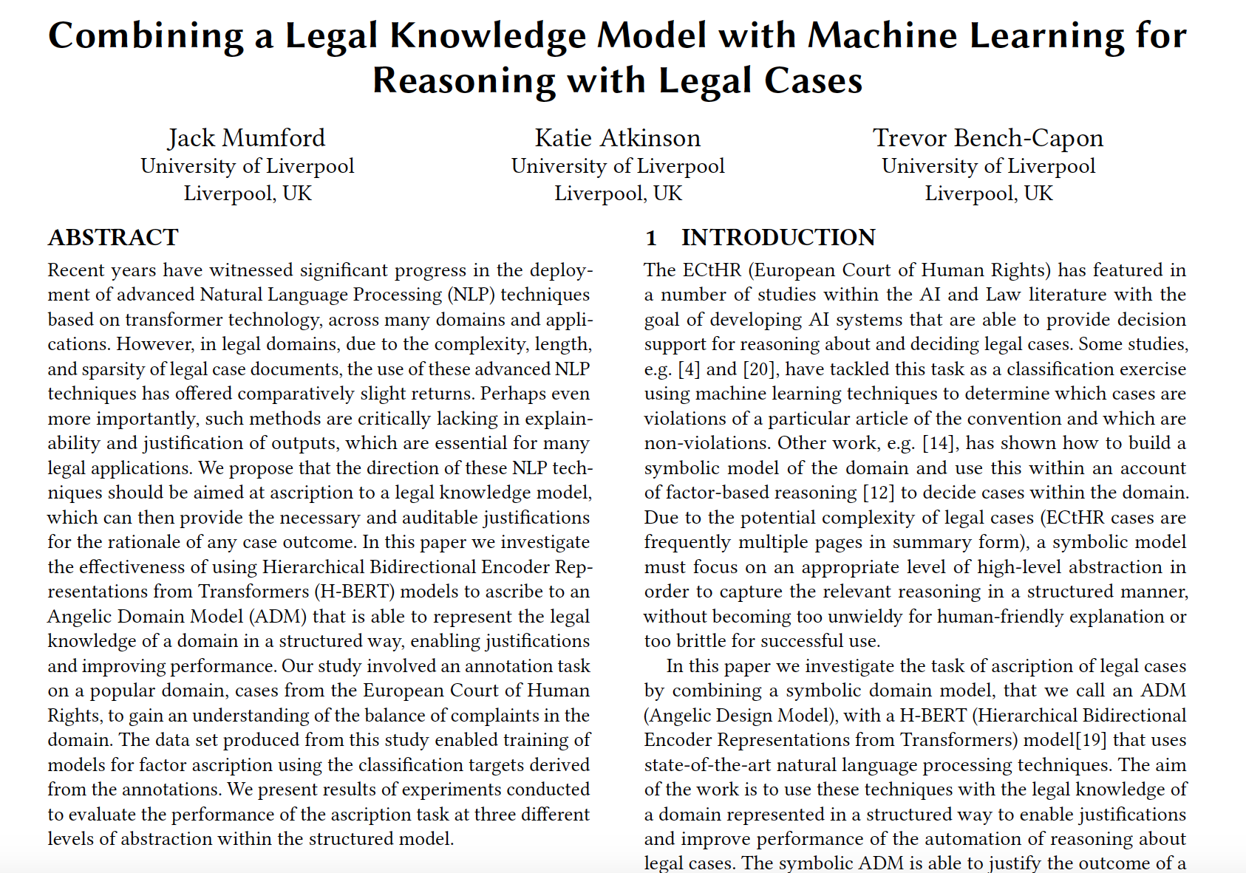
Current and future research on AI and law
‘Hybrid AI’ systems: combining multiple AI techniques into powerful models – symbolic models, machine learning, generative AI.
Significant opportunities for Lawtech

Slide 12
Thank you

