Slide 1
Use of AI In Industrial R&D
Dr Jonathan Hague
Head of bright future science and technology
Unilever homecare
29th April 2025

Slide 2
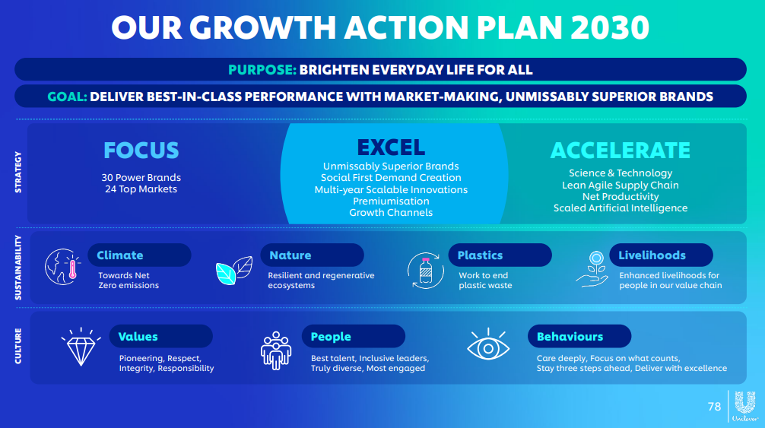

Slide 3
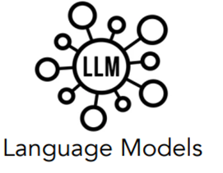



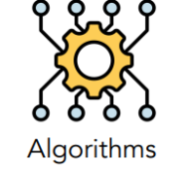


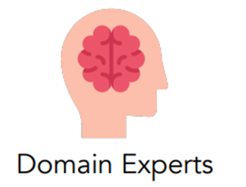
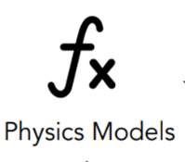
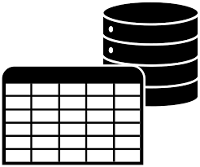
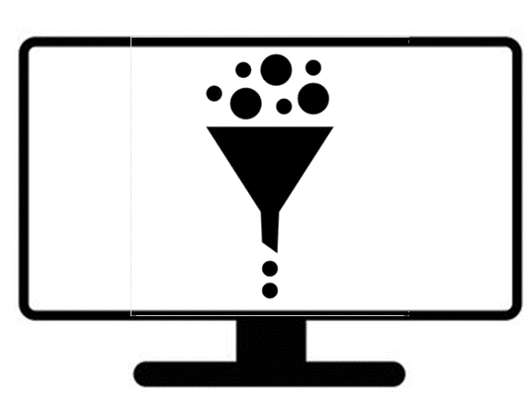
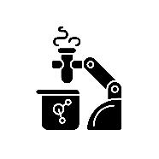

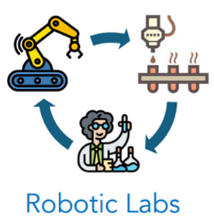
Scientific Discovery Accelerated By AI in Unilever
Elements of Hybrid AI are already in use
Scientific Discovery
Extraction, Integration and reasoning - knowledge at scale
Prior art
Hypothesize
Experiment
Analysis
Report
Question
AI Screening
Identifying goals based on business needs
Generative/predictive models propose new hypothesis that expand discovery space
IP
Report and knowledge database for data mining
Virtual screening of all possible candidates expanding design space
Pattern and anomaly detection from data
High throughput experimentation with physical property testing

Slide 4
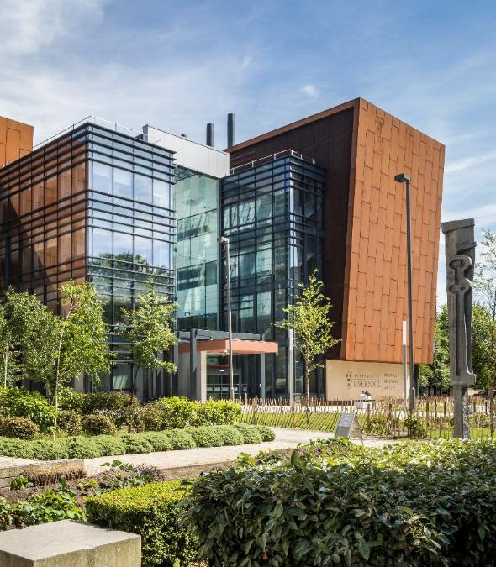
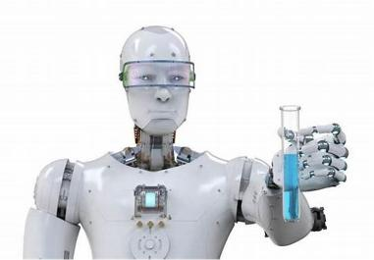
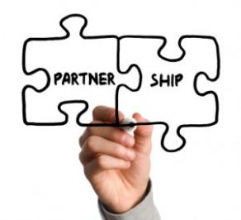
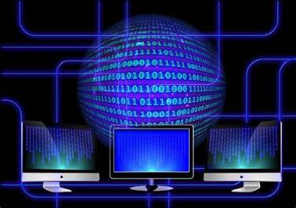
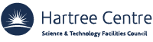








THE MATERIALS INNOVATION FACTORY (MIF)
The Vision for the MIF:
New ingredients formulated in new ways for exceptional product performance using automated and computer aided material science
Notes:
Vision: “Discovering new ingredients and products by the application of automation and computer aided material science”
Investment into MIF is over £100m sourced from UK government, academia, Leverhulme Trust and companies including Unilever (founding partner with UoL)
University of Liverpool Chemistry is 3rd in the UK for world-leading (4*) impact of its research, as the results of REF2021 show. UoL itself is one of the internationally renowned research-intensive Russell Group of UK universities and collaborates with other 1300 global organisations. In financial year 2021-22, UoL’s income was £615m, with research income of £114m and capital assets of £781m
Original Unilever business case for investment has been fully delivered. Unilever’s investment has secured funding leverage into infrastructure of at least 4-fold Unilever’s investment.
Since 2020, an additional £15m of external leverage has been secured to support B&W, HC and PC innovation programmes. The largest project is the £8.8m Prosperity Partnership (Engineering and Physical Sciences Research Council) to work with the Universities of Liverpool and Oxford to reduce the carbon footprint of consumer products.
Automation and Digital Capability
There are 12 automated robotic platforms on the Unilever floor of the MIF. Every one of them is a bespoke design and unique anywhere in the world. Compared to manual methods, the automated robotic platforms provide increased throughput of experiments (typically 5-10 times), improved accuracy and precision of data measured and complete digital logging of all aspects of the experiment and the measurements made.
Unilever also accesses another 6 robotic platforms on the MIF OAA floor (focussed on formulation make and measure) as well as another £10m of world leading scientific analytical/measurement equipment.
The MIF boasts one of the planet’s highest concentration of robots and equipment supporting development of new ingredients and products for the FMCG market.

Slide 5
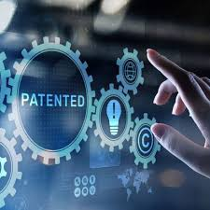
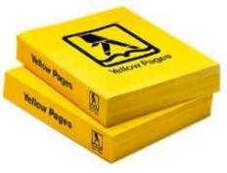



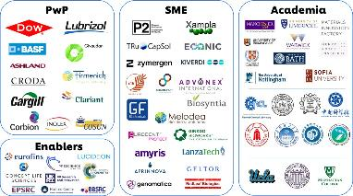
Innovation facts about The Materials Innovation Factory
>300
2-3x
intellectual property productivity per scientist
Dozens
patents filed
since 2020
of new technologies rolled out at scale in UK and beyond
>15TB
of chemical and biological data points generated
100’s
partnerships with suppliers, SMEs and academics
25%
of long term funnel value
is MIF enabled
Notes:
15TB data is equivalent to 1.275million phone directories or 6.6billion printed pieces of A4 paper. Or 5,000 times as much data as in the original Human Genome project.
The entire human genome requires three gigabytes of computer data storage space. (One million base pairs of sequence data equals one megabyte of storage space; the human genome has three billion base pairs.) Every second, Human Genome Project computers decode 12,000 letters.
NOVA Online | Cracking the Code of Life | Genome Facts – PBS
The Human Genome Project is one of the greatest scientific feats in history. The project was a voyage of biological discovery led by an international group of researchers looking to comprehensively study all of the DNA (known as a genome) of a select set of organisms. Launched in October 1990 and completed in April 2003.
The Human Genome Project was a large, well-organized, and highly collaborative international effort that generated the first sequence of the human genome and that of several additional well-studied organisms. Carried out from 1990–2003, it was one of the most ambitious and important scientific endeavours in human history. The sequencing of the human genome involved researchers from 20 separate universities and research centres across the United States, United Kingdom, France, Germany, Japan and China. The groups in these countries became known as the International Human Genome Sequencing Consortium.
The Human Genome Project
As @ 27.03.23
Stats on MIFOMICS / Microbiome Innovation Centre from Mike Hoptroff
Market claims for Dove, Vaseline, Zendium, Signal, Zendium
More than 10 patents in the last 12 months
16,000 samples since 2016 = 6 microbiome samples per day since 2016
Samples fly into Liverpool from around the world (not China/India due to bio-export regs)
~4x more data that the NIH had for the human microbiome project
USP’s..,
Unilever data is fully harmonised with consistent metadata, meaning we can readily use it to drive AI and data mining
This means partners want to work with us.., e.g. AI partnerships with IBM/Hartree (publications, zero cash from us, I’d est 500K in-kind from IBM/Hartree.
Stats on MIF from Andy Mitchell
The number of datapoints in the EMS database currently stands at 834034096.
If I read the database correctly, there is 143gb of data in it, although most of the storage is in the filestore, which is a few tetrabytes I believe
As @ 2021
Topline since opening MIF—OMICS has generated over 14,000 samples, meaning over 12 terabytes of data, which represents over 90% of all Unilever microbiome data has been generated by mifomics. Have ppt slide with this stuff on, will send when back on wifi. For context the NIH only had 8000 samples for its whole Human Microbiome Project....so mifomics has generated more than that.
We upload around 8 million data points to the MIF UL database each year at the moment, so you could extrapolate to 32 million since MIF opened. However a lot of those points were timeseries data, so for MIF we have switched to attaching files, rather than ingesting into the database. We attach around 75000 a year (but each of those attachments could contain 100000 datapoints, if they were to be ingested into the database in full).
1TB of data is equivalent to around 85,000 phone directories or 440 million printed sheets of A4 paper

Slide 6
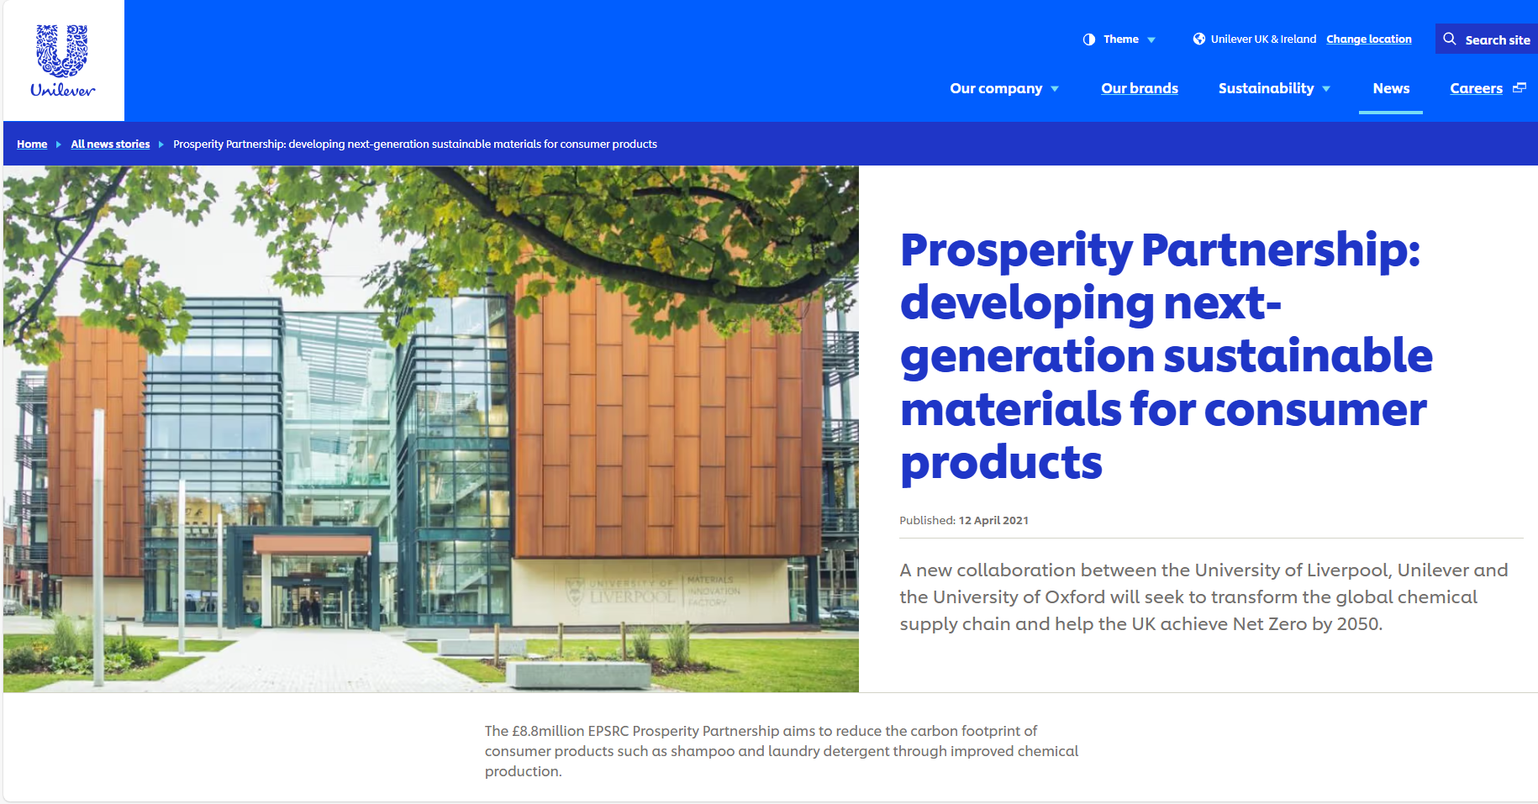
Notes:
15TB data is equivalent to 1.275million phone directories or 6.6billion printed pieces of A4 paper. Or 5,000 times as much data as in the original Human Genome project.
The entire human genome requires three gigabytes of computer data storage space. (One million base pairs of sequence data equals one megabyte of storage space; the human genome has three billion base pairs.) Every second, Human Genome Project computers decode 12,000 letters.
NOVA Online | Cracking the Code of Life | Genome Facts – PBS
The Human Genome Project is one of the greatest scientific feats in history. The project was a voyage of biological discovery led by an international group of researchers looking to comprehensively study all of the DNA (known as a genome) of a select set of organisms. Launched in October 1990 and completed in April 2003.
The Human Genome Project was a large, well-organized, and highly collaborative international effort that generated the first sequence of the human genome and that of several additional well-studied organisms. Carried out from 1990–2003, it was one of the most ambitious and important scientific endeavours in human history. The sequencing of the human genome involved researchers from 20 separate universities and research centres across the United States, United Kingdom, France, Germany, Japan and China. The groups in these countries became known as the International Human Genome Sequencing Consortium.
The Human Genome Project
As @ 27.03.23
Stats on MIFOMICS / Microbiome Innovation Centre from Mike Hoptroff
Market claims for Dove, Vaseline, Zendium, Signal, Zendium
More than 10 patents in the last 12 months
16,000 samples since 2016 = 6 microbiome samples per day since 2016
Samples fly into Liverpool from around the world (not China/India due to bio-export regs)
~4x more data that the NIH had for the human microbiome project
USP’s..,
Unilever data is fully harmonised with consistent metadata, meaning we can readily use it to drive AI and data mining
This means partners want to work with us.., e.g. AI partnerships with IBM/Hartree (publications, zero cash from us, I’d est 500K in-kind from IBM/Hartree.
Stats on MIF from Andy Mitchell
The number of datapoints in the EMS database currently stands at 834034096.
If I read the database correctly, there is 143gb of data in it, although most of the storage is in the filestore, which is a few tetrabytes I believe
As @ 2021
Topline since opening MIF—OMICS has generated over 14,000 samples, meaning over 12 terabytes of data, which represents over 90% of all Unilever microbiome data has been generated by mifomics. Have ppt slide with this stuff on, will send when back on wifi. For context the NIH only had 8000 samples for its whole Human Microbiome Project....so mifomics has generated more than that.
We upload around 8 million data points to the MIF UL database each year at the moment, so you could extrapolate to 32 million since MIF opened. However a lot of those points were timeseries data, so for MIF we have switched to attaching files, rather than ingesting into the database. We attach around 75000 a year (but each of those attachments could contain 100000 datapoints, if they were to be ingested into the database in full).
1TB of data is equivalent to around 85,000 phone directories or 440 million printed sheets of A4 paper

Slide 7
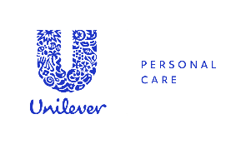




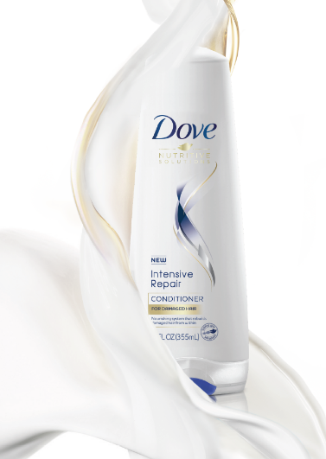
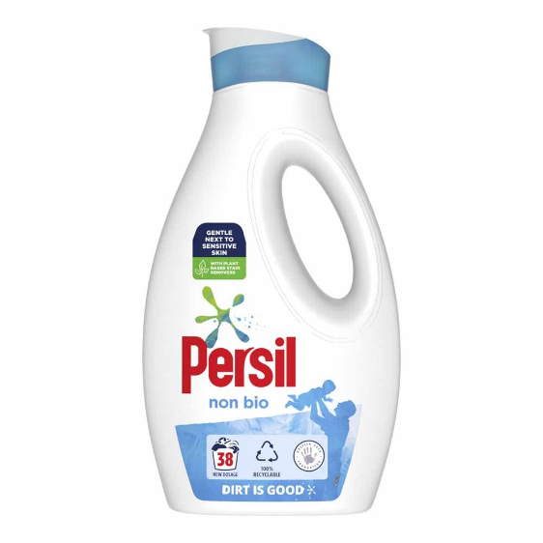

INNOVATION & DELIVERY FOR OUR BUSINESS GROUPS
FIBRE SHIELD
SUPERIOR CARE
ECOBOOST
SUPERIOR PRODUCT
50% GHG REDUCTION
ACTIVATED ALUMINIUM SALTS
BETTER CLINICAL PERFORMANCE
Notes:
Specific Technology Launches Enabled by MIF
Launched in 2019, Unilever’s proprietary and superior MIF enabled antiperspirant active is now (July 2023) present in at least 50% of our global Deodorants business (which in 2022 turned over €4bn)
Launched in 2018, “Fibre Shield” (Unilever’s proprietary hair damage repair/prevention active for conditioners) is now present in global brands such as Sunsilk, Tresemme and Dove contributing technology to about 20% of 2022 Unilever Hair turnover of over €6bn.
Launched from 2018, MIF enabled a proprietary Laundry Liquid technology that delivers superior performance and a dramatic reduction in greenhouse gas footprint. Now present in around 60% of Unilever’s ca €1.9Bn laundry liquids business globally.
Overall Contribution to Unilever’s Future Innovation Pipeline
MIF enables 20-25% of the combined three relevant business group’s pipelines of innovations, (the business groups are Beauty and Wellness, Homecare and Personal Care). Estimated to be worth around €4Bn in new turnover over a six-year horizon.
Intellectual Property Powerhouse
Between 2020 and 2022, MIF enabled over 200 patent first filings for new technologies/innovations. This is around 50% of the total patent first filings made with “Unilever R&D Port Sunlight” as Applicant over the same period. This is the highest concentration of patent filings in Unilever and helps to make Unilever the number 1 or number 2 filer of patents in the UK, amongst any company.

Slide 8
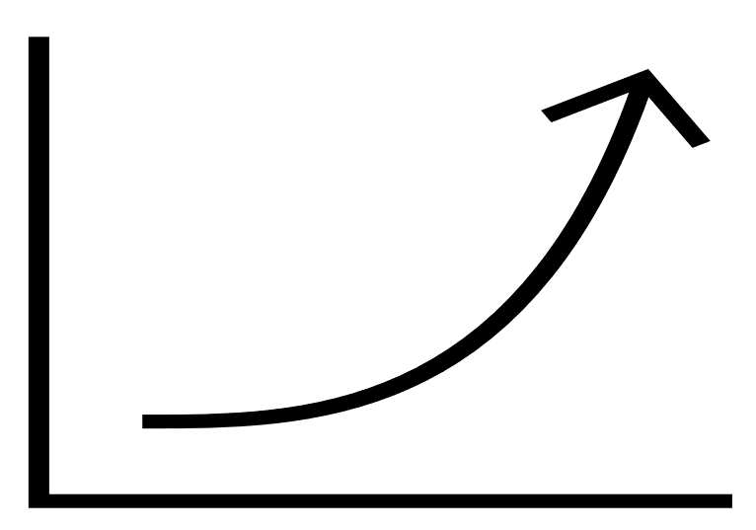
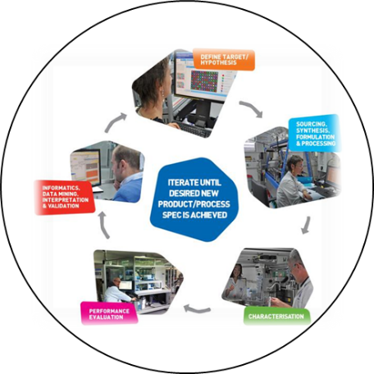
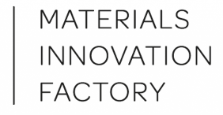

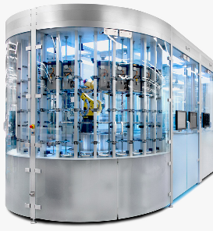
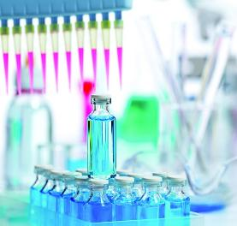
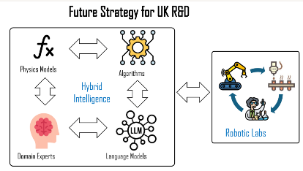
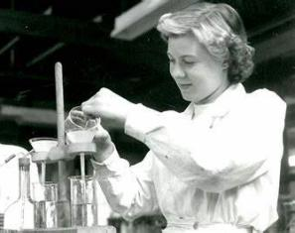
THE FUTURE: THE CYCLE OF INNOVATION BUT exponentially FASTER
AIM HI
ROBOTIC LABS AND
and HYBRID INTELLIGENCE
E2E Innovation:
From Molecule
to Superior Product
High Throughput
with Big Data
In Vitro
Product Performance
Traditional Manual Methods
High Thoughput
Ingredient Synthesis
<2000
2000
2010
2020
2030
Notes:
Robotic scientists will 'speed up discovery' - BBC News
Jon Hague, 19.40, 26 June 2023
looks good .. context is superior performance in a world heading to net zero ..like 1

Slide 9
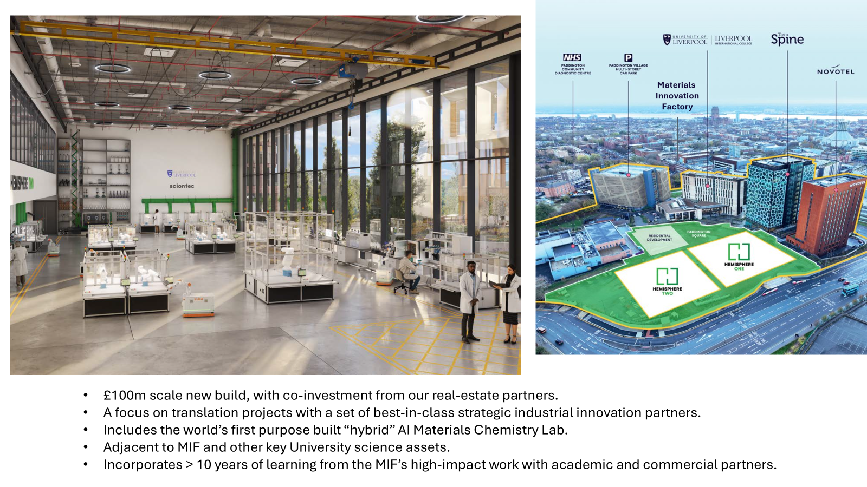
Future ambition - AIM HI
Notes:
Robotic scientists will 'speed up discovery' - BBC News
Jon Hague, 19.40, 26 June 2023
looks good .. context is superior performance in a world heading to net zero ..like 1

Slide 10

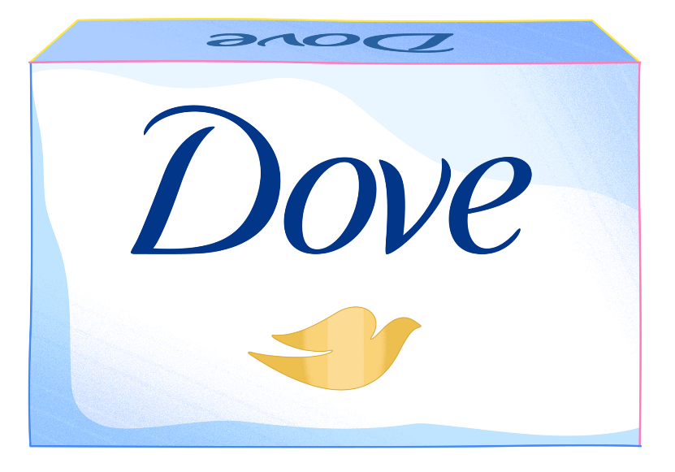

Thank you
Notes:
[Optional slide; depending on whether you bridge to more slides or do only a Unilever overview]

