Slide 1



LawtechUK is turbocharging
the UK’s legal tech sector
The programme is operated by CodeBase and Legal Geek with guidance from the LawtechUK Panel. It engages with the existing lawtech ecosystem across the UK.

Slide 2
Mission
Help develop a culture of innovation within the legal services sector
Increase understanding of lawtech’s benefits for all legal service providers
Help grow the legal sector’s economic contribution
Support the development of technology to increase access to legal
services and aim to reduce unmet legal need

Slide 3

Advisory Panel

Slide 4



Slide 5
Free programmes to support lawtechs
Programmes
Fundamentals: introducing pre-startups to the lawtech landscape and entrepreneurship
Builder: introducing pre-MVP founders to startup best practices and playbooks
Mentoring: objective-led one-to-one support with industry experts
Bridge: brings startups and legal market players together to explore approaches to innovation
176
startups supported
on an educational programme
694
Prospective lawtech entrepreneurs enrolled on the Fundamentals
Notes:
18 startups supported on an educational programme
We have helped a large proportion of the sector
These educational programmes for everyone, from early-stage businesses to scale-ups
They are all free

Slide 6







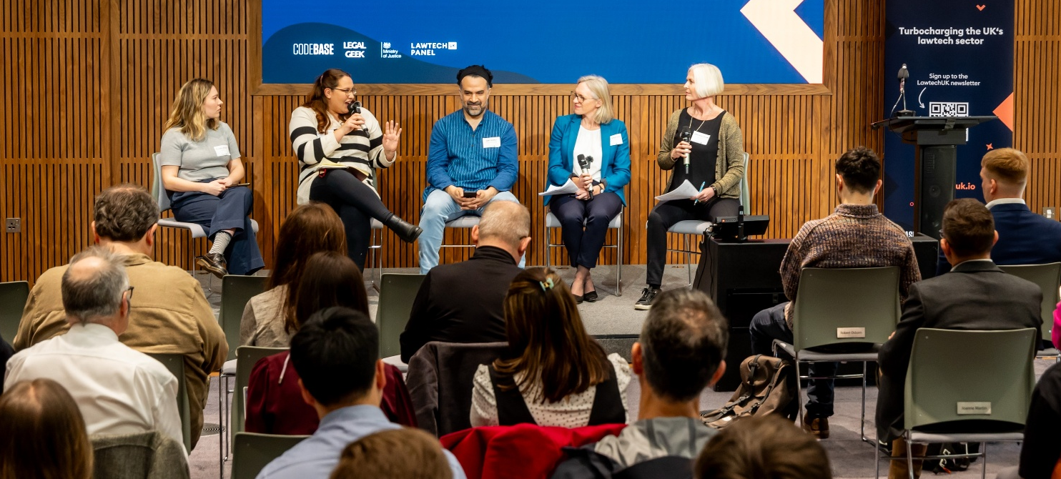




Free events
We organise events across the UK to connect and grow the legaltech ecosystem, all delivered in partnership with local and national organisations, particularly Universities
8
UK cities (across every UK Nation) hosted a LTUK event
>2000
Individuals attended events across the UK
Notes:
979 attendees over nine UK-wide LawtechUK events
We've hosted free events in every nation in the UK
We're continuing this, with our next event in Liverpool (where you are speaking!)

Slide 7
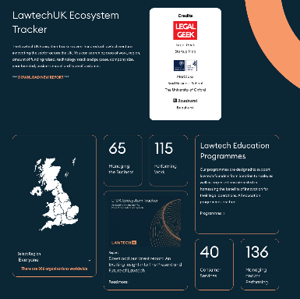
Ecosystem Tracker
The LawtechUK Ecosystem Tracker covers 374 lawtech ventures innovating the sector across the UK. You can search by area of work, region, amount of funding raised, technology stack and purpose, company size, year founded, business model and type of customer.
The 2024 and 2025 reports are now available to download.
Notes:
356 businesses mapped on our Lawtech Ecosystem Tracker
This is the first comprehensive piece of research tracking every legaltech provider active in the UK
It's a free online tool and report

Slide 8
UK Jurisdiction Taskforce (UKJT)
“The UKJT has punched far above its weight in international legal and academic circles concerned about digital assets and new technologies. It is referred to in literally hundreds of judgments, articles and books. The UKJT is now seeking to establish a sister International Jurisdiction Taskforce to try to achieve harmonisation between the approaches in the other main private law jurisdictions that are likely to be relevant to digital assets and digital trading as the markets expand.”
Sir Geoffrey Vos, Master of the Rolls
Notes:
356 businesses mapped on our Lawtech Ecosystem Tracker
This is the first comprehensive piece of research tracking every legaltech provider active in the UK
It's a free online tool and report

Slide 9
11 million
individuals with unmet legal needs in England and Wales annually
1.8 million
small businesses experience 15.4m legal issues each year
Legal Needs of Individuals in England and Wales Summary Report 2024
Small Business Legal Needs Report 2022

Slide 10

Access to Legal
A2L Workshops
To bridge the gap between third-sector organisations working to address access to legal and technology business
B2C Blueprint
Document outlining the key challenges, opportunities, and considerations for developing AI-driven solutions in the B2C lawtech space
57
connections made
Notes:
356 businesses mapped on our Lawtech Ecosystem Tracker
This is the first comprehensive piece of research tracking every legaltech provider active in the UK
It's a free online tool and report

Slide 11








LawtechUK’s Impact
176 startups
on education programmes
> 2,000 attendees
at events across eight cities
£41.66 million in 2024
funding raised by LTUK-supported techs
>390k
visitors since website re-design and launch
33.85M
Monthly unique users reached across all media outlets
12
regulators convened as the RRU, incl. FCA, SRA, BSB, ICO, and LSB
376
UK lawtech companies mapped on the Lawtech Ecosystem tracker
694
Prospective lawtech entrepreneurs enrolled on the Fundamentals course
>1,000
Downloads of the UKJT assets

Slide 12
£1.7 billion raised to date
£139.6 million secured in 2024
LTUK-engaged companies contributed to almost a third of funding raised in 2024.
Notes:
270 UK-founded lawtechs tracked in the Ecosystem Tracker, 58 of which have engaged with LTUK.
Strong long-term growth in lawtech investment – the Ecosystem Tracker (which tracks lawtechs founded since 1990) has established that to date, UK-founded lawtech companies have collectively raised £1.7 billion in total investment
Recent surge in investment activity – In 2024, the UK lawtech sector experienced a significant rise in investment activity, contributing £139.6 million. Nearly a third of these ventures participated in LawtechUK programmes, collectively raising £41.66 million.

Slide 13
40% of all UK lawtech acquisitions in the past five years took place in 2024
Notes:
2024 saw a record number of UK lawtech acquisitions, with 40% of all UK lawtech acquisitions in the past five years taking place in the last year alone.
US investment in UK lawtech is growing, with US-based VC firms increasingly recognising UK startups (good case study = Litera acquiring Office & Dragons)

Slide 15

Find out more

