Slide 1
Prof. Gareth Hinds
Senior NPL Fellow, National Physical Laboratory
Notes:
Since our humble beginnings in 1900, with a team of 22 scientists and engineers focused on standardising instruments, testing materials and determining physical constants at Bushy House, we have gone on a monumental journey.
Fast forward 125 years, our 1,000+ strong workforce has cemented NPL as a world-class centre of excellence, proudly responsible for maintaining the UK’s primary measurement standards and improving prosperity and quality of life the world over.
We take great pride in our heritage, the impact our world-class expertise is making on today's communities and the legacy we are creating for future generations.

Slide 2
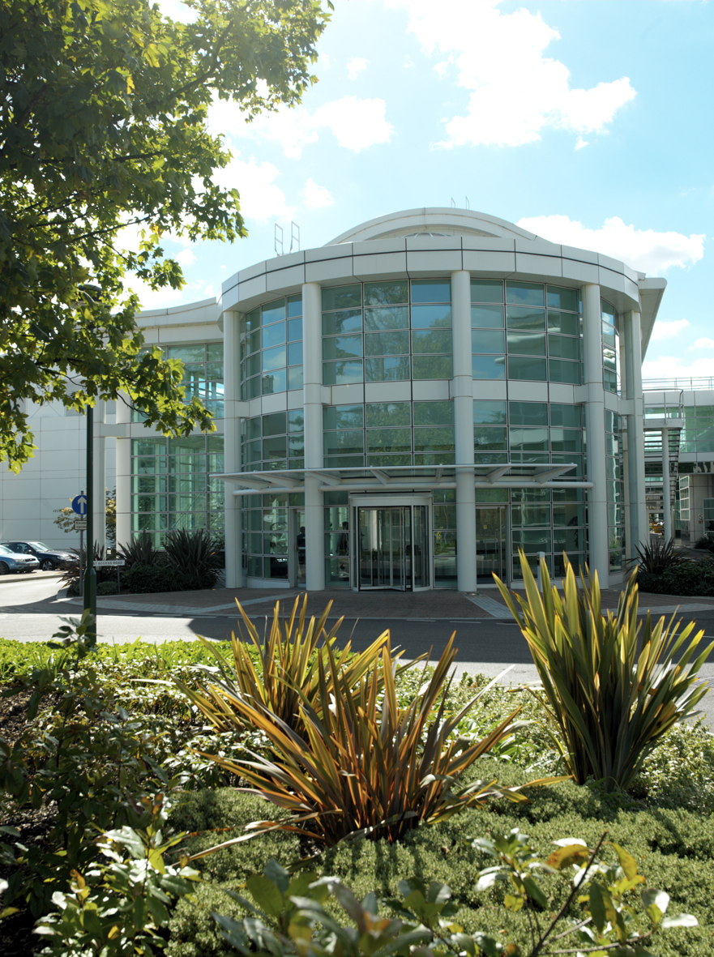
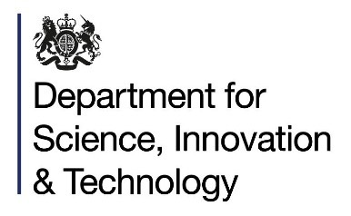
UK’s National Metrology Institute founded in 1900
Provides the measurement capability that underpins UK prosperity and quality of life
Public Corporation and PSRE owned by DSIT
1400+ staff
200+ visiting researchers
Provide independent & impartial advice to government, the public and private sector
About NPL
World-leading breadth & depth of science, engineering & metrology expertise
Huddersfield, Cambridge, Glasgow, Guildford, Solihull and Teddington

Slide 3

Creating impact
Our world-leading measurement solutions are critical to business and government, accelerating research and innovation, improving quality of life and enabling trade.
4,500 businesses use NPL per year, they employ about one million people with a turnover of £188 billion, spending £10.2 billion on measurement each year.
A further 74,000 organisations are indirectly supported through the provision of calibration services delivered by the 190 UKAS accredited labs taking traceability directly from NPL (and the other NMS labs). These figures indicate the scale of the total impact measurement has on the UK economy.
About NPL
Notes:
Insert a A4I or M4B slide in immediately after this slide

Slide 4
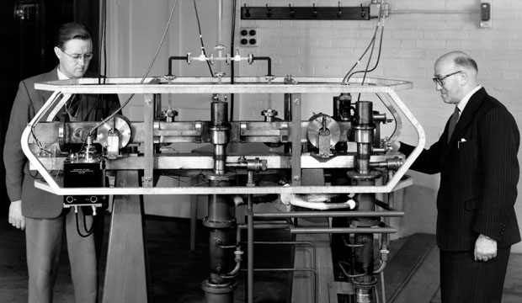
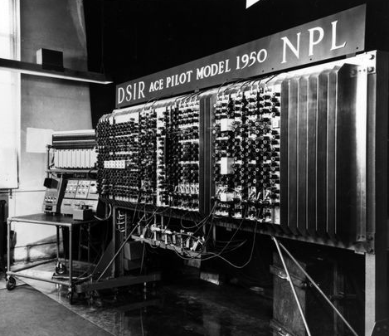
Notes:
1946 – Work began on the worlds first Automatic Computing Engine (ACE)
1955 – First accurate caesium atomic clock

Slide 5
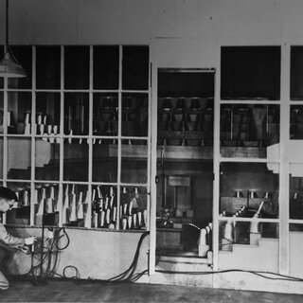
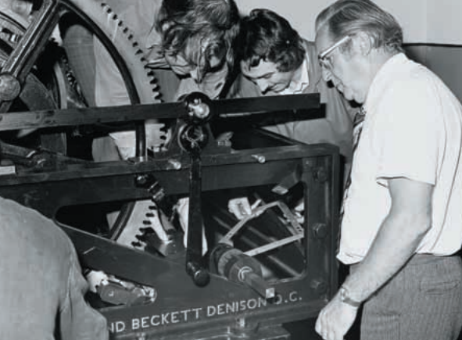
Notes:
1923 – Ventilation of the House of Commons
1976 – NPL designed and fitted new fail-safe brakes for the chiming mechanism of Big Ben – the old brakes having catastrophically failed after being in service sing 1854.

Slide 6
125 years of impact
For people
Creating positive impact for people’s lives
For prosperity
Working with industry to grow the UK economy
For planet
Using science to make changes for our changing planet

Slide 7
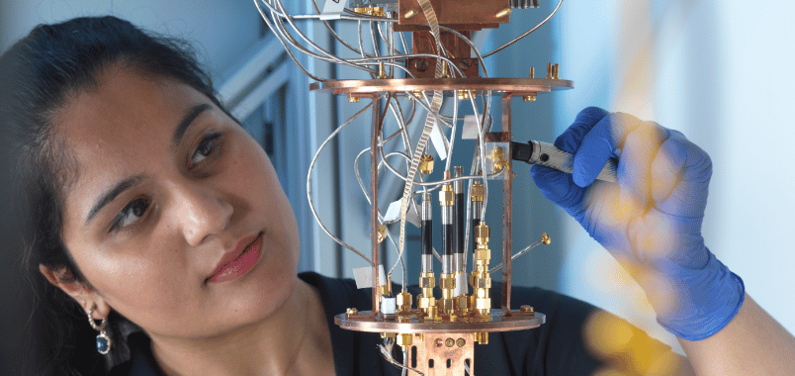
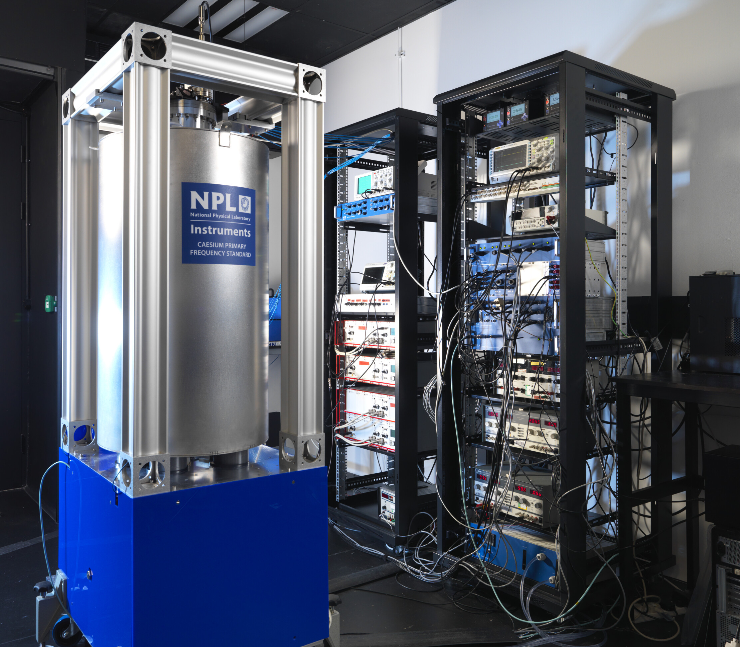
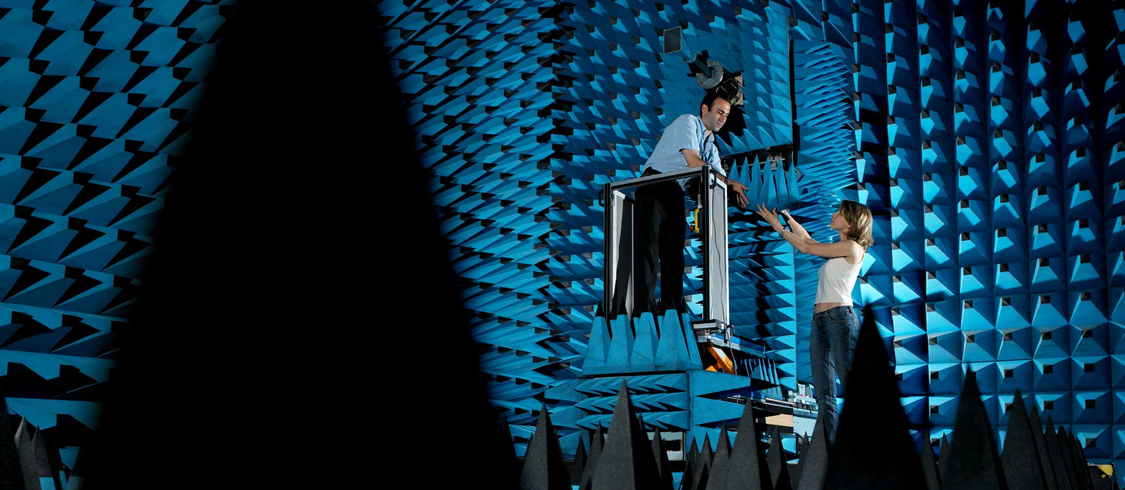
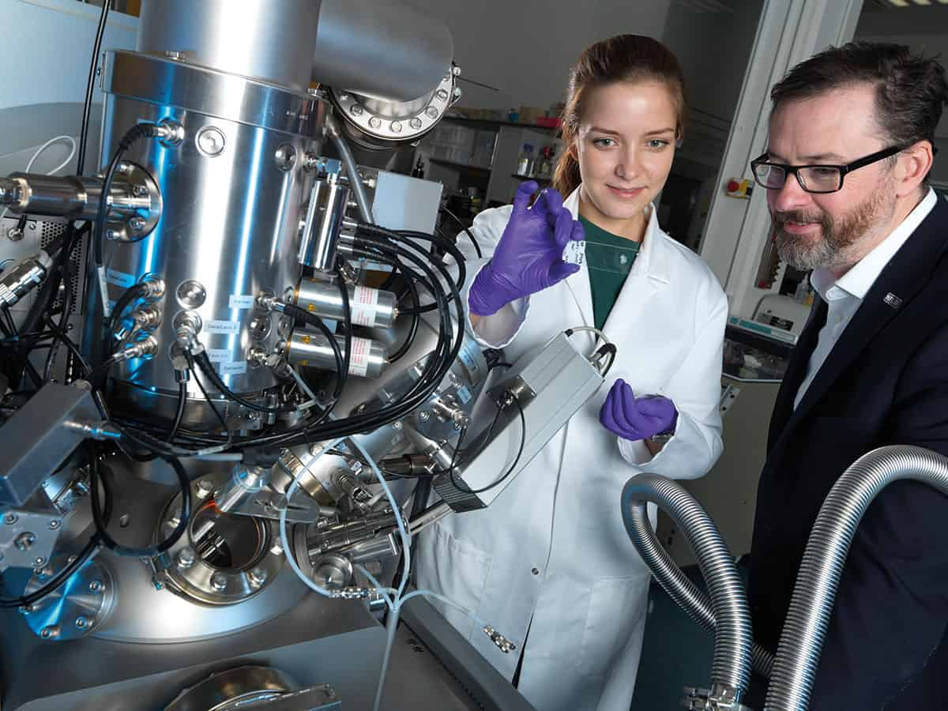
Notes:
Quantum metrology (materials, sensors, computing and communications)
NPL-made atomic clocks sold around the world, R&D into timing resilience, and next-generation atomic timekeeping
Advanced communications technologies – 6G and beyond
Bio-metrology, mass spectrometry and Engineering Biology

Slide 8
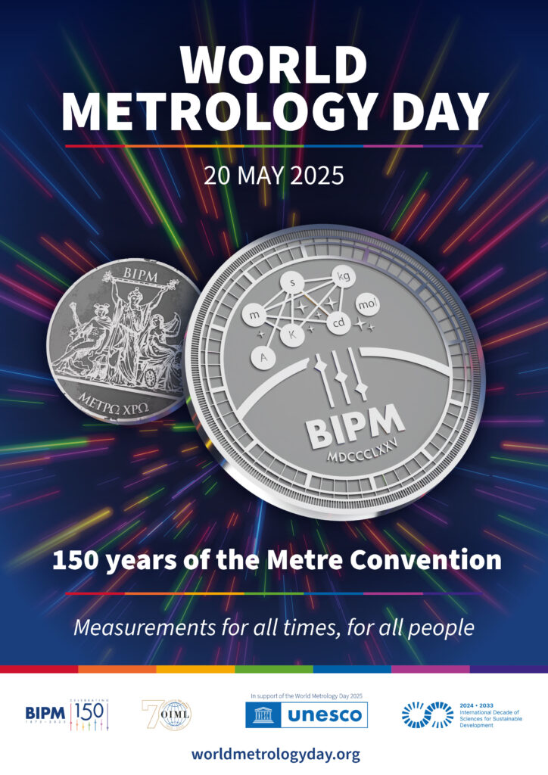
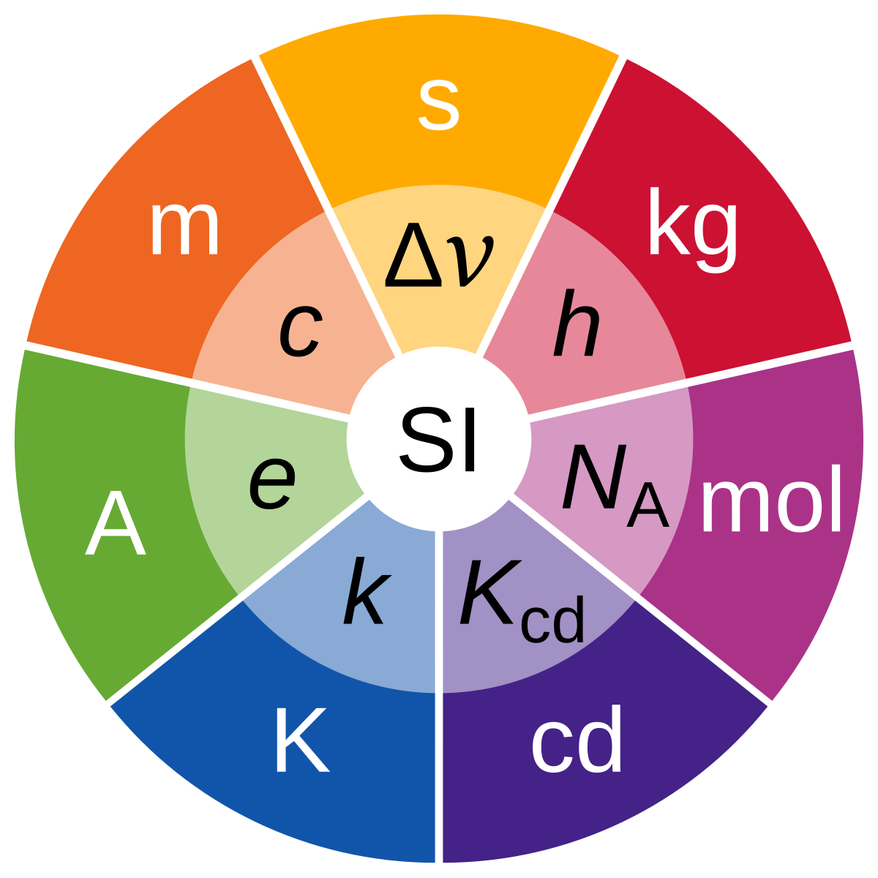
Notes:
2025 marks the 150th Anniversary of the Metre Convention.
This anniversary celebrates a century and a half of international collaboration in metrology, highlighting the profound impact of measurements on our past, present and future.
metrology plays an essential role in driving progress and innovation—ensuring fair trade, advancing scientific discovery and addressing global challenges.

Slide 9
Why is materials metrology important?
Dr Andrew Pollard
Principal Scientist in Advanced Materials, National Physical Laboratory

Slide 10
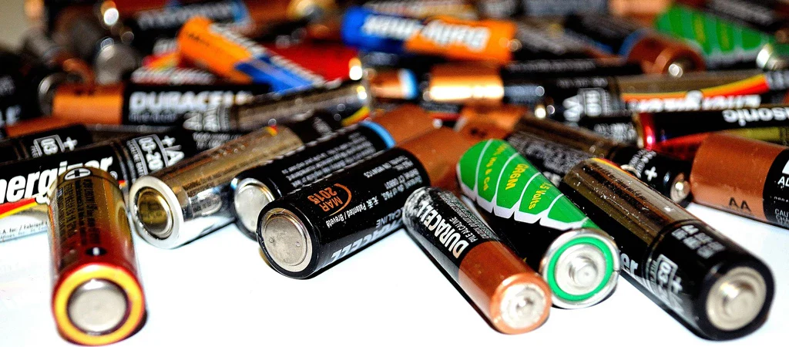



Why are materials important?
Credit: wastepackgroup.co.uk
Credit: tomsguide.com
Credit: BBC
Credit: midlandheart.org.uk
Materials innovation businesses contribute an estimated £45 billion each year to the UK economy.
Notes:
Focus on economic aspects in mine
Materials all around us
For any innovation in products, need advanced materials
Examples, particularly green technologies
Materials enable 6 times more across wider production
At the same time we need more sustainable materials and more and more advanced materials
Without metrology, cannot innovate, lets take a recent example

Slide 11
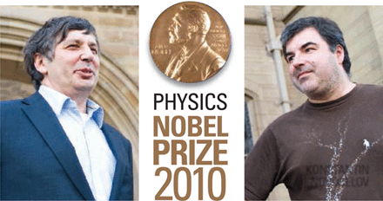
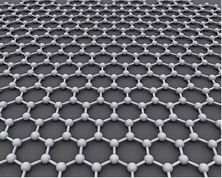


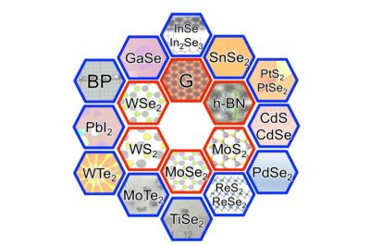

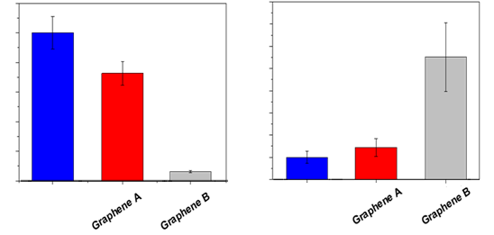
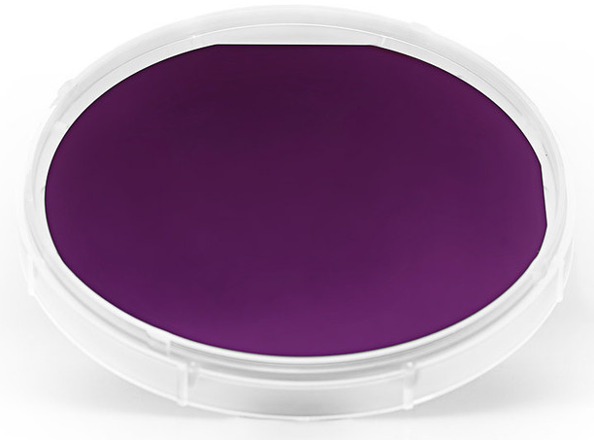
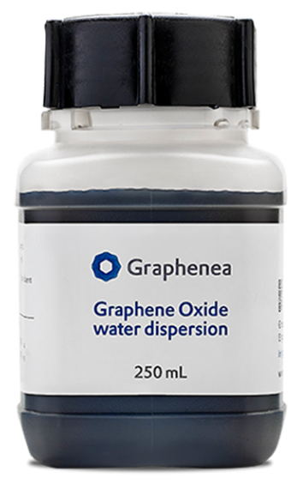
Past: Nobel Prize to industry need
What is this stuff?!
Credit: Nanyang Technical University
www.graphenea.com
www.appliedgraphenematerials.com
Brennan et al. App. Surf. Sci. 403 403-412 (2017)
DerHexer, Wikimedia Commons, CC-by-sa 4.0
www.davidkelly.me
Notes:
Wonder materials isolated in UK, 2010 Nobel prize
Nanomaterial that is strongest and most conductive
But work is needed to get any new material into industry and real-world products
Example of a small company trying to use graphene
Because real material isn’t what you expect etc.
Becomes the wild west

Slide 12

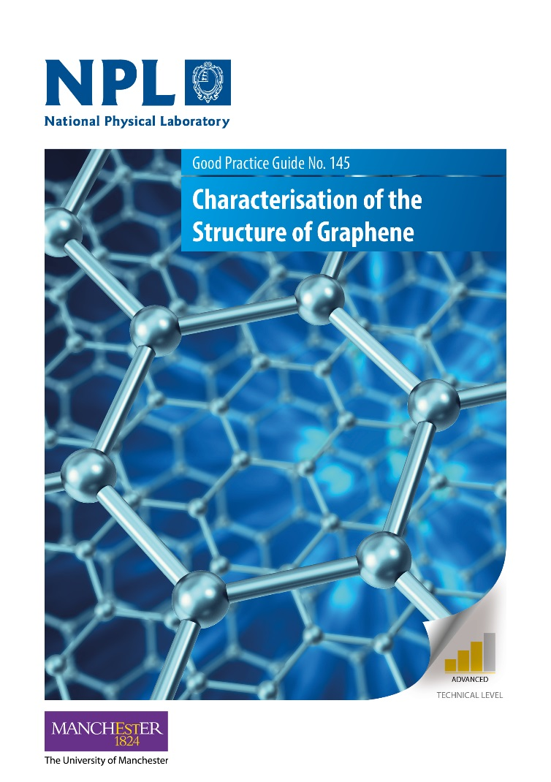
Present: Applying Metrology
Require accurate and precise measurements and confidence in data
Metrology enables industry and innovation
International standards are key to new materials
  Require international validation!
Good practice guide (GPG) series released by NPL
  Rapid dissemination to industry
International standards developed allowing supply chains to compare materials available
Provides UK industry with economic advantage
UK GDP growth and skilled jobs
£60M
private investment
Notes:
Where metrology comes in
Can’t innovate if you don’t know what you have
Need reliable and reproducible measurements for confidence in the supply chain
This needs ILCs to get international standards
In this case NPL provided the robust measurement protocols needed
Helped dozens of UK companies
Growing number of staff by a factor of 2-11
Investment of ~£60M across 3 companies (2021)
Ensured UK companies could prosper compared and not undercut by other countries

Slide 13
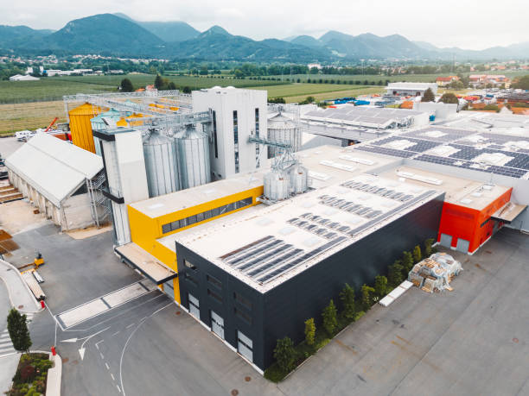
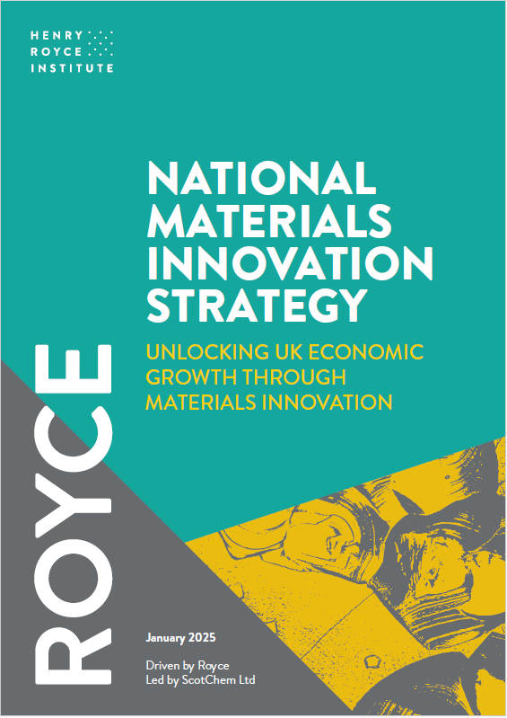

Future: Quality Control at Scale
Reducing 30% of costs
Notes:
But this isn’t the end
Not batch-to-batch reliability not provided by the best measurements
Need verified rapid and cost effective measurements
Examples of us helping companies develop inline processes
One company had 30% costs
Now this material is in all kinds of products, from cement to phones to cars
This is one story, there are now a whole family of materials with different properties (superconducting, insulating semiconductor)
Other new families of materials
New or improved materials for sustainability
All will need the same journey that we have seen for over 125 years

Slide 14
Radiotherapy: Shaping Patient Dose Accuracy
Dr Ana Lourenço
Principal Scientist in Radiotherapy and Radiation Dosimetry, National Physical Laboratory
Notes:
STEM for Britain, previous medal winner, DEFINES DOSE FOR RADIOTHERAPY

Slide 15
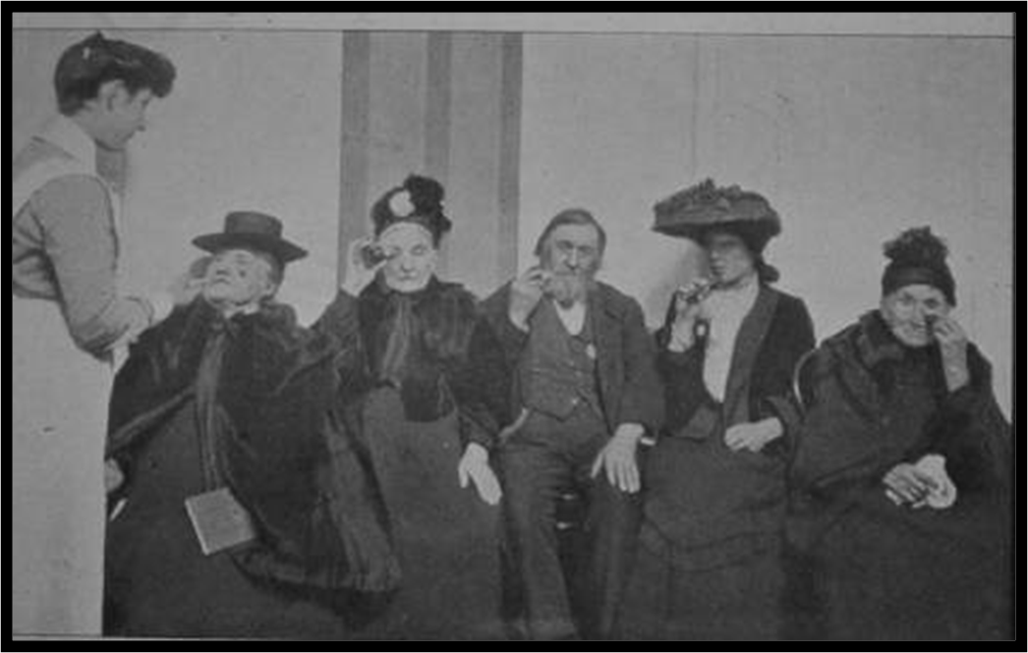
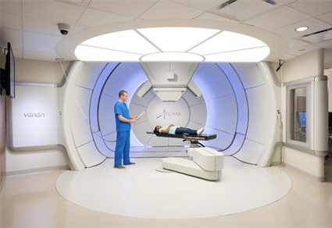
1 in 2 of us will face cancer in our lifetime
50% of cancer patients rely on radiotherapy - it amounts just 5% of the NHS cancer budget
Effective, safe cancer care, with better outcomes, starts with the right radiation dose
1913: NPL measured radiation based on simple methods
Trusted, world-leading MEASUREMENT makes it possible
In 1988, NPL launches the world’s first calibration service for absorbed radiation dose
Notes:
Radiotherapy saves significantly money to the NHS!
A machine is used to carefully aim a beam of radiation at the cancer cells, with a mm precision
NPL makes it possible: confidence, independence, reliability
Early measures – relied on simple measures
Over time, understand what is going on in the body
UK has the most rigorous system and the best system in the world
Sources:
https://www.accuray.com/blog/radiotherapy-an-overlooked-pillar-of-cancer-care-learn-how-radiotherapy-uk-is-driving-change-for-a-better-future/#:~:text=Lack%20of%20long%2Dterm%20planning,cancer%20budget%20directed%20towards%20it.
https://radiotherapy.org.uk/wp-content/uploads/2024/10/Radiotherapy-Productivity-Report.pdf

Slide 16
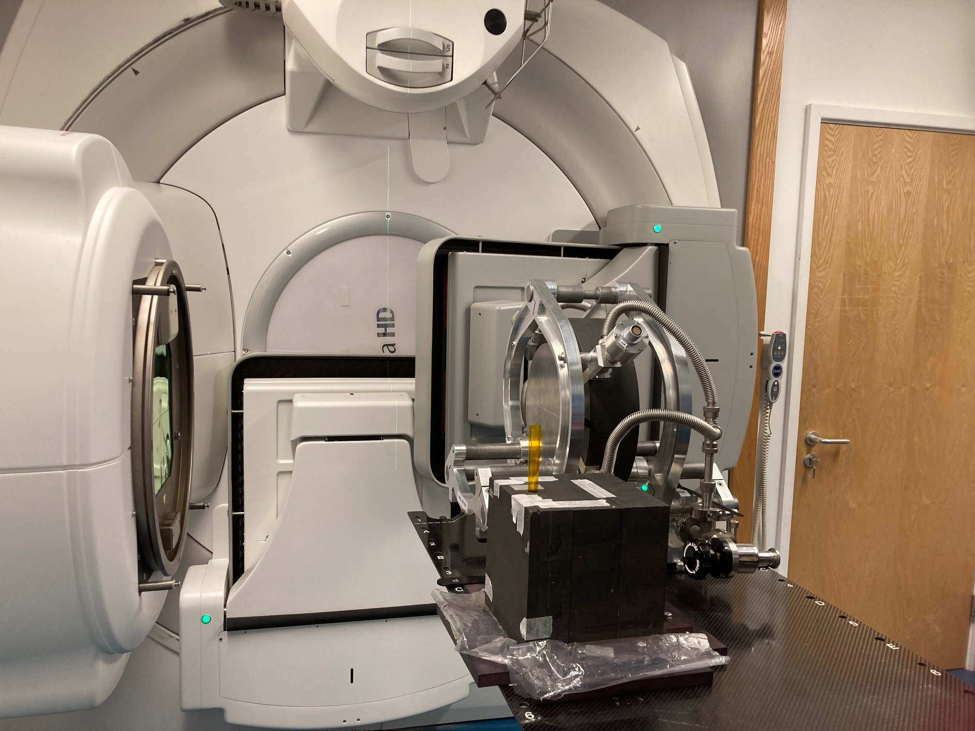
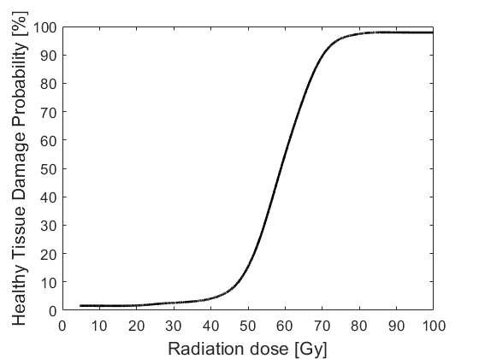
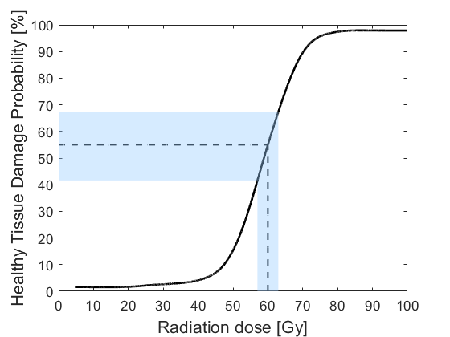
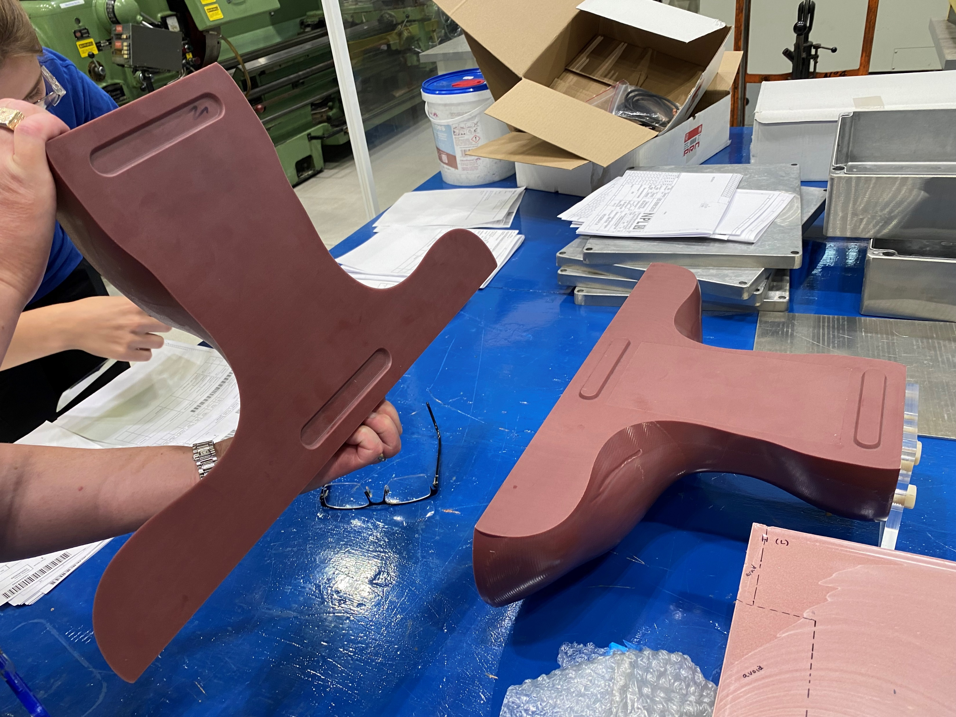
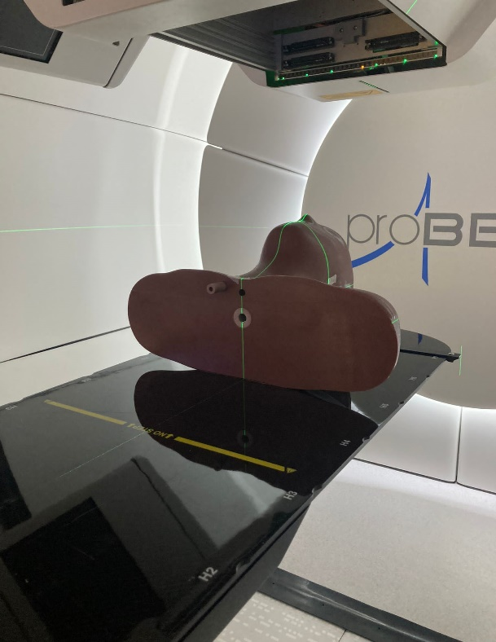
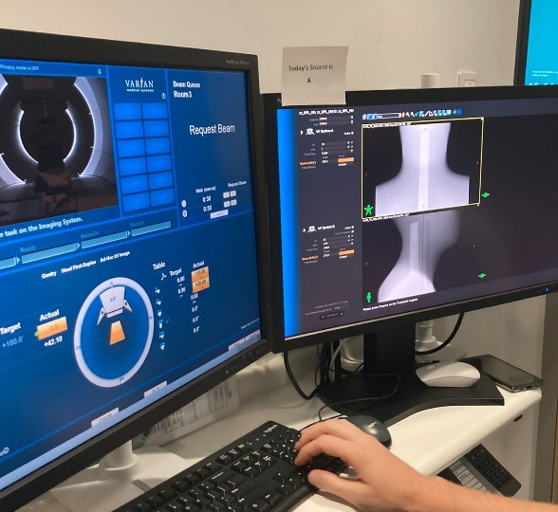
Why radiation dose accuracy matters?
Small error in the radiation dose can lead to harmful consequences
All NHS radiotherapy centres rely on NPL for safer, more accurate cancer treatments. Every patient, receives the right dose.
1% error
30% more risk damage
Cognitive decline, etc
NPL verifies the entire radiotherapy workflow through independent audits – essential for clinical trials
NPL ensures new techniques are delivered to patients safely
Notes:
All radiotherapy involves risk because even a small error in the dose can lead to harmful consequences
1% error in dose can produce 20-30% change in the chance of damaging healthy tissue damage: brain tumour - cognitive decline, vision loss
We calibrate all the radiotherapy machines in the country
Source:
https://iopscience.iop.org/article/10.1088/1742-6596/444/1/012006/pdf

Slide 17
Radiotherapy: high-energy X-rays vs protons
Radiation
beam
high-energy
X-rays
protons
Notes:
Cross-section, better patient outcomes for your constituents

Slide 18
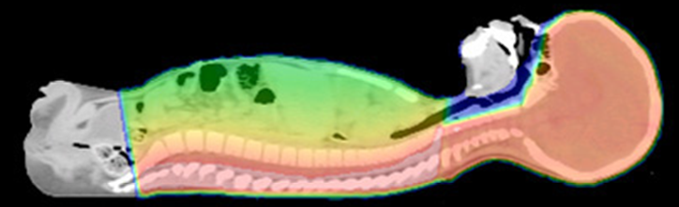
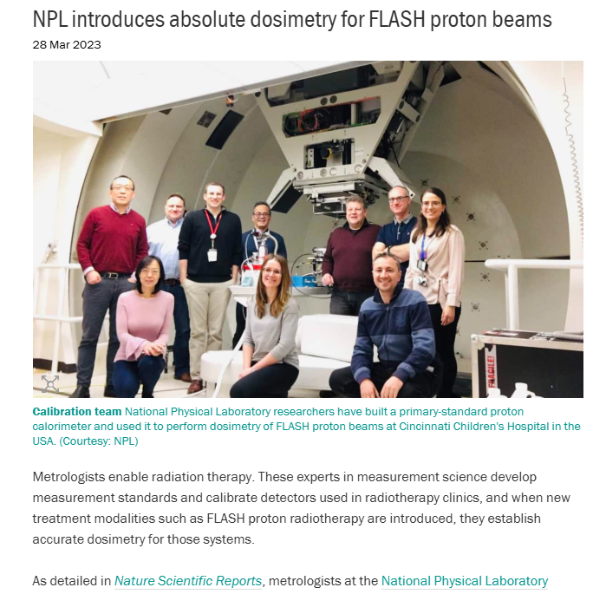
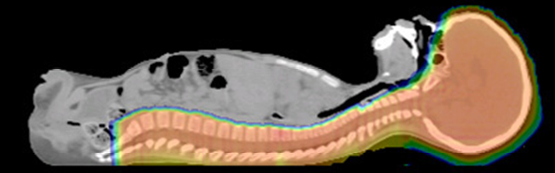
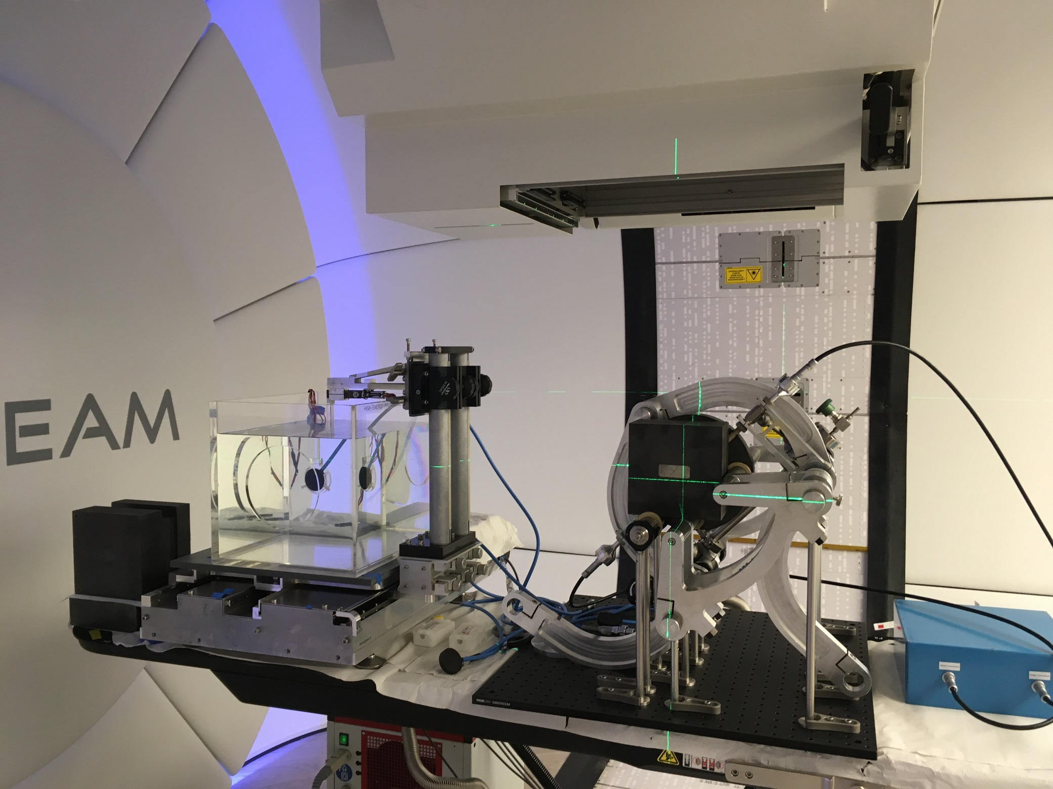
A clinical example
pediatric medulloblastoma patient
X-rays therapy
An ultra-fast cancer treatment that could cure cancer in 1 week
Proton therapy
NPL world’s 1st dedicated measurement standard for proton radiotherapy in the 1st high-energy NHS proton radiotherapy centre
Notes:
Colour shows the radiation dose maps, where radiation dose is deposited
Underpinned FDA approval
This is what NPL does today - supporting safer, faster, and more precise cancer treatments
But as the cancer burden grows and waiting times worsen, the need for NPL’s expertise is only going to intensify

Slide 19
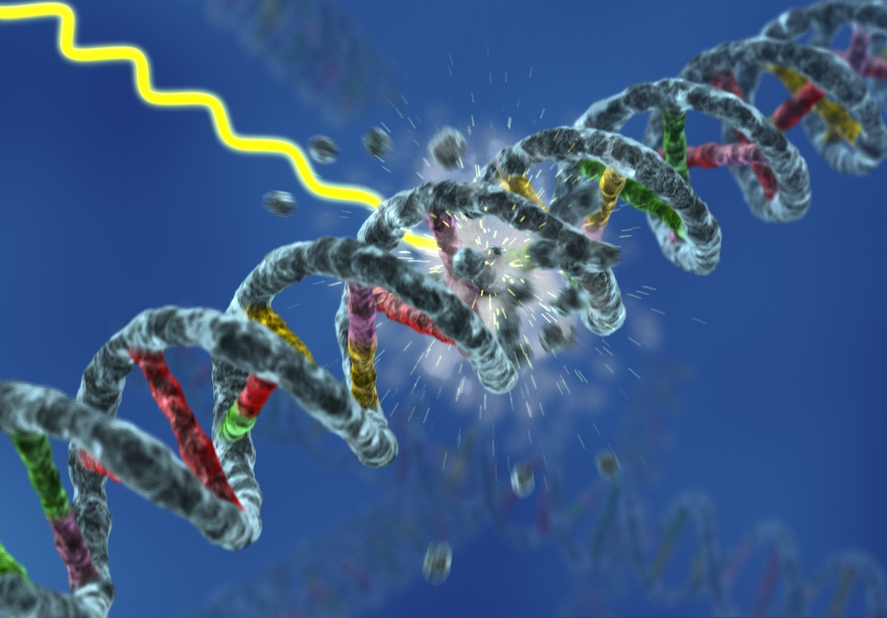
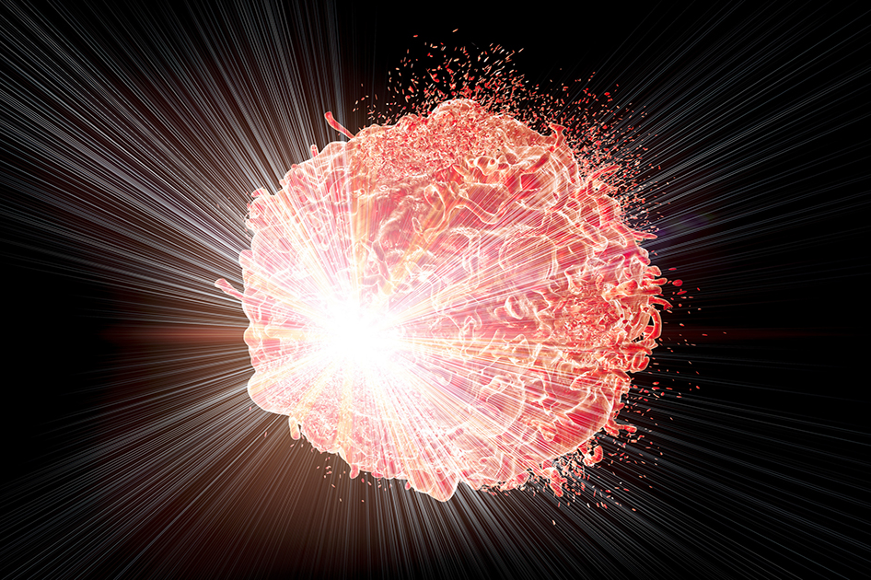
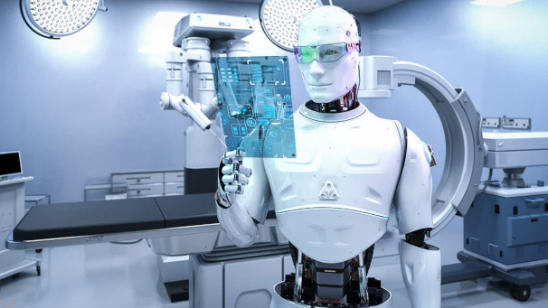
By 2040, cancer cases in the UK are expected to rise by one third - reaching over 500,000 new cases each year
Accelerating adoption of advanced treatments
Personalised cancer care
Artificial Intelligence
Science to understand how different patients respond to radiation
Standards that make it safe
Explainable and trusted validation
Right patient. Right treatment. Right time. Right dose.
Notes:
Meeting this challenge will require smarter, faster, and more precise radiotherapy.
NPL is already playing a critical role — and here’s how we can go further
We are developing the science to understand how different tissues respond to radiation at the DNA level - enabling truly personalised cancer care
FLASH delivers radiation up to 10× faster. We are building the standards that make this safe and clinically usable - helping to bring this from lab to clinic
AI can help optimise treatment planning and reduce delays - but only with rigorous, trusted validation and quality assurance. That is where NPL comes in
Meeting these challenges will require faster, and more precise radiotherapy.
NPL is already playing a critical role - and here is how we can go further
We can develop the science to understand how different tissues respond to radiation at the DNA level - enabling truly personalised cancer care
New treatments coming into place. We are building the measurement standards that make this safe and clinically usable
Integrating Artificial Intelligence safely and effectively - but only with rigorous, trusted validation and quality assurance. That is where NPL comes in
We want every patient to get the right treatment, at the right time.
NPL is helping make that future a reality
We want every patient to get the right treatment, at the right time.
NPL is helping make that future a reality

Slide 20
Professor Josephine Bunch
NPL Fellow in Biomolecular Analysis, National Physical Laboratory
Notes:
STEM for Britain, previous medal winner

Slide 21


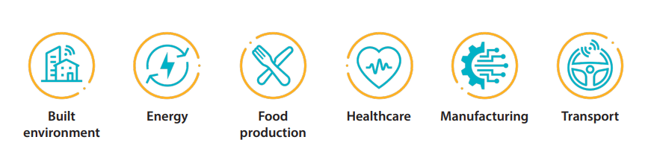
And for the next 150 years?
Developing the future of metrology and metrology for the future
NPL foresighting

Slide 22




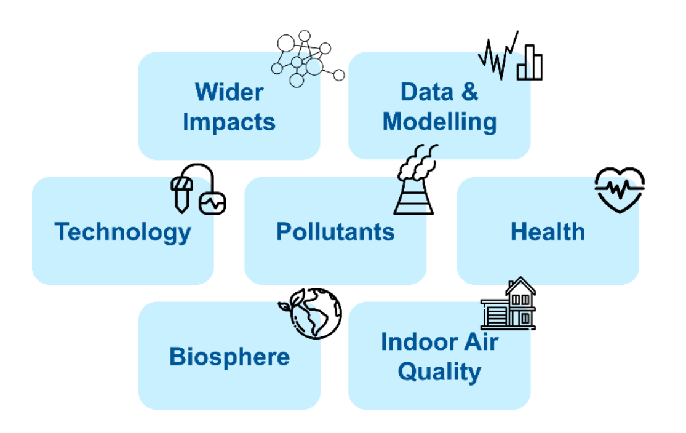
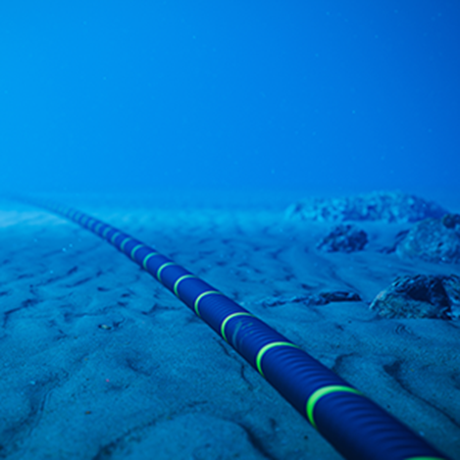
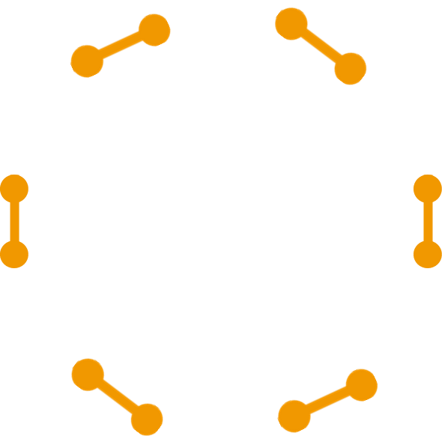
Developing the future of metrology and metrology for the future
New approaches to tackle highly complex and interconnected systems
New approaches to uncertainty calculation
Improved SI-traceable methods
Trusted AI

Slide 23
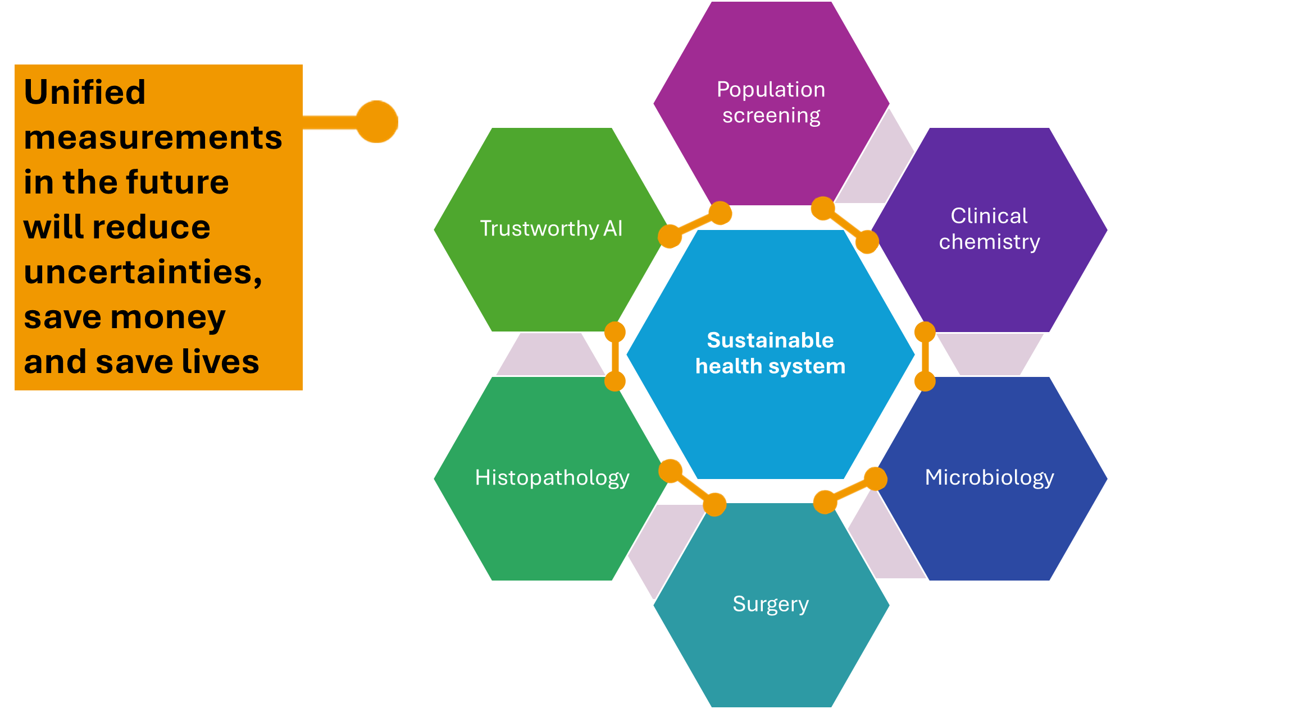
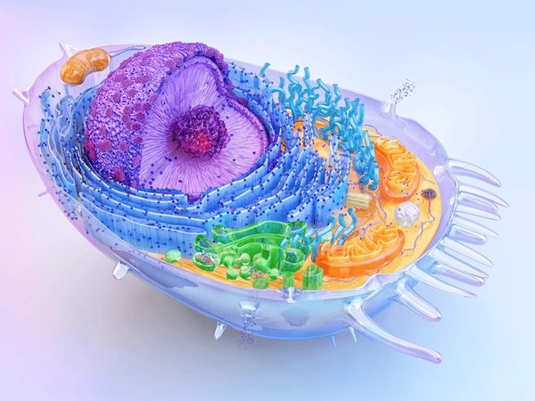
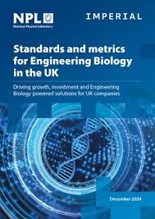
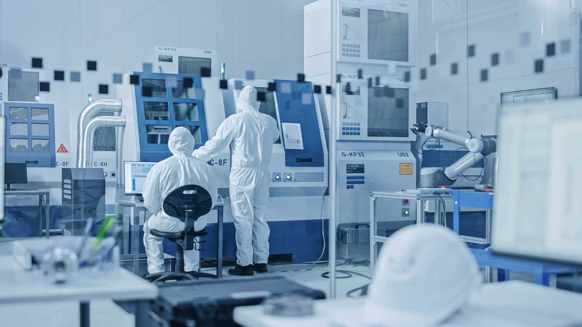
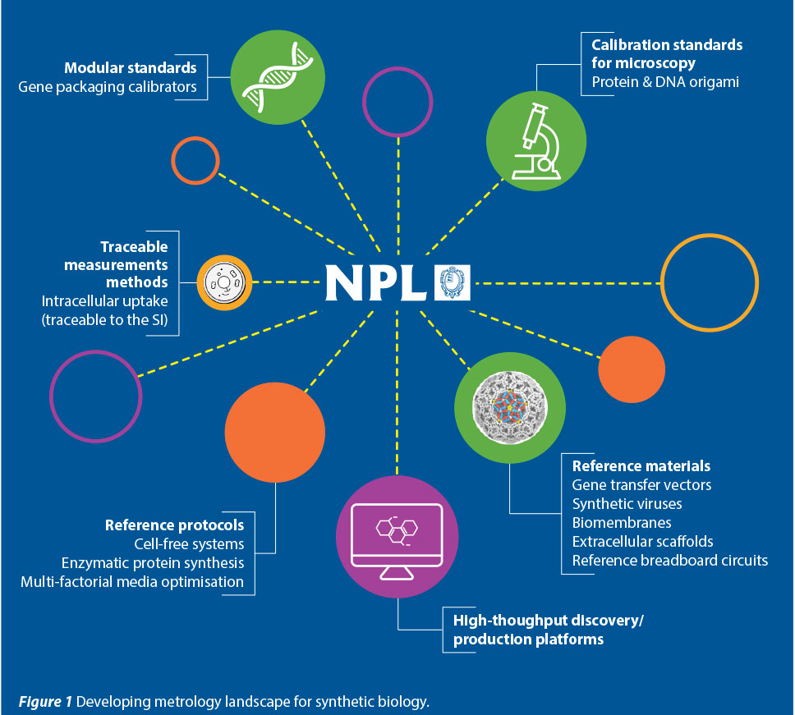
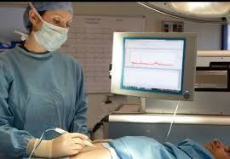
Developing the future of metrology and metrology for the future
New approaches to tackle highly complex and interconnected systems
New approaches to uncertainty calculation
Improved SI-traceable methods
Trusted AI

Slide 24
Q&A

