Slide 1
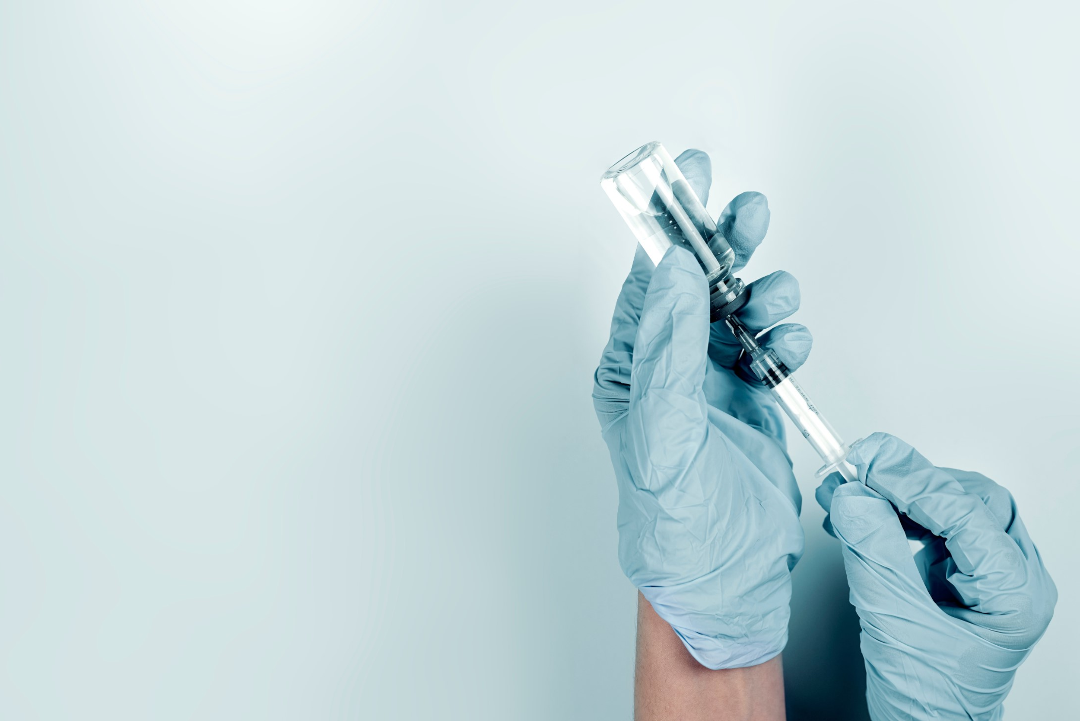

Dr. Stephen A. Wells
Biologicals without refrigeration
Ensilication – using silica to stabilize biomolecules, avoiding refrigeration, freeze drying, and the “cold chain”.

Slide 2
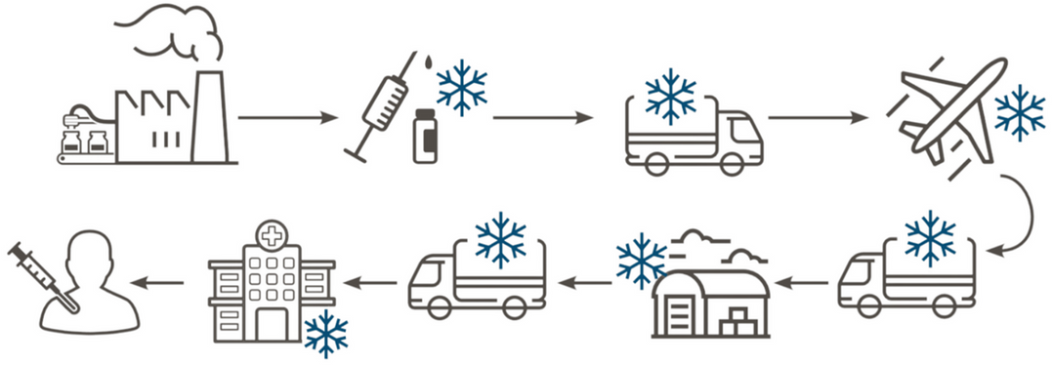
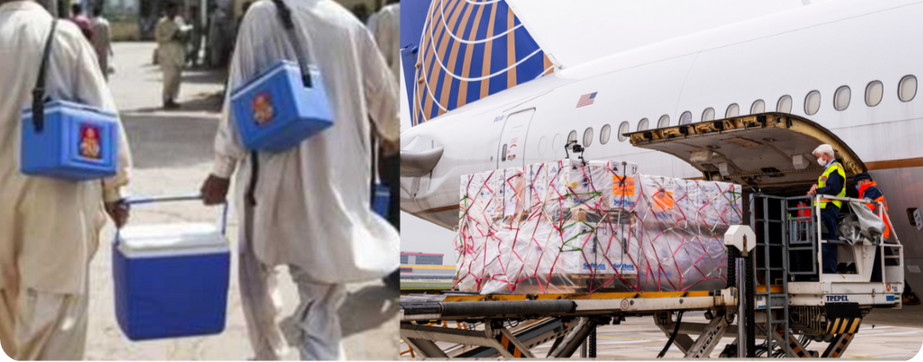
The “cold chain” – costly, complex and fragile.
Most biomolecules, including vaccines and antibodies, are not temperature-stable.
Currently they are preserved by a “cold chain” of refrigeration, and/or by freeze-drying (“lyophilization”).
Costly ( £ $ € and energy/CO2 ) and risky – molecules may be damaged.
On average 10-25% of vaccines are wasted due to cold chain failures.
More than a million infants die every year from vaccine-preventable diseases.

Slide 3
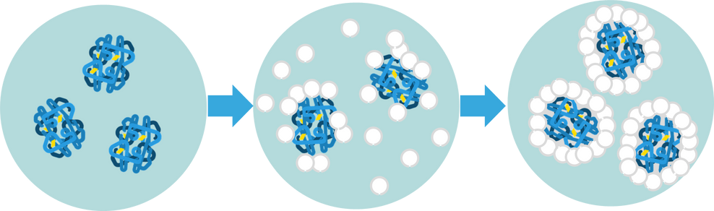
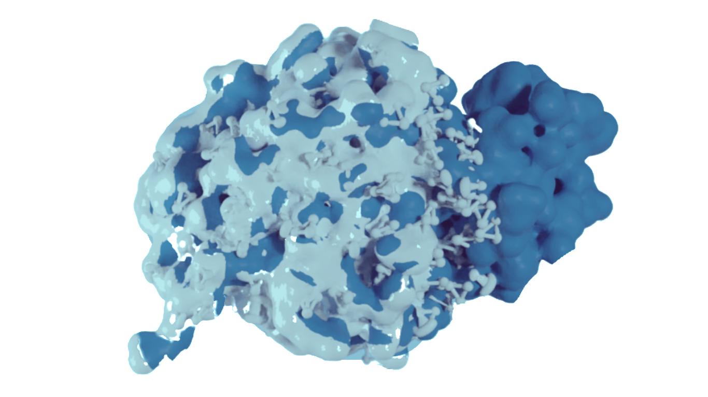
Ensilication makes biomolecules thermally stable
We can deposit a layer of silica (cheap, non-toxic) around each individual biomolecule, preserving them perfectly – they cannot lose their shape or stick together.
Silica disintegrates naturally and safely in the body, releasing the biomolecule.
Biomolecule
Silica deposits on surface creating protective barrier

Slide 4

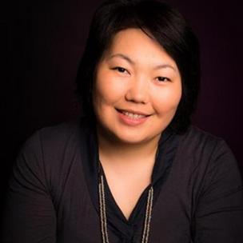
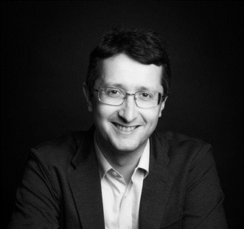
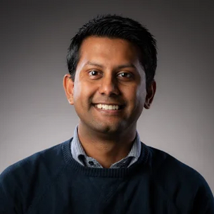
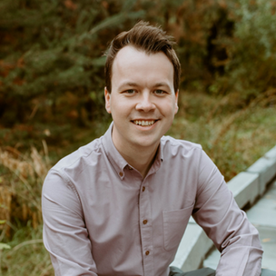
Our founding science team
Dr Asel Sartbaeva
CEO
Co-inventor of ensilication
PhD Cantab., researcher in silicate materials synthesis and structure.
Dr Stephen A. Wells
Scientific Advisor
Co-inventor of ensilication
PhD Cantab., researcher in flexibility and rigidity of silica and protein structures.
Dr Aswin Doekhie
CTO
PhD in Ensilication from University of Bath
Formerly Crucell and Mymetics
Dr Matt Slade
COO
PhD in Ensilication from University of Bath
ICURe Lead
…the company now has more than a dozen staff and we are still expanding…

Slide 5



Company timeline
2022
Company launched
Oversubscribed pre-seed investment round: £1.2M
2023
Won £1.7M SBRI government contract to develop 1st ensilicated mRNA vaccine
2024
Won £1.4M Innovate UK grant to develop ensilication of antibodies
2025
Completing £3.5M seed investment round at £10M valuation
2023
PoC 1: Paid PoC (3 assets) with a Global Top 10 Animal Vaccine Company
2024
PoC 2: Paid PoC with World Leading Research Institute
2024-5
PoC 3, 4: Paid PoC agreed with Global Top 10 Animal Vaccine Company and Top 5 animal biopharma company
Awards

Slide 6
A growing IP portfolio…
A: foundational
method (2016-)
Granted USA 2021
C: charge-adaptive, widest range of targets (2024-)
C1: method of silica preparation
C2: ensilicated products
B: virus/phage
(2022-)
Biomolecule Preservation – EP17752432.9A
In progress, EPO
Biomolecule Preservation – US16/322,312
Granted, USA
Passed (summer 2024) from PCT stage to selected jurisdictions worldwide.
In progress, EPO
Method application to UKIPO – GB2415935.2
Filed 29/10/24
Product application to UKIPO – GB2415936.0
Filed 29/10/24
A: ensilicated biomolecules
B: ensilicated virus/phage
C: adaptively ensilicated biologicals

Slide 7
Our IP journey: first patent…
Idea – 2012 onwards – research begins in Sartbaeva group.
Invention – 2016 – patent filed before research publication, to protect IP.
“Biomolecule preservation” – filed under University of Bath IP strategy:
Initial GB filing; then
International (PCT) filing; then
National jurisdictions: US and EPO.
US patent granted 2021 – making Ensilitech possible.
After multiple rounds of objection and rebuttal…
European patent – still under consideration!
Process of objection and rebuttal still under way.

Slide 8
Our IP journey: second patent…
Ensilicated virus or phage – doctoral research in Sartbaeva group; patent filed before thesis or paper publication.
“Particle comprising a virus” – filed under University of Bath IP strategy:
Initial GB filing 2022; then
International (PCT) filing 2023; then
National jurisdictions (2024) chosen by Ensilitech:
US, EPO, China, Japan, South Korea – “the Big Five”; also
Brazil, India, Singapore, South Africa, Mexico, Canada.
Now under consideration…
Cost of applications: about £40,000.

Slide 9
Our IP journey: third patent…
Charge-adapted method – in-house research at Ensilitech! Makes ensilication adaptable to suit the target surface – huge step forward for our technology.
Matching Method and Product patents filed: GB 2024.
We have a plan…
International (PCT) filing autumn 2025, followed by choice of national jurisdictions (Big Five ++)
But also…
Continue GB process to obtain UK IP protection sooner.

Slide 10
Lessons learned
As scientists we had no training or experience with IP/patenting (thanks to HLK for being very patient with us!). Steep learning curve!
Everything takes more time and money than you expect.
A virtuous cycle…
IDEA!
INVENTION
RESEARCH
PATENT
INVESTMENT
PRODUCTS

