Slide 1



LISA HICKS
Founder, CEO &
Inventor

Slide 2
What is SNOAP?
SNOAP’s protection
BBC IP coverage
Dragons appreciate IP
Positive Impact
Questions
AGENDA

Slide 3
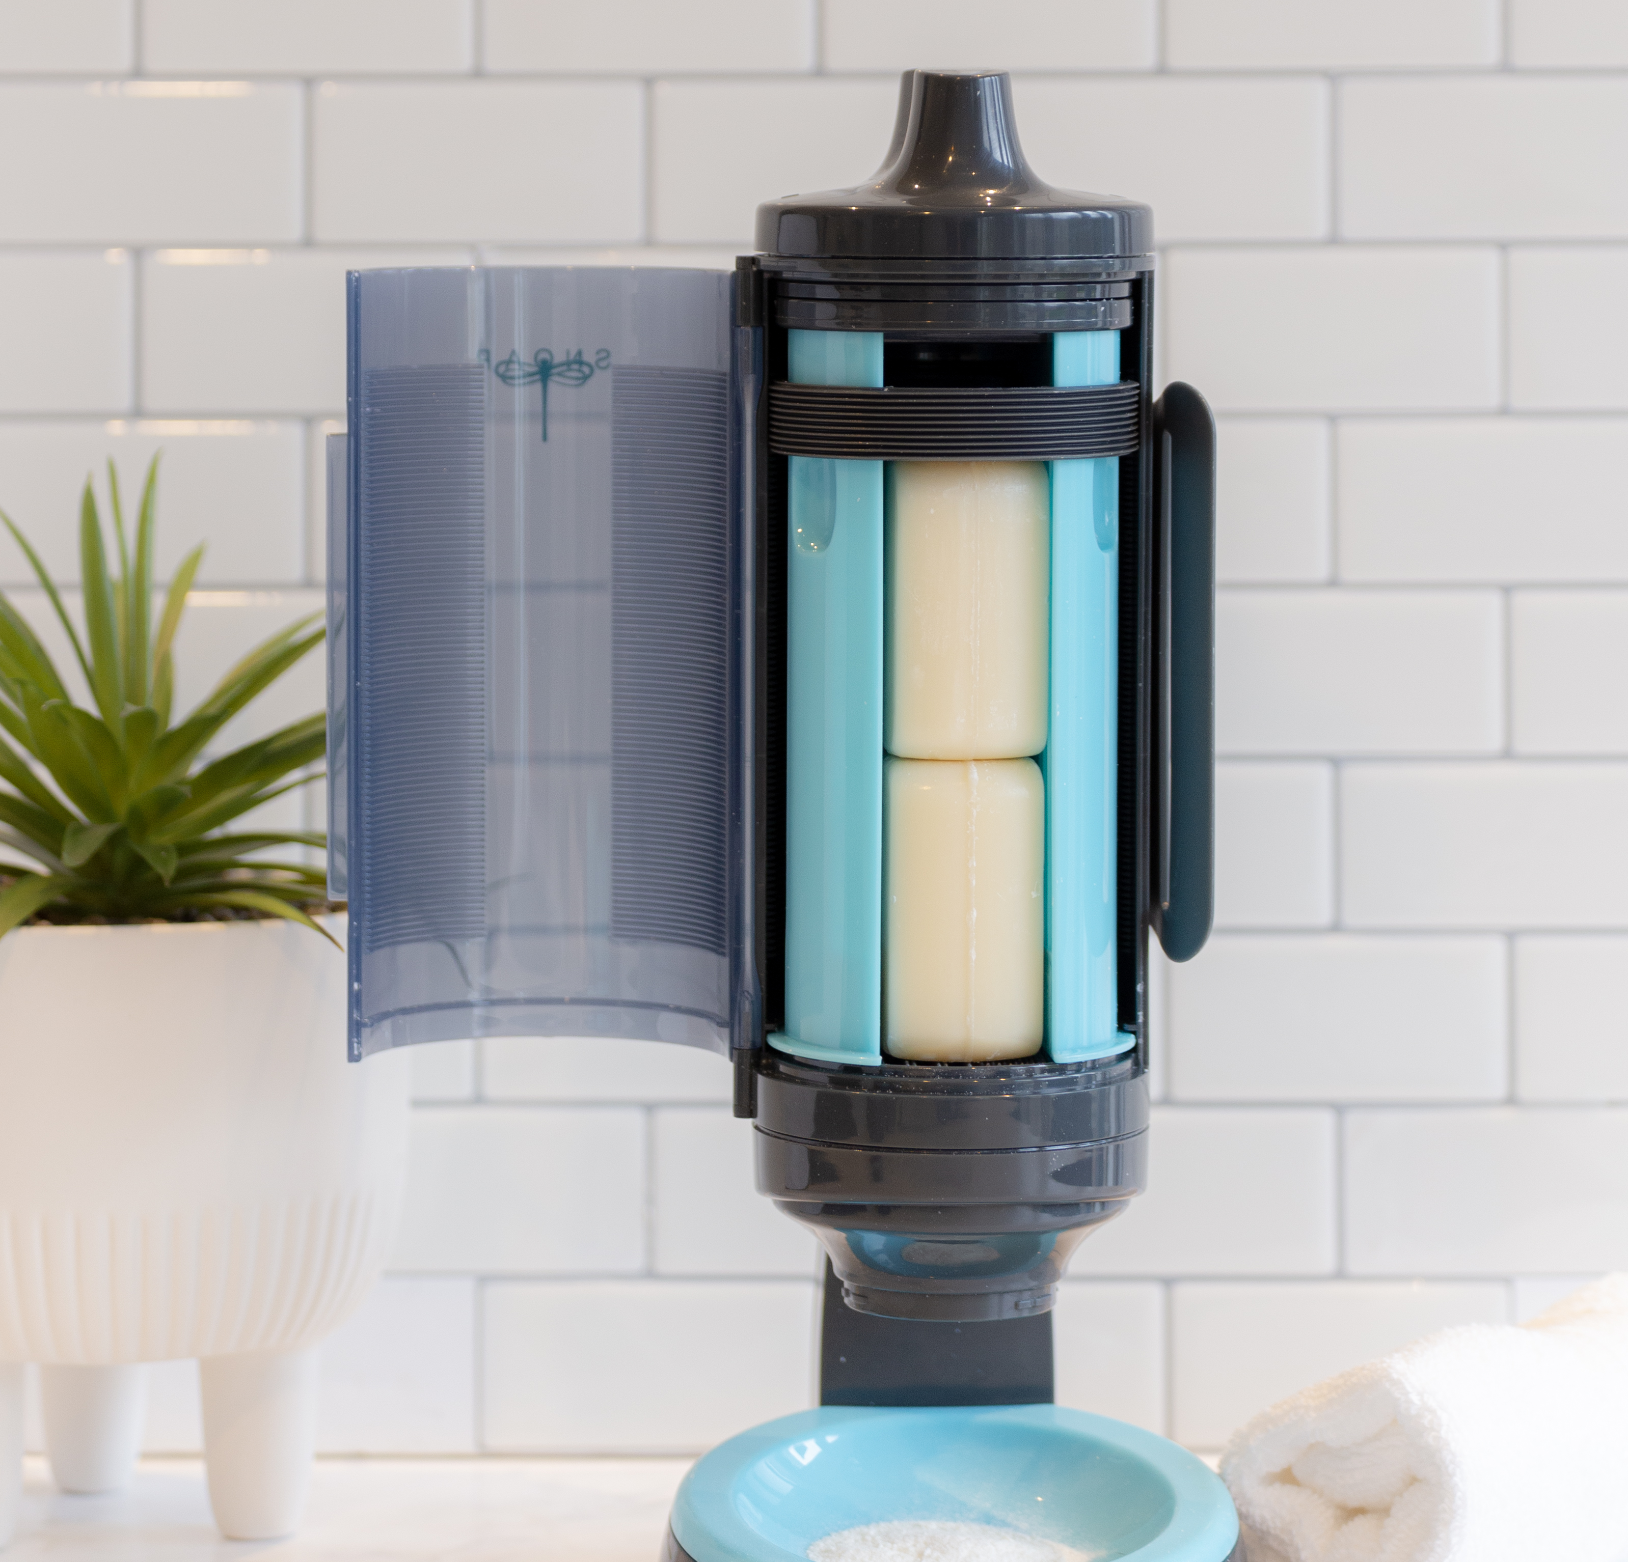
SHARING THE STORY
WHAT IS SNOAP?
SNOAP is a revolutionary, patented and multi award winning solid soap and solid shampoo dispenser
Read it here

Slide 4
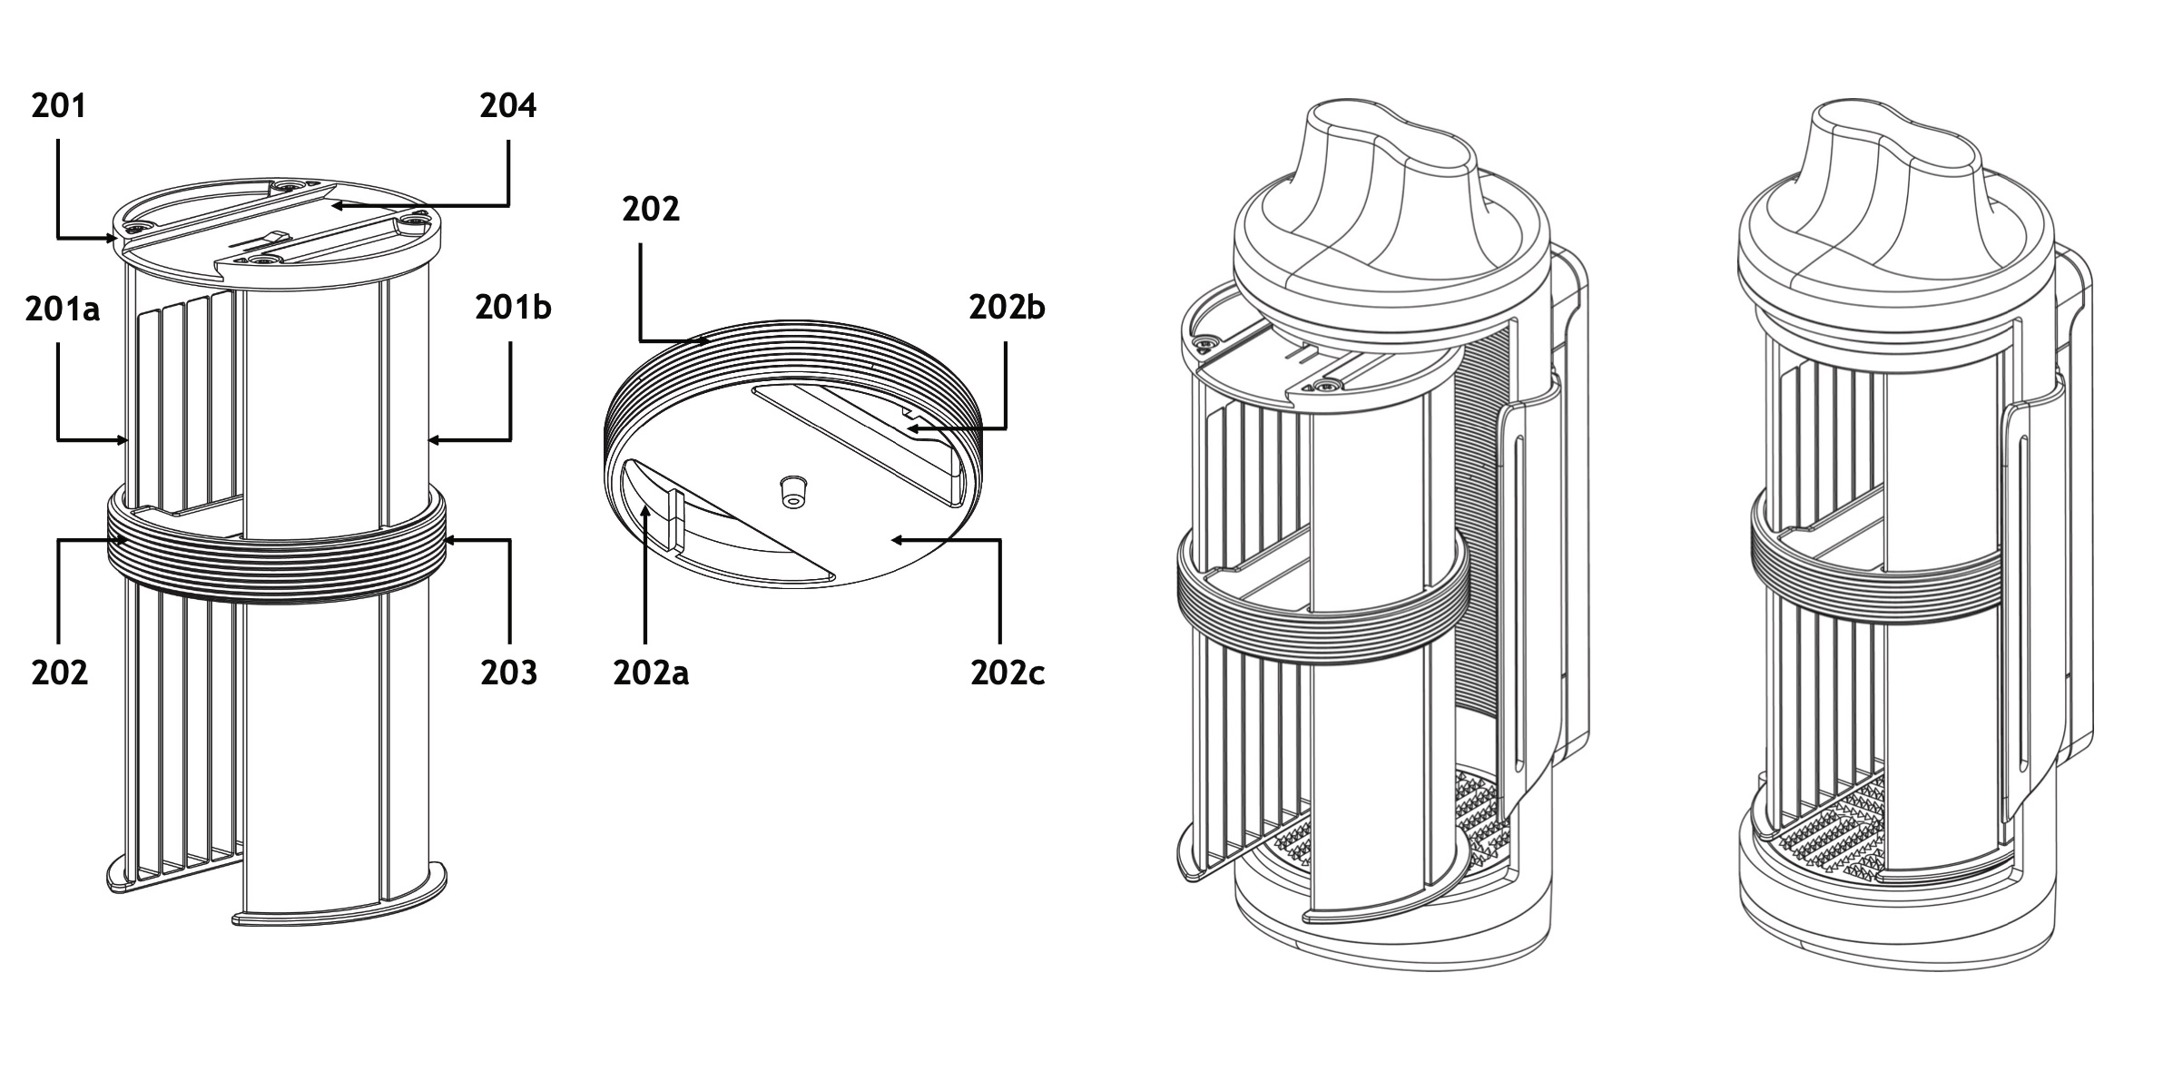
WHY SNOAP
PROTECTION
Dispenser has 4 divisional claims
P10238GB, P10238GBD1, P10238GBD2, P10238GBD3
· Threads on inside surface
· Grating element on bottom
· Driving mechanism – rotate and urge downwards using feeder legs
· Centring element using nipple protrusion
on grating surface and on driving mechanism
· Front loading door
· Handle engaged to rotate feeder legs
· Feeder legs that slide forward to disengaging the threads of the feeder to allow easy insertion of soap bars
Read it here

Slide 5
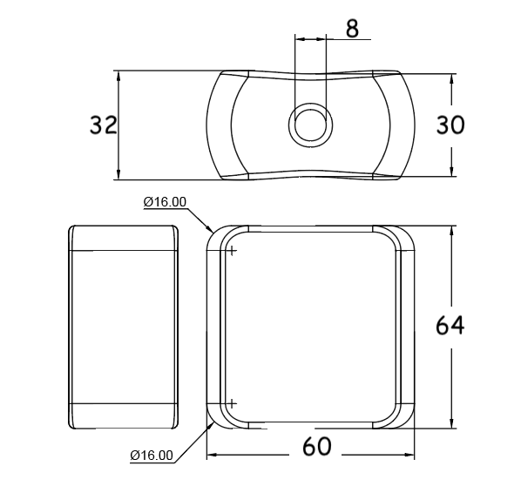
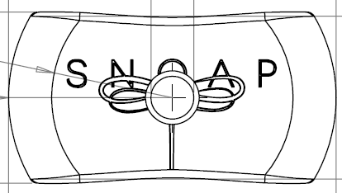
Why snoaP
PROTECTION
Soap covers (P10239GB1):-
· Shape of bars
· Hole through centre
· Consistency of bars
· Etching in top and/or bottom
Read it here

Slide 6
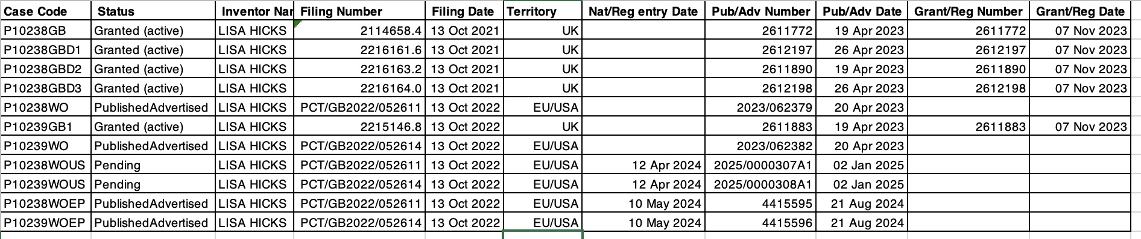

Why snoaP
PROTECTION
Read it here

Slide 7


Why snoap
IP on TV
Read it here

Slide 8
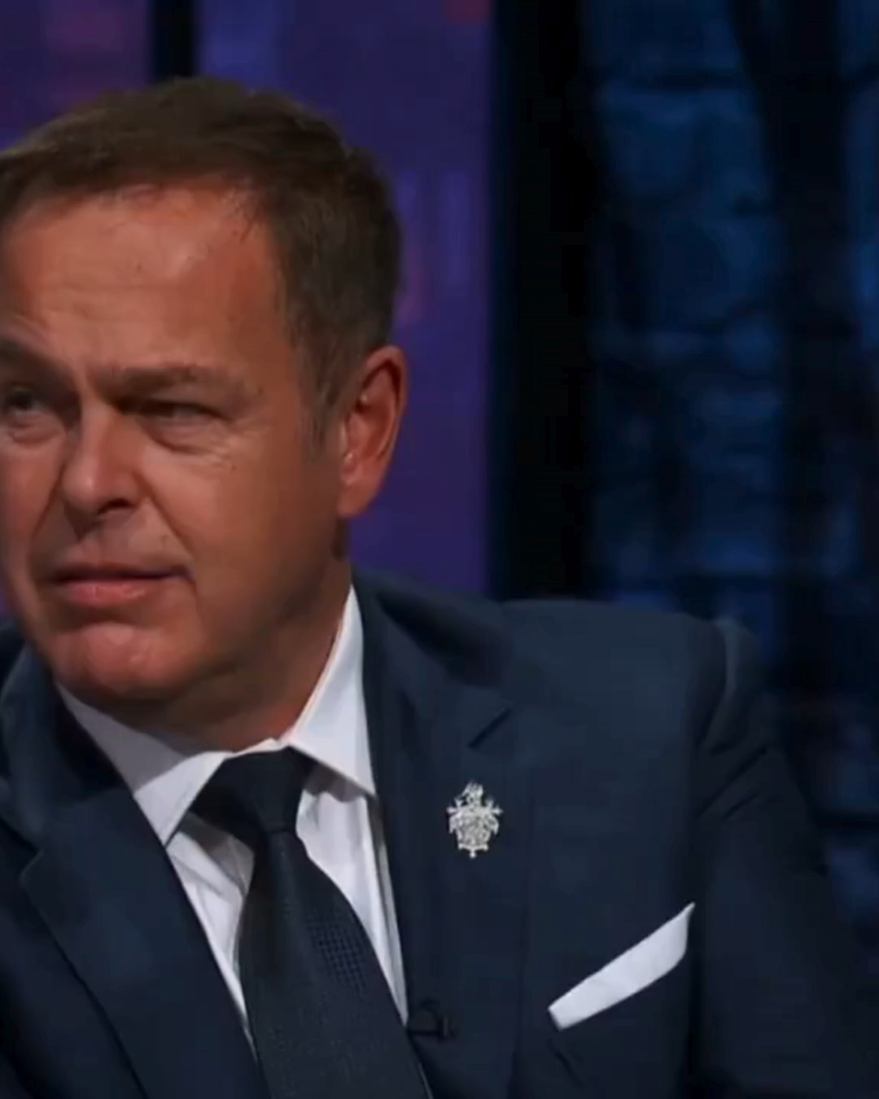
Why snoap
Ongoing Success
TV Appearance
🐉 5 Dragons’ fighting for us
3,500 Households
220 Businesses
Stopping >184,000 Single-use plastic bottles polluting our planet
Export
Read it here

Slide 9

QUESTIONS
Read it here

