Slide 1

International Year of Quantum
31 July 2024
Tom Grinyer, IOP Group Chief Executive Officer

Slide 2
2025: International Year of Quantum Science and Technology
June 2024, the UN General Assembly declared 2025 the International Year of Quantum Science and Technology
Celebrates 100 years since the initial development of quantum mechanics
A worldwide initiative aiming to increase public awareness of the importance of quantum science and applications
The IOP is coordinating UK and Ireland contributions to the International Year of Quantum Science and Technology with the aim of:
"Celebrating the milestone for the community, exciting more people from a range of backgrounds to join us, and maintaining political momentum"
Notes:
Intro to IYQ – background; aims; relevance to this audience (of quantum employers)
“The mission of the International Year of Quantum Science & Technology (IYQ) is to use the occasion of 100 years of quantum mechanics in 2025 to help raise public awareness of the importance and impact of quantum science and applications on all aspects of life.” particularly given the critical role of quantum science and technology in developing sustainable solutions in energy, education, communications, and human health.

Slide 3

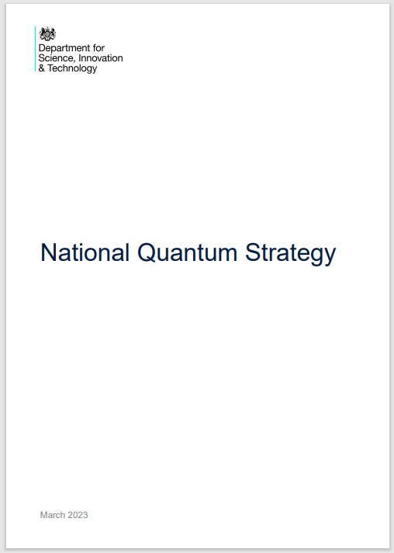
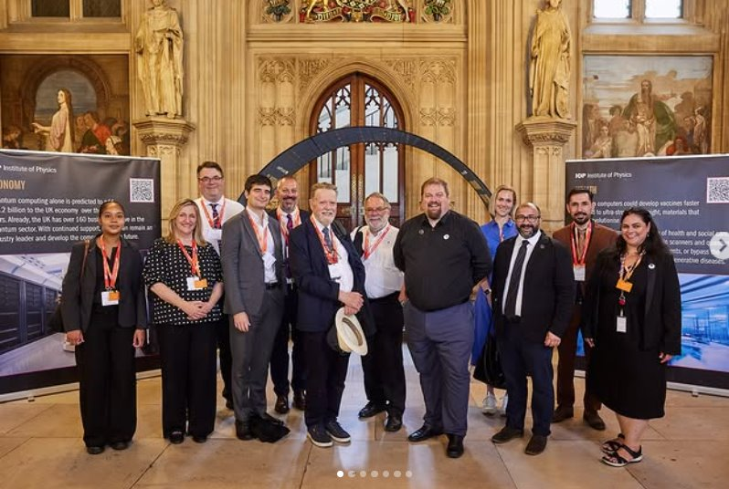
2025: International Year of Quantum Science and Technology
The IOP is coordinating UK and Ireland contributions to the International Year of Quantum Science and Technology with the aim of: maintaining political momentum
UK parliament quantum exhibition,
16 – 20 June 2025
Notes:
Intro to IYQ – background; aims; relevance to this audience (of quantum employers)
“The mission of the International Year of Quantum Science & Technology (IYQ) is to use the occasion of 100 years of quantum mechanics in 2025 to help raise public awareness of the importance and impact of quantum science and applications on all aspects of life.” particularly given the critical role of quantum science and technology in developing sustainable solutions in energy, education, communications, and human health.

Slide 4
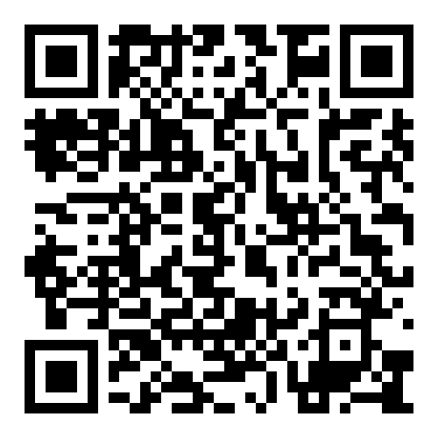

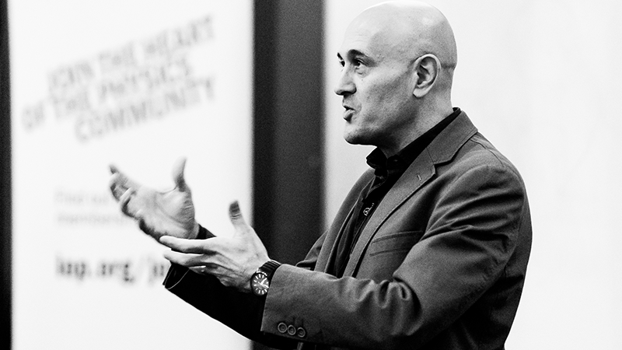
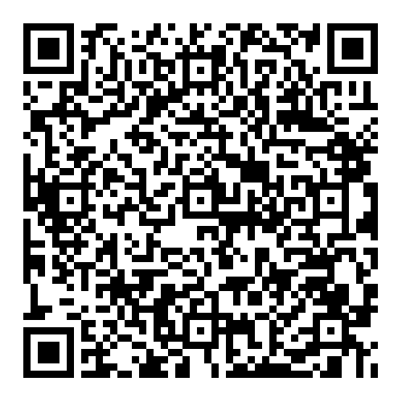
2025: International Year of Quantum Science and Technology
The IOP is coordinating UK and Ireland contributions to the International Year of Quantum Science and Technology with the aim of: exciting more people from a range of backgrounds to join us
FIND OUT MORE
BOOK ONLINE
Jim Al Khalili - A New Quantum World: “spooky” physics to
7 November 2025, 19:20 - 20:45 GMT
Notes:
Intro to IYQ – background; aims; relevance to this audience (of quantum employers)
“The mission of the International Year of Quantum Science & Technology (IYQ) is to use the occasion of 100 years of quantum mechanics in 2025 to help raise public awareness of the importance and impact of quantum science and applications on all aspects of life.” particularly given the critical role of quantum science and technology in developing sustainable solutions in energy, education, communications, and human health.

Slide 5
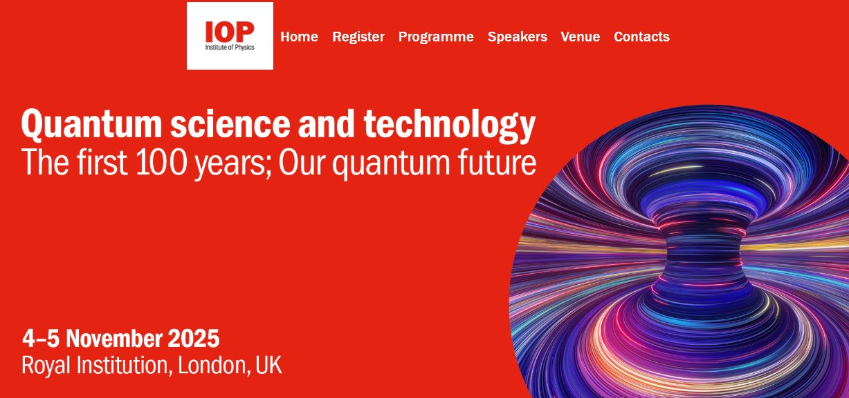
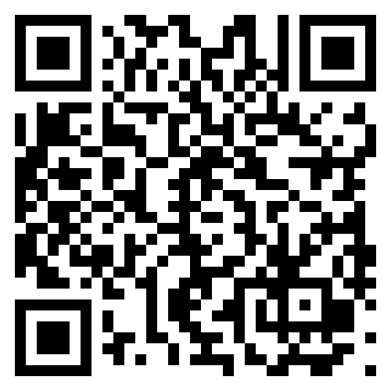
2025: International Year of Quantum Science and Technology
The IOP is coordinating UK and Ireland contributions to the International Year of Quantum Science and Technology with the aim of: celebrating the milestone for the community
BOOK NOW
Notes:
Intro to IYQ – background; aims; relevance to this audience (of quantum employers)
“The mission of the International Year of Quantum Science & Technology (IYQ) is to use the occasion of 100 years of quantum mechanics in 2025 to help raise public awareness of the importance and impact of quantum science and applications on all aspects of life.” particularly given the critical role of quantum science and technology in developing sustainable solutions in energy, education, communications, and human health.

Slide 6
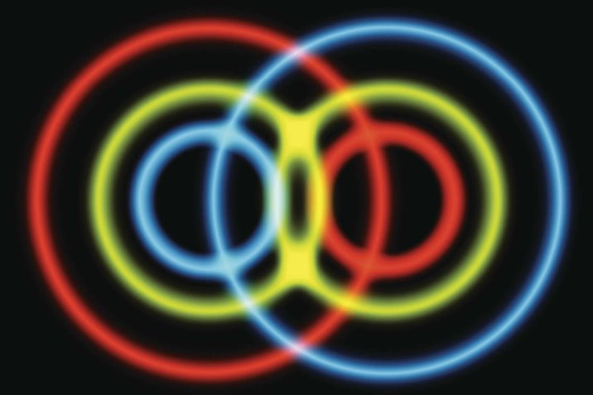
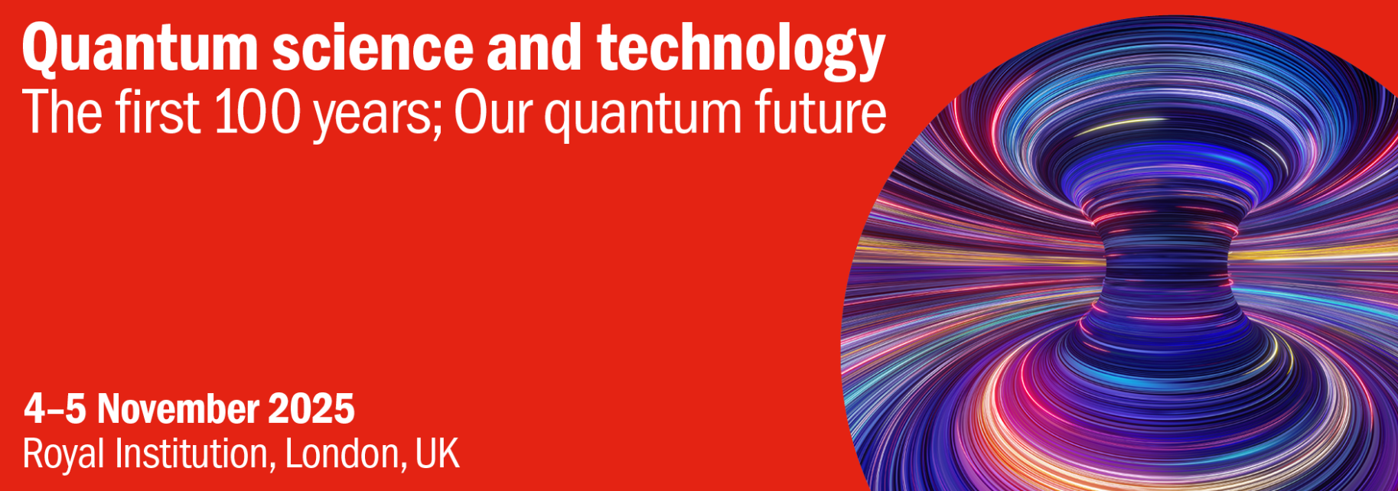

2025: International Year of Quantum Science and Technology
A week of quantum events – 3 – 7 November 2025
Monday 3 November –
Quantum Metrology: From Foundations to the Future
NPL
Tuesday 4 November –
Quantum Science and Technology: The First 100 Years – IOP
Wednesday 5 November - Quantum Science and Technology: Our Quantum Future
IOP
Wednesday 5 November - UKQuantum Business Reception
UKQuantum
Friday 7 November - UK National Quantum Technologies Showcase 2025
Innovate UK
Friday 7 November - Quantum Schools Celebration
IOP
Friday 7 November - Jim Al-Khalili – A New Quantum World: “Spooky” Physics to Tech Revolution –
IOP and Royal Institution
Notes:
Intro to IYQ – background; aims; relevance to this audience (of quantum employers)
“The mission of the International Year of Quantum Science & Technology (IYQ) is to use the occasion of 100 years of quantum mechanics in 2025 to help raise public awareness of the importance and impact of quantum science and applications on all aspects of life.” particularly given the critical role of quantum science and technology in developing sustainable solutions in energy, education, communications, and human health.

Slide 7
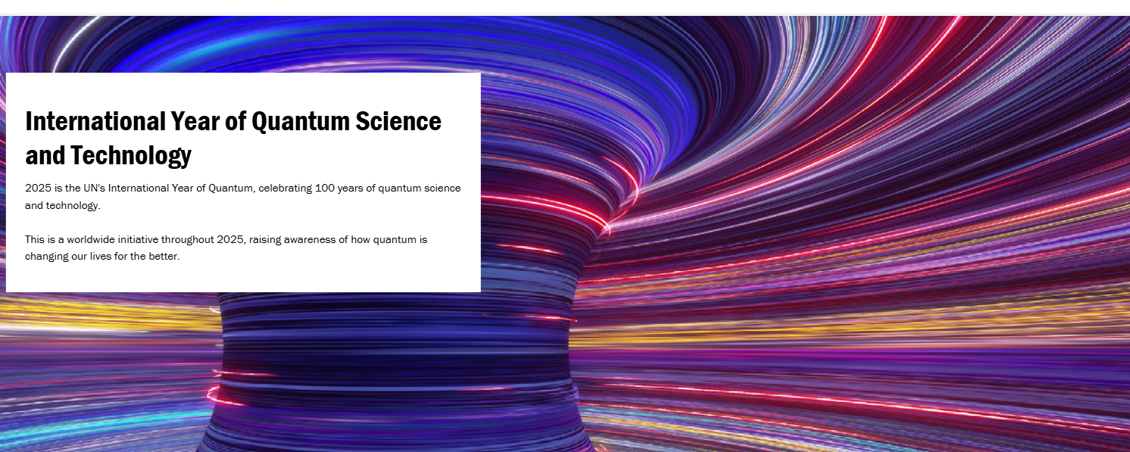
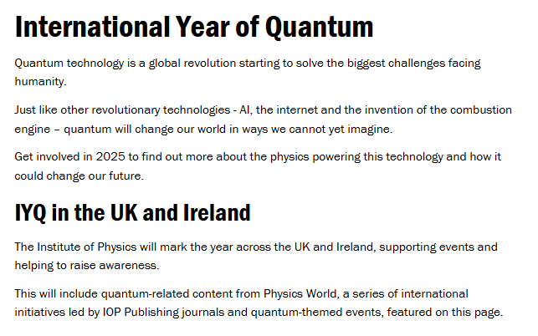
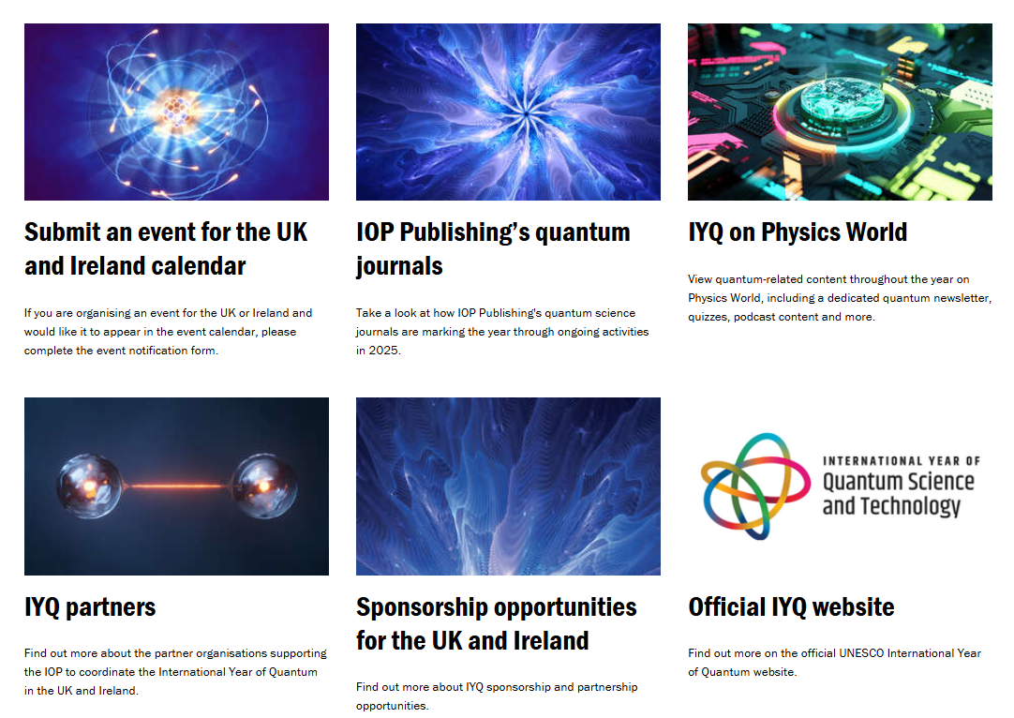
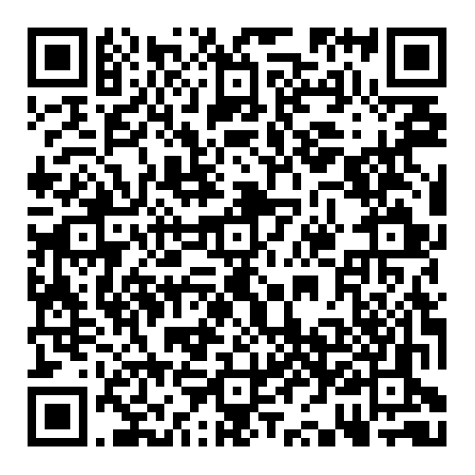
2025: International Year of Quantum Science and Technology
FIND OUT MORE

Slide 8
The UK and Ireland calendar

Slide 9
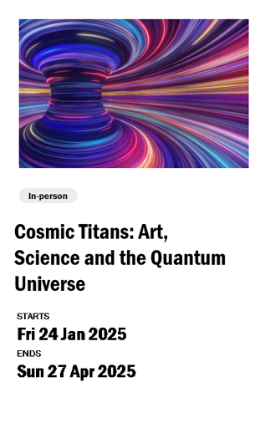

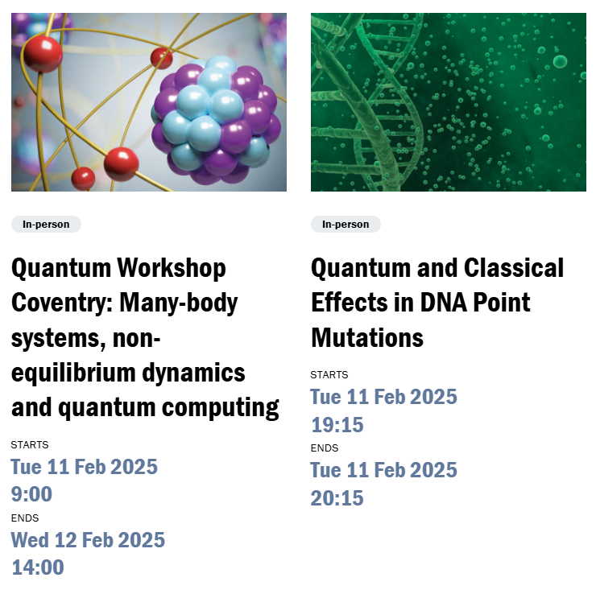
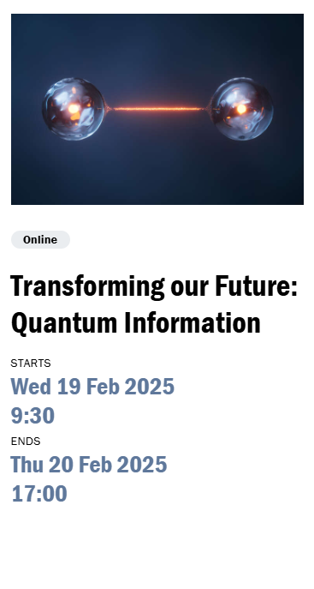
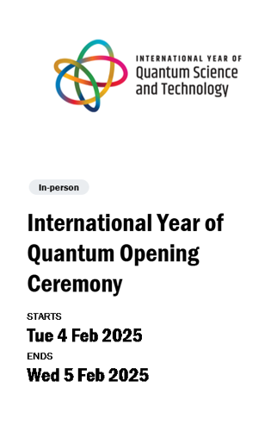
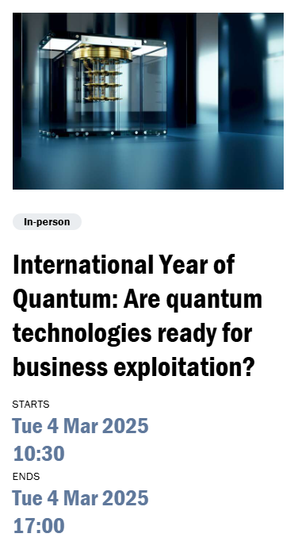
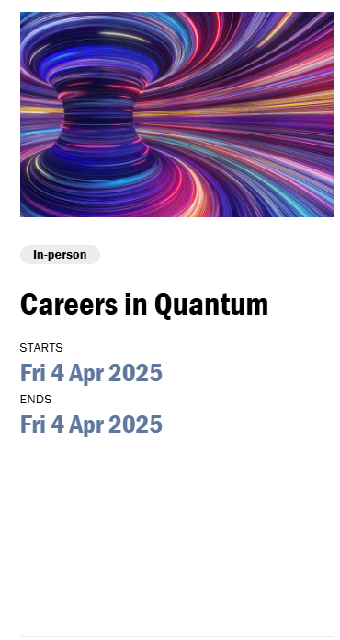

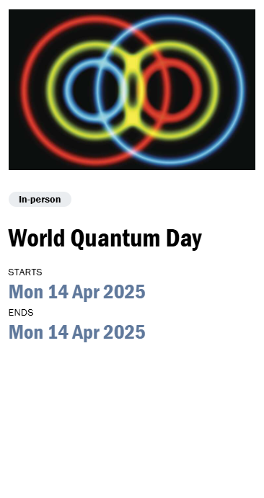
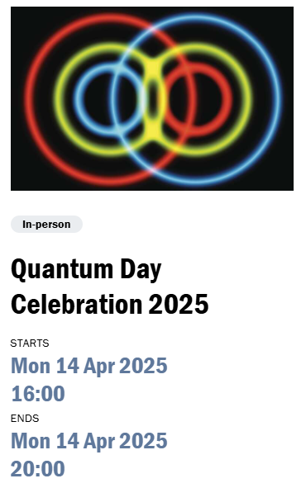
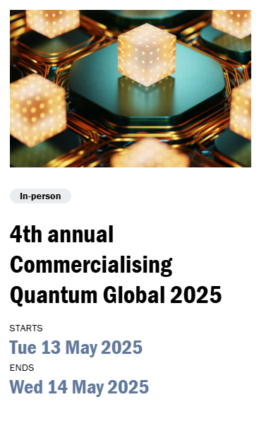
Notes:
All categories of event - Jan - May

Slide 10
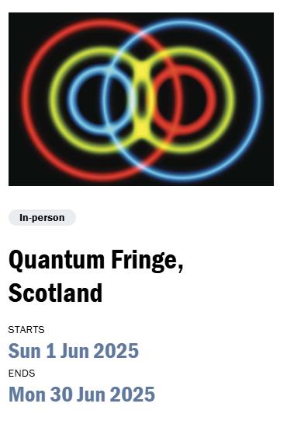

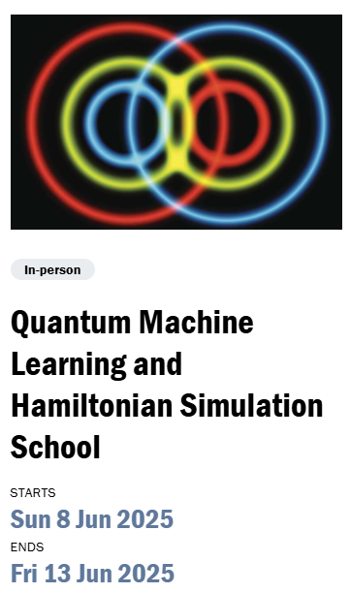
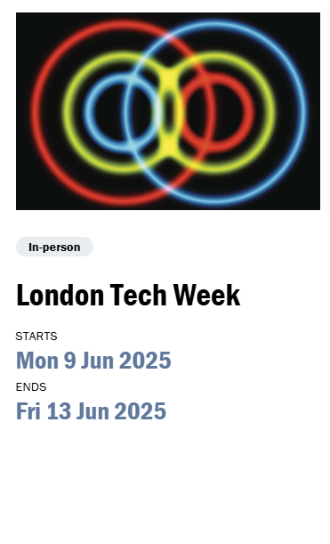
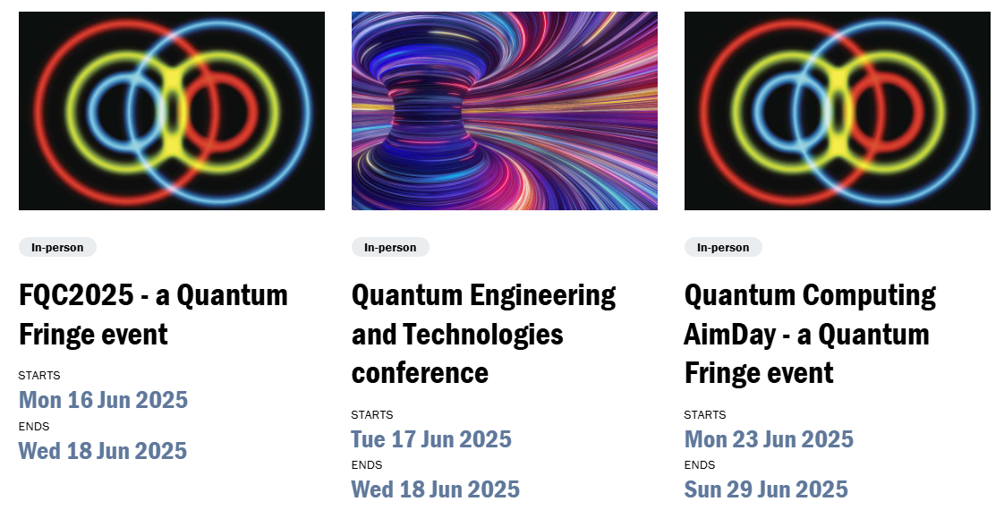
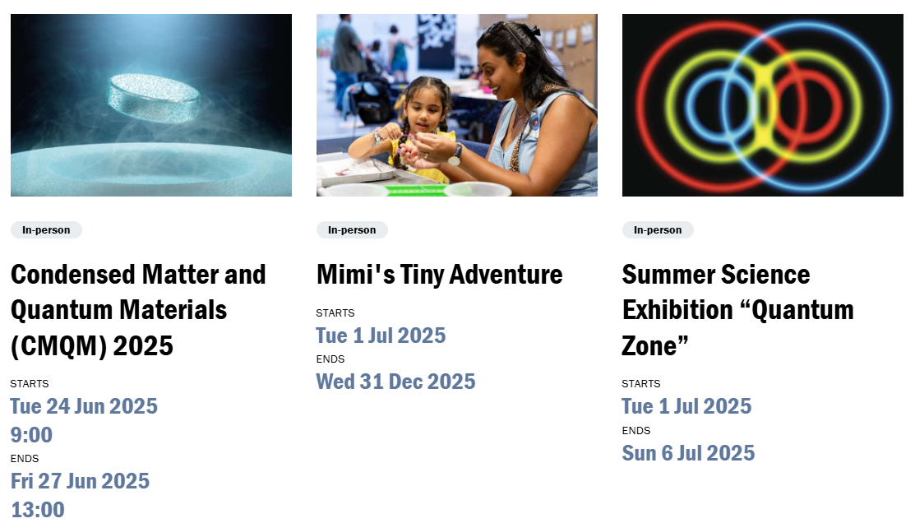
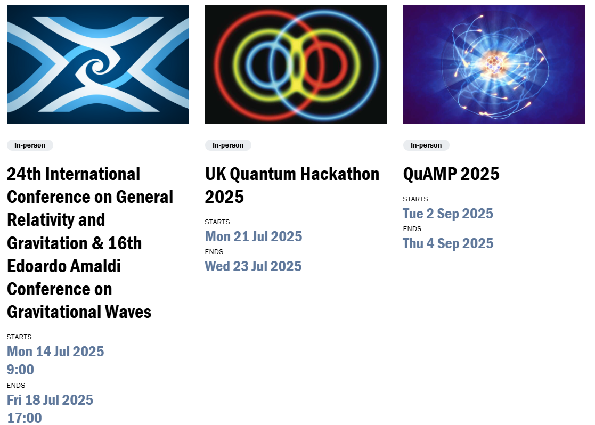
Notes:
All categories of event - Jun - Jul

Slide 11
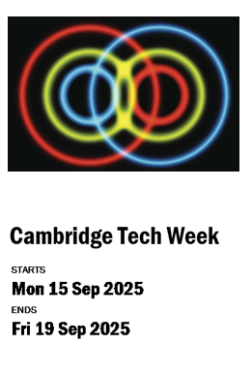
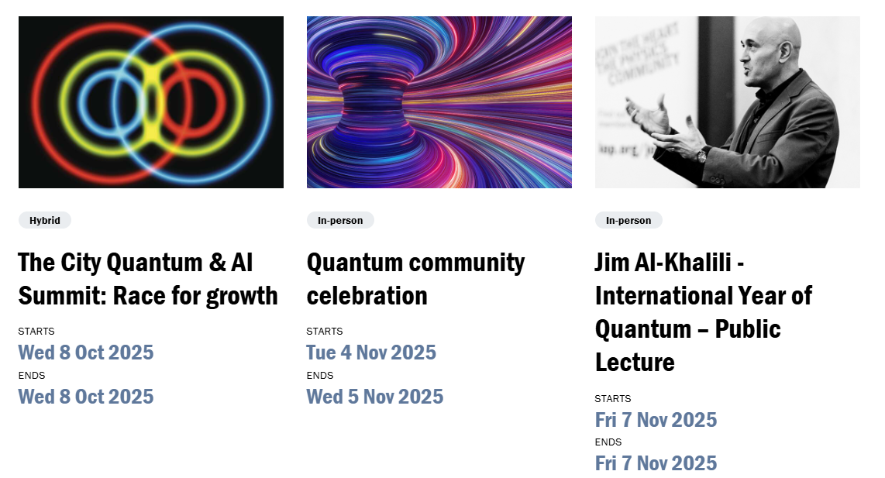
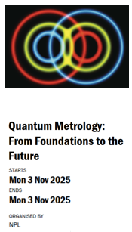


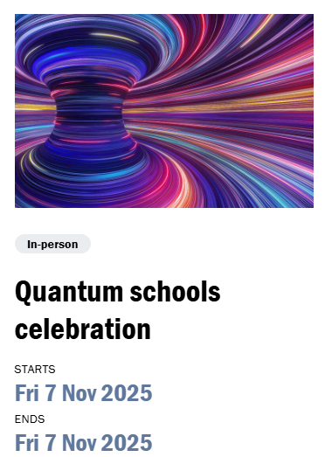
Notes:
All categories of event - Sep - Dec

